Slide 1
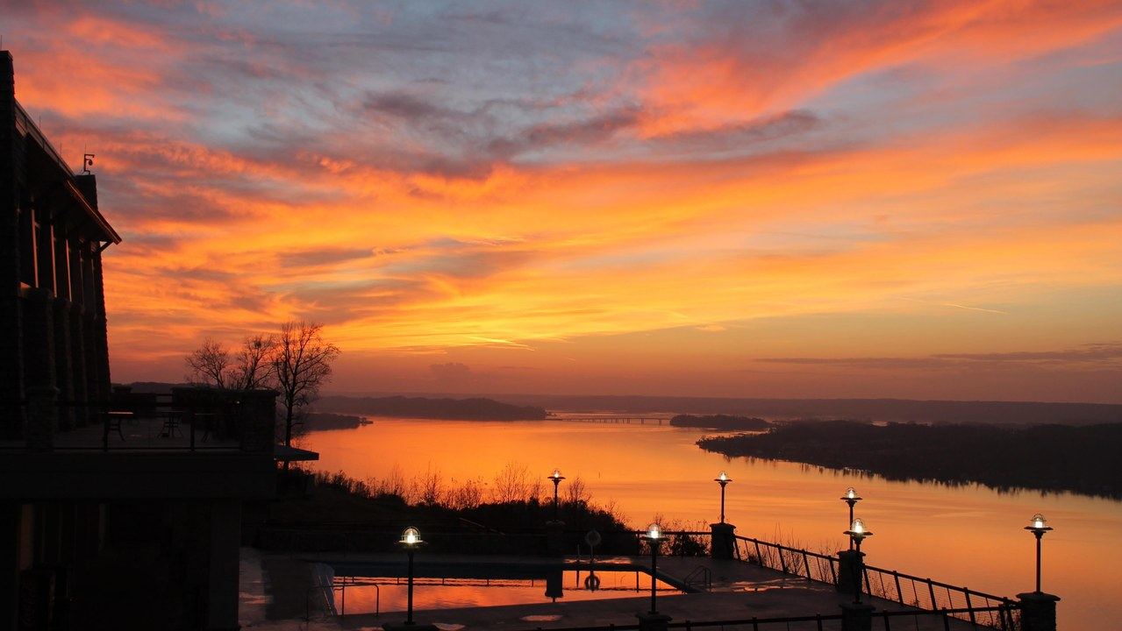
LAKE GUNTERSVILLE STATE PARK · ALABAMA
Repositioning Thesis
A structured strategy to convert a scenic lodging asset into a regional
revenue engine — increasing group room nights, banquet revenue, and
repeatable bookings across defined high-value segments.
4
5
$1M+
24 Mo
Demand Segments
Commercial Plays
Revenue Model
Execution Timeline

Slide 2
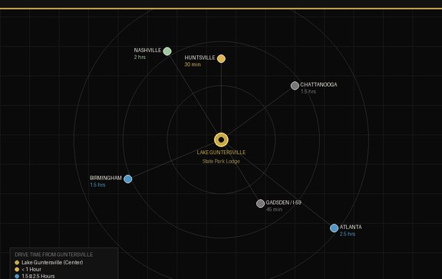
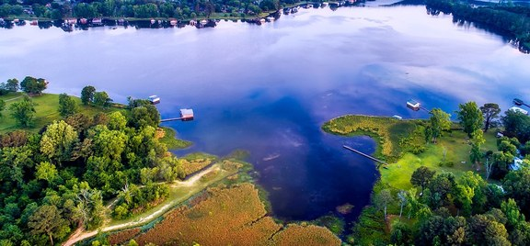
THE REAL OPPORTUNITY
A Scenic Off-Site Within Reach
of Five Major Markets
Lake Guntersville State Park Lodge sits at the center of a drivable corridor connecting five significant demand markets. The property does not need reinvention — it needs clearer segmentation, stronger packaging, and disciplined outreach.
Huntsville, AL
~45 min
Birmingham, AL
~1.5 hrs
Nashville, TN
~2.5 hrs
Chattanooga, TN
~1.5 hrs
Atlanta, GA
~3 hrs
Gadsden / I-59
~45 min

Slide 3
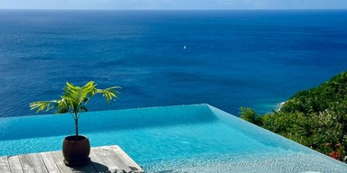
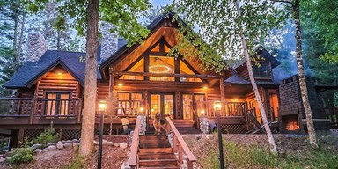
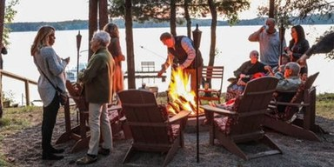
THE MARKET TRUTH
The Drivable Scenic Off-Site
Lake Guntersville occupies a distinct and underserved position in the regional market — between the transactional city hotel and the expensive premium resort. It is the practical premium: scenic, accessible, and capable of delivering a retreat-quality experience at a price point that works for serious group buyers.
City Hotels
Premium Resorts
Lake Guntersville
Transactional. No scenery.
No retreat feel.
High cost. Fly-in logistics.
Out of reach for most groups.
Scenic. Drivable. Group-ready.
Practical premium.
Not a substitute
Different category
THE OPPORTUNITY

Slide 4
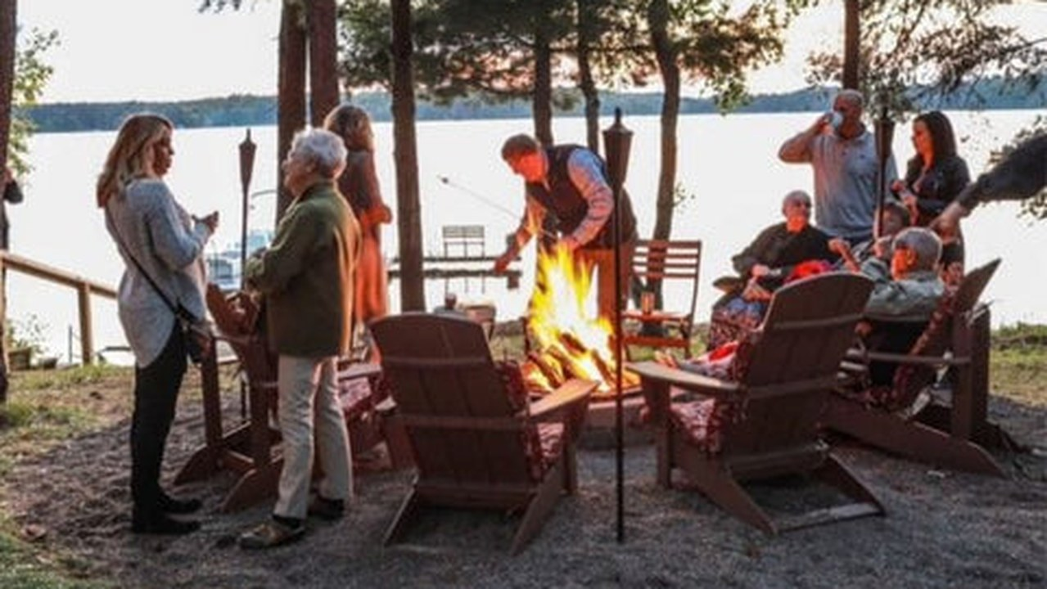
POSITIONING STATEMENT
"The Practical Premium"
Scenic. Accessible. Group-ready.
A retreat-quality experience at a price point that works.

Slide 5
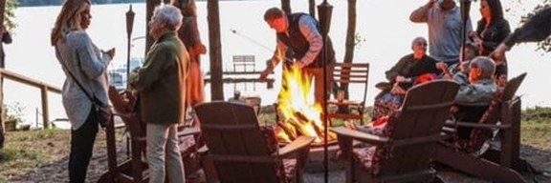

DEMAND ENGINES
High-Value Segments
01
02
Enterprise &
Institutional
Ministry &
Faith Communities
TARGETS
TARGETS
▸ Huntsville defense & aerospace
▸ Regional megachurches
▸ Alabama manufacturers
▸ Denominational networks
▸ Healthcare systems
▸ Faith-based nonprofits
USE CASES
USE CASES
▸ Leadership retreats
▸ Pastoral retreats
▸ Planning sessions
▸ Leadership gatherings
▸ Team off-sites
▸ Congregation events

Slide 6
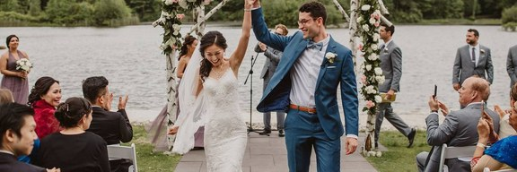
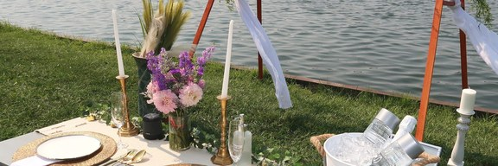
DEMAND ENGINES (CONTINUED)
High-Value Segments
03
04
Weddings &
Milestone Celebrations
Alumni, HBCU &
Affinity Groups
TARGETS
TARGETS
▸ Engaged couples
▸ HBCU alumni chapters
▸ Wedding planners
▸ Greek-letter organizations
▸ Family reunion organizers
▸ Professional associations
USE CASES
USE CASES
▸ Weekend weddings
▸ Retreats
▸ Rehearsal dinners
▸ Leadership gatherings
▸ Multi-day celebrations
▸ Celebration events

Slide 7
COMMERCIAL PLAYS
Five Tactical Demand Plays
Play 1
Play 2
Play 3
Huntsville Executive Retreat
Manufacturing Leadership
Ministry Network
▸ Build top 50 employer list
▸ Target OEM and supplier ecosystem
▸ Build top 100 church relationships
▸ Direct outreach to leadership coordinators
▸ Create recurring retreat cadence
▸ Develop recurring retreat pipeline
▸ Promote packaged retreats

Slide 8
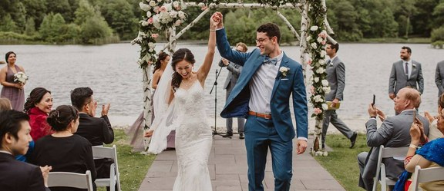
COMMERCIAL PLAYS (CONTINUED)
Five Tactical Demand Plays
Play 4
Play 5
Wedding Weekend Play
Planner Credibility Play
▸ Simplify packages
Northeast & Mid-Atlantic planners whose clients want a scenic, drivable alternative to the Caribbean or Martha's Vineyard — premium feel, without coastal logistics or cost.
▸ Reduce decision friction
▸ Accelerate response time
▸ Target NE & Mid-Atlantic agencies
▸ Position as drivable Caribbean alternative
▸ Selective high-value bookings
▸ Referral network development
▸ PRA Business Events
▸ Eventique
▸ Meridian Events
▸ The Castle Group
▸ Albrecht Events

Slide 9
EXECUTION STRUCTURE
GM & DOS: Complementary, Not Competing
OWNS
OWNS
General Manager
Director of Sales & Marketing
▸ Operations
▸ Demand Generation
▸ Guest Experience
▸ Account Strategy
▸ Event Delivery
▸ Pipeline Development
▸ Market Partnerships
▸ Segment Growth
This structure strengthens the GM role. It does not compete with it.

Slide 10
REVENUE MODEL & KPIs
Objectives, Revenue Streams & Dashboard
OBJECTIVES
REVENUE STREAMS
DASHBOARD KPIs
▸ Increase group room nights
▸ Corporate group room blocks
▸ Group room nights / month
▸ Grow banquet & event revenue
▸ Ministry retreat packages
▸ Banquet revenue / quarter
▸ Improve weekday occupancy
▸ Wedding weekend packages
▸ Weekday occupancy %
▸ Build repeatable demand pipeline
▸ Alumni & reunion events
▸ Pipeline value ($)
▸ Planner referral commissions
▸ Repeat booking rate

Slide 11
SUCCESS TIMELINE
Measurable Milestones — First 24 Months
6 Months
12 Months
24 Months
▸ Pipeline established across all 4 segments
▸ Measurable lift in group room nights
▸ Stronger, diversified revenue mix
▸ First multi-segment group wins booked
▸ Increased banquet & event revenue
▸ Repeatable demand engines running
▸ Early revenue on the books
▸ Weekday occupancy improvement visible
▸ Improved off-peak performance
▸ Planner relationships initiated
▸ Repeat bookings emerging
▸ Property recognized as regional venue

Slide 12
ILLUSTRATIVE REVENUE MODEL
Planning Model — Not Actual Performance
Based on explicit assumptions for a scenic lodge and event destination.
Segment
Room Revenue
Catering / Events
Total
Corporate Retreats
$108,000
$95,400
$203,400
Ministry Retreats
$97,200
$86,100
$183,300
Weddings
$259,200
$222,480
$481,680
Reunions / Alumni
$79,920
$70,000
$149,920
TOTAL
$544,320
$473,980
$1,018,300
6-MONTH BOOKED REVENUE
24-MONTH MATURE REVENUE
$320,830
$1,447,170
Illustrative — 6-month ramp
Illustrative — full-year mature model

Slide 13
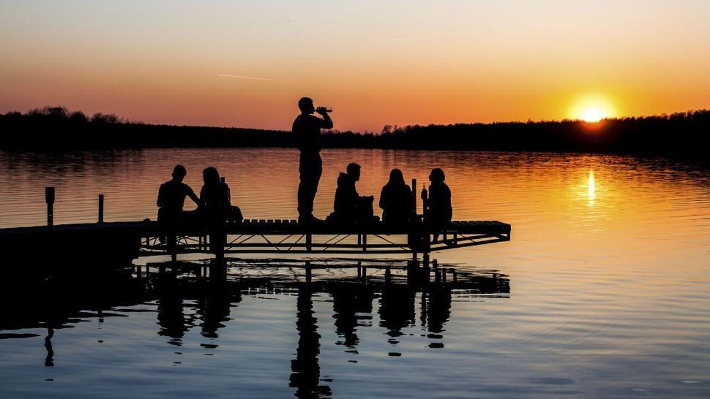
KEY TAKEAWAY
Seven-Figure Annual Revenue Impact
Lake Guntersville does not need reinvention.
It needs clearer segmentation, stronger packaging, disciplined outreach, and repeatable demand.
Clearer Segmentation
Stronger Packaging
Disciplined Outreach
Repeatable Demand

Slide 14
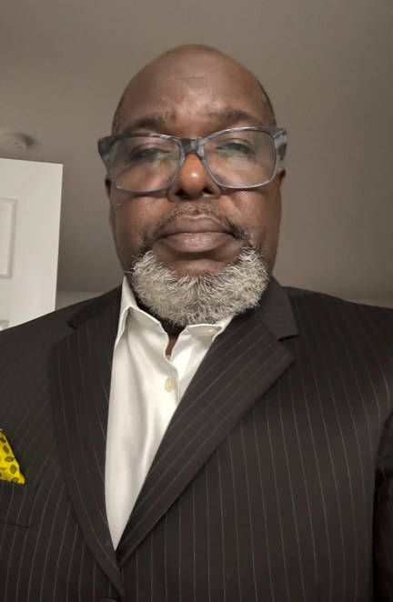
WHY MARIO SHIRLEY
Mario Shirley
▸ 20+ years in business development and revenue growth
▸ Complex, relationship-driven markets — opening doors,
building pipeline, converting difficult opportunities
▸ Public sector, enterprise, partnerships, and
experiential business development
▸ Builder's mindset: demand generation, measurable
revenue, commercial discipline
WHAT I BRING TO THIS PROPERTY
▸ A hunter's mindset with structured follow-through
▸ Ability to translate place into revenue
▸ Experience building momentum in overlooked markets
▸ Commitment to strengthening the property and supporting the GM

Slide 15
This strategy converts Lake Guntersville from a scenic lodging asset into a structured regional demand engine — by increasing group room nights, banquet revenue, and repeatable bookings across defined high-value segments.
Mario Shirley
Director of Sales & Marketing — Candidate
marioshirley@ba-kaya.com · 954-668-1963

Slide 16
Planner Credibility:
Target Agency Analysis
Northeast & Mid-Atlantic planners whose clients want a scenic, drivable alternative
to the Caribbean or Martha's Vineyard — premium feel, without coastal logistics or cost.

Slide 17
PRIORITY #1
PRA Business Events
Chicago, IL · pra.com
PROFILE
WHY TARGET
Founded 1981 · 350–400 employees · 32+ states · 100+ destinations
PRA's entire business model is destination placement. Getting Lake Guntersville into PRA's portfolio means direct access to their full national client base across healthcare, finance, technology, and associations — companies that run annual incentive trips and leadership retreats with defined budgets. This is the highest-leverage single relationship in the strategy.
SPECIALTIES
▸ Destination incentive programs
▸ Corporate retreats & conferences
▸ Themed events & team building
▸ Recognition & award programs
OUTREACH ANGLE
CLIENTS
"PRA places clients into destinations — we want to be one of them. Lake Guntersville State Park Lodge offers a scenic, professionally run, group-ready destination in the Southeast that your incentive travel and corporate retreat clients haven't seen before. We'd like to be added to your destination portfolio and arrange a site visit."
▸ Healthcare & Pharma
▸ Insurance & Financial Services
▸ Technology & Retail
▸ Associations & Tradeshows

Slide 18
PRIORITY #2
Eventique
New York City, NY · eventique.com
PROFILE
WHY TARGET
Founded 2006 · 10–50 employees · 14 industry awards since 2020
Eventique's blue-chip NYC client roster — financial services, technology, media — are frequent buyers of off-site retreats and leadership gatherings. These are companies whose teams are fatigued by the same Hamptons and Caribbean rotation. A well-positioned domestic alternative with natural scenery and full event infrastructure is a compelling new option for their planners.
SPECIALTIES
▸ Corporate events & brand launches
▸ Large-scale conferences
▸ Experiential & multi-city events
▸ Virtual & hybrid production
OUTREACH ANGLE
CLIENTS
"Your clients have done the Caribbean. They've done the Hamptons. Lake Guntersville State Park Lodge gives Eventique's planners something fresh — a scenic, drivable destination with the infrastructure for serious group events, at a fraction of the coastal cost. We'd like to be in your destination portfolio."
▸ Morgan Stanley · Spotify · TikTok
▸ ADP · H&M · HBO Max
▸ Jordan Brand · UNICEF · UN

Slide 19
PRIORITY #3
Meridian Events
New York, NY & Palm Beach, FL · meridianevents.com
PROFILE
WHY TARGET
Founded circa 2018 · Boutique (~12 staff) · Featured: Vogue, WSJ, Page Six
Meridian's luxury brand clients — LVMH, Gallo — expect curated, image-conscious destinations. A scenic Alabama lake lodge, professionally run and visually striking, is exactly the kind of 'hidden gem' discovery a boutique agency can present as a differentiator. For wine and spirits clients, the intimate retreat setting is a natural fit for brand immersion events and executive off-sites.
SPECIALTIES
▸ Luxury corporate events
▸ Executive hospitality & VIP events
▸ Brand immersion trips
▸ Venue scouting & destination events
OUTREACH ANGLE
CLIENTS
"We're offering Meridian's luxury clients something the Caribbean can't: a scenic, private, drivable destination that feels discovered, not packaged. Lake Guntersville State Park Lodge delivers the visual drama and intimacy your clients expect — without the flight, the crowds, or the cost premium of coastal alternatives."
▸ LVMH
▸ E. & J. Gallo Winery
▸ Top Vendry-rated planner

Slide 20
PRIORITY #4
The Castle Group
Boston, MA (+ Atlanta & Maui) · thecastlegrp.com
PROFILE
WHY TARGET
Founded 1996 · Women-owned · 11–50 staff
The Castle Group's Atlanta office is the key differentiator — they already operate in the Southeast corridor and serve both Northeast and Southeast clients. Their hospitality and tourism sector expertise means they understand destination positioning. Their PR capabilities also make them a potential media and awareness partner, not just a booking channel.
SPECIALTIES
▸ Event management
▸ Public relations & public affairs
▸ Marketing communications
▸ Hospitality & tourism sector
OUTREACH ANGLE
CLIENTS
"With your Atlanta office and your Northeast client base, The Castle Group sits at exactly the intersection we're targeting. Lake Guntersville State Park Lodge is a scenic, drivable destination for both markets — and we think there's a story here worth telling together. We'd welcome a conversation about both event placement and destination storytelling."
▸ Fortune 500 to startups
▸ Office of Gov. Maura Healey
▸ MassBio · Boston Business Journal
▸ Healthcare, tech, financial services

Slide 21
PRIORITY #5
Albrecht Events
Lansdale, PA (Greater Philadelphia) · albrechtevents.com
PROFILE
WHY TARGET
Founded 2005 · Boutique (2–10 staff) · 3x Best of PA Meetings + Events (2016–18)
Albrecht's university, non-profit, and association client base directly mirrors the ministry, alumni, and HBCU segments in the Lake Guntersville demand engine strategy. University retreats, alumni leadership gatherings, and non-profit board off-sites are exactly the use cases the property can serve. As the most accessible boutique firm on this list, they are the best entry point for an initial outreach conversation.
SPECIALTIES
▸ Destination management services
▸ Corporate & charitable events
▸ Conferences & team building
▸ Galas, fundraisers, festivals
OUTREACH ANGLE
CLIENTS
"Your university, association, and non-profit clients run annual retreats and leadership gatherings — and they're often looking for scenic, affordable alternatives to coastal destinations. Lake Guntersville State Park Lodge offers exactly that: a professionally run, group-ready destination in the Southeast that delivers a premium experience at a price point that works for mission-driven organizations."
▸ University of Pennsylvania · ADP
▸ ACLU · Caron Treatment Centers
▸ National associations & non-profits

Slide 22
AGENCY SUMMARY
Priority Ranking & Strategic Advantage
Priority
Agency
HQ
Best-Fit Segment
Strategic Advantage
#1
PRA Business Events
Chicago, IL
Corporate / Incentive
Destination placement model = direct client access
#2
Eventique
New York City, NY
Corporate Retreats
Blue-chip roster fatigued by coastal rotation
#3
Meridian Events
NY & Palm Beach
Luxury / Brand
Hidden-gem positioning for LVMH-tier clients
#4
The Castle Group
Boston + Atlanta
Corporate / PR
SE corridor presence + media storytelling partner
#5
Albrecht Events
Philadelphia, PA
Alumni / Non-profit
Best entry point; mirrors HBCU/ministry segments

