Slide 1


THE VISION
4 Elements Consulting Limited | Civil Engineering & Strategy
Ir. Nigel T. Dearden | BEng(Hons) CEng MICE MHKIE MCIWEM C.WEM RPE(CSB)
Chief Executive Officer | 4 Elements Consulting Ltd
www.4ecl.com

Slide 2
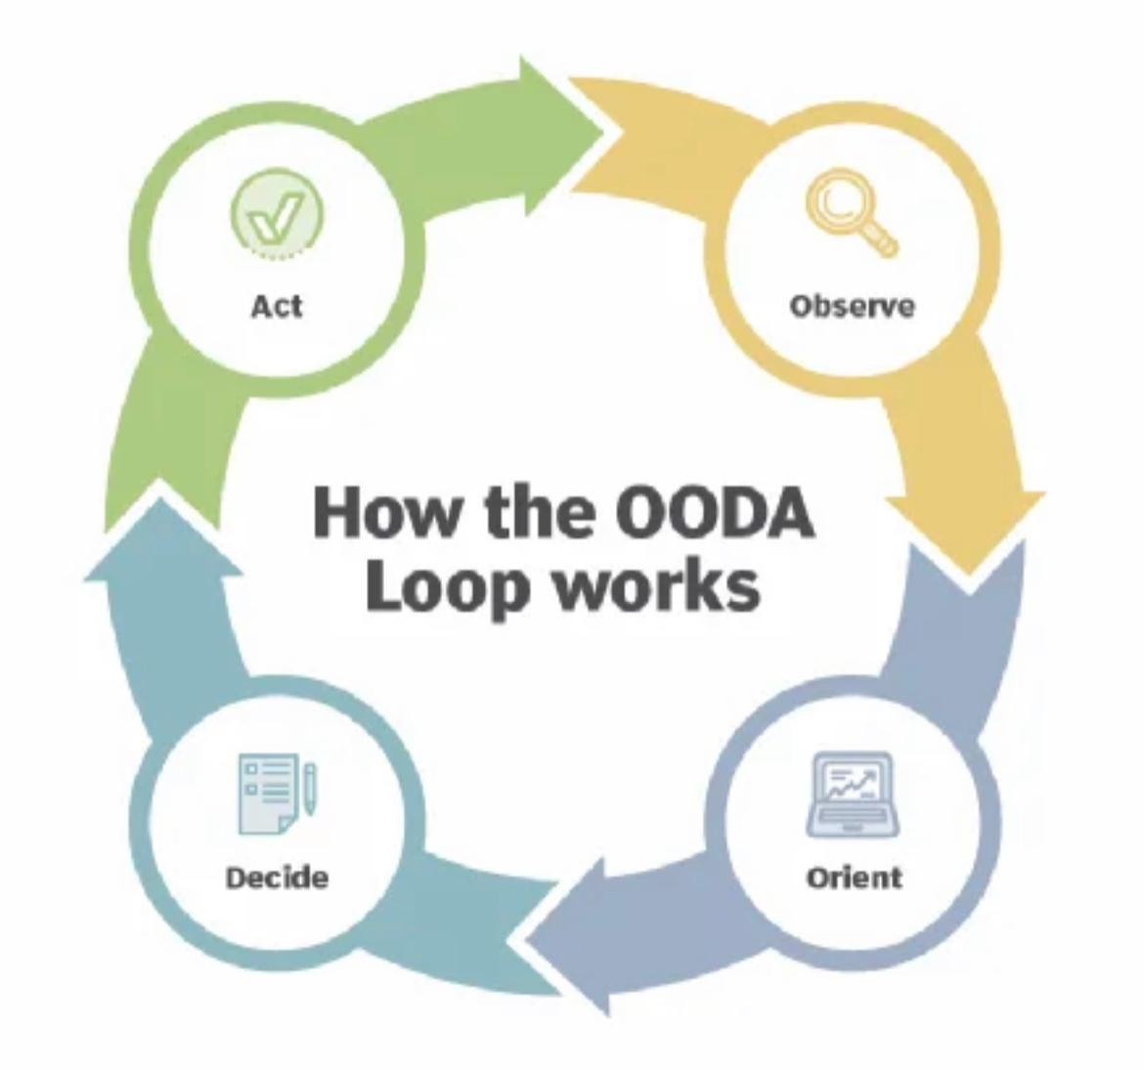
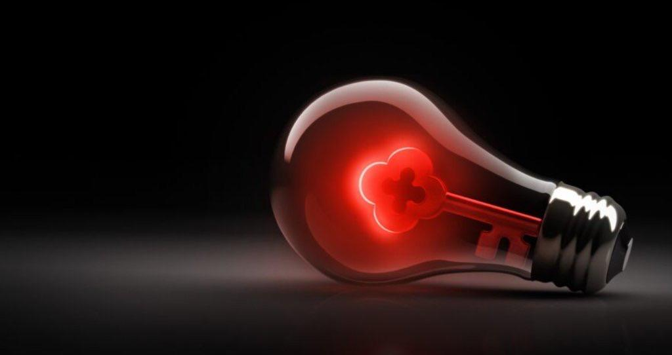


Slide 3
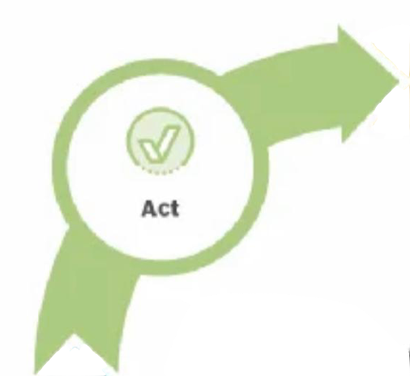
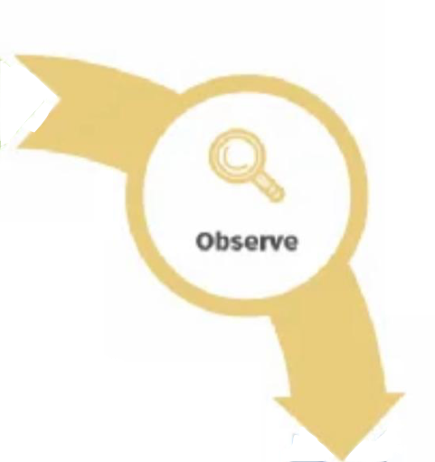
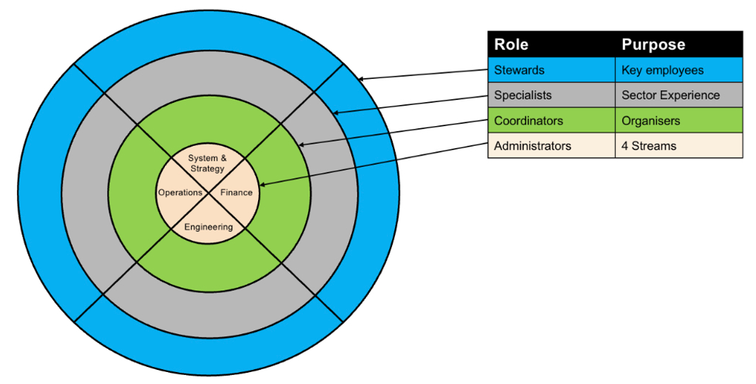
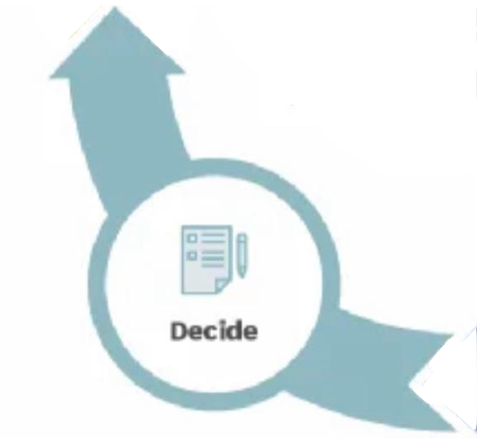
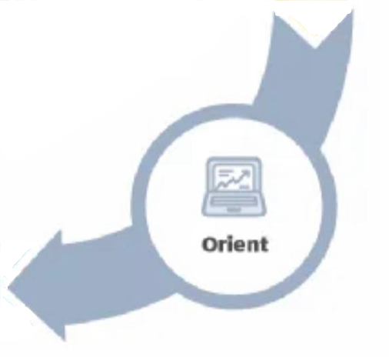
'In and Out / Out and In’ vs. ‘Down and Up / Up and Down’
Information
Ripples vs. Snowflakes

Slide 4
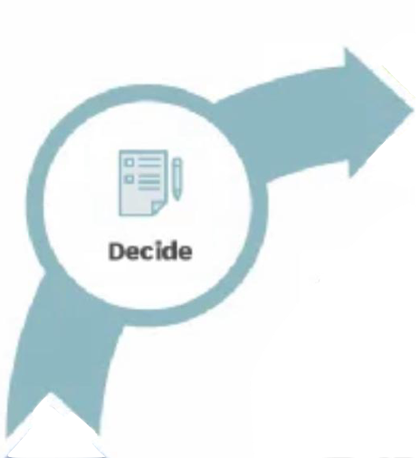
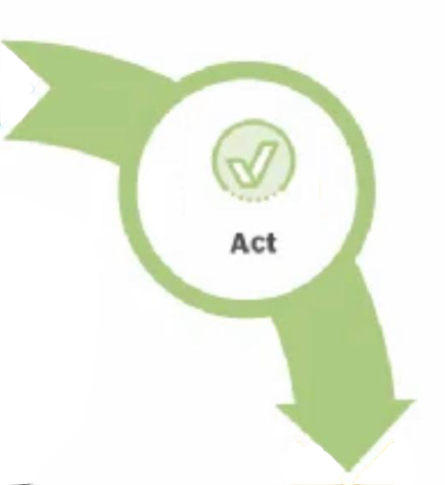
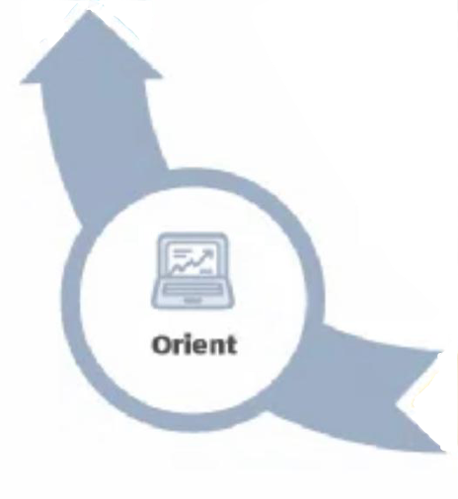
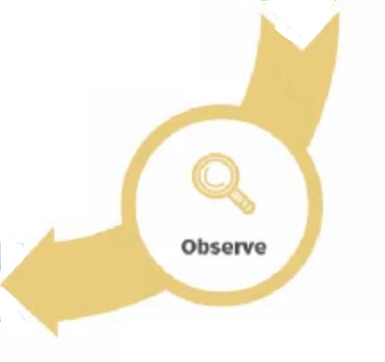
'In and Out / Out and In’ vs. ‘Down and Up / Up and Down’
Information
Ripples vs. Snowflakes

Slide 5
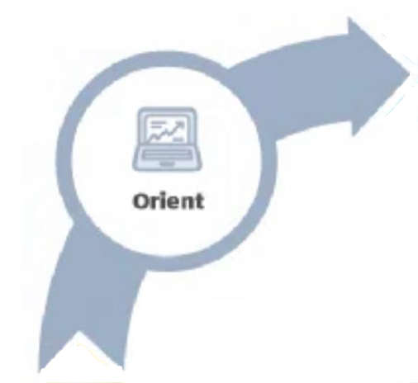
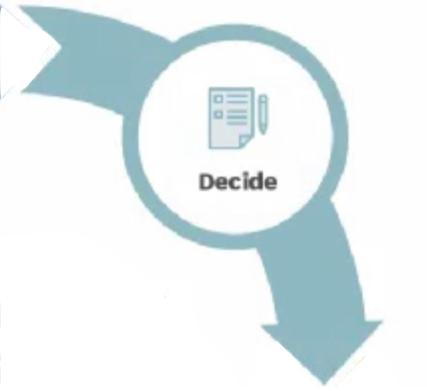
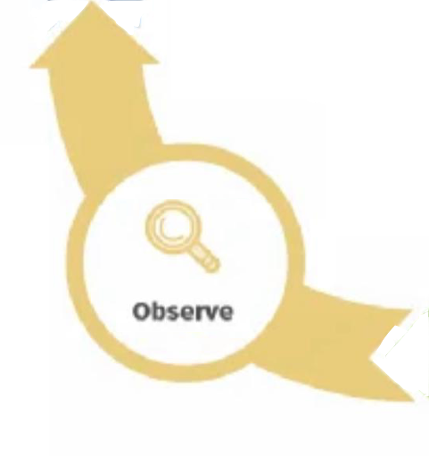
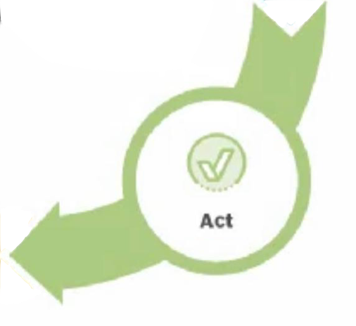
'In and Out / Out and In’ vs. ‘Down and Up / Up and Down'
Information
Ripples vs. Snowflakes

Slide 6
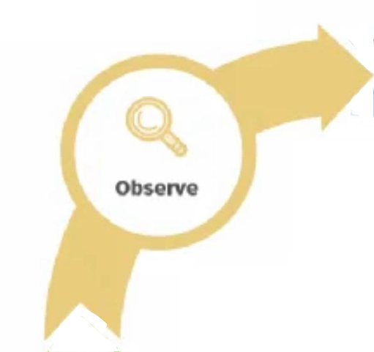
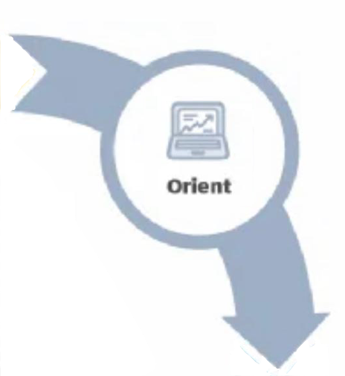
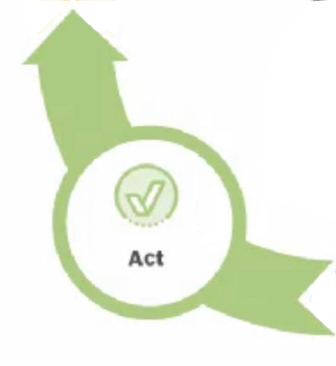
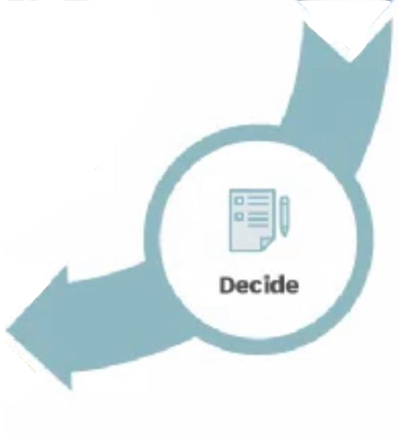
'In and Out / Out and In’ vs. ‘Down and Up / Up and Down’
Information
Ripples vs. Snowflakes

Slide 7
'In and Out / Out and In’ vs. ‘Down and Up / Up and Down’
Information
Ripples vs. Snowflakes

Slide 8
'In and Out / Out and In’ vs. ‘Down and Up / Up and Down’
Information
Ripples vs. Snowflakes

Slide 9
'In and Out / Out and In’ vs. ‘Down and Up / Up and Down’
Information
Ripples vs. Snowflakes

Slide 10
'In and Out / Out and In’ vs. ‘Down and Up / Up and Down’
Information
Ripples vs. Snowflakes

Slide 11
'In and Out / Out and In’ vs. ‘Down and Up / Up and Down’
Information
Ripples vs. Snowflakes

Slide 12
'In and Out / Out and In’ vs. ‘Down and Up / Up and Down’
Information
Ripples vs. Snowflakes

Slide 13
'In and Out / Out and In’ vs. ‘Down and Up / Up and Down’
Information
Ripples vs. Snowflakes

Slide 14
'In and Out / Out and In’ vs. ‘Down and Up / Up and Down’
Information
Ripples vs. Snowflakes

Slide 15
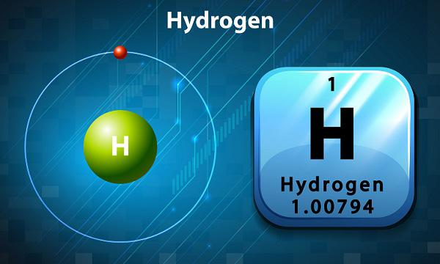
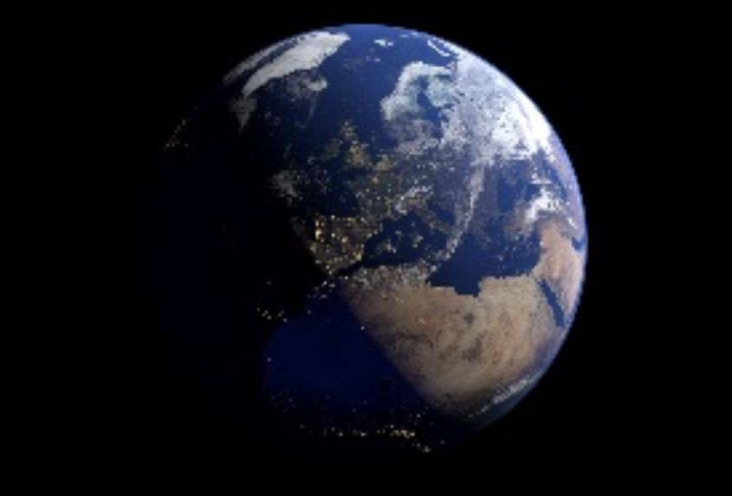
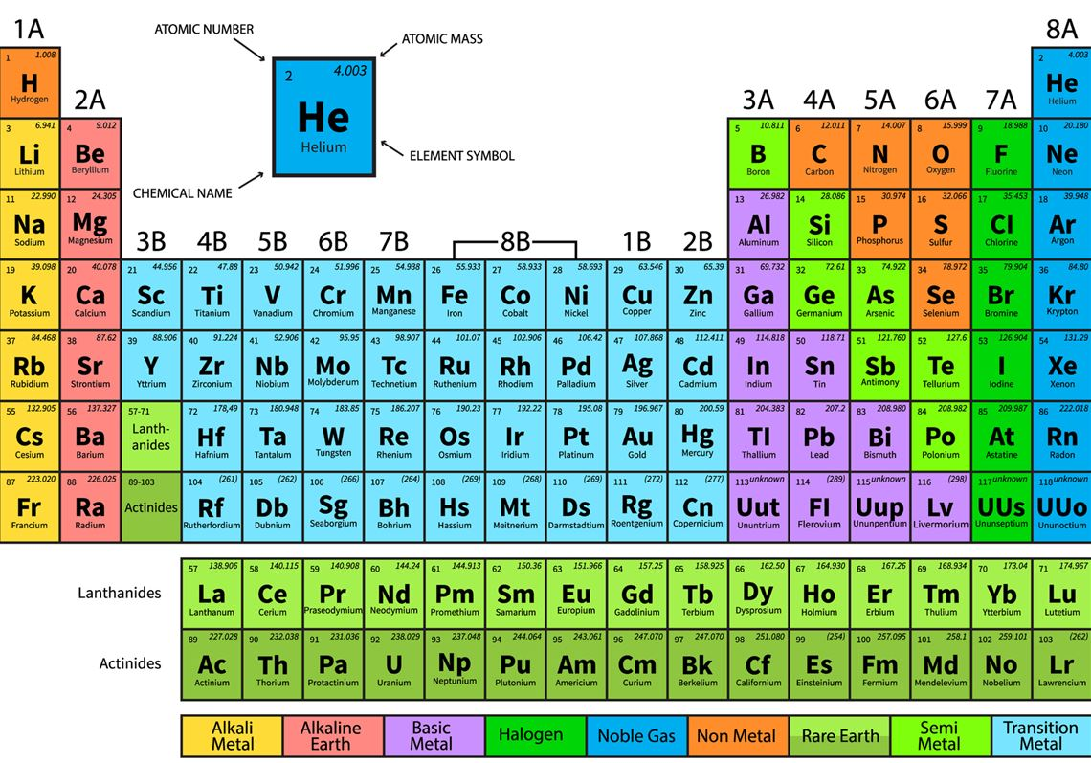
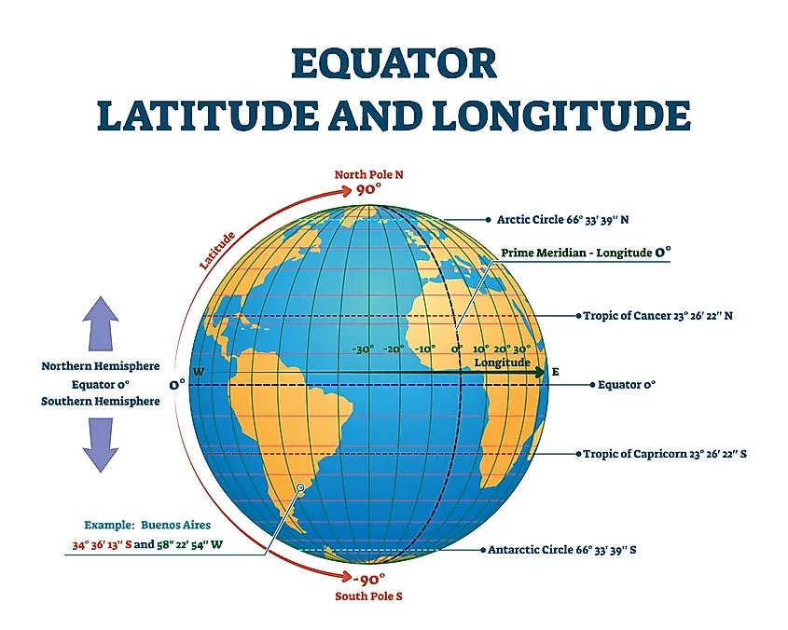
Just as electrons revolve around the nucleus…
...and the atmosphere revolves around Earth…

Slide 16
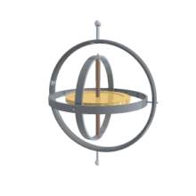
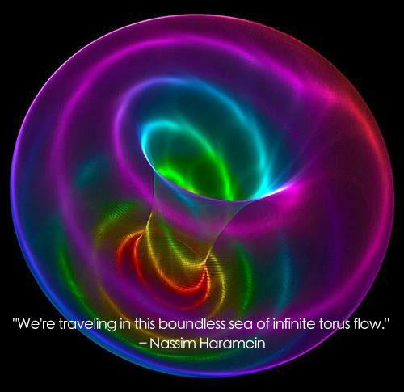

We orient ourselves around our center, at rest, whilst we build.

Slide 17
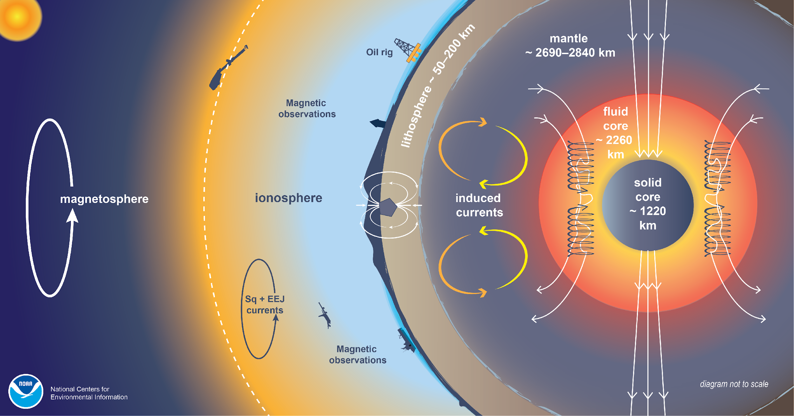
byoGuard envelops the Earth, protecting it as the magnetosphere and ionosphere does.

Slide 18
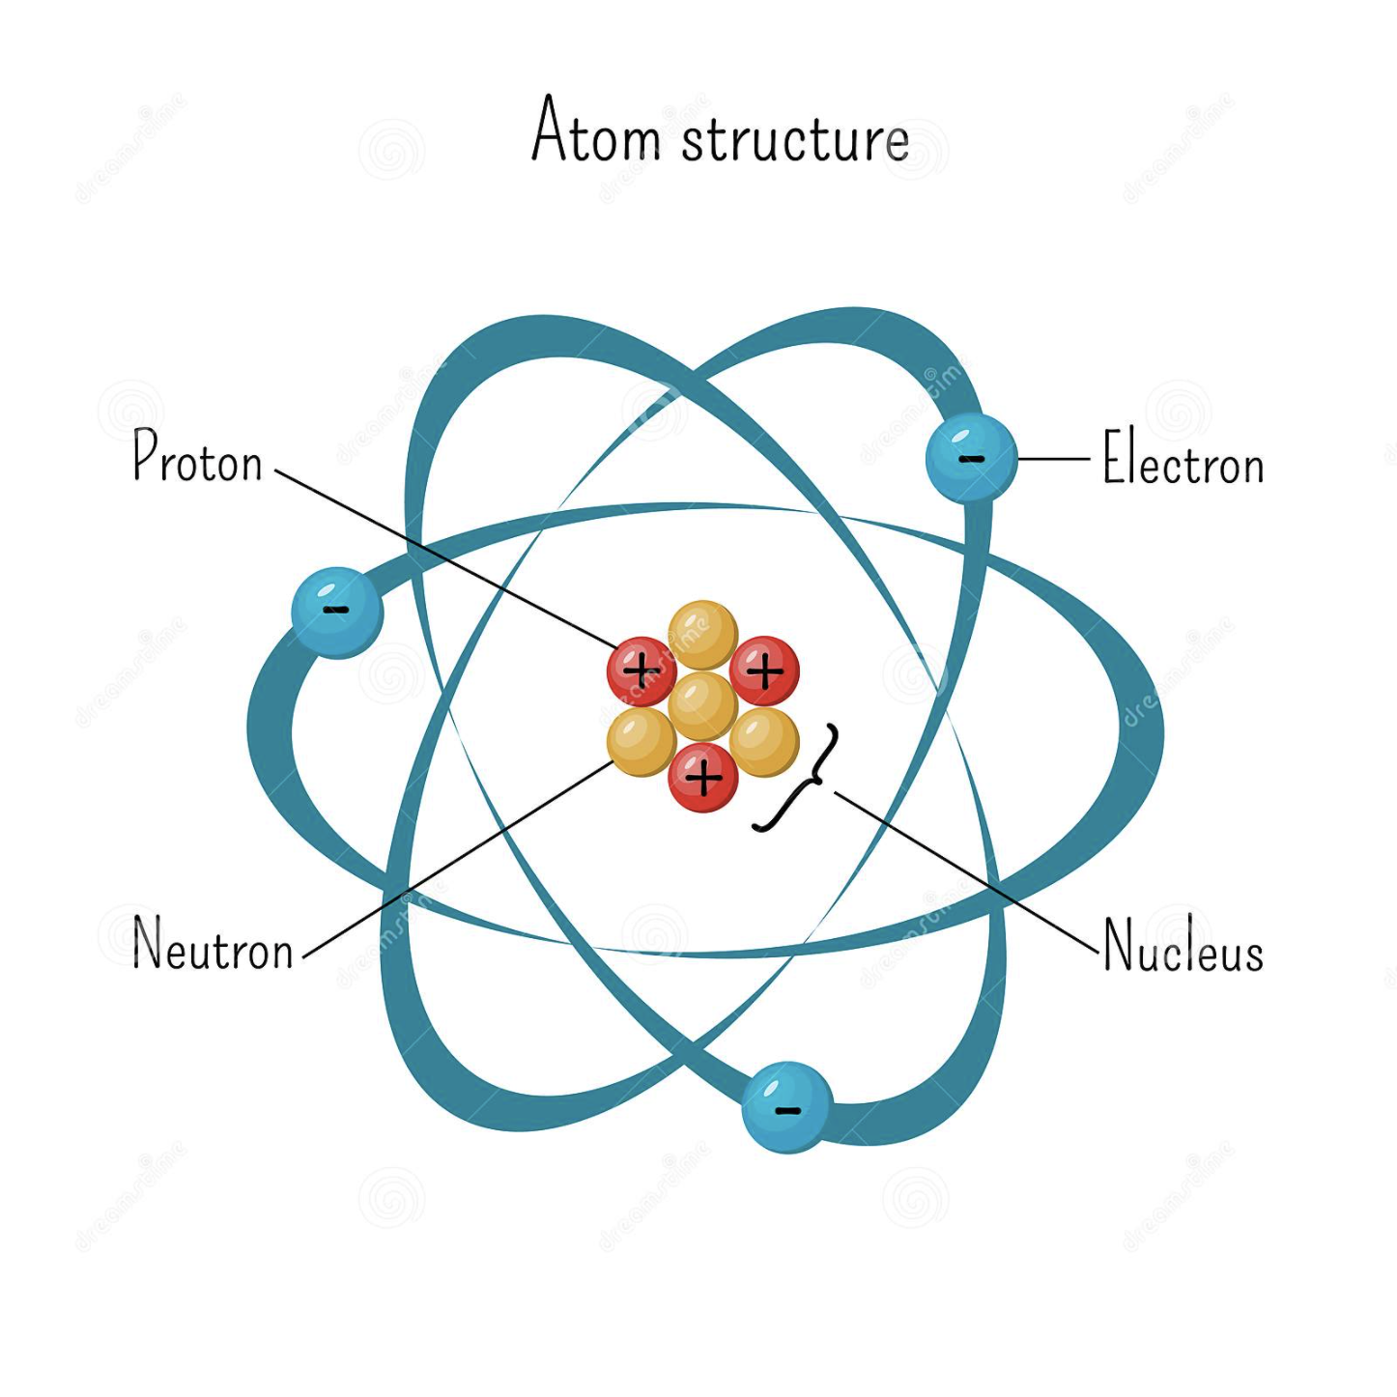
Atomic structures are inevitable, at macro and micro scale!

Slide 19
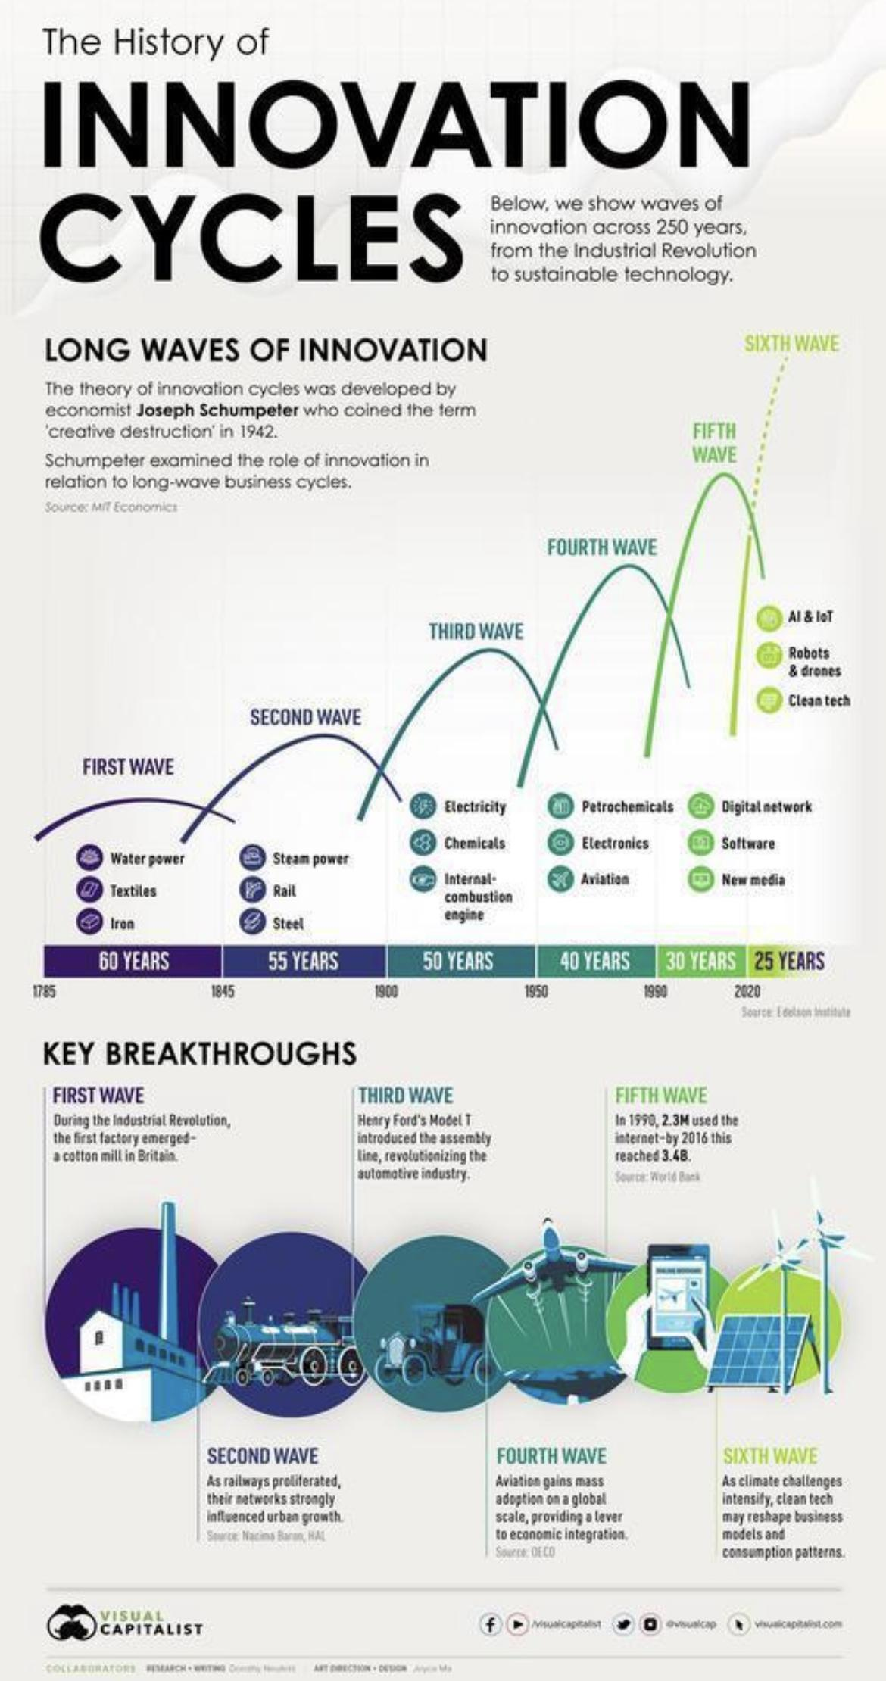
byoGuard is the 6th Industrial Revolution. The ship has left the pad and we’re taking our environment with us.
Why? To have a planetary overview and the ability to protect the Earth. We look at our sphere called Earth and will wrap it with the world's best available technology to safeguard, control and protect our predictable planet via sensors and active protection agents that are both biodegradable and natural. We are harnessing the forces of nature for the betterment of humankind.
Our vision is simple - one United Love achieved through raised awareness and the ability to give invention light. Come fly with us.
Ir. Nigel T. Dearden, Managing Director (Administrator) - Engineering, byoGuard Industries Ltd.

Slide 20
Our Mission/Vision byoGuard is the Sixth Wave of Innovation.

Slide 21
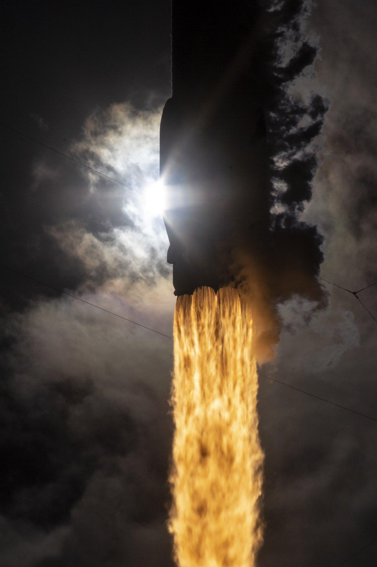
The rocket ship has already left the pad and we’re taking our environment with us.

Slide 22
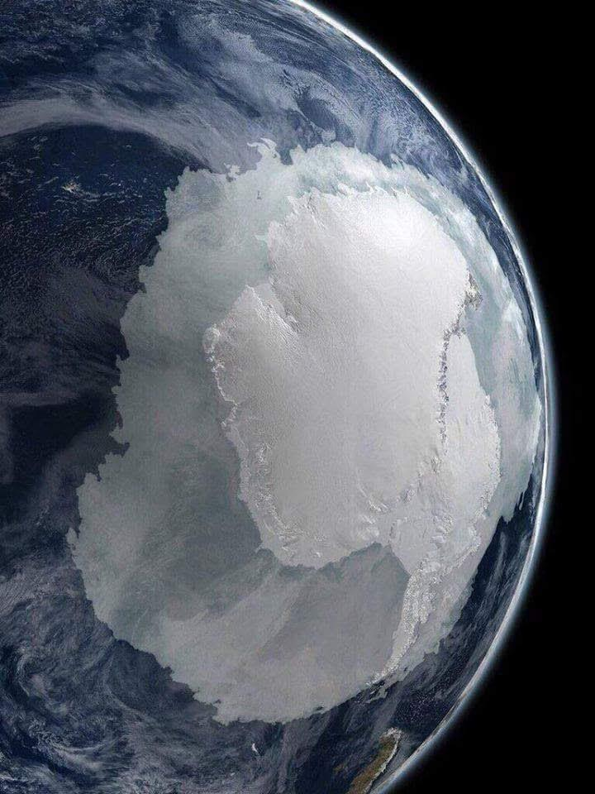
To have a planetary overview and the ability to protect the Earth.

Slide 23
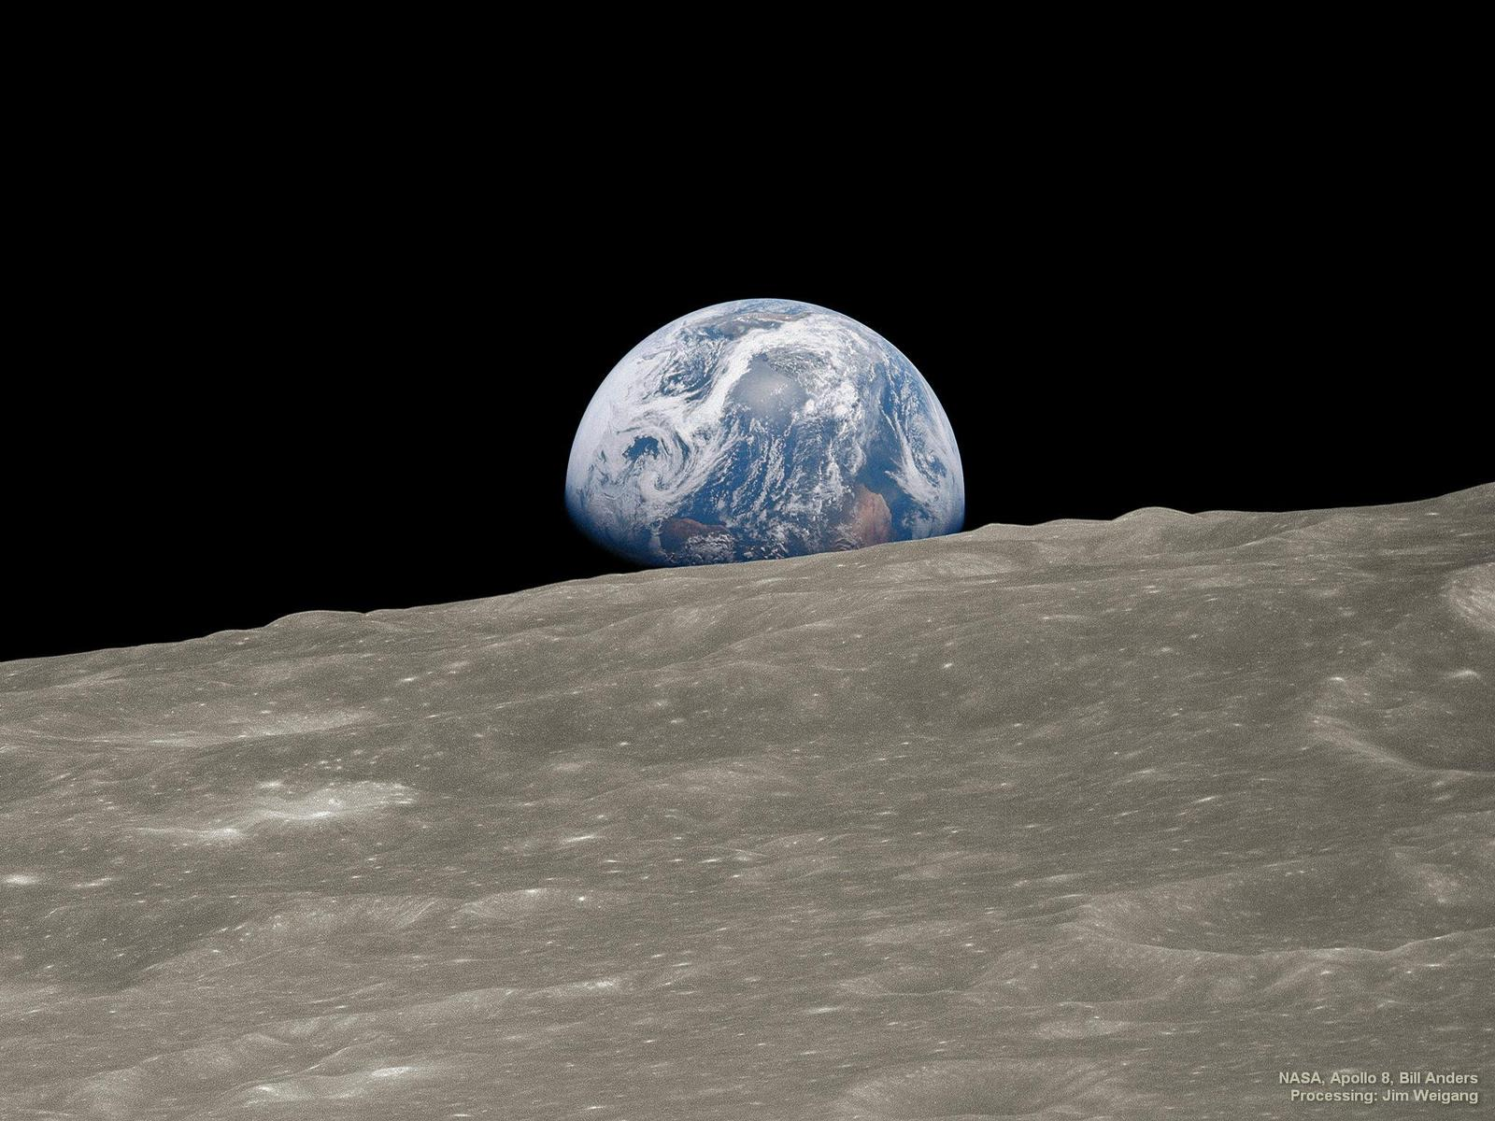
We look at our sphere called Earth, and we will wrap ourselves with the world's best available technology to safeguard, control, and protect our predictable planet via sensors and active protection agents that are both biodegradable and natural.

Slide 24
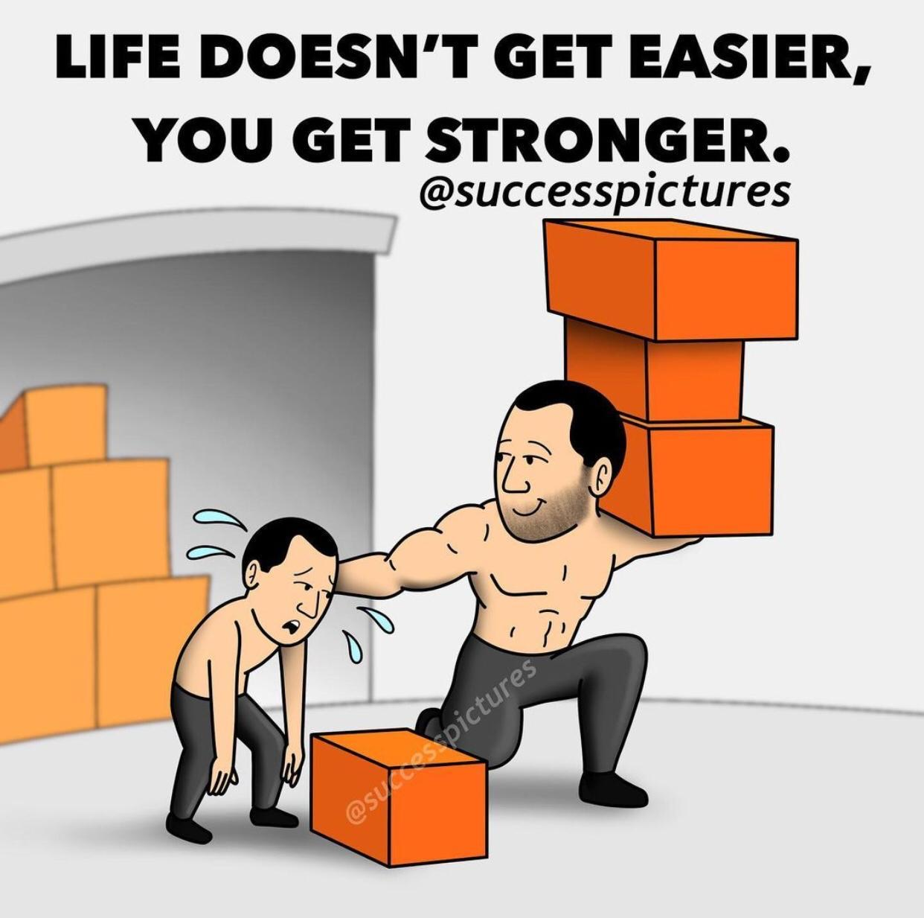
We are harnessing the forces of nature for the betterment of humankind.

Slide 25
Our vision is simple - one United Love achieved through raised awareness and the ability to give invention light.
Come fly with us.
- byoGuard

Slide 26

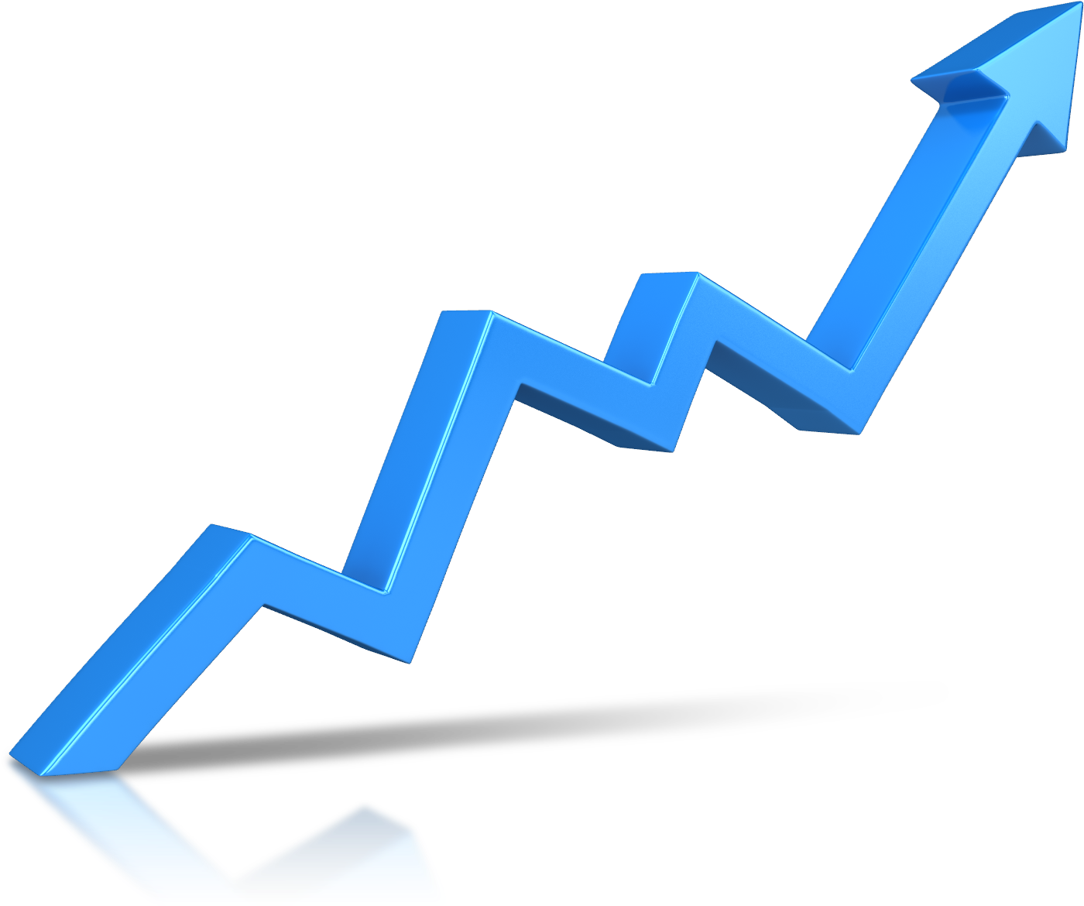





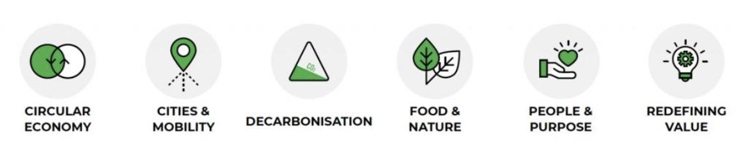

Integrated Design & Construction Management
Health & Wellbeing
Sustainable Site
Aligning ReThink’s 6 sustainability goals towards desired outcomes
Complementing the 7 pillars of BEAM Plus
Material & Waste
Energy Use
Water Use
Innovations & Additions

Slide 27
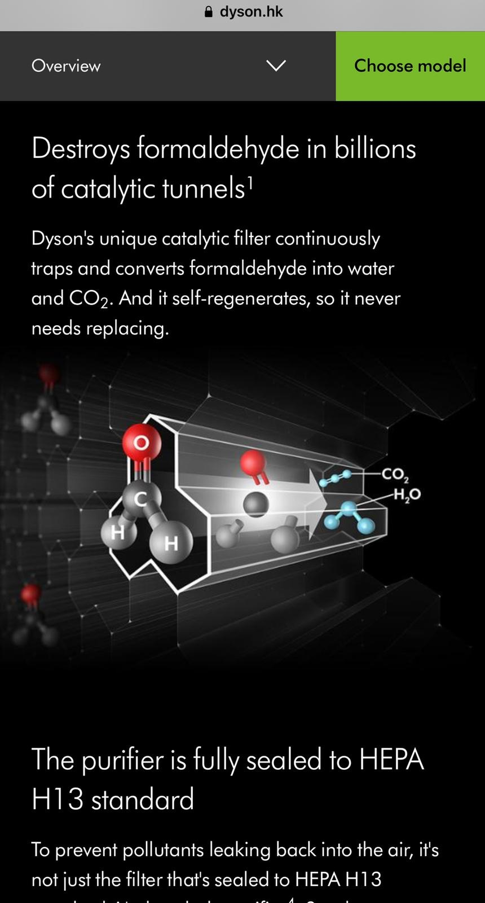
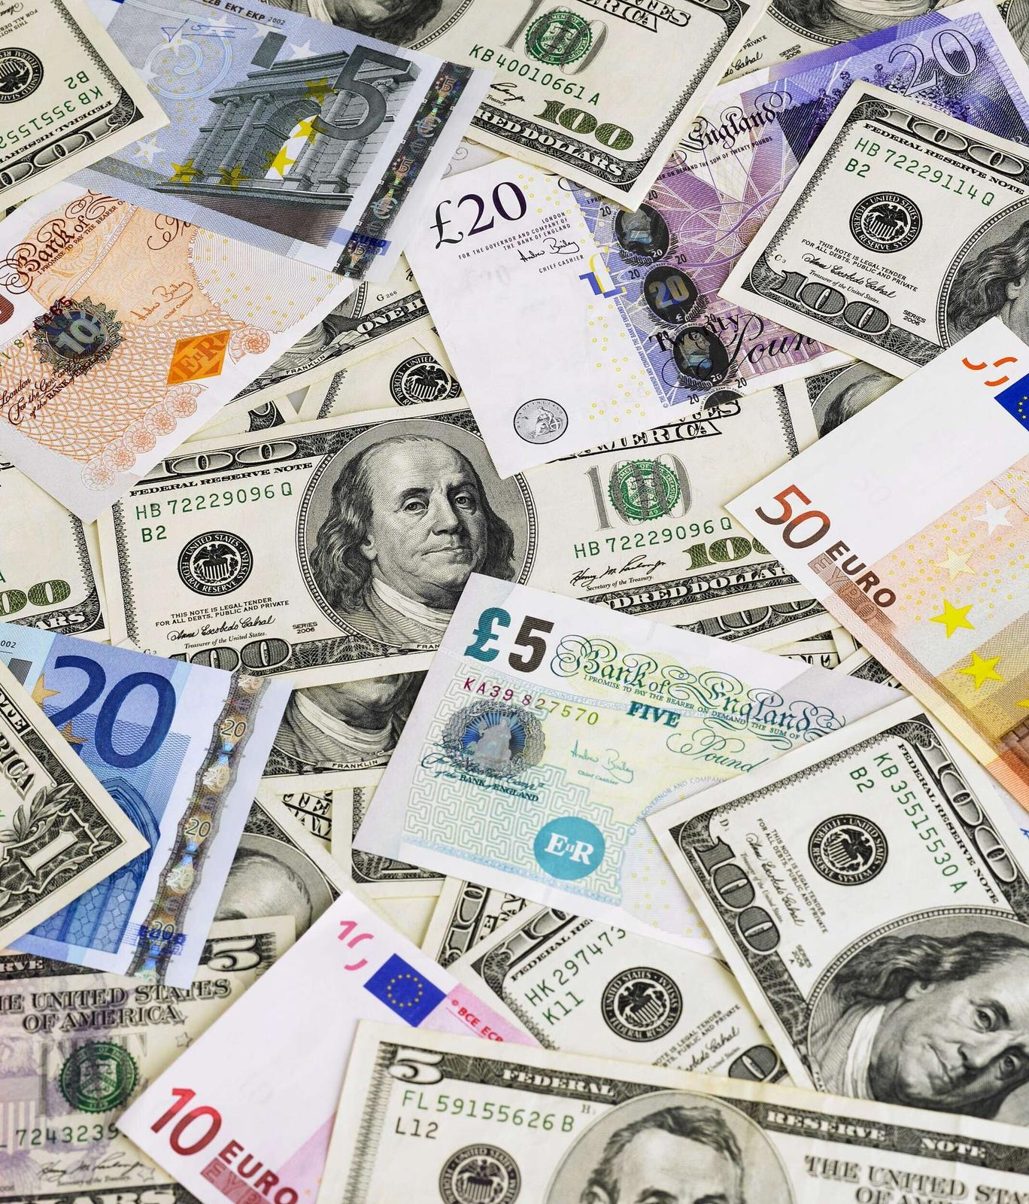
From our drive to heal the world, it will repay us double-fold

Slide 28
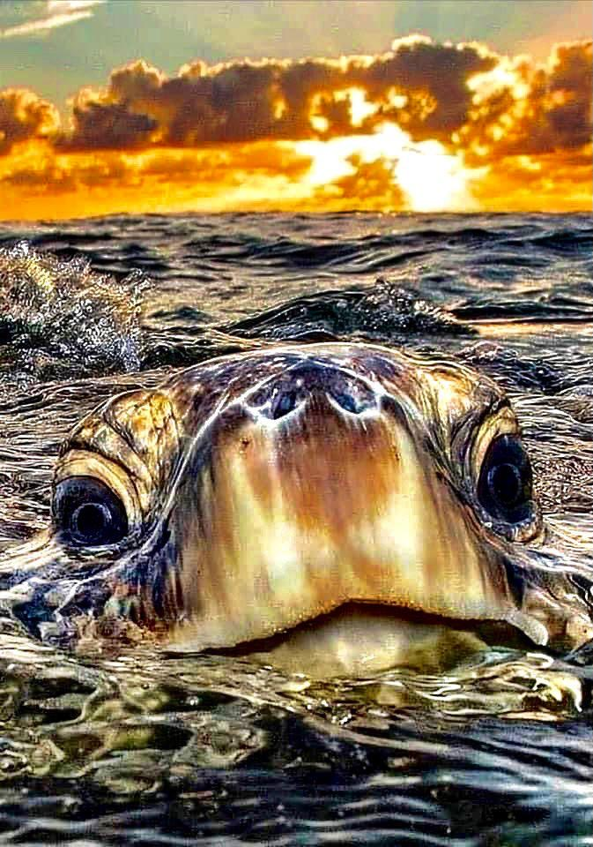
Stewardship is an ethic that embodies the responsible planning and management of resources. Not just for us, but for the beautiful species we share our planet with.

Slide 29
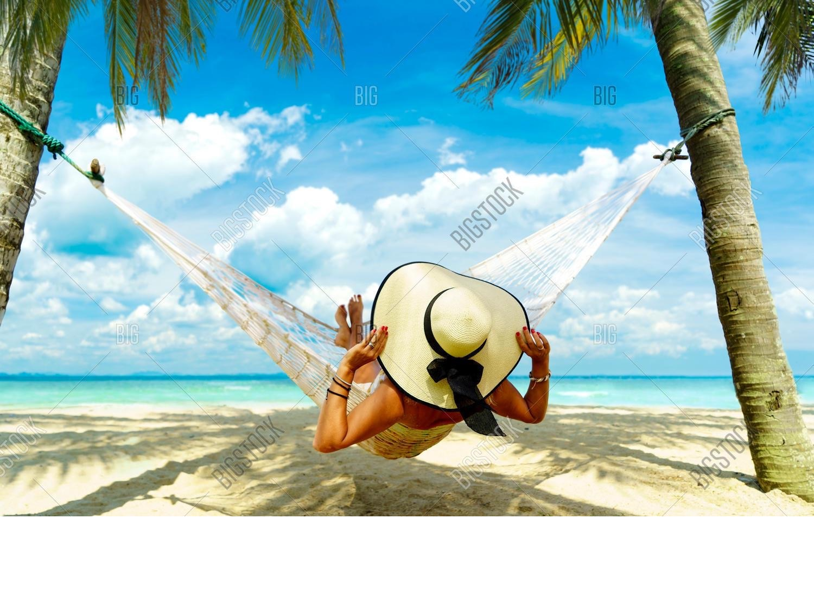
The concepts of stewardship can be applied to the environment and nature, economics, health,
property, information, theology, cultural resources, etc.

Slide 30
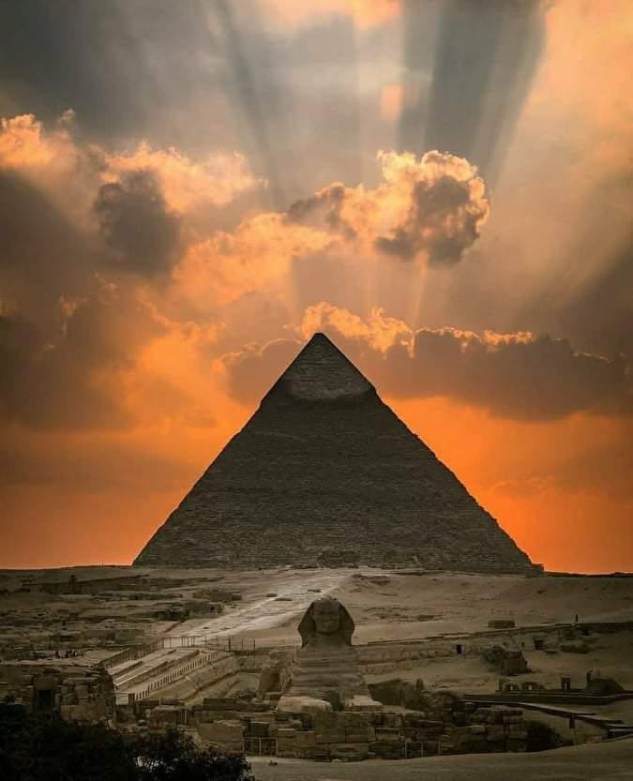
Humanity’s innovation stretches far beyond our imaginations. With simple maths and tools, we've achieved wonders and will do so again.

Slide 31
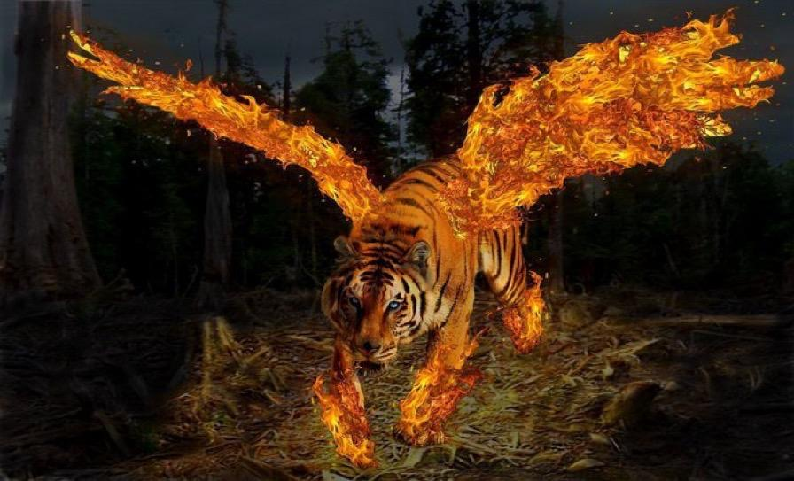
Through byoGuard, it will be reborn.

Slide 32
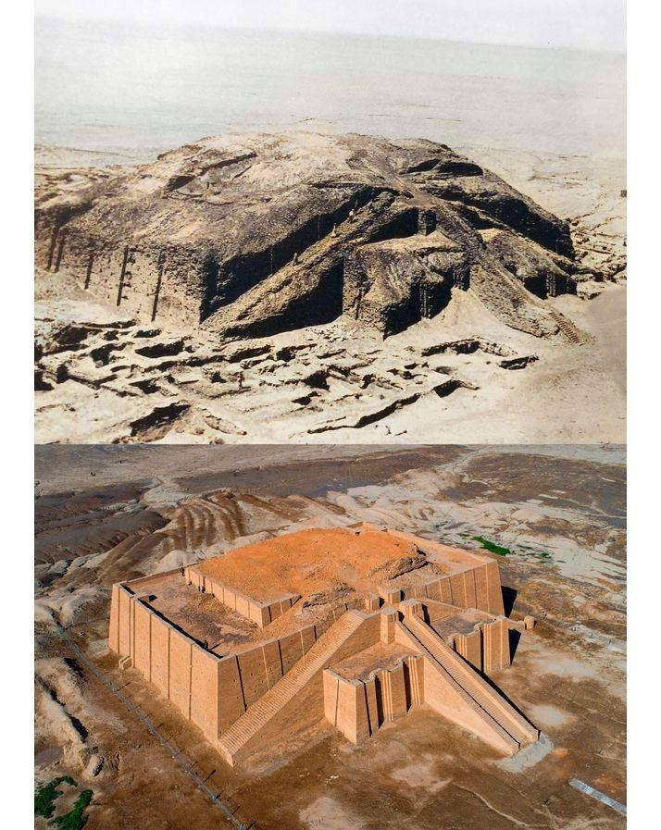
From the past to the present.
From the Ur-Net springs the EarthNet.

Slide 33
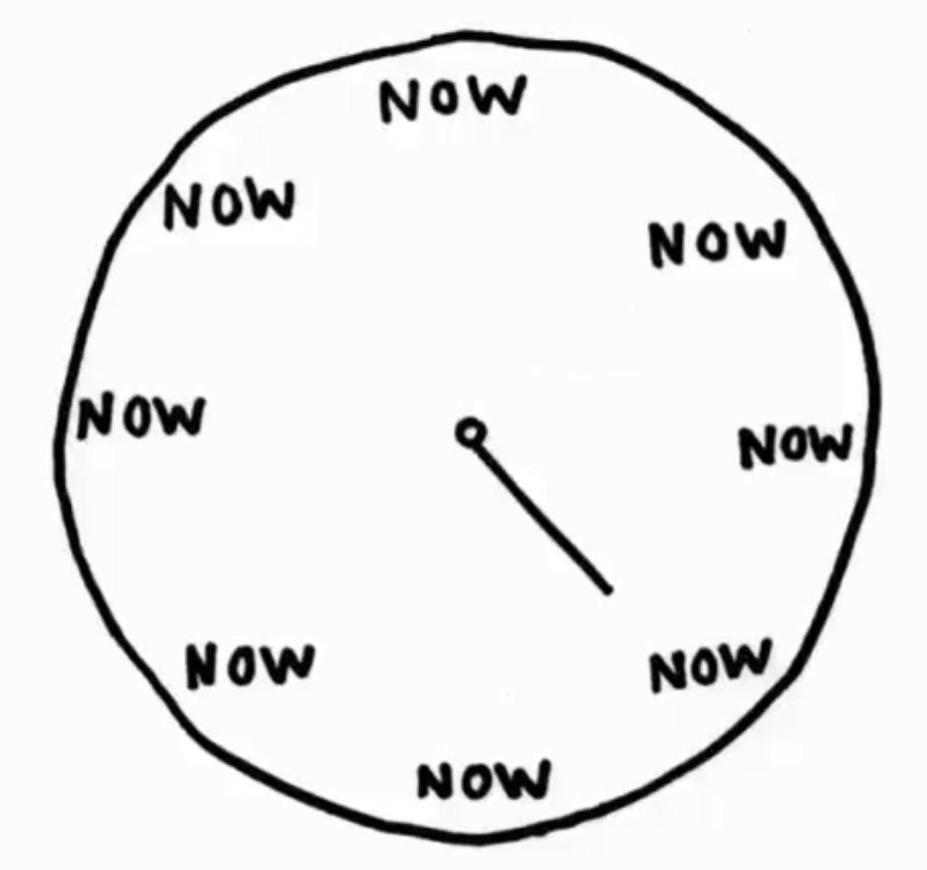
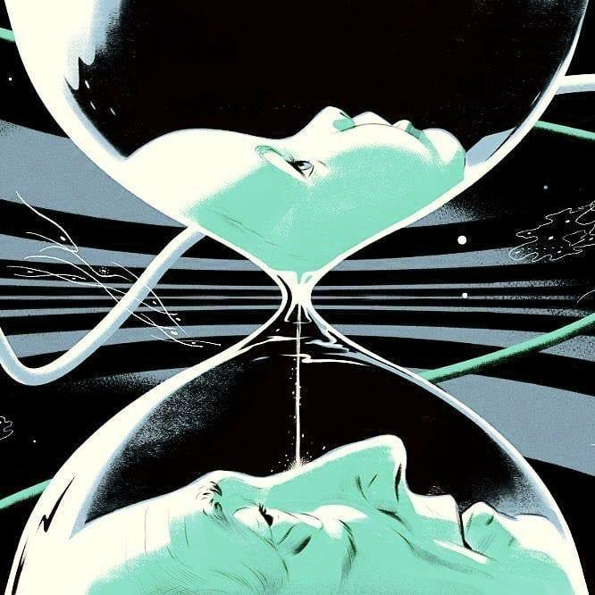
The time is now… and our 8 ‘nows’ tip into infinity!
8
+
8

Slide 34
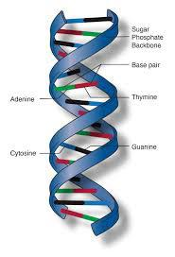
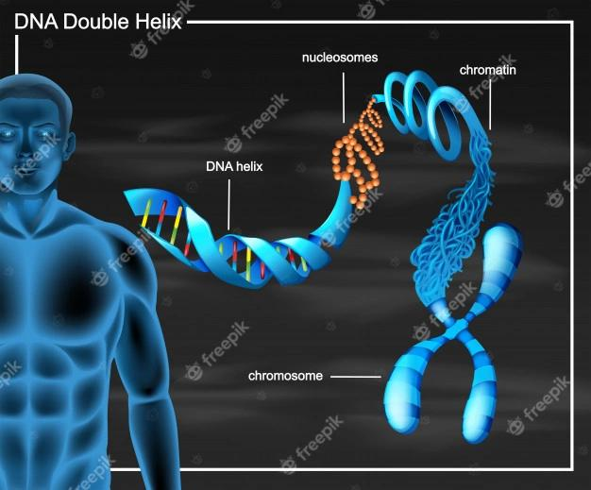
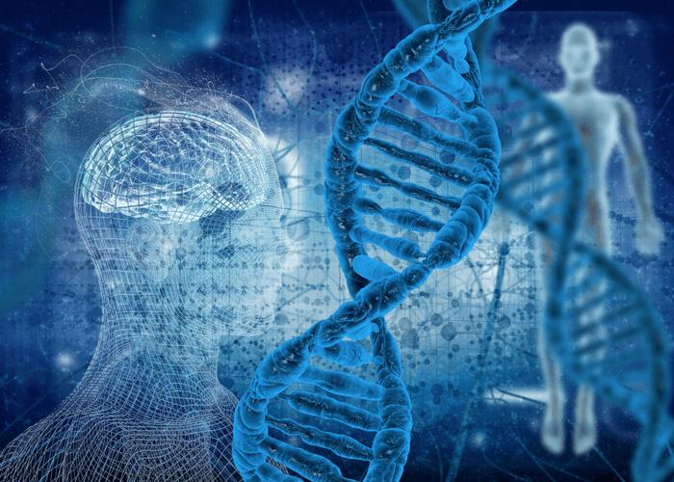

Together, we will unlock humanity’s true potential.

Slide 35
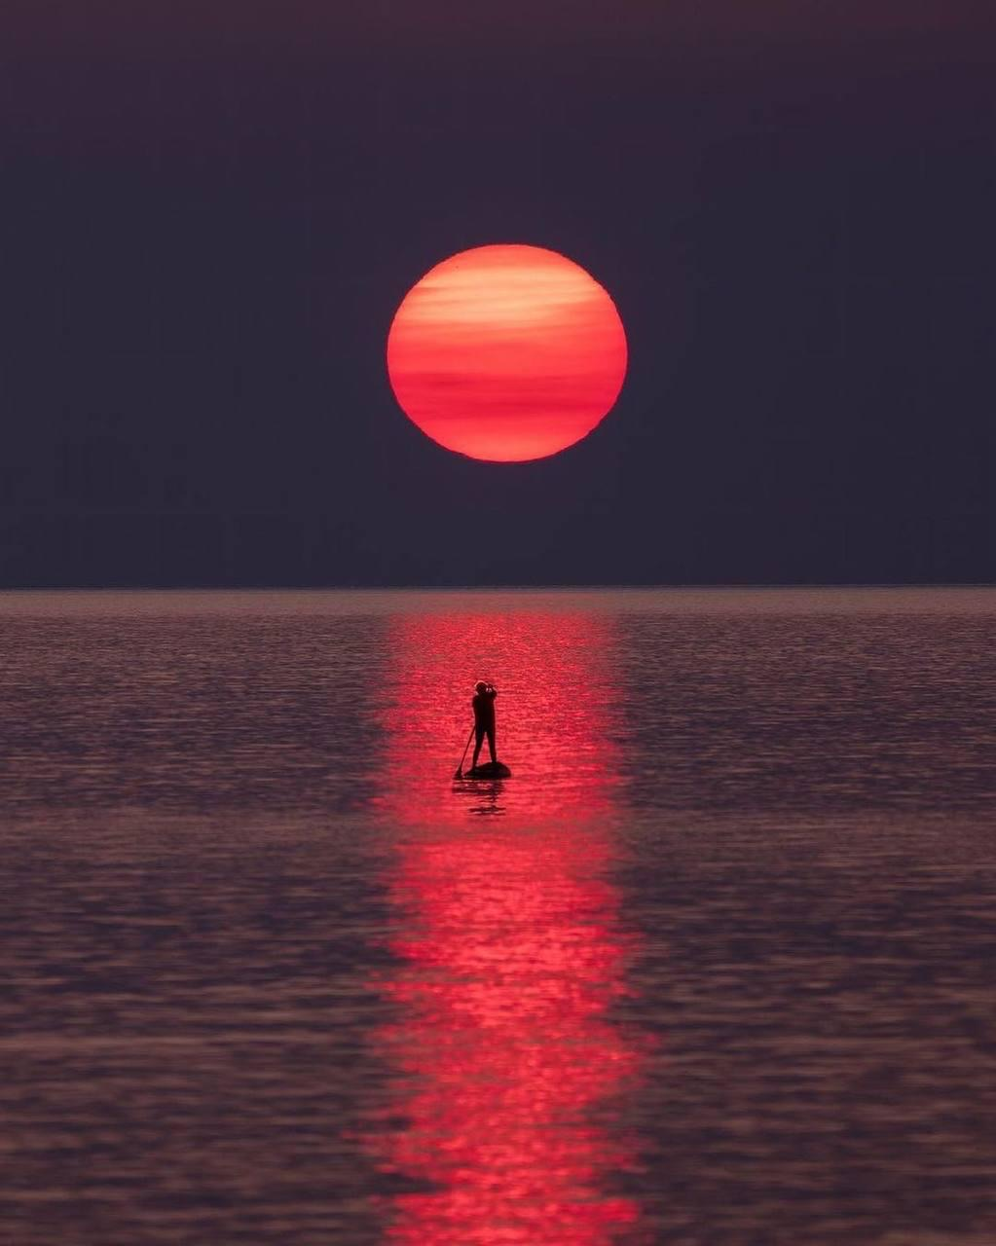
As we work to create light for others…

Slide 36
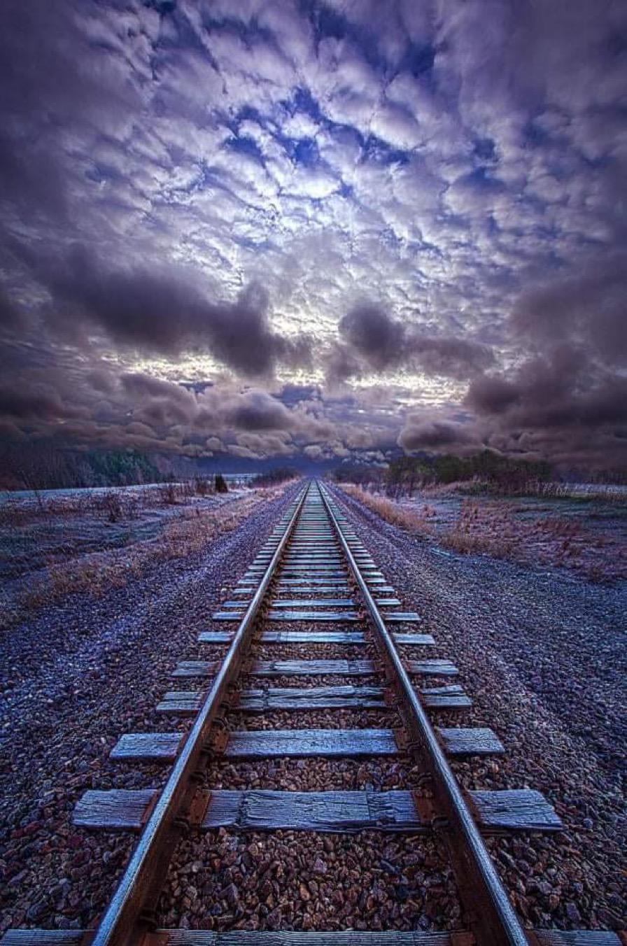
…we naturally light our own way.
- Marcus Aurelius

Slide 37
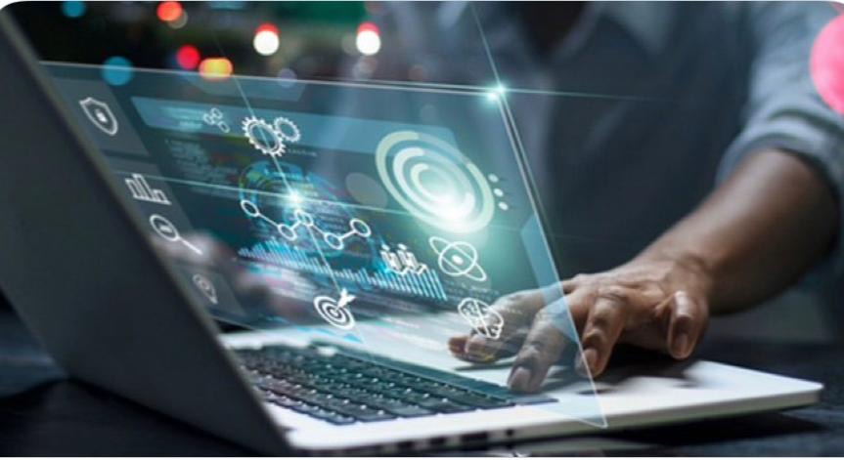
As we strive to build for the future.

Slide 38
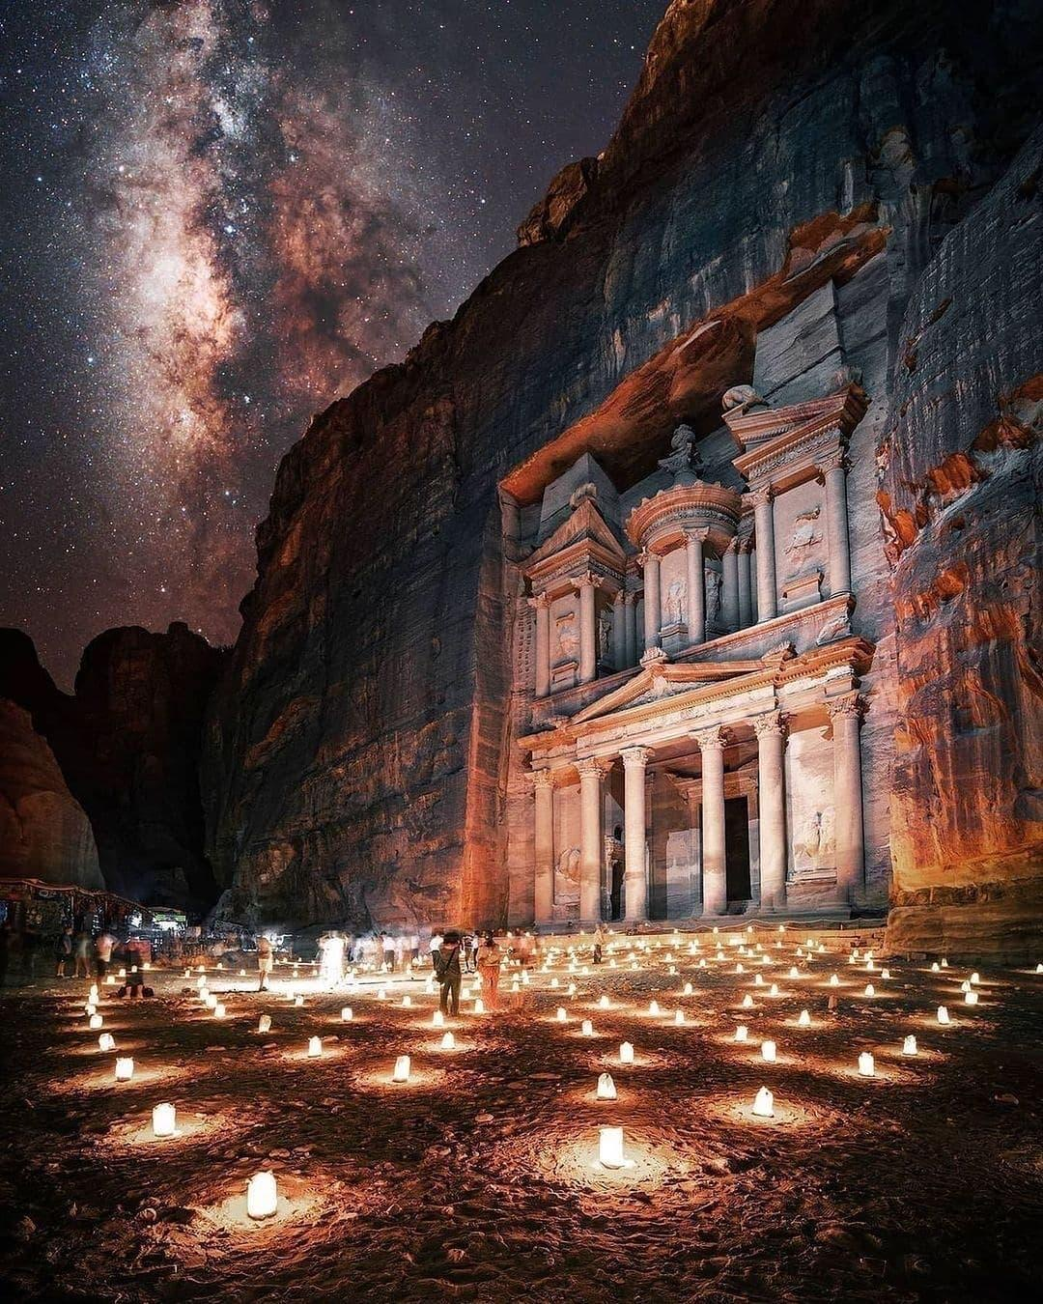
We must understand our past.

Slide 39

Innovation never dies.
It is an echo that occurs throughout time and space.

Slide 40

From discovering our own world...

Slide 41

To the worlds awaiting beyond.

Slide 42

We must remain vigilant and live by the process.
Observe.
Orient.
Decide.
Act.

Slide 43


Beware, lest history repeat itself.

Slide 44

By accomplishing this, we turn thought into action.
We push beyond what we believe we understand.

Slide 45
From the past to the present.
From the Ur-Net springs the EarthNet.

Slide 46



Just as humanity has pushed innovation through time...
4.1
4.4
4.6

Slide 47

The Lion.
King of the Jungle.

Slide 48

Our WORLD.
We are King of the Earth.

Slide 49

This is our home.

Slide 50

And this is what’s happening.

Slide 51

It is our duty to save it.

Slide 52

Whatever the mind can conceive and believe, the mind can achieve.
- Napoleon Hill

Slide 53


The secret to unlocking success is no mystery.

Slide 54

The choice is simple!

Slide 55

80% results.
20% effort.

Slide 56

Push past what you know.

Slide 57

What you think you know...

Slide 58

Achieving the impossible…

Slide 59


…is entirely possible.

Slide 60

It’s just a matter of effort!
What can I do for you?
What can we do for ourselves as a unit?

Slide 61

Innovation springs from all sources.

Slide 62

Innovation creates a profound ripple.

Slide 63

We see it throughout history.

Slide 64

The blueprints are everywhere we look, because...

Slide 65

...we’ve decoded them before and use them every day.

Slide 66


The potential to do so lies within, only a small effort away.

Slide 67


Together, we can, may,
and will achieve the impossible.

Slide 68

We'll reach the stars together.

Slide 69

The idea is simple.
Draw a solution from nature.

Slide 70

Creativity is observing that it’s all been done before...

Slide 71

…one way or another…

Slide 72

...the question remains in its application.

Slide 73

Our environment is precious.

Slide 74



Slide 75



Slide 76

The potential is there.
What are we going to do?

Slide 77

EarthNet by byoGuard
Inspired by Nature
Powered by Innovation

Slide 78

We are the Universal Network.
The Unth.

Slide 79

A whole world, integrated by byoGuard.

Slide 80

As past
talks to present,
talks to past...

Slide 81

As cells divide and repopulate…

Slide 82

…and supernovas live and die…

Slide 83

Our world sits in the center of this grand balance.
We must not lose it.

Slide 84

We are in orbit.
We surround the center of life.

Slide 85




Slide 86


Slide 87


Slide 88
We are byoGuard.

Slide 89



We build our road to success.

Slide 90
It is our duty to record and catalogue history in the making.

Slide 91

It is our duty to observe and unlock the elements.

Slide 92

We will give back to our world.

Slide 93

It is our duty to build byoGuard, our safe space.
We'll bring indoor and outdoor air into one united AirScape.

Slide 94

We will start this new era.
This is the sixth wave of innovation.

Slide 95

And we will save ourselves.

Slide 96

A Diamond class spider network – indestructible, flexible, and centered as a resilient framework harnessing the fabric and forces of nature for the betterment of humankind.

Slide 97
We’ve passed proof of concept for byoGuard’s secret sauce as the Trojan Horse with our secret sauce.

Slide 98

With sensors to monitor, we track data and serve as an integrator business for YOUR purposes.
The air story is supplemented by power savings in HVAC systems creating carbon credit potential as countries strive for zero carbon outcomes in the near to mid term.

Slide 99

We sequester carbon as carbon footprint required to manufacture and provide is less than the energy saving.
This realizes we are a required utility and zero carbon modifier.

Slide 100

We are a game changer from ‘Clean Air as a Service' (CAaaS) to carbon capture and human wellness integrator.

Slide 101

We are indeed ‘Protected by Nature.’

Slide 102

We see the potential.

Slide 103


We are aligned and balanced.

Slide 104

We are ready for takeoff.

Slide 105

We are the key that unlocks the puzzle.

Slide 106
Credits:
Executive Director, Producer, Storyboard, Script- Ir. Nigel Dearden
Producer, Storyboard, Editor, Script – Liam Eric McDowell
Producer, Storyboard, Script – Penny Chau
Music - Cameron Reay 2022 ©

