Slide 1

INVESTOR PITCH · PRE-SEED
FOUNDER
Lunari
Solange Asangapong ACCA
STAGE
The Finance Execution System for the Mid-Market
Pre-seed, pre-revenue
CONTACT
ASolange@lunari.cloud
“Finance hasn’t had its Salesforce moment yet. Lunari is built to be that system of record.”
One system. One data model. No integration tax.
RAISING
$1M SAFE
$8M cap

Slide 2
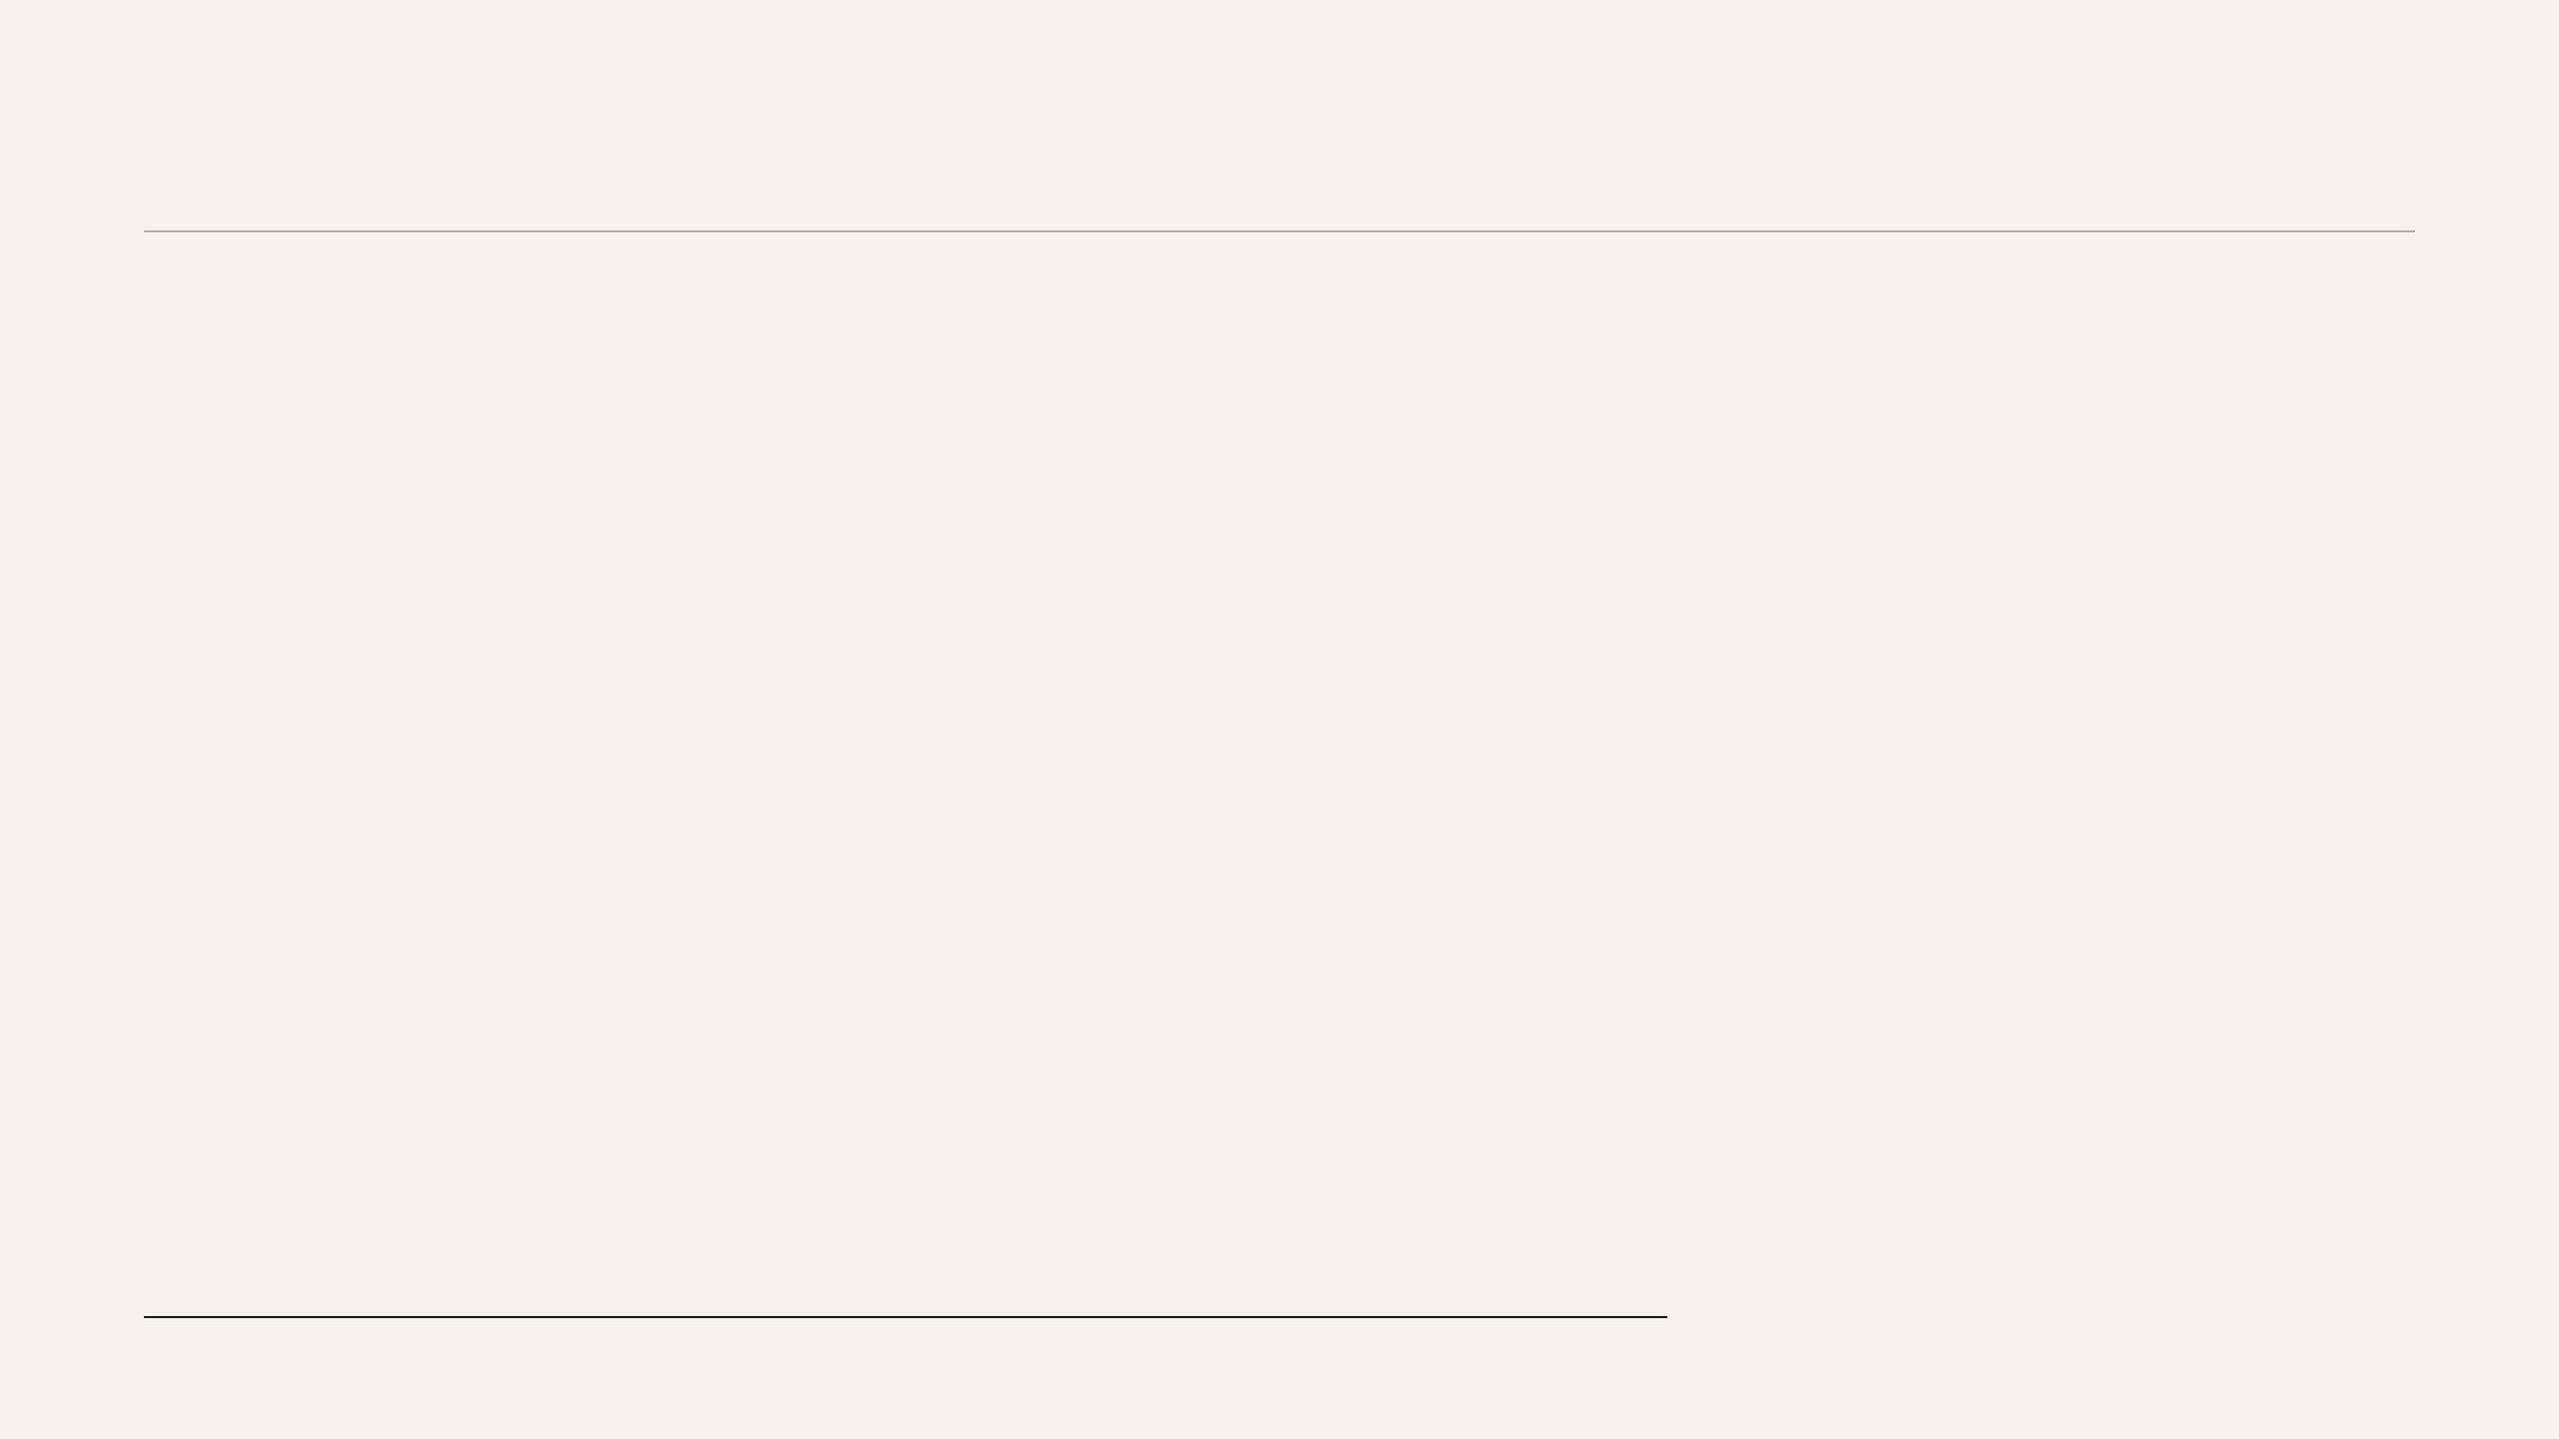
Finance Needs Its Salesforce Moment
“Ten months ago I was exploring AI for bookkeeping. The more I dug, the clearer it became: the opportunity is not bookkeeping. It is the entire execution layer of finance. And AI is not failing because the models are weak. It is failing because the foundation is fragmented.”

Slide 3

THE PROBLEM
Finance Runs on Broken Infrastructure
The average mid-market finance team runs 8–14 tools. None of them share a data layer.
What exists today
What it costs
WHAT THAT CREATES
Close still takes 8–10 days because it is an integration project, not a verification step.
ERP (NetSuite, Sage, QuickBooks)
$50K–$150K/yr
AP / expense tools (Tipalti, Ramp, Expensify)
$20K–$60K/yr
Audits still take 8–12 weeks because evidence is scattered across 10+ systems.
Reconciliation / close tools (FloQast, BlackLine)
$30K–$100K/yr
Reporting / BI tools
$20K–$80K/yr
AI is layered on stale, fragmented, context-free data and quietly fails.
Total stack
$150K–$600K+/yr
Teams maintain 40+ integrations, each a separate fragility point.
CORE INSIGHT
Mid-market companies are not stuck on Excel because they lack ambition. They are stuck because enterprise software is overbuilt, overpriced, and still requires Excel to bridge the seams between systems.

Slide 4

THE REAL DIAGNOSIS
AI Fails Because the Foundation Is Fragmented
The problem is not the models. It is the system they are being asked to operate on.
TODAY’S REALITY
LUNARI FIXES IT
Each tool owns a slice of data with no shared context.
One data model captures every transaction once, with full context.
The close becomes a monthly integration project.
22 integrated modules share one architecture from day one.
Audits become a manual hunt across systems and files.
Close, journals, and reconciliation run as one continuous flow.
AI sits on stale, incomplete, fragmented data.
$200K–$600K+ in tools and 40+ integrations still leave teams doing manual work.
An immutable audit trail timestamps every action and decision.
AI works because the finance foundation is finally unified.
KEY LINE
If the foundation is not unified from day one, the problem does not go away — you are simply recreating fragmentation in a new wrapper.

Slide 5
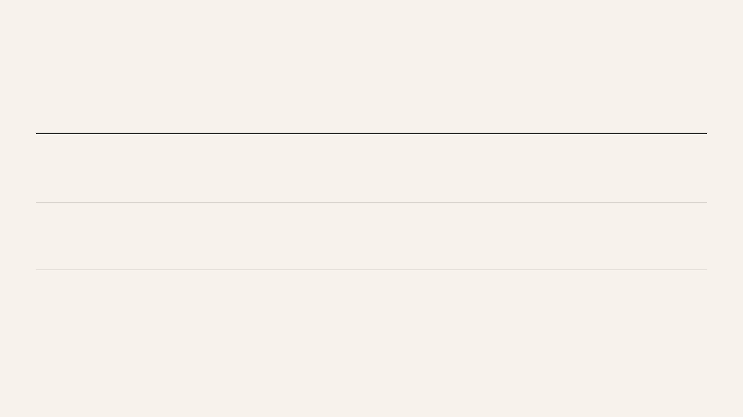
THE INSIGHT
Depth First, Then Expansion
The conventional SaaS playbook says to pick one problem and expand later. In finance, that logic breaks because fragmentation is the problem. The close, reconciliation, AP, and the transaction layer are operationally inseparable.
EXAMPLE 1
Procure-to-Pay
Request → Approval → Invoice Capture → Coding → Posting → Reconciliation → Settlement
EXAMPLE 2
Fixed Assets
Acquisition → Capitalisation → Depreciation Engine → Policy Control → Rollforward → Disposal
EXAMPLE 3
Month-End Close
Transaction Capture → Journal Posting → Reconciliation → Variance Analysis → Sign-off → Lock
Lunari is not stitched together from adjacent tools. It is one continuous finance operating flow built on one data model from the start.

Slide 6

THE PRODUCT
22 Integrated Modules on One Foundation
One data model. One audit trail. One currency and entity context. No stitching between systems.
Layer
Modules
Core Finance Engine
CloseIQ (close orchestration) · ReconcileIQ (reconciliation + variance) · JournalIQ (multi-currency journal engine) · CashIQ (cash classification + bank intelligence)
Accounts Layer
PayIQ (full AP lifecycle) · ReceivableIQ (AR workbench + disputes + collections) · BillingIQ (billing + subscriptions) · Revenue Recognition (ASC 606 / IFRS 15)
Asset & Schedule Layer
AssetIQ (fixed assets lifecycle, depreciation, policy, rollforward) · CapEx & CWIP tracking · Lease Accounting (IFRS 16 / ASC 842) · Prepaids & amortisation schedules
Operations Layer
Procurement · Expense Management (full lifecycle + reconciliation) · Card, OCR, reimbursement, settlement
Governance & Audit Backbone
Audit workflows + PBC tracking · Evidence Vault (cross-module linkage) · Compliance & control tracking
What matters is not the number of modules. What matters is that every module runs on the same architecture, eliminating reconciliation between tools and removing the integration tax at the core.

Slide 7

GO-TO-MARKET
Win the Close, Then Expand
Lunari does not go to market with all 22 modules. It enters through the one problem every CFO can measure immediately: the monthly close.
PHASE 1
PHASE 2
PHASE 3
Beachhead
Expansion
Platform
0–6 months · CloseIQ
6–18 months · AP, AR, Reconciliation
18–36 months · Full Finance OS
The close is the highest-pain, highest-visibility workflow in mid-market finance. Winning the close wins the relationship and opens every adjacent module.
Once the close runs inside Lunari, the data is already there, the trust is already there, and the adjacent workflows become natural product pull.
The full 22-module system becomes the default operating layer for mid-market finance teams globally.
TARGET
ICP
ENTRY PRICE
SUCCESS METRIC
Series A–C companies with 50–500 employees and $10M–$200M revenue
Head of Finance, VP Finance, or Controller currently closing in 8–10 days
$2,500–$5,000/month
Close in 3 days or fewer within 90 days

Slide 8

MARKET OPPORTUNITY
The Largest Underserved Segment in Enterprise Software
About 200,000 companies are stuck between software that is too simple and software that is too expensive. That gap is the market.
Segment
Size
Current solution
TAM
$8.6B
SMB (<$10M revenue)
Served by QuickBooks / Xero
Adequate — not the target
Financial close and reporting software, growing at 11% CAGR.
SAM
$2.1B
Mid-market ($10M–$500M revenue)
~200,000 companies in the US alone
Excel + fragmented stack — underserved
Mid-market opportunity across the US, UK, and EU.
Enterprise (>$500M revenue)
Served by BlackLine / SAP
Overbuilt for mid-market needs
MARKET PROOF
BlackLine discloses 200,000 target customers but only 4,400 served, leaving 195,600 companies still waiting for a better answer.
The mid-market is not a consolation prize. It is the largest underserved segment in enterprise software, and it is where Lunari’s unified architecture is most differentiated.

Slide 9

COMPETITIVE LANDSCAPE
Incumbents Cannot Rebuild from Here
Every incumbent is structurally prevented from becoming Lunari because they sit on top of fragmented systems rather than owning the finance execution layer itself.
Competitor
What they do well
Why they cannot respond
BlackLine
Reconciliation depth for Fortune 500
Built on a 20-year-old architecture; it cannot rebuild the transaction layer without breaking 4,400 enterprise customers.
FloQast
Close checklist for mid-market
It is a checklist on top of the same fragmented stack and does not own the underlying data.
Tipalti
AP automation at scale
Single-function by design; adding a close module would require a data model it does not have.
NetSuite
ERP breadth
General-purpose ERP; finance execution is an afterthought rather than the product core.
Ramp
Expense and card intelligence
It cannot add an AI Controller without first owning a ledger.
Excel
Flexibility
It is the symptom of the problem rather than the solution to it.
The architectural constraint is the moat. Evolving into a unified finance OS requires rebuilding the transaction layer from scratch, which incumbents cannot do without disrupting their installed customer base.

Slide 10
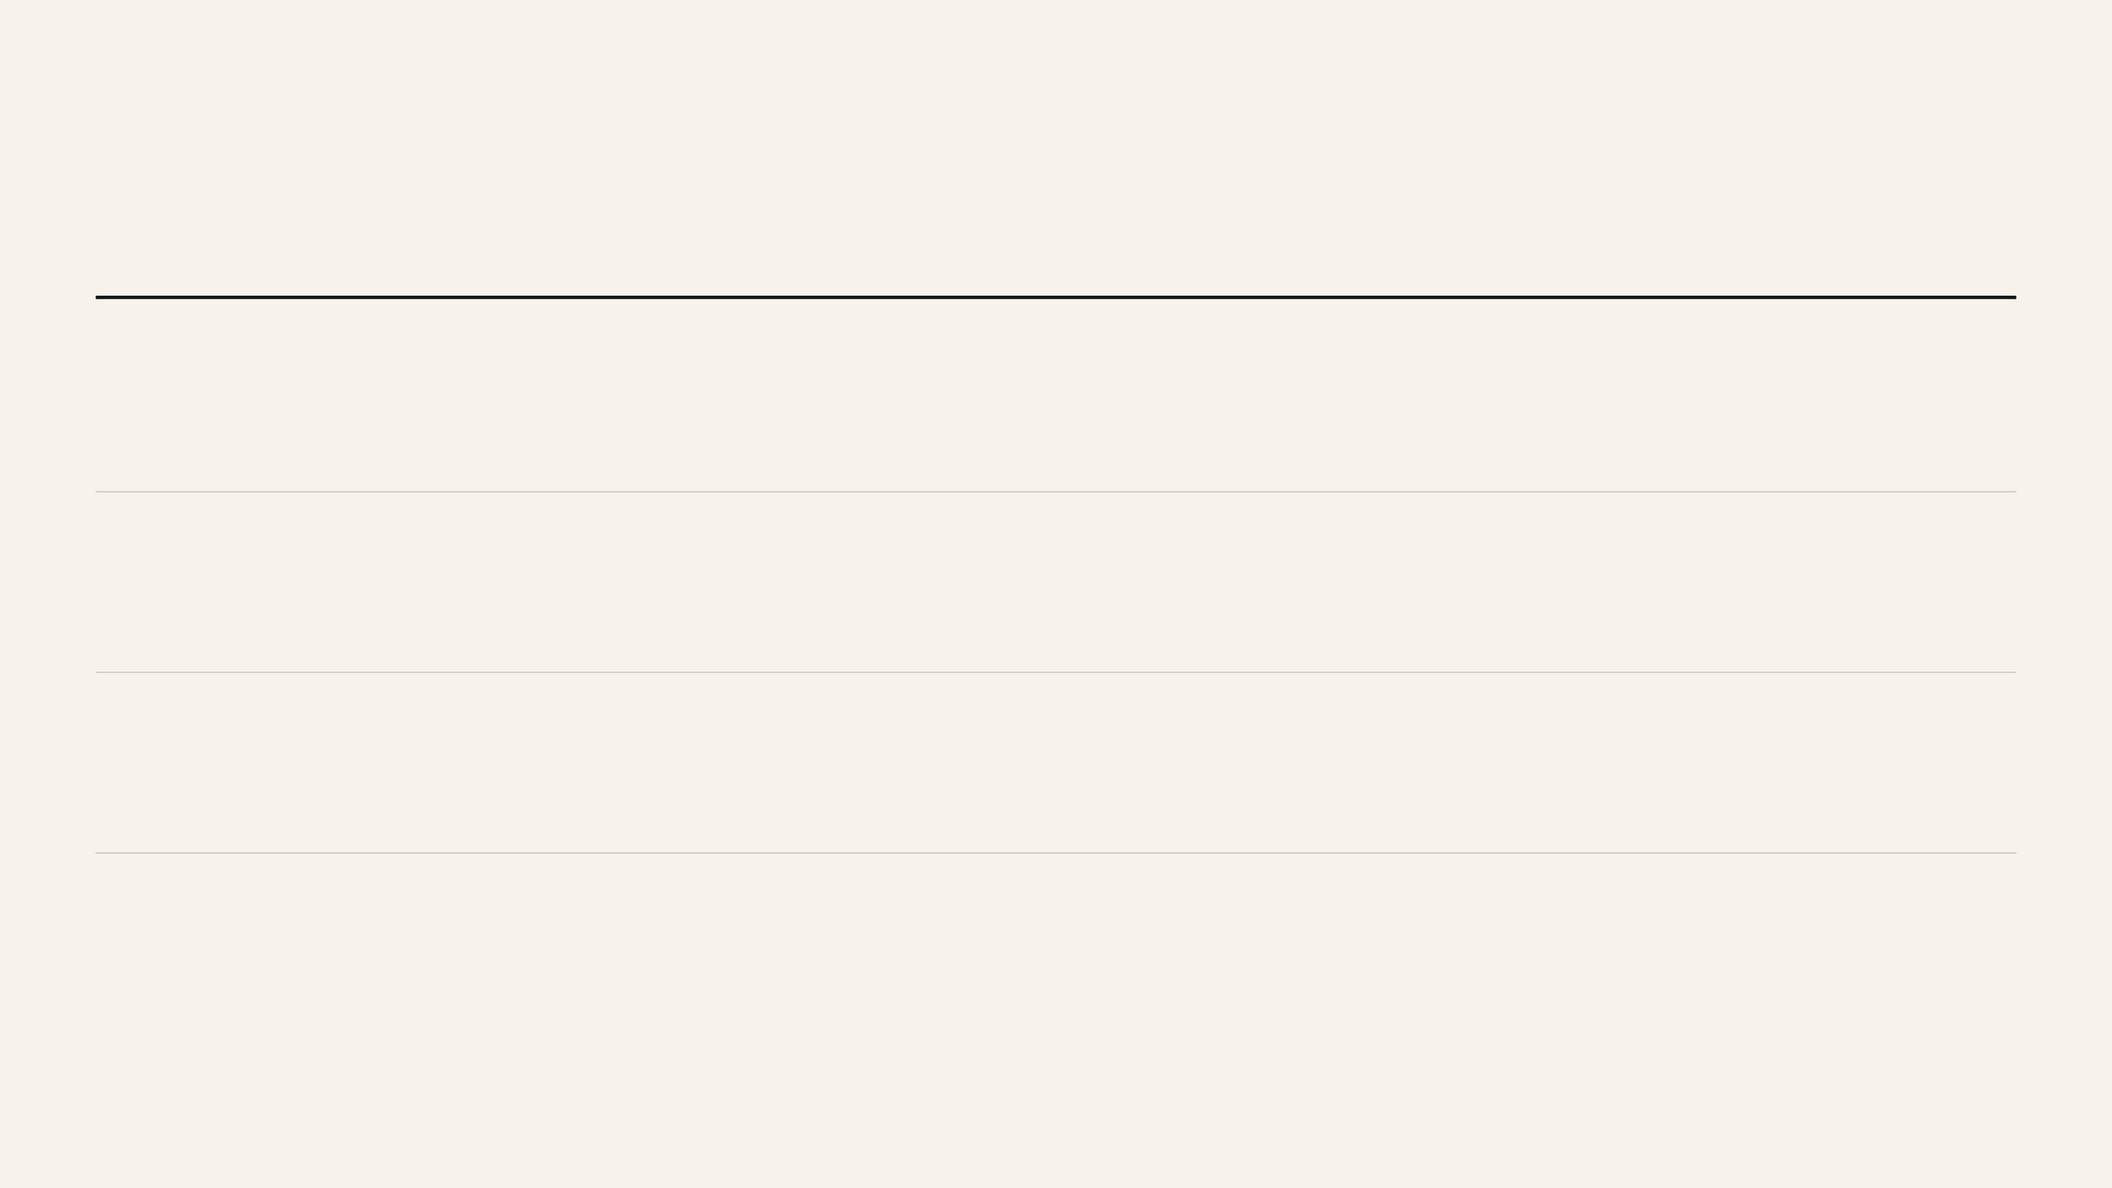
THE MOAT
Four Moats Compound Over Time
The defensibility is not a single feature. It is a stack of reinforcing advantages that become harder to cross with each month of usage.
01
Every transaction improves coding rules, anomaly detection, and company-specific intelligence. After two years, a customer’s Lunari ledger becomes trained operational knowledge that no competitor can migrate cleanly.
Ledger Network Effect
02
Each transaction carries an evidence chain. Auditors working through one cycle with Lunari’s evidence packs, and acquirers seeing stronger diligence readiness, become advocates for staying.
Third-Party Reinforcement
03
Incumbents cannot replicate a unified transaction layer without rebuilding from scratch. Doing so would break the installed customer bases their businesses already depend on.
Architectural Impossibility
04
Over 6–12 months, approval rules, close logic, reconciliation workflows, and entity structure become encoded into Lunari. Replacing it means rebuilding the company’s financial operating system.
Institutional Configuration Lock-In
This is not feature defensibility. It is operating-system defensibility built through accumulated data, embedded workflows, and time.

Slide 11

THE FOUNDER
A Founder with Rare Domain Depth
The hardest part of building a finance OS is not engineering alone. It is knowing, at practitioner depth, what must exist in the system and why current tools fail at the seams. These modules have already been built in AI assisted environment.
Solange Asangapong ACCA · Founder & CEO
DOMAIN EXPERTISE
Visa — global payments infrastructure and multi-currency transaction processing at scale.
This is a solo-founder raise, and that is a strength rather than a weakness. Lunari’s 22-module architecture reflects a single product vision shaped by deep operating experience rather than a roadmap assembled by committee.
Schlumberger — complex multi-entity, multi-jurisdiction finance operations across 120+ countries.
IFRS & US GAAP — practitioner knowledge including ASC 606 and IFRS 16 / ASC 842.
The investor case is straightforward: product depth in fixed assets, revenue recognition, billing, lease accounting, procure to pay, order to cash, treasury and cash management, intercompany logic, and audit workflows is only possible because the founder has lived these processes at global scale.
Complex contracts — milestone billing, variable consideration, and multi-element arrangements.
AI-FIRST EXECUTION MODEL
A 4-person engineering team augmented by AI is designed to deliver the output of a 20-person team, which is why a $1M raise is sufficient to reach GA rather than merely begin building the product.
Why this matters: the rare asset here is not generic technical talent. It is domain-native product judgment — the ability to know exactly what a finance execution system must do before writing the first line of code.

Slide 12
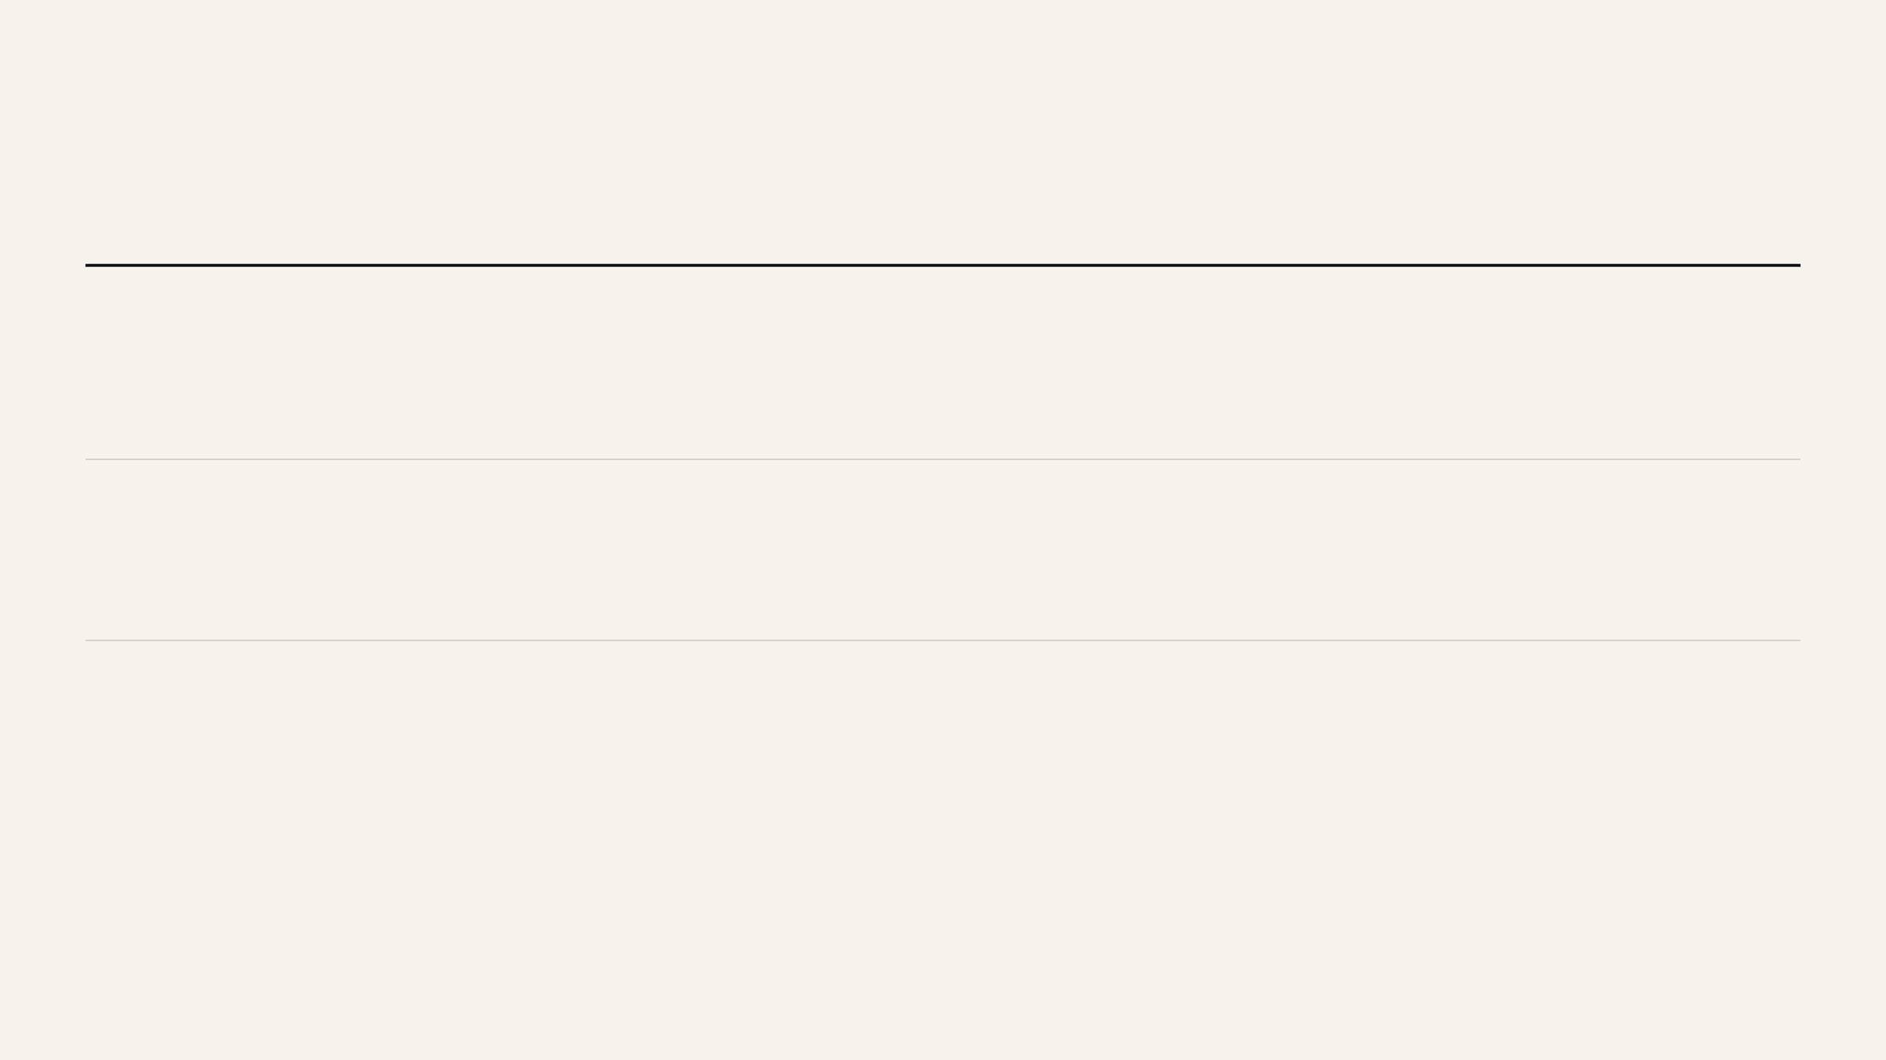
WHY NOW
Why Now Is an 18-Month Window
Three forces are converging for the first time, creating a narrow but highly attractive category-opening moment.
1
AI is viable — but only on clean data
LLMs and agents are finally capable of real finance work. The bottleneck is not model quality; it is whether the underlying finance system provides structured, contextual, trustworthy data.
2
Mid-market CFOs are actively looking
Post-2022 efficiency pressure has made tool sprawl and close-cycle length impossible to ignore. The buyer question has shifted from whether to consolidate to what platform to consolidate onto.
3
Incumbents are paralysed
BlackLine, FloQast, and Tipalti face the same structural problem: rebuilding the transaction layer would disrupt the customer bases their current businesses depend on. That creates a real window for a category leader to emerge.
This window will not remain open indefinitely. Once a well-funded challenger reaches meaningful scale on the right architecture, the category leadership position will begin to lock in.

Slide 13

THE ASK
$1M Funds Go-to-Market, Not the Build
$1,000,000 SAFE · $8M cap · 20% discount · 18-month runway
Allocation
Amount
Purpose
Engineering (AI-first team)
$350,000
4 engineers across 12 months; Close Engine GA plus 6 adjacent modules, .
Founder salary
$120,000
$6,667/month, below market and founder-aligned.
Design partners & GTM
$380,000
Onboarding, implementation support, and the first 10 customers.
Infrastructure & tooling
$80,000
Cloud, AI APIs, security, and compliance.
Legal & operations
$70,000
SAFE docs, IP protection, and entity setup.
MONTH 6
MONTH 12
MONTH 18
Close Engine at GA · first 5 paying customers · ARR above $150K
AP + AR live · 20 customers · ARR above $600K
Series A ready · 50+ customers · ARR above $1.5M · full platform in beta
Why $1M is sufficient: the AI-first engineering model gives Lunari 20-person output from a 4-person team. The raise funds the commercial proof, not product discovery.
I have built the modules with great depth without raising outside capital.

Slide 14

THE VISION
The Salesforce Moment for Finance
Finance is reaching the same category inflection point that CRM reached when a fragmented toolset gave way to a true system of record.
Salesforce did not invent CRM. It unified a fragmented category of contact databases, deal trackers, and communication tools into one operating system of record.
5-YEAR OUTLOOK
Year
Customer target
ARR target
Strategic milestone
1
50
$1.5M
Close Engine + AP/AR established
Finance now sits at that same moment. The data exists. The workflows exist. The AI exists. What does not yet exist is a unified system that ties them together on one data model with one audit trail.
2
200
$6M
Full platform; UK + EU expansion
3
500
$18M
Series B; enterprise tier launched
Lunari is building that system. Not a better close checklist or reconciliation tool, but a finance execution system that makes every downstream workflow materially better because the foundation is finally correct.
4
1,200
$38M
Category leadership established
5
2,500
$56M
IPO-ready or strategic acquisition target
The category thesis is simple: once finance has a true system of record, the pre-Lunari workflow stack will look as outdated as pre-Salesforce CRM.

Slide 15

CLOSING
We Are Building the Platform Mid-Market Finance Has Been Waiting For
RAISE
$1M SAFE
to prove the architecture in market
NEXT STEP
A live walkthrough is the fastest way to see why this approach is different.
200,000 companies are still stuck on Excel and fragmented tools. Lunari is building the system of record they have been waiting for.
“The approach is simple: capture everything once, at the moment it is created. Keep it in one system. Let everything else — close, reporting, audit, and AI — flow from that.” — Solange Asangapong ACCA
I am not asking only for capital. I am looking for a partner who understands that the hardest problems in enterprise software are the ones that require a decade of domain experience to even see clearly.
CONTACT
ASolange@lunari.cloud

