Slide 1


Notes:
Good morning. We're here to introduce Wight Bear Trading Company, a convergence of global commodity trading, advanced blockchain settlement, and strategic Arctic resource development. The polar bear, our emblem, signifies the strength, endurance, and environmental stewardship inherent in our mission. We're building a robust platform for the next generation of commodity markets. Our focus is on delivering institutional-grade efficiency and security in a sector ripe for innovation.

Slide 2
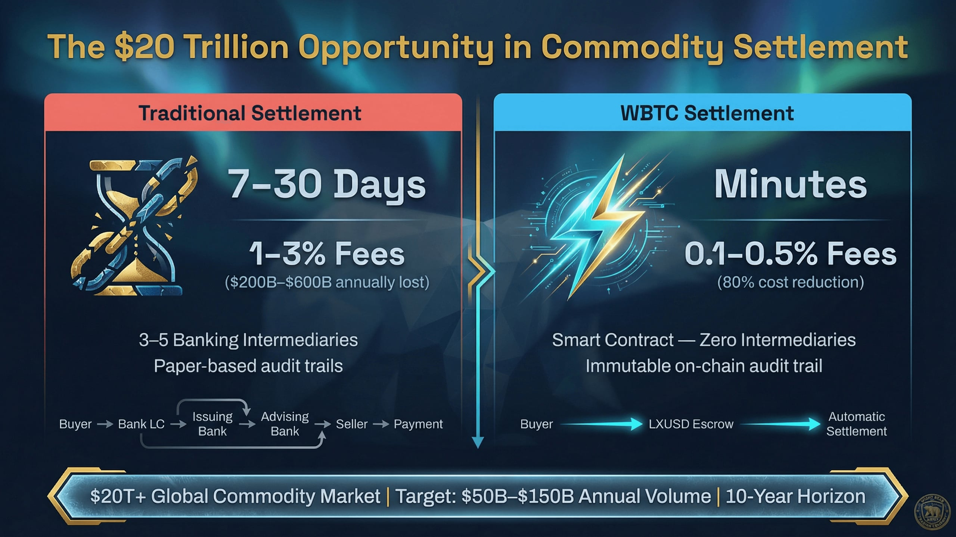
Notes:
The global commodity market, exceeding $20 trillion annually, operates on an outdated settlement infrastructure. This presents a monumental opportunity for disruption. Traditional Letters of Credit incur 1-3% fees and take 7-30 days to settle, costing the industry hundreds of billions annually. WBTC leverages instant smart contract settlement with LXUSD stablecoin, reducing costs by 80% and settlement time by 99%. We project capturing $50 billion to $150 billion in annual trading volume within a decade. This isn't just an incremental improvement; it's a fundamental re-architecture of commodity finance. Let's examine how this translates into a tangible settlement flow.

Slide 3
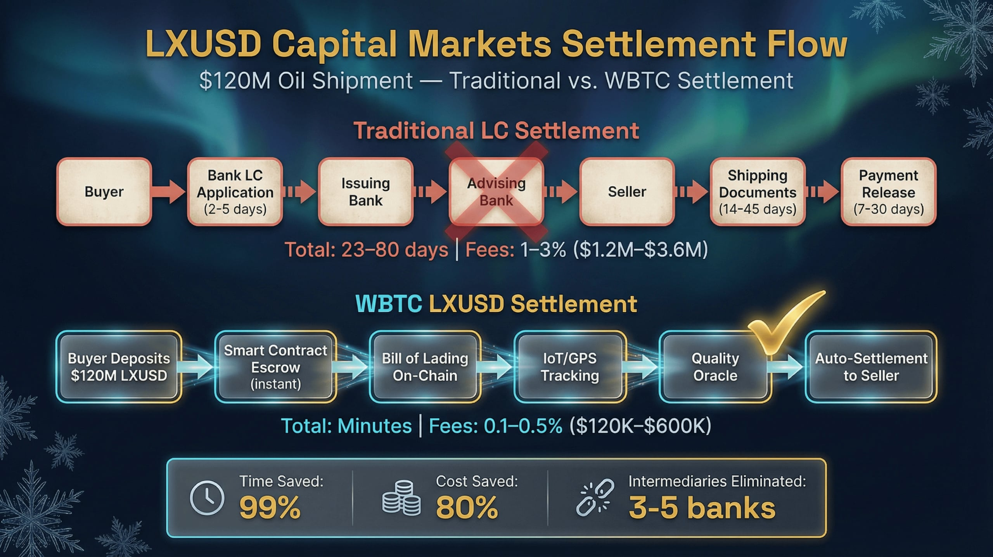
Notes:
This diagram illustrates the stark contrast between traditional and WBTC settlement. A $120 million oil shipment, under the old system, would involve multiple intermediaries, taking 23 to 80 days and incurring significant fees. Our LXUSD Capital Markets Settlement Flow streamlines this to minutes. The buyer deposits LXUSD into a smart contract escrow, with on-chain verification of the Bill of Lading and IoT tracking. This eliminates $1.2 million to $3.6 million in fees and collapses settlement time. This efficiency gain is transformative for liquidity and risk management. Now, let's look at the underlying structure supporting this innovation.

Slide 4
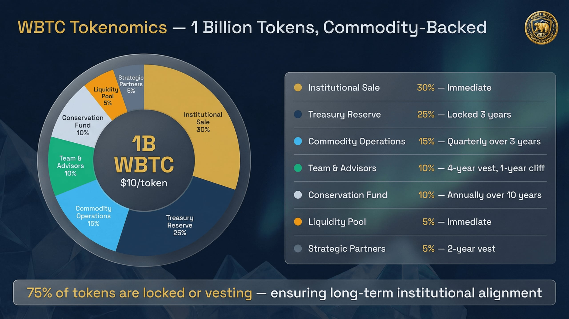
Notes:
Our tokenomics are designed for institutional stability and long-term alignment. The WBTC token, an SPL token on Solana, has a total supply of 1 billion, launching at $10.00. We're targeting a $100 million raise. Notably, 75% of tokens are locked or vesting, ensuring a controlled supply and commitment from key stakeholders. The institutional sale accounts for 30% with immediate release, while significant portions are reserved for treasury, operations, and a conservation fund with multi-year vesting schedules. This structure underpins our commitment to sustainable growth. Next, we'll explore the specific commodity sectors driving our projected volume.

Slide 5
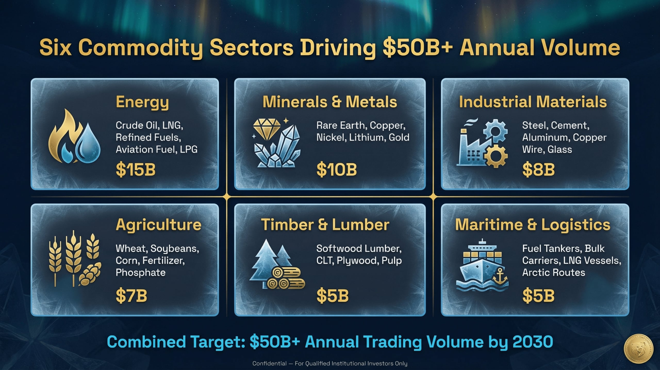
Notes:
WBTC is strategically positioned across six major commodity sectors, each representing multi-billion dollar trading opportunities. We're targeting over $50 billion in annual trading volume by 2030. Energy, including crude oil and LNG, leads with a $15 billion target. Minerals and Metals, critical for modern technology, aim for $10 billion. Industrial Materials, Timber and Lumber, Agriculture, and Maritime and Logistics each contribute substantial targets. This diversified approach mitigates sector-specific risks while capitalizing on broad market demand. Our next slide will detail a key strategic advantage in one of these critical sectors.

Slide 6
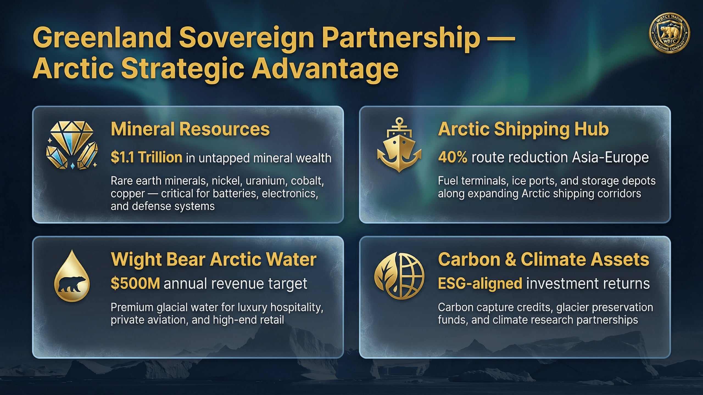
Notes:
Greenland presents a strategic advantage, offering unparalleled access to critical resources and emerging trade routes. This partnership is central to our long-term vision and complements our commodity sector focus. Greenland holds an estimated $1.1 trillion in untapped mineral wealth, including rare earths, nickel, and cobalt, essential for modern technology and defense. The expanding Arctic shipping routes, particularly the Northern Sea Route, reduce Asia-Europe transit times by 40%, creating new logistical efficiencies. We're also launching Wight Bear Arctic Water, targeting $500 million in annual revenue from premium glacial water. This unique blend of resource access, logistical advantage, and brand development underpins our Arctic strategy. Now, let's examine the institutional structure supporting these ventures.

Slide 7
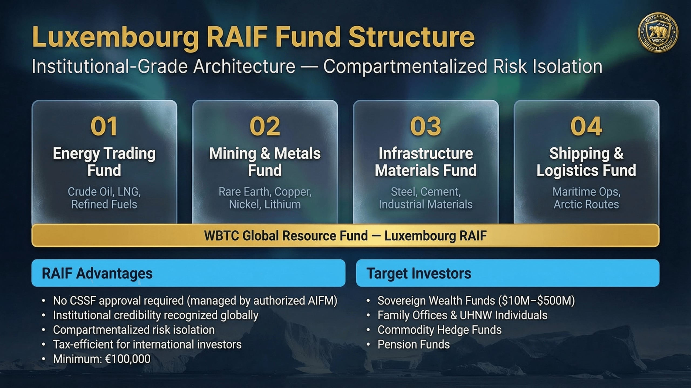
Notes:
Our Luxembourg RAIF structure provides the institutional-grade architecture necessary for managing these diverse opportunities. This structure offers critical advantages for sophisticated investors like yourselves. The RAIF allows for compartmentalized risk isolation across our four distinct funds: Energy Trading, Mining & Metals, Infrastructure Materials, and Shipping & Logistics. This means each strategy operates independently, protecting capital across different asset classes. Furthermore, the RAIF's tax-efficient framework and institutional credibility are recognized globally, making it ideal for sovereign wealth funds and large institutional allocations. We require a minimum investment of €100,000 for qualified investors. With this robust structure in place, let's discuss how we plan to deploy the capital raised.

Slide 8
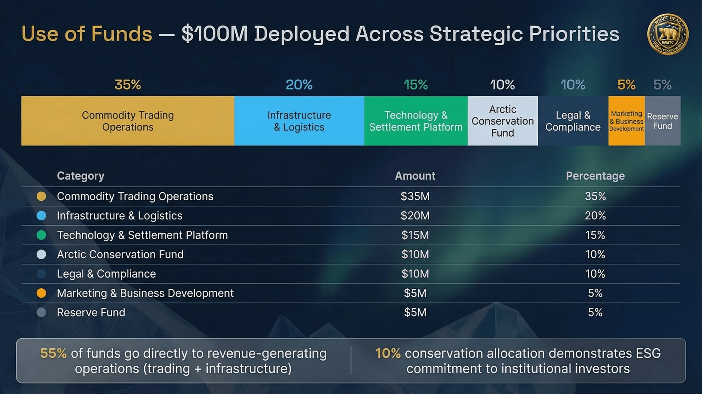
Notes:
Our $100 million raise is strategically allocated to maximize operational efficiency and accelerate revenue generation. We've designed this deployment to directly support our core business and strategic priorities. 55% of the funds are directed to revenue-generating operations, specifically commodity trading and infrastructure. This ensures immediate impact on our bottom line. A significant 10% is allocated to our Arctic Conservation Fund, demonstrating our commitment to ESG principles and aligning with our Arctic narrative. This balanced approach ensures both financial performance and responsible stewardship. Next, we'll delve into the technological backbone that enables our operational excellence.

Slide 9
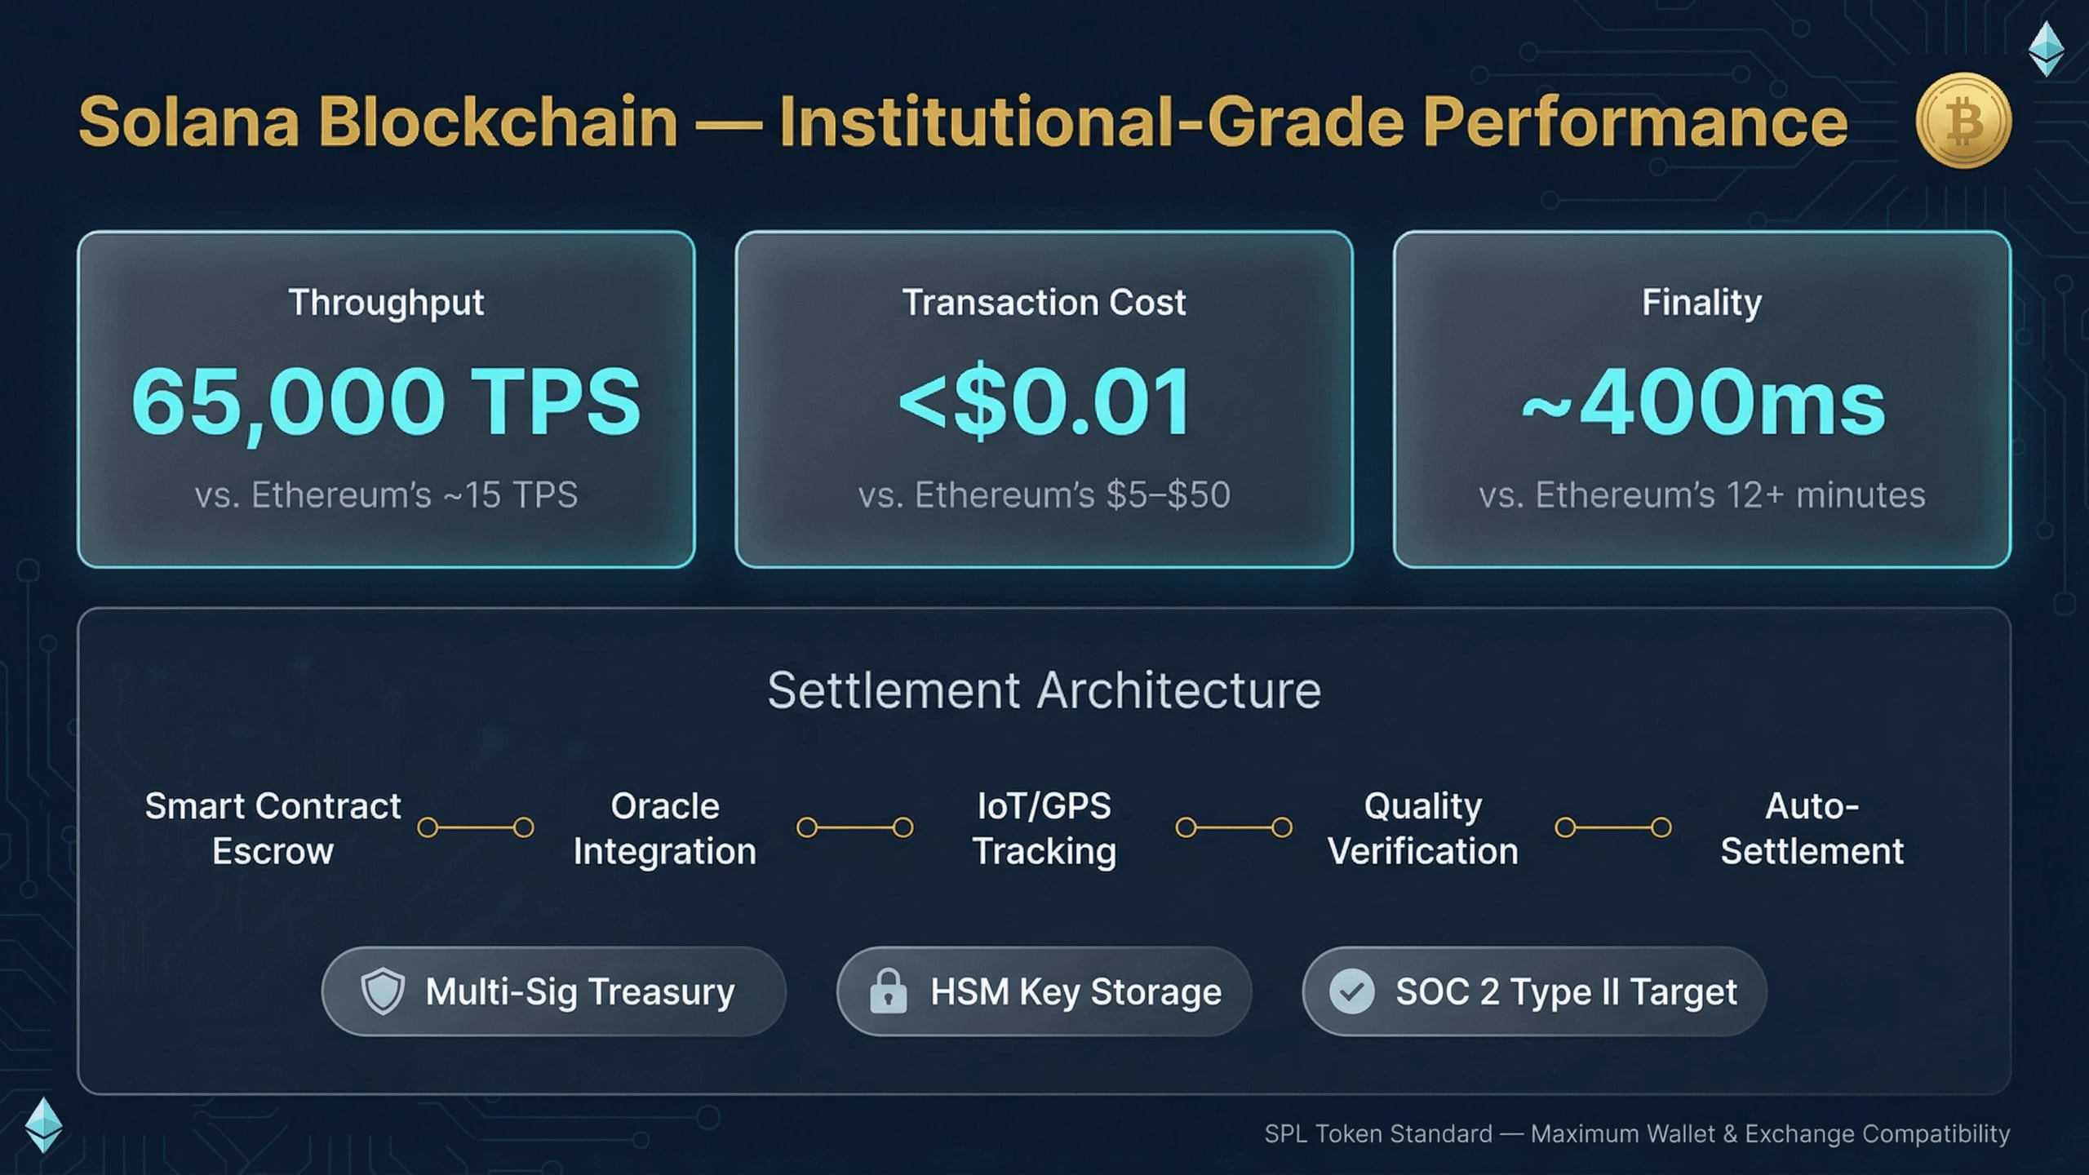
Notes:
Our choice of Solana as the underlying blockchain is critical for delivering institutional-grade performance and security. This technology is fundamental to our ability to execute rapid, cost-effective settlements. Solana processes 65,000 transactions per second at less than one cent per transaction, with near-instant 400-millisecond finality. This dramatically outperforms traditional systems and other blockchain alternatives. Our settlement architecture integrates custom smart contracts, oracle data feeds for real-world information, and IoT tracking for complete transparency. We are targeting SOC 2 Type II compliance and employ hardware security modules and digital asset insurance to ensure robust security. This technological foundation is key to our competitive advantage.

Slide 10
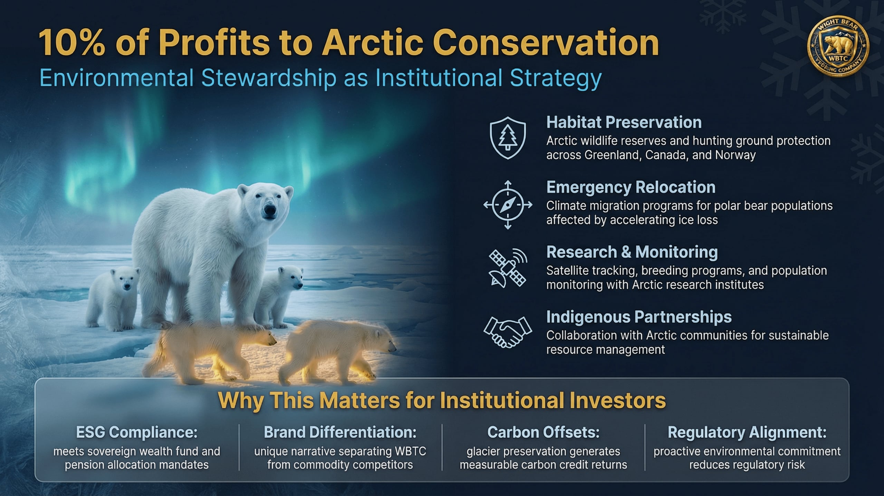
Notes:
Beyond our technological superiority, our commitment to ESG principles is fundamental to our value proposition. We dedicate 10% of annual profits to Arctic conservation, directly aligning our commercial success with environmental stewardship. This commitment is not merely philanthropic; it's a strategic imperative. It ensures ESG compliance for major institutional investors and differentiates WBTC in a competitive market. This direct alignment between our Arctic operations and conservation efforts creates a powerful, positive brand narrative. This commitment is integral to our long-term vision, as outlined in our development roadmap.

Slide 11
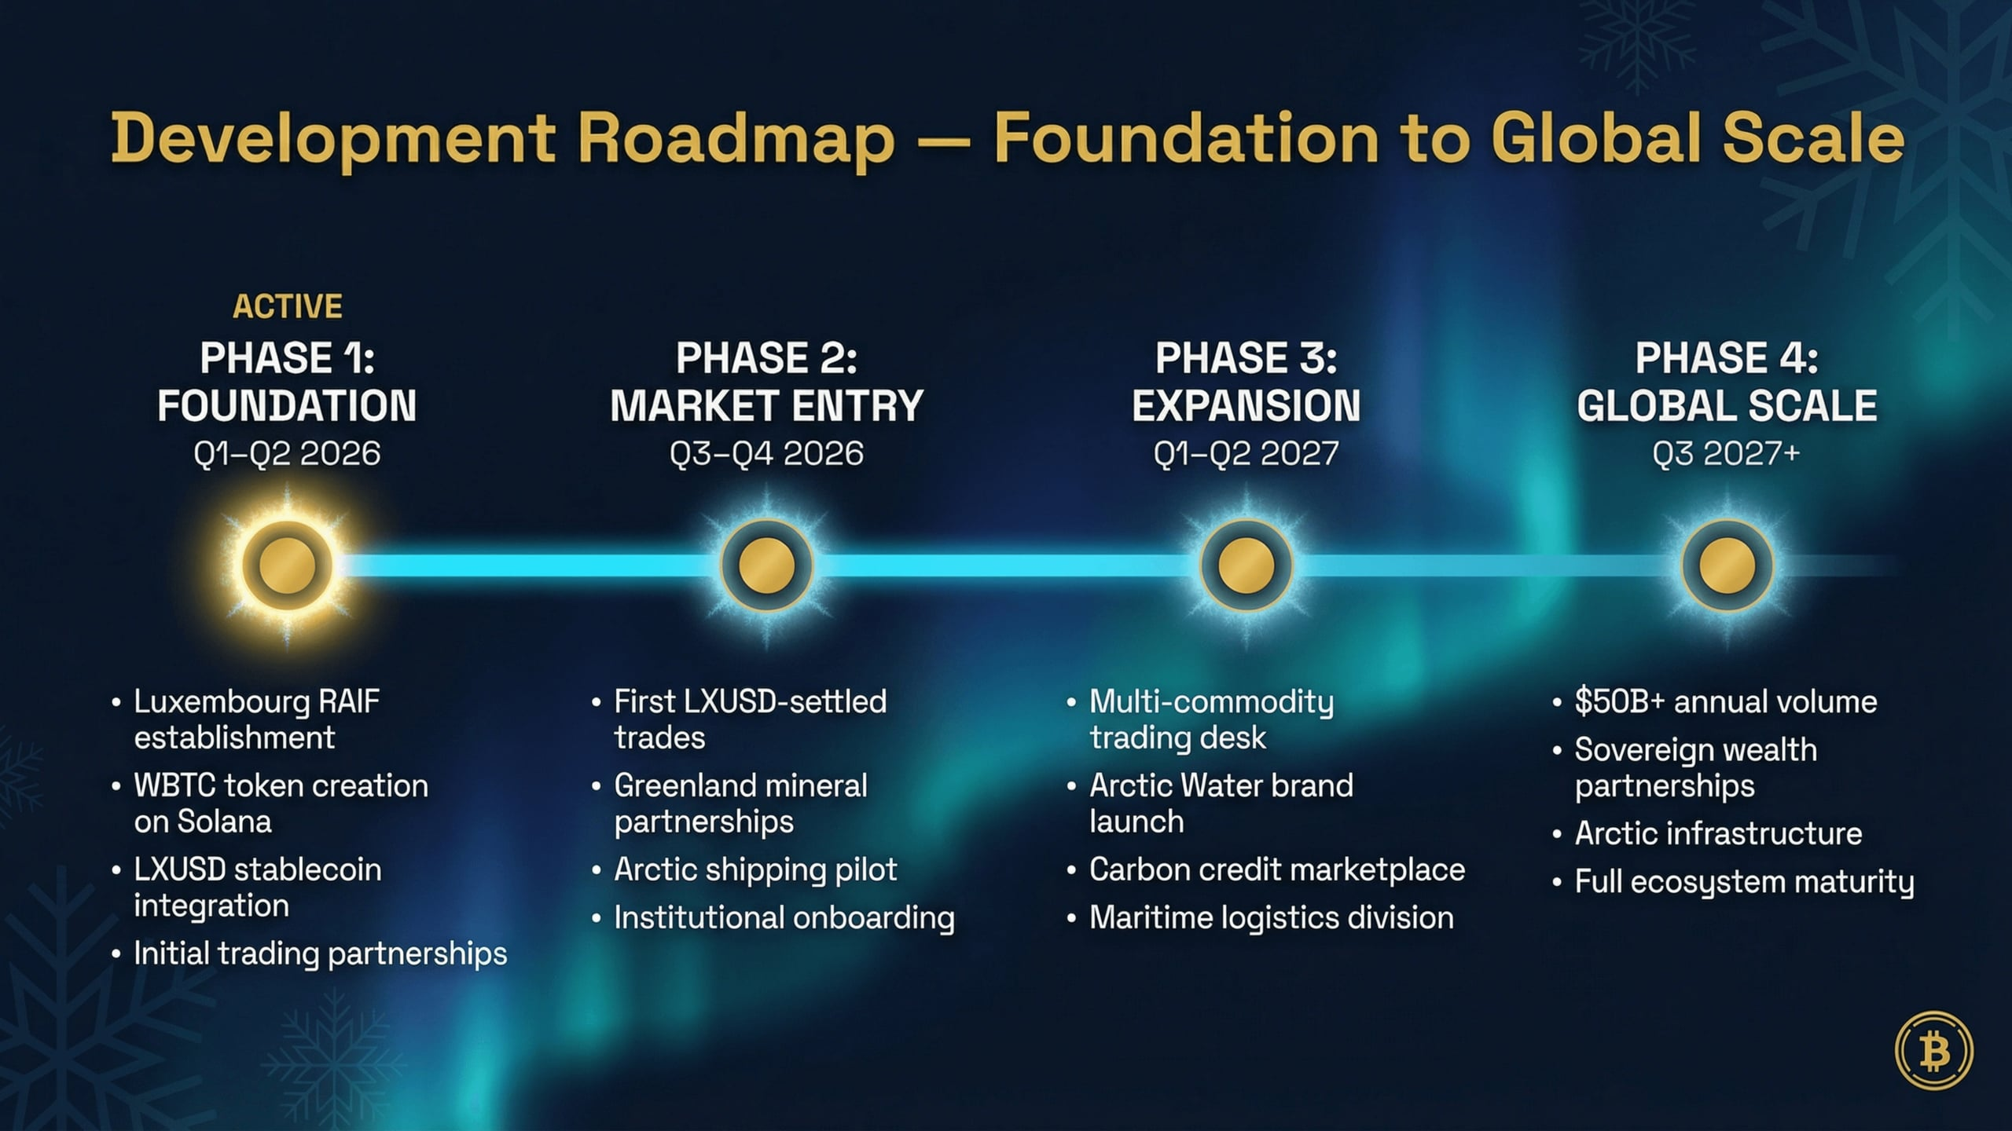
Notes:
Our development roadmap outlines a clear, phased approach from foundational build-out to global market dominance. Phase 1, the Foundation phase, establishes our Luxembourg RAIF and integrates LXUSD for initial trading partnerships. By Phase 3, Expansion, we will launch our multi-commodity trading desk and the Wight Bear Arctic Water brand. Our ultimate goal in Phase 4 is to achieve over $50 billion in annual trading volume and full ecosystem maturity. This structured progression underpins our investment thesis, which I will now detail.

Slide 12
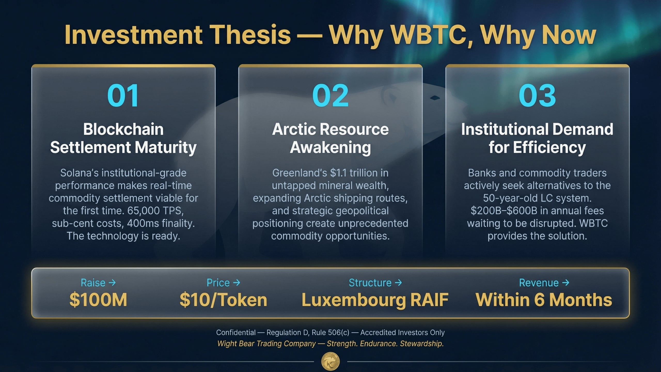
Notes:
Our investment thesis rests on three converging forces, creating an unparalleled opportunity for significant returns. First, Solana's institutional-grade performance has matured blockchain settlement, making real-time commodity transactions viable. Second, the Arctic's $1.1 trillion in mineral wealth and expanding shipping routes present unprecedented commodity opportunities. Finally, there is an urgent institutional demand for efficiency, with banks and traders actively seeking alternatives to outdated settlement systems. We are requesting a $100 million institutional raise at $10 per token, structured within a Luxembourg RAIF for compartmentalized risk. We project revenue generation within six months, driven by trading fees, commodity margins, and fund management fees.

