Slide 1
Advanced International Marketing
Lecture 4
March 26, 2026

Slide 2
Contents
The evolution of the Marketing theories
Cases of Marketing Related Research
For the Next Class, Prepare research proposal related to the international marketing
Q&A and Quizzes

Slide 3
1.The evolution of the Marketing theories

Slide 4
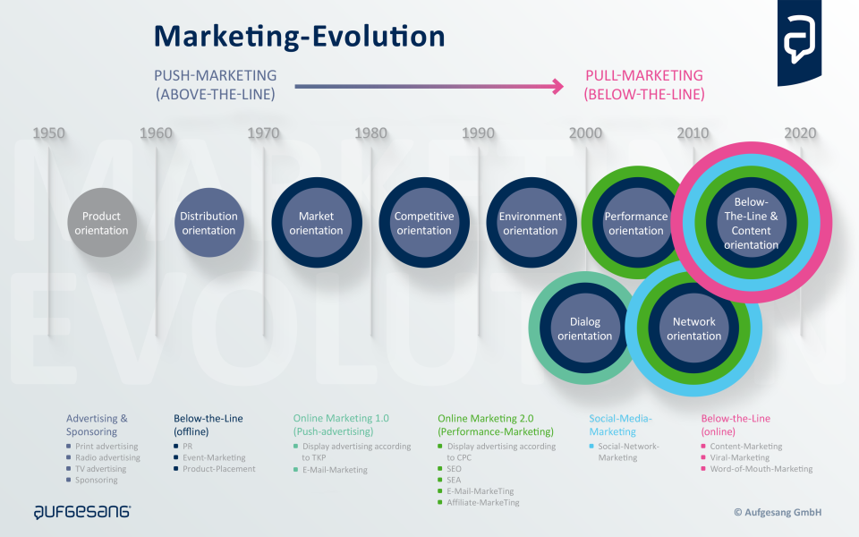

Slide 5
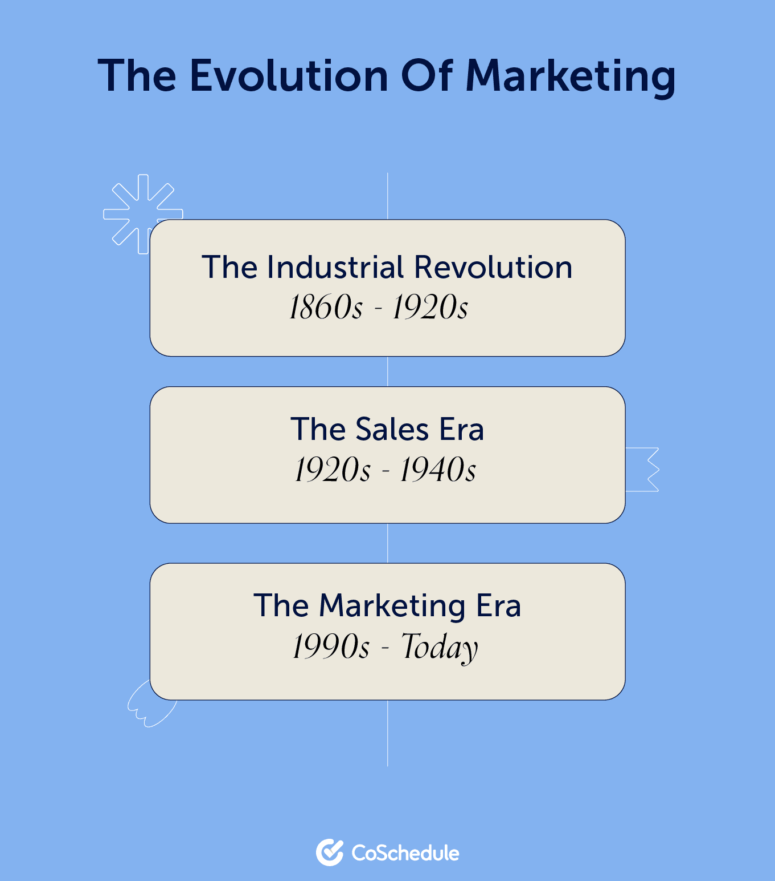

Slide 6
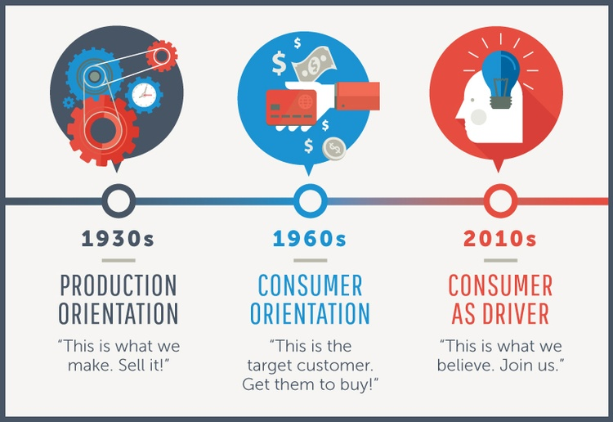

Slide 7
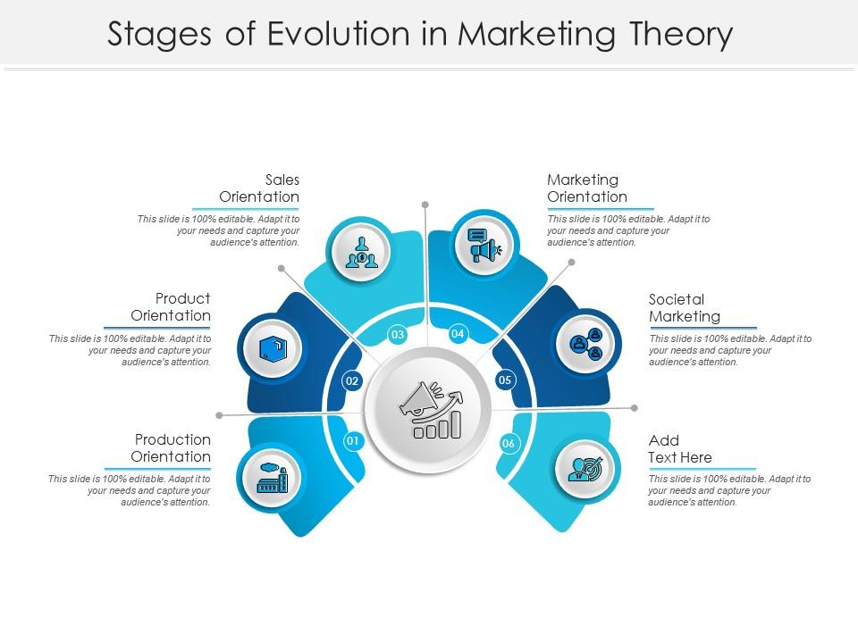

Slide 8
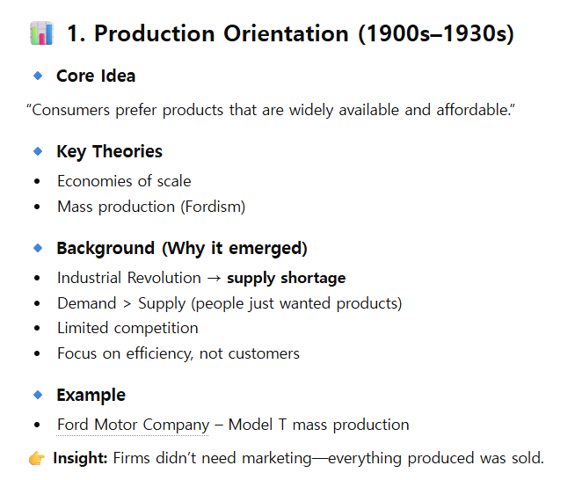

Slide 9
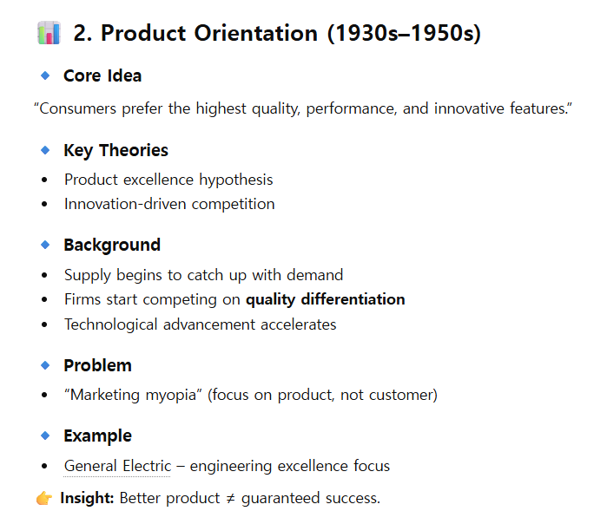

Slide 10
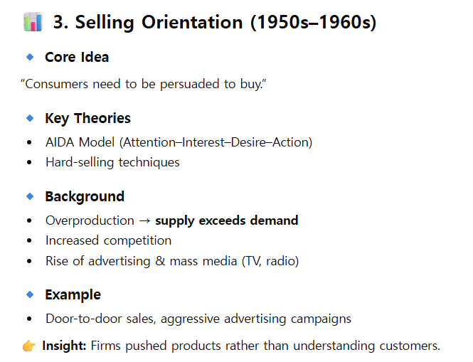

Slide 11
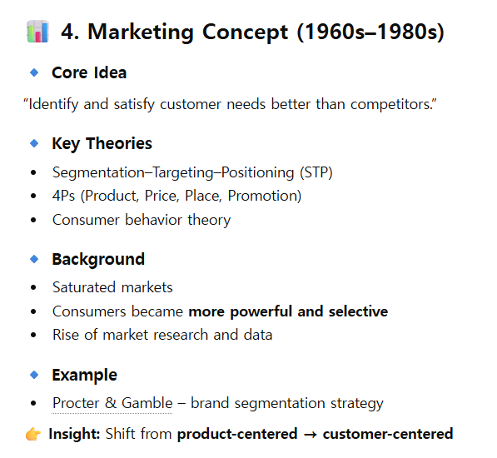

Slide 12
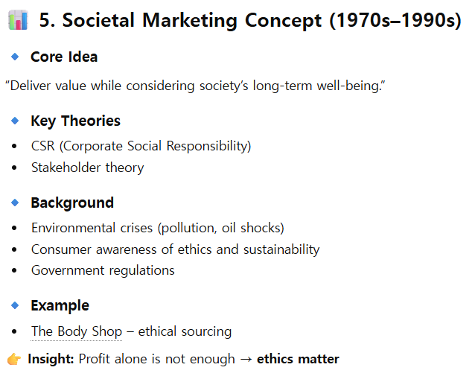

Slide 13
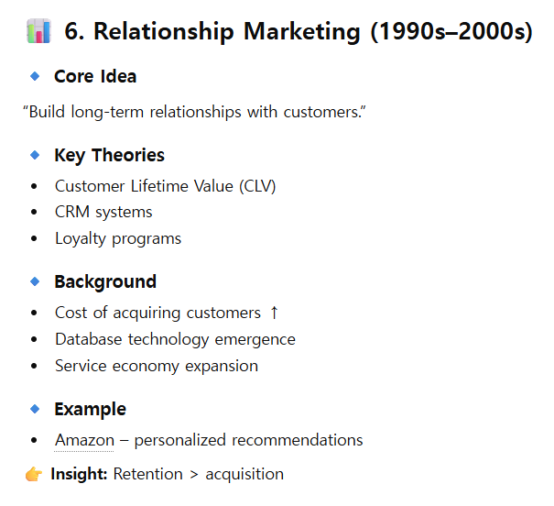

Slide 14
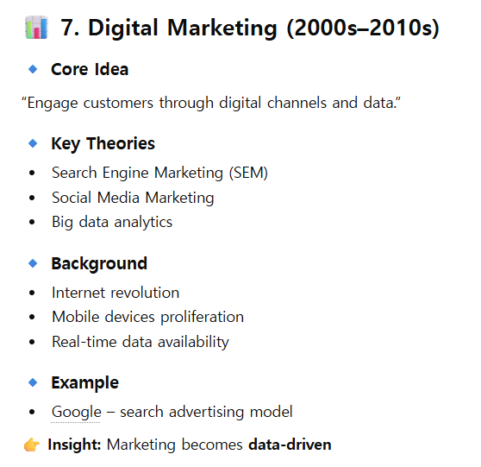

Slide 15
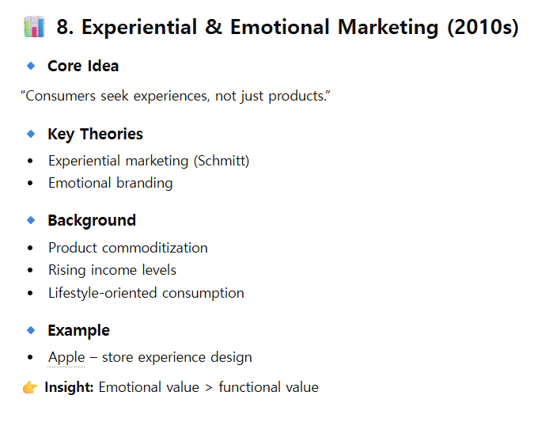

Slide 16
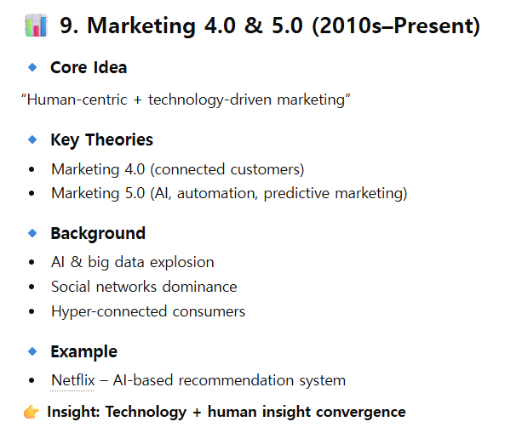

Slide 17
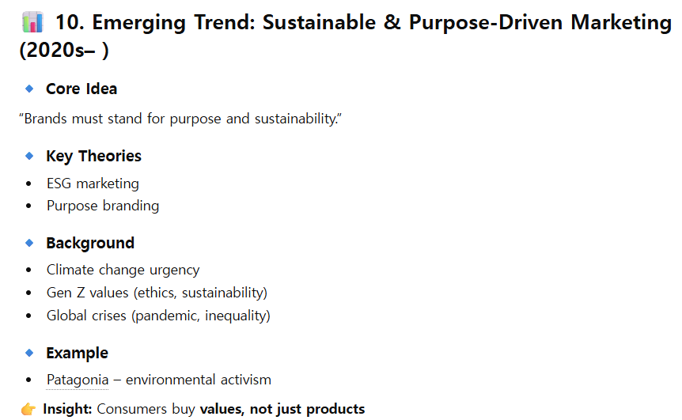

Slide 18
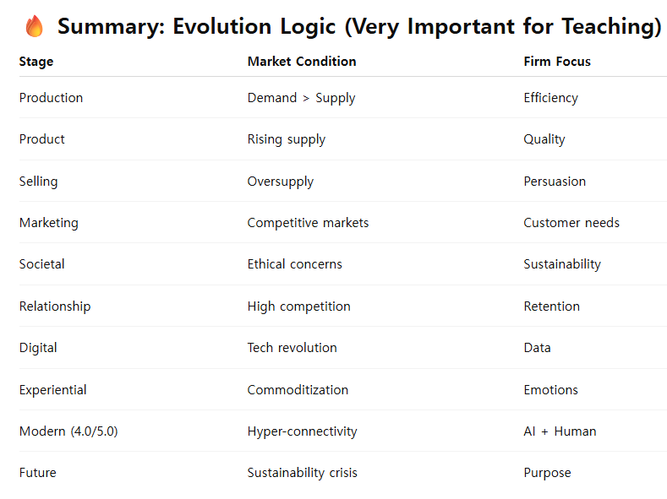

Slide 19
II. Cases of Marketing related research

Slide 20
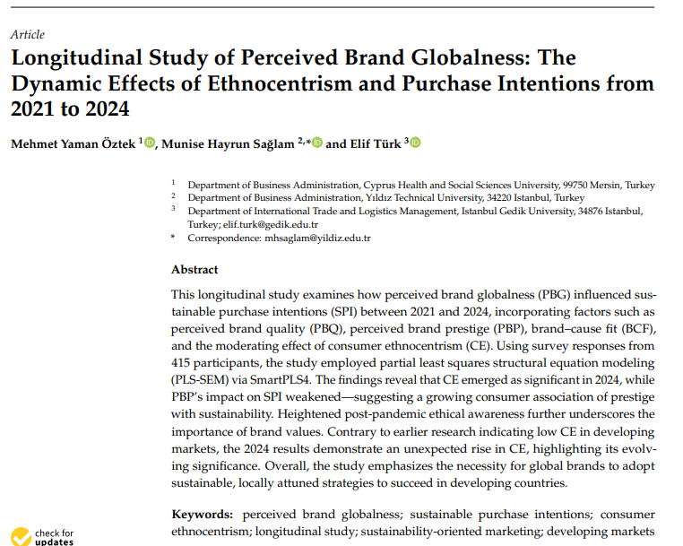

Slide 21
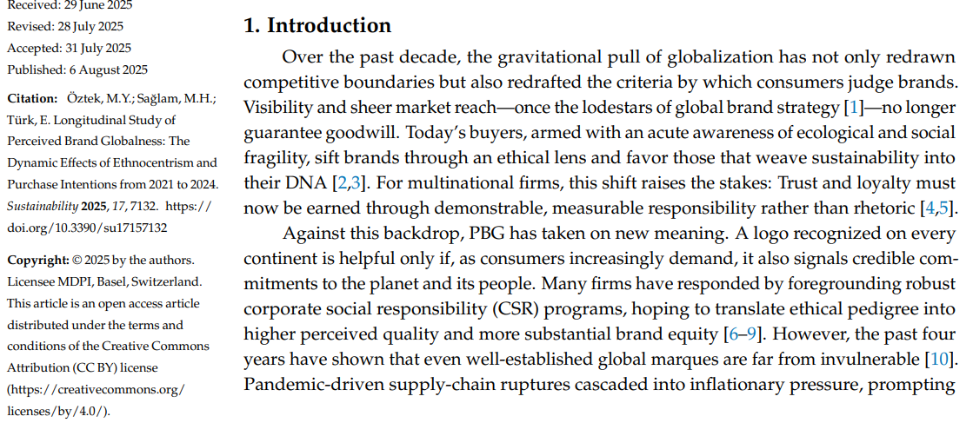

Slide 22
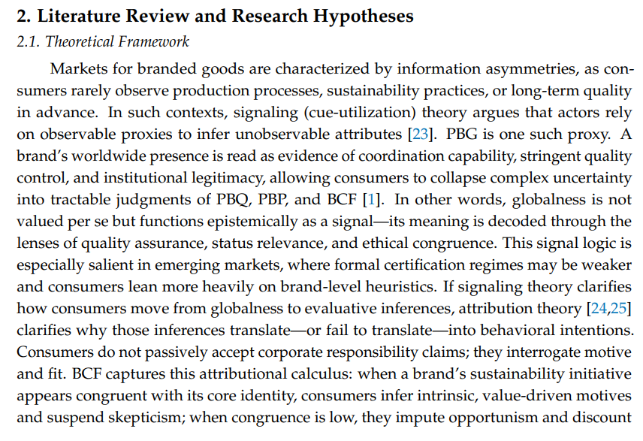

Slide 23
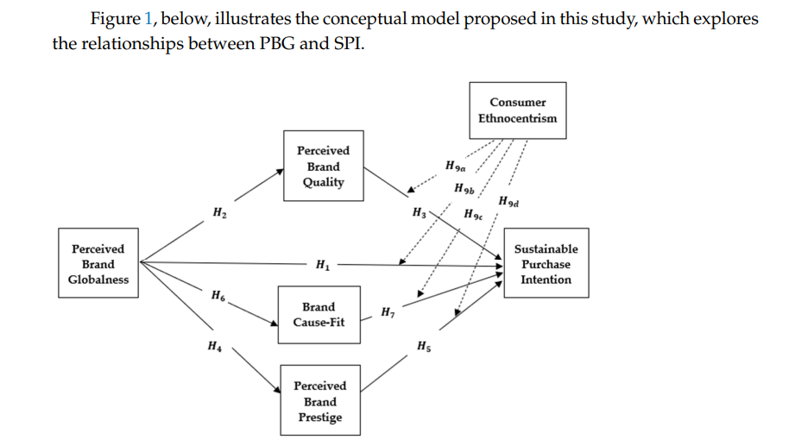

Slide 24
III. For the Next Class, Prepare research proposal related to the international marketing
Research Objective
Related Literature
Research Model and Testable Hypotheses
Research Methodology
Results and Finding
Conclusion and Implications

Slide 25
IV. Q&A and Quizzes

