Slide 1
Advanced International Marketing
Lecture 1
March 12, 2026

Slide 2
Contents
Syllabus
What is Marketing ?
Process of Marketing Management
Examples of Successes and Failures in the Marketing
Case Study: APR
Q&A and Quizzes

Slide 3
I. Syllabus

Slide 4
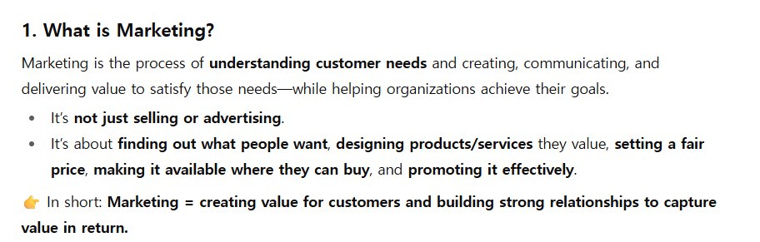
II. What is marketing ?

Slide 5
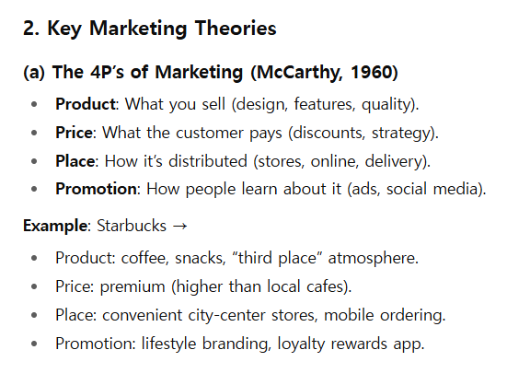

Slide 6
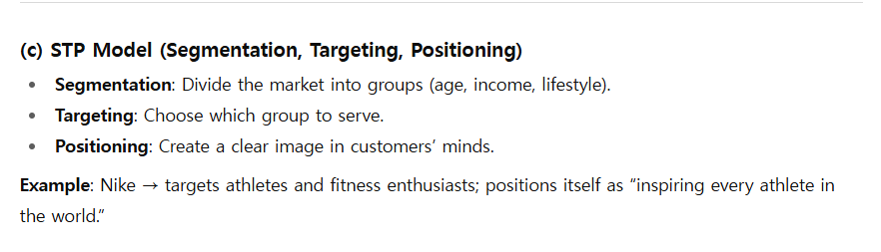

Slide 7
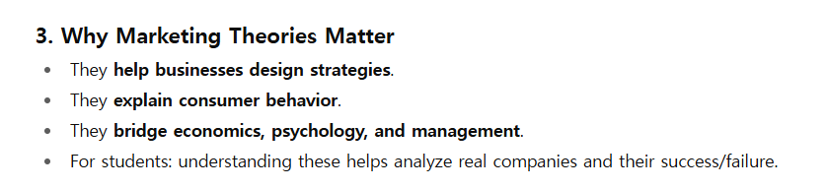

Slide 8
III. Process of Marketing Management
((R-> STP-> MM-> I-> C))
R: Research (March Research)
STP: Segmentation, targeting, and positioning
MM: Marketing Mix (popularly known as the four P’s (product, price, place, and promotion.))
I : Implementation
C: Control (getting feedback, evaluating results, and revising or improving STP strategy and MM tactics)

Slide 9
V. Examples of Successes and Failures in the Marketing

Slide 10
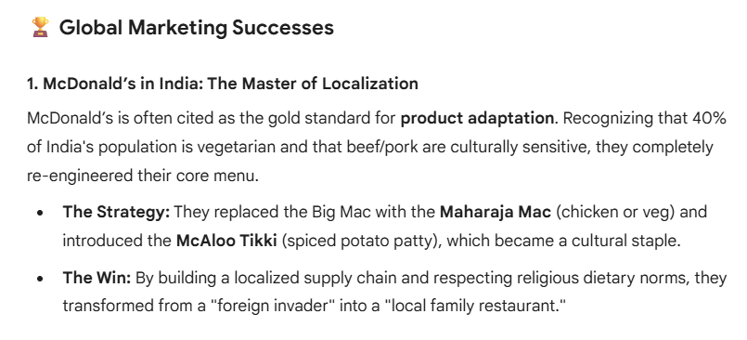

Slide 11
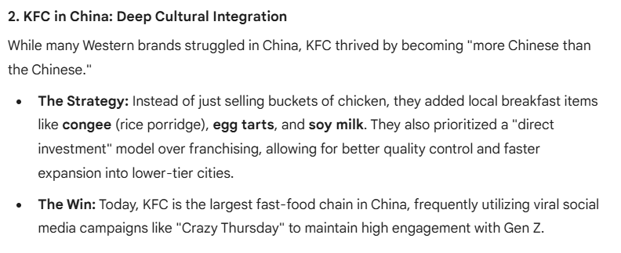

Slide 12
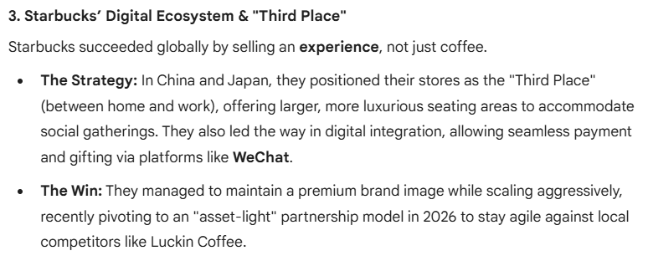

Slide 13
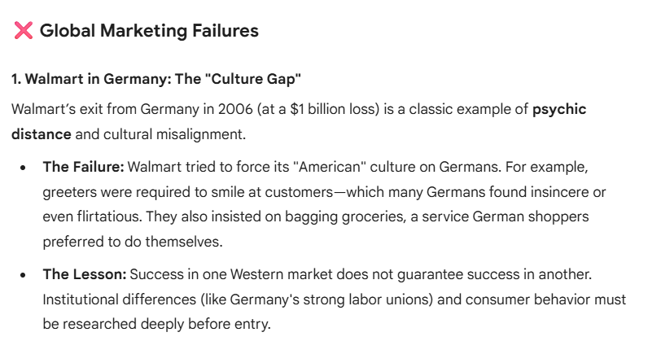

Slide 14
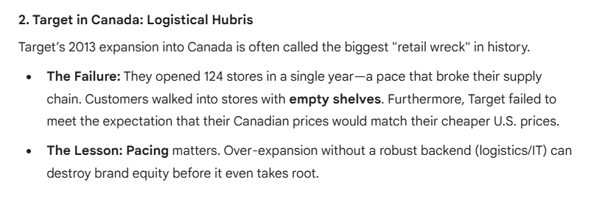

Slide 15
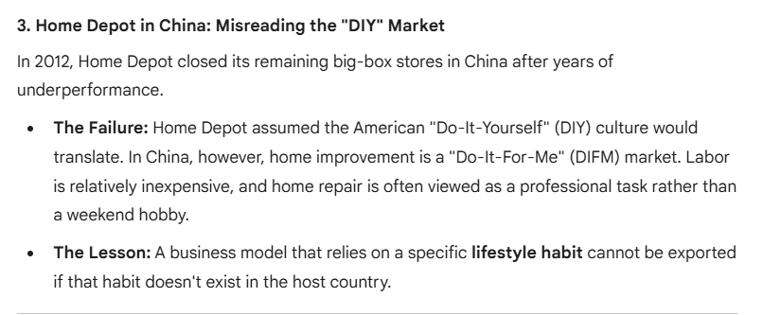

Slide 16
V. Case Study: APR

Slide 17
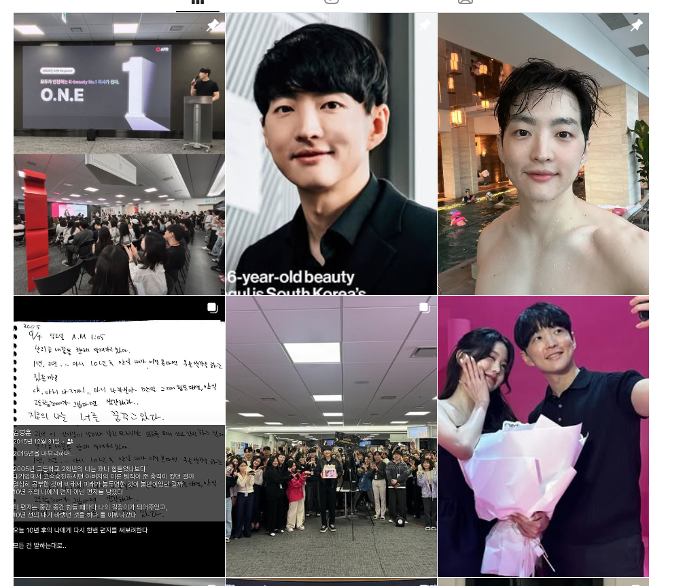

Slide 18
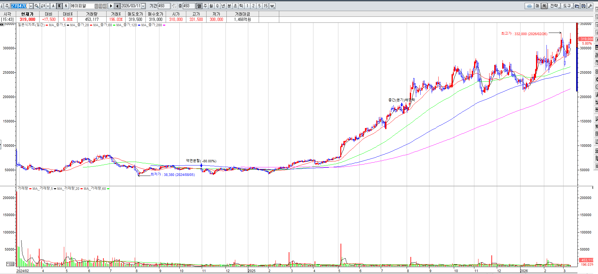

Slide 19
Company Overview
APR Corp founded in Korea
Flagship brand: Medicube
Focus on beauty technology + skincare
Rapid global expansion

Slide 20
APR Growth
Revenue growth driven by exports
Strong presence in US and Asia
Digital-first brand strategy

Slide 21
K‑Beauty Industry
Global popularity of Korean cosmetics
Innovation in skincare routines
Digital marketing leadership

Slide 22
International Marketing Framework
STP Analysis
4P Marketing Mix
Global Strategy
Entry Strategy
Competitive Positioning

Slide 23
Global Cosmetic Market
Global skincare market growing rapidly
Demand for anti‑aging products
Influence of social media

Slide 24
Key Competitors
Amorepacific
LG Household & Health Care
Shiseido
Estée Lauder

Slide 25
Competitive Landscape
Traditional brands rely on retail distribution
APR relies on digital platforms

Slide 26
Segmentation
Gen Z digital consumers
Millennials seeking anti‑aging
Beauty technology enthusiasts

Slide 27
Target Market
Digital-native consumers
International skincare users
Online beauty shoppers

Slide 28
Positioning
Clinical skincare
Technology-driven beauty
Affordable premium

Slide 29
Product Strategy
Skincare products
Beauty devices
Integrated beauty ecosystem

Slide 30
Product Example
Medicube Zero Pore Pads
AGE‑R beauty devices
Dermatology-inspired formulations

Slide 31
Pricing Strategy
Mid-premium pricing
More affordable than luxury brands

Slide 32
Distribution Strategy
Amazon
TikTok Shop
Global e-commerce

Slide 33
Retail Expansion
Ulta Beauty in the US
Don Quijote in Japan
Hybrid online-offline model

Slide 34
Promotion Strategy
Influencer marketing
TikTok viral campaigns
Celebrity endorsements

Slide 35
Digital Marketing Advantage
High social media engagement
Fast product trend adoption

Slide 36
Global Strategy
Mostly standardized products
Localized marketing content

Slide 37
Market Adaptation
Regional influencers
Language localization
Local distribution partners

Slide 38
International Entry Strategy
Cross-border e-commerce
Social media testing
Retail partnerships

Slide 39
Competitive Advantage
Beauty device innovation
Digital-first marketing
Strong brand storytelling

Slide 40
Competitor Comparison
APR: digital-first
Traditional brands: retail-focused

Slide 41
Amorepacific Strategy
Luxury brands
Department store distribution

Slide 42
Shiseido Strategy
Premium skincare
Strong R&D

Slide 43
Estée Lauder Strategy
Global prestige beauty brands

Slide 44
Challenges for APR
Regulatory issues
Dependence on viral marketing
Rising competition

Slide 45
Future Opportunities
Global expansion
Beauty device innovation
AI skincare personalization

Slide 46
Discussion Questions
Why has APR grown quickly globally?
Is the beauty device model sustainable?

Slide 47
Conclusion
APR represents the new generation of global K-beauty companies
Digital marketing drives international success

Slide 48
VI. Q&A and Quizzes

