Slide 1
Global Business Strategy
Lecture 6
2026.4.7

Slide 2
Contents
Team Presentation (Pick one big global firm and analyze it using the SWOT, Life-cycle, Porter’s 5 forces) And offer the best success strategy.
Foreign Market Entry Strategies
Global Marketing Strategy
Global Investment Management Strategy
Q&A

Slide 3
I. Team Presentation
Topic: Pick one global firm and analyze it with 1) SWOT, 2) Life Cycle, 3) M. Porter’s 5 forces
Offer your team’s idea of strategy how the firm will succeed in the future.
Presentation time: within 10 minutes, including Q&A
All members should participate in the presentation
Presentation material should be loaded in advance and should be sent to email: stevekim7@naver.com

Slide 4
II. Foreign Market Entry Strategy

Slide 5
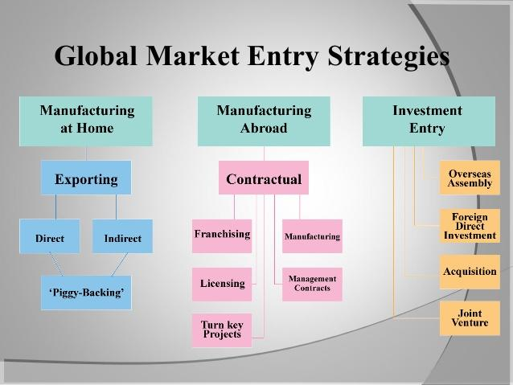

Slide 6
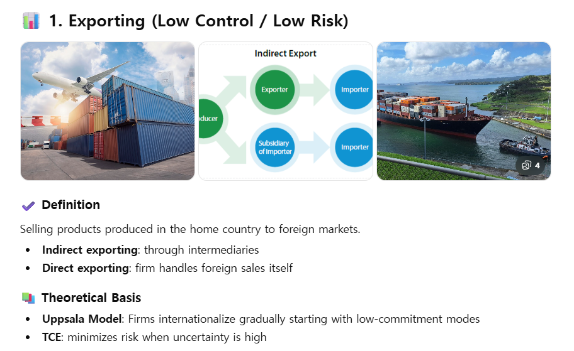

Slide 7
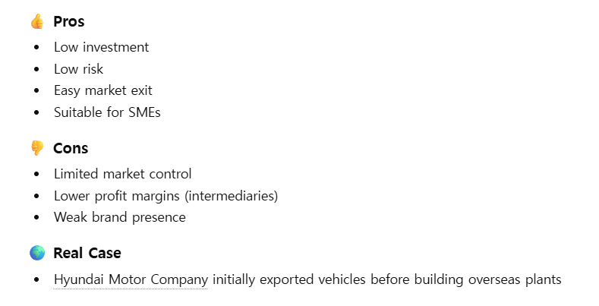

Slide 8
Uppsala model

Slide 9
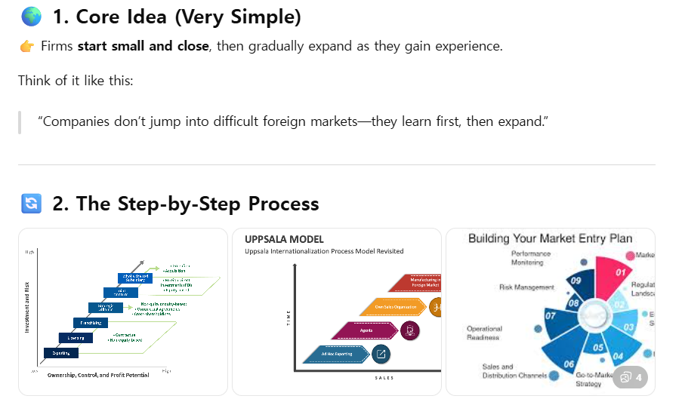

Slide 10
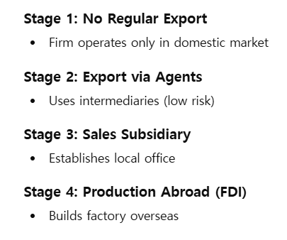

Slide 11
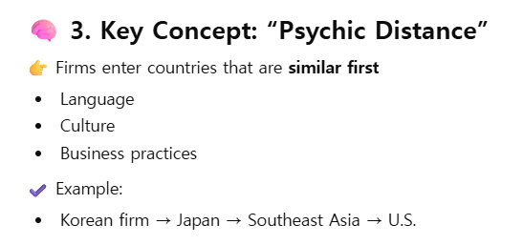

Slide 12
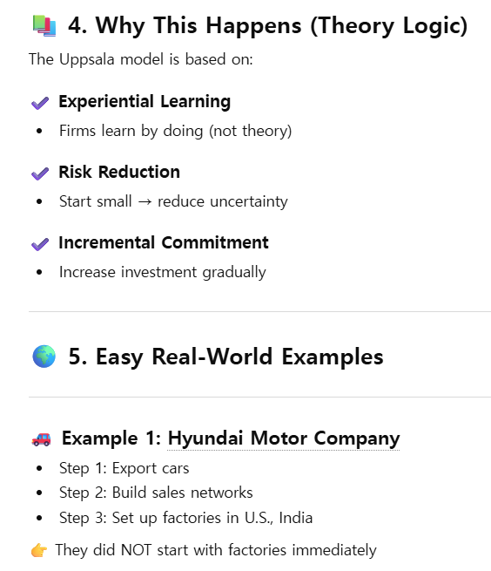

Slide 13
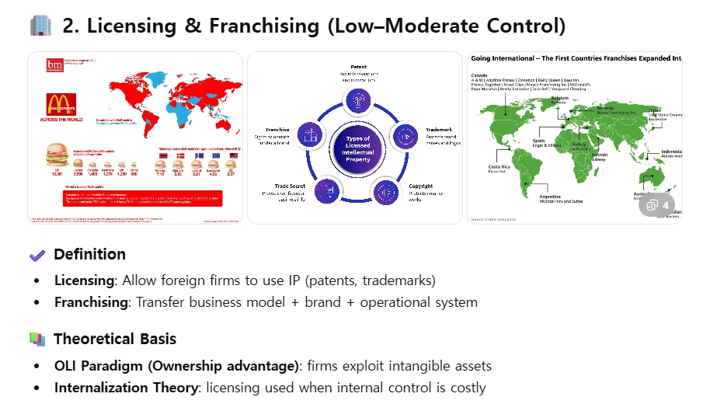

Slide 14
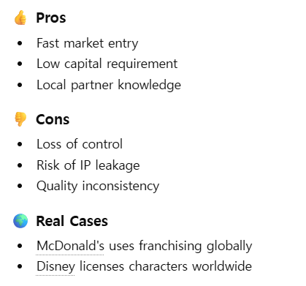

Slide 15
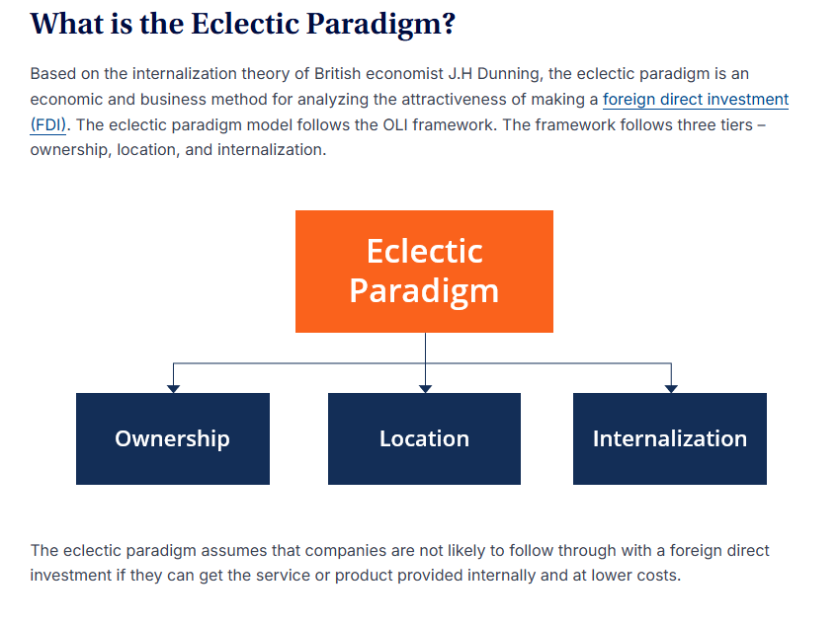

Slide 17
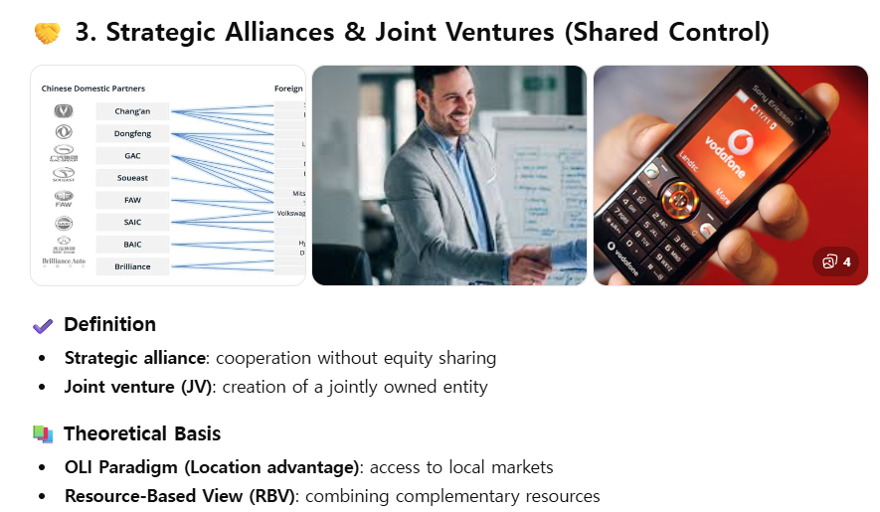

Slide 18
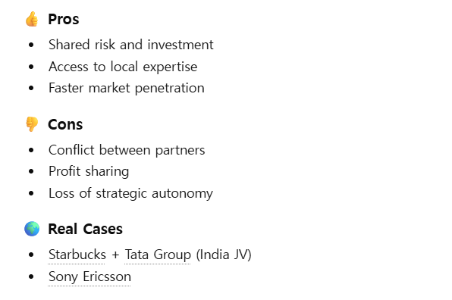

Slide 19
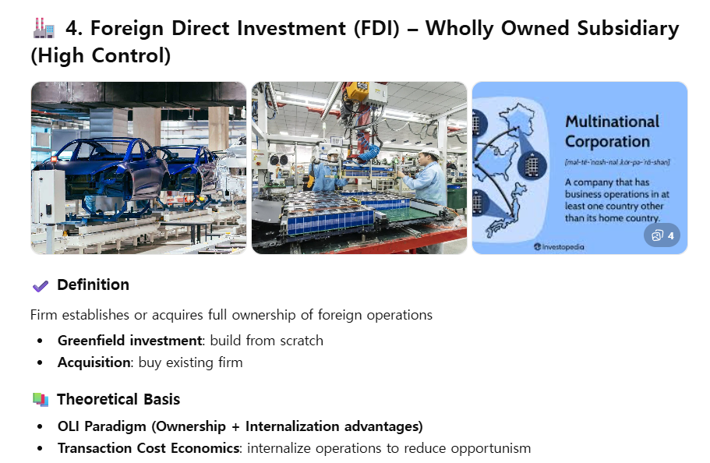

Slide 20
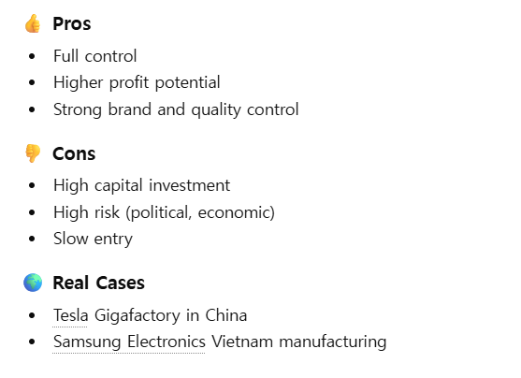

Slide 21
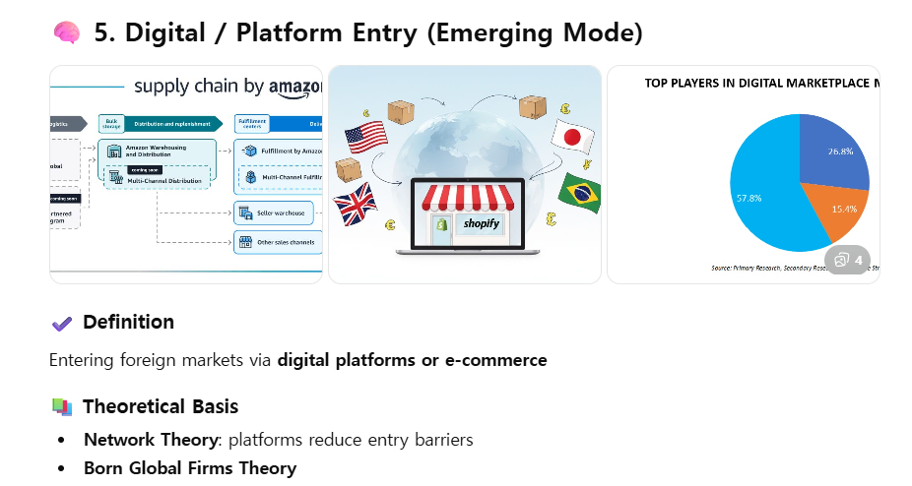

Slide 22
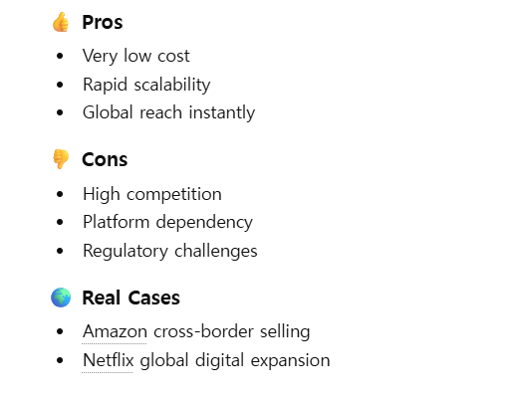

Slide 23
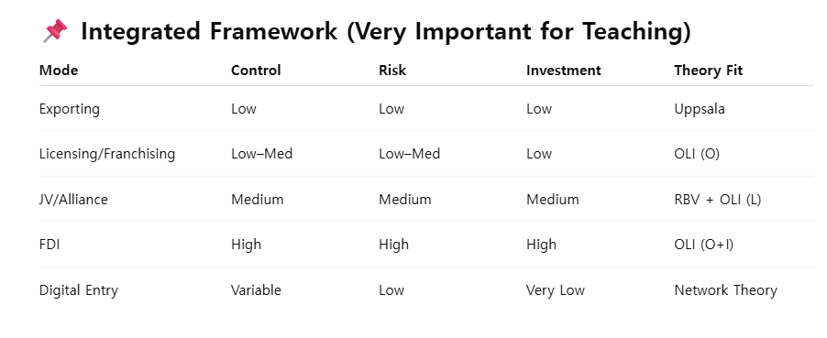

Slide 24
IV. Q&A and Quizzes

