Slide 1
International Marketing
Lecture 6
April 8, 2026

Slide 2
Contents
The evolution of the Marketing theories
Q&A and Quizzes

Slide 3
1.The evolution of the Marketing theories

Slide 4
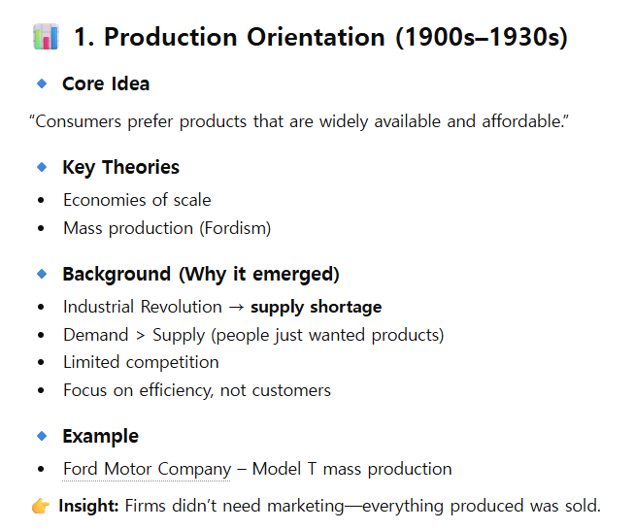

Slide 5
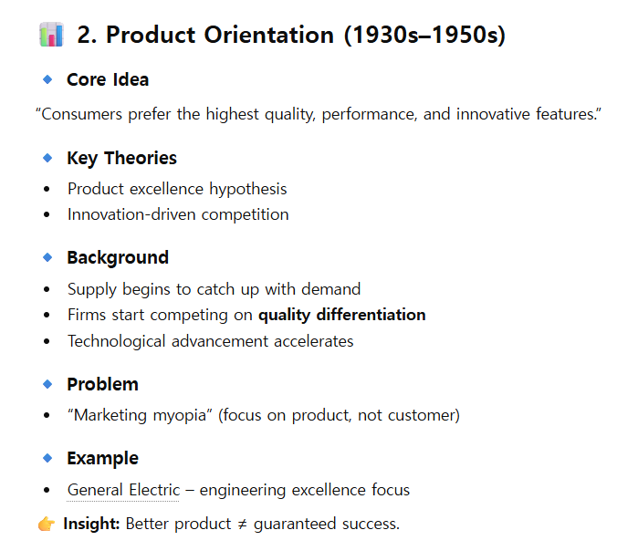

Slide 6
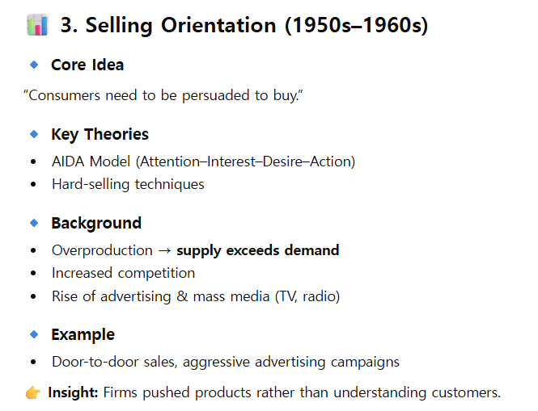

Slide 7
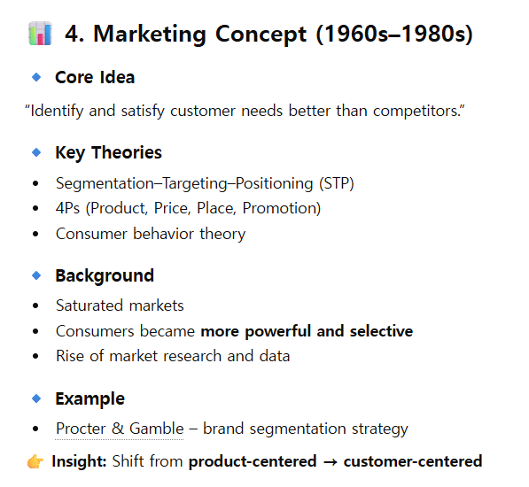

Slide 8
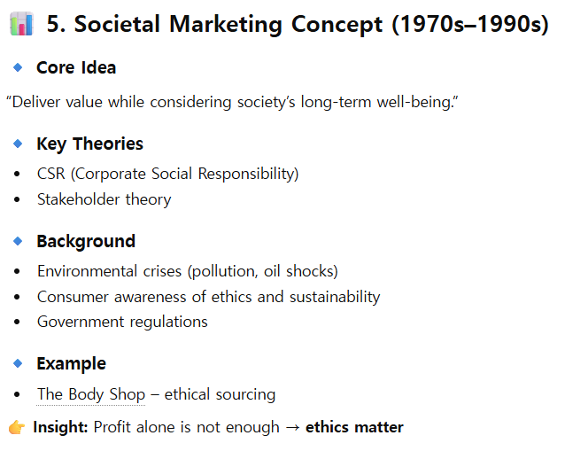

Slide 9
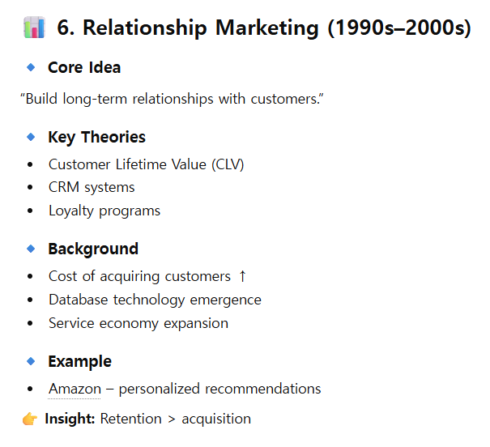

Slide 10
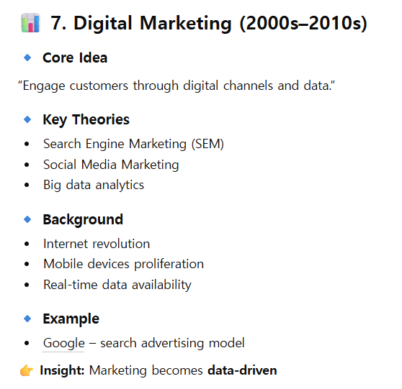

Slide 11
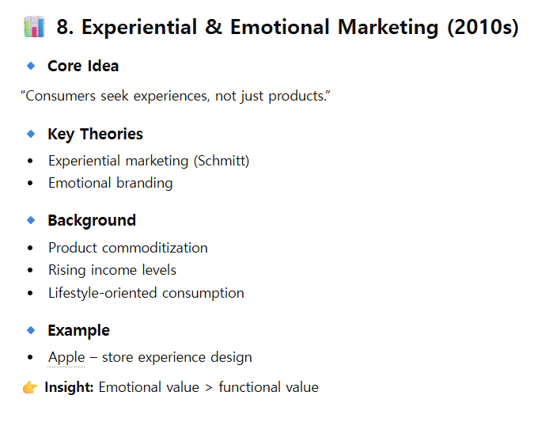

Slide 12
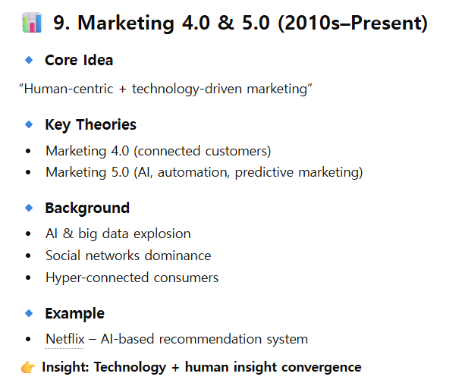

Slide 13
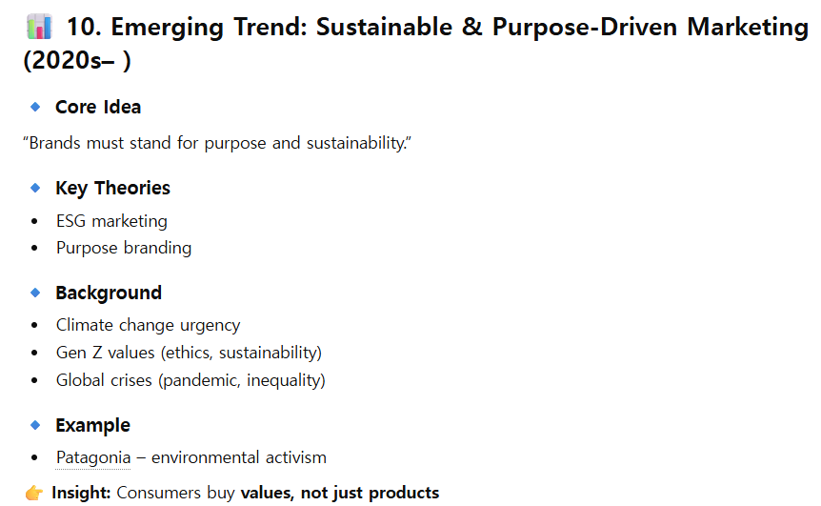

Slide 14
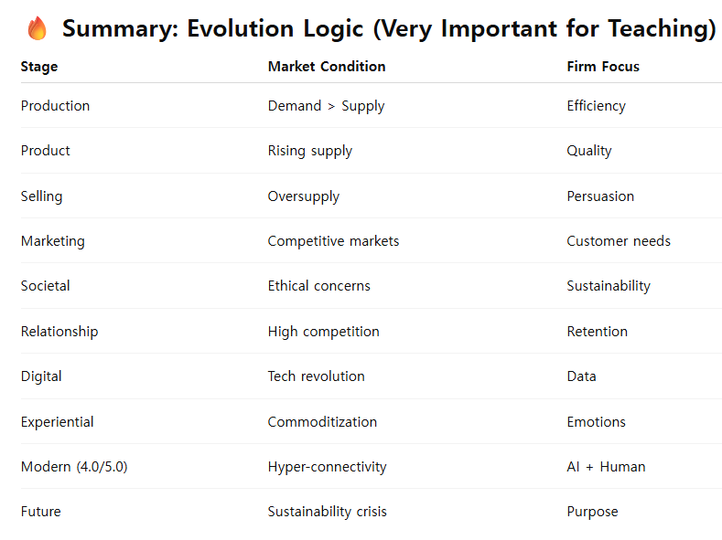

Slide 16
IV. Q&A and Quizzes

