Slide 1
International Marketing Management
Class 7
April 15, 2026

Slide 2
Contents
A Case Study: APR (a leading Korean Cosmetic Firm)
Examples of Marketing Failures by the Global Firms
Lessons from the Failures
Quiz 1

Slide 3
I. A Case Study: APR (a leading Korean Cosmetic Firm)

Slide 4
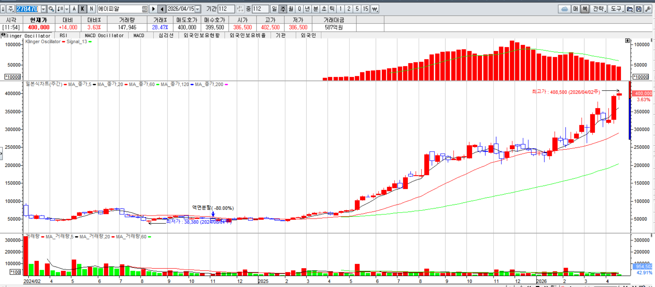

Slide 5
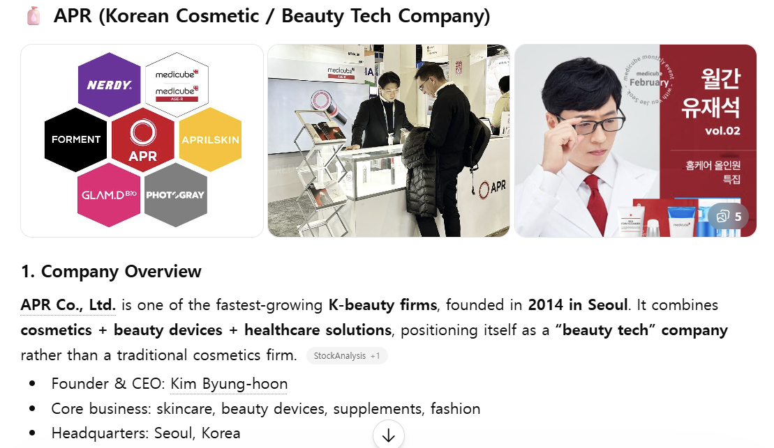

Slide 6


Slide 7


Slide 8
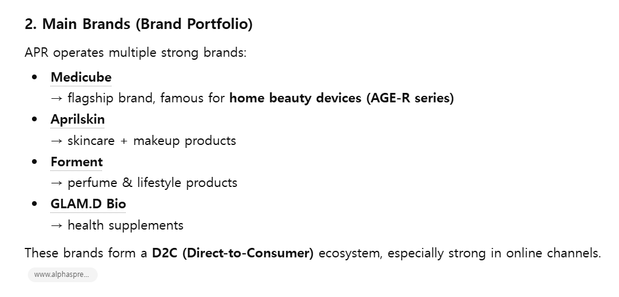

Slide 9
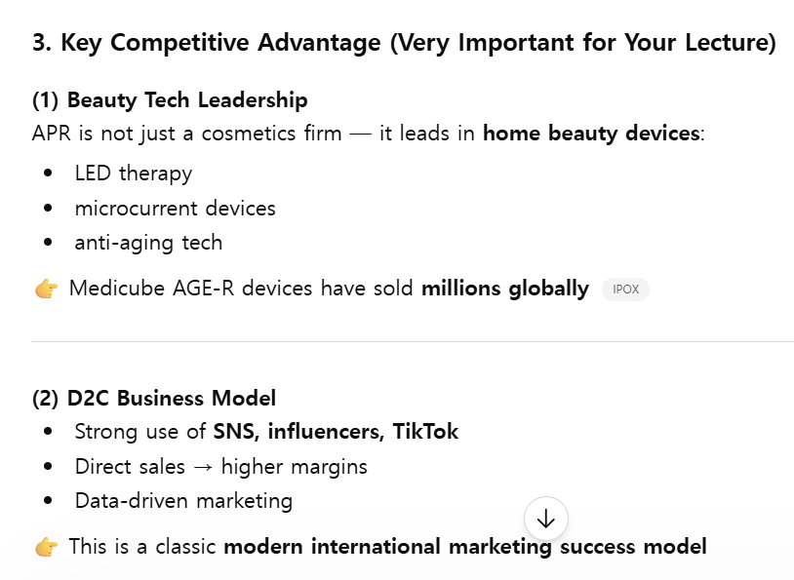

Slide 10
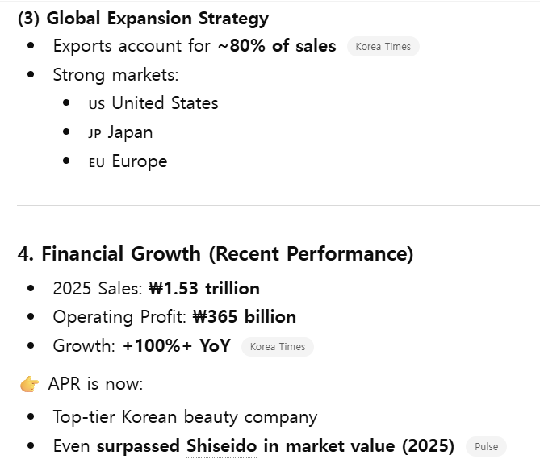

Slide 11
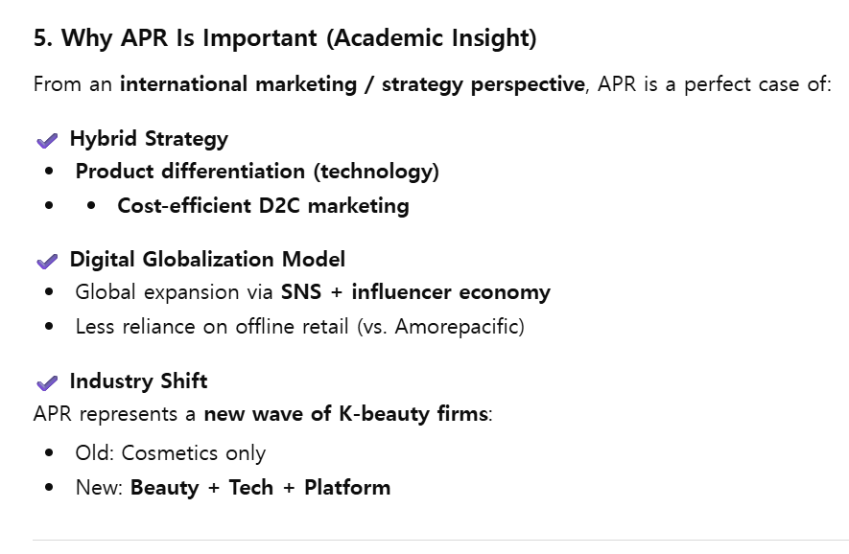

Slide 12
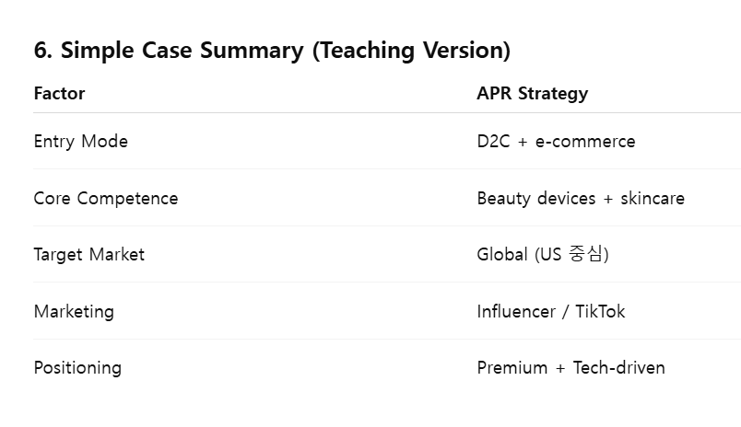

Slide 16

II. Examples of Marketing Failures by the Global Firms

Slide 17
I. Examples of Marketing Failures by the Global Firms

Slide 18



Slide 20



Slide 22



Slide 24



Slide 26


Slide 28
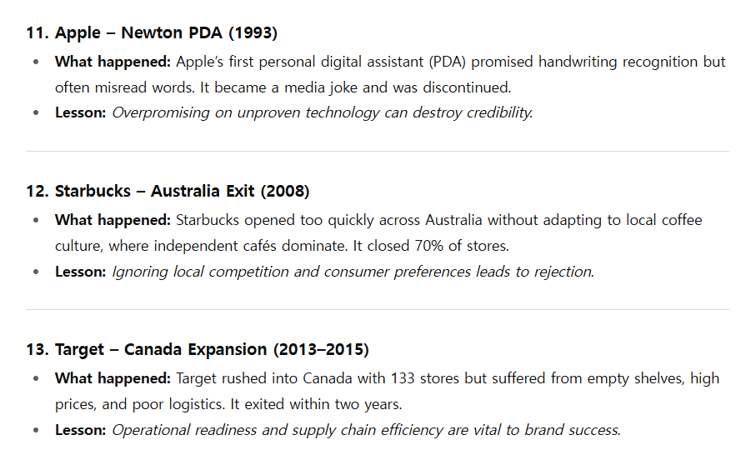

Slide 30
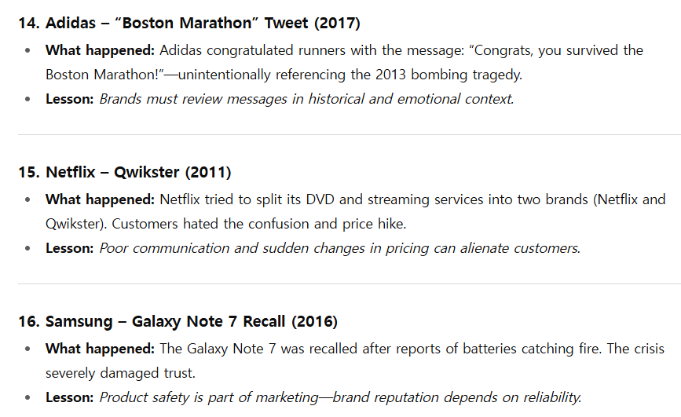

Slide 32
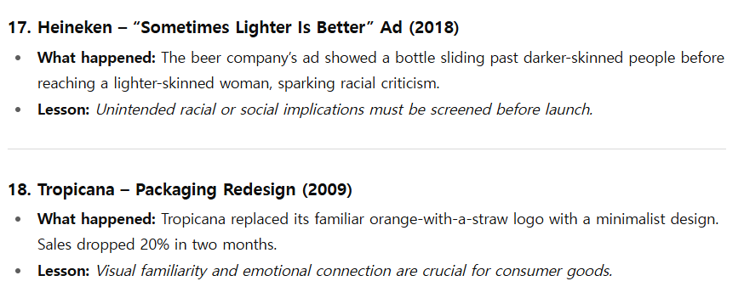

Slide 34
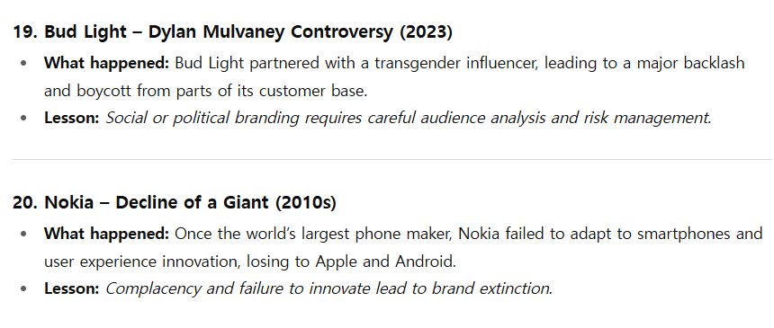

Slide 36
Korean Cases

Slide 37
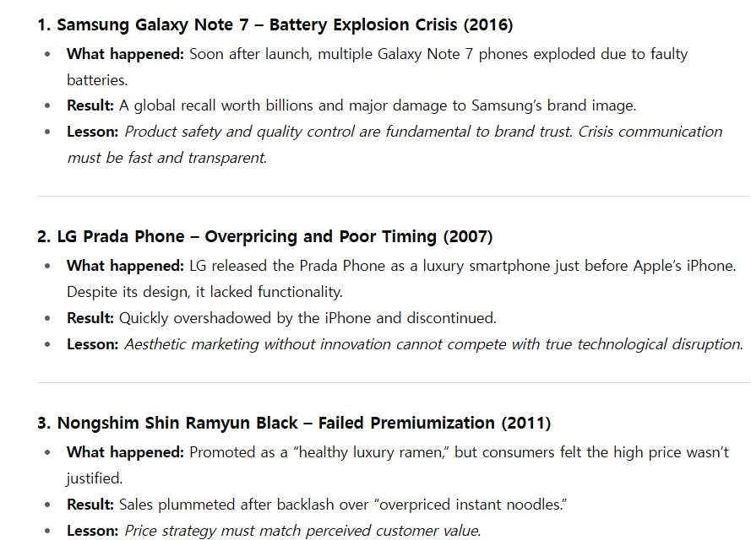

Slide 38
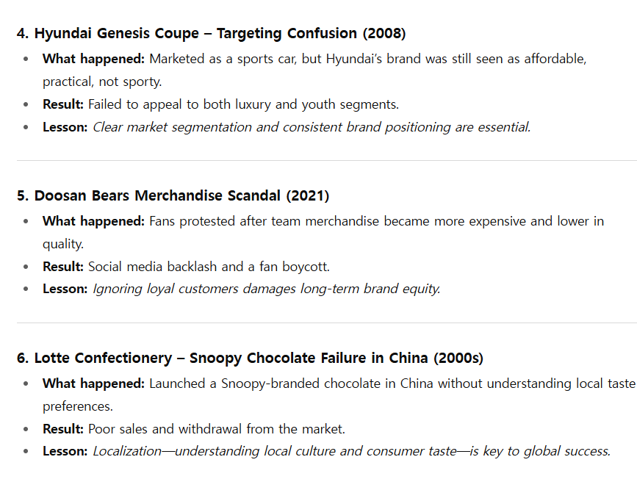

Slide 39
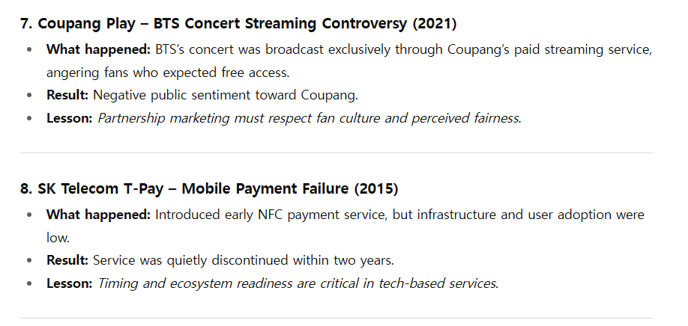

Slide 40
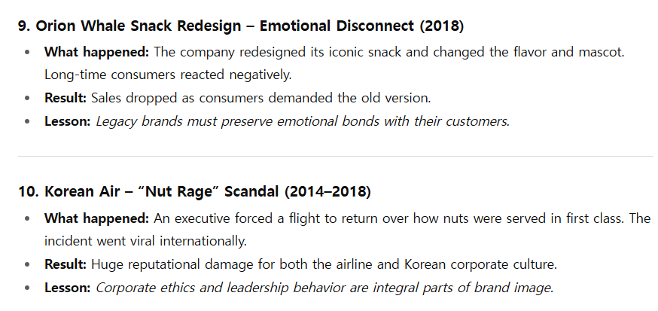

Slide 41
China Cases

Slide 42
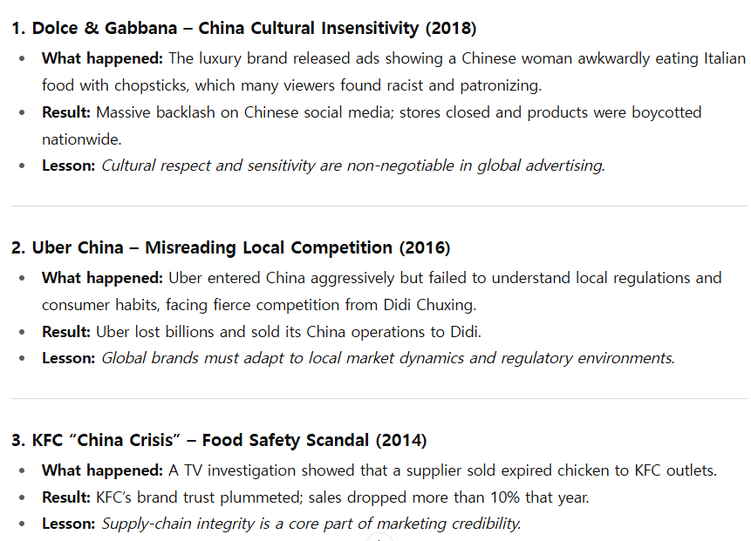

Slide 43
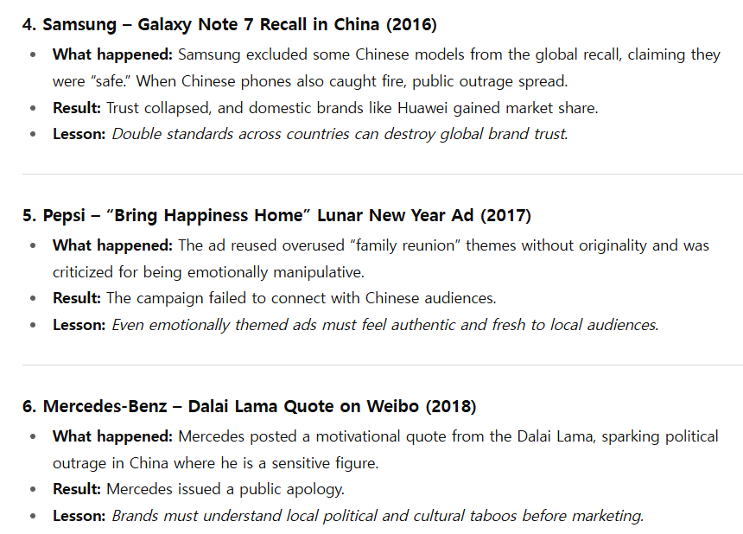

Slide 44
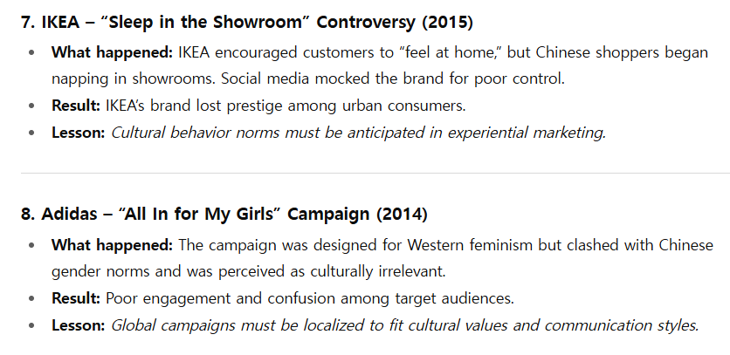

Slide 45
