Slide 1




The Non-Arm’s Length Sale of CLICO’s Assets to the Social Security Board of St. Kitts and the Financial Impact on Policy Holders
Property
Douglas Estate, St. Kitts
40.1 Acres (1,746,756 sq ft)
2010 Valuation
EC $18,500,000
Financial Forensic Review
2010-2025
2013 Sale Price
EC $12,000,000
CLICO International Life Insurance Ltd.
2025 Market Value
EC $28,821,474
Social Security Board of St. Kitts & Nevis
November 11, 2025
Prepared for:
Legal and Accounting Review

Slide 2

FINAL ANALYSIS
THE AUTHORITY OF THE JUDICIAL MANAGER TO RECOVER ASSETS.
The Judicial Manager is empowered under Section 3(b) and 3(xxii) of the Varied Court Order of December 10, 2020, to seek the Court’s assistance for an order of examination of persons believed to be knowledgeable of the affairs, assets and property of the CLICO St. Kitts Branch and to assist the Judicial Manager in the recovery of the assets and property of the Branch. Action can be taken against anyone who was involved with CLICO’s management, prior to the appointment of the Judicial Manager, including the Registrar of Insurance, (who oversaw the operations of CLICO between May 7, 2010, and April 28, 2011, pursuant to Section 57 of the Insurance Act).
Recovery of the company’s assets is not an attempt to relitigate CLAIM NO. SKBHCV2012/0212, which was made by the Social Security Board against CLICO, to force the Judicial Manager (Mr. Gardner who was appointed in 2011), to honor an agreement which he did not make, for the sale of CLICO’s 40.19 acres of lands at Douglas Estate, valued at EC$18.5 million at the time, but which was sold to the Social Security Board at EC$12 million (EC$6.5 million less). It is an effort to hold the Registrar of Insurance accountable for her role in the non-arm’s length transactions, to the detriment of the policy holders at the time, who she was obligated to protect.

Slide 3
FINAL ANALYSIS
INTRODUCTION: CRITICAL DATES, FACTS
AND IMPLICATIONS
CRITICAL DATES/TIMELINES
3. Omax was the External Auditor of SSB long before his appointment and until 2019. Was he conflicted? (Ref page 2, par 5 and 6 of Court Document-CLAIM NO. SKBHCV2012/0212). He opposed the sale and went to Court to stop it.
1. CLICO Trinidad (CL Financial-the parent company) collapsed in 2009. The Registrar of Insurance intervened in the affairs of CLICO St Kitts on May 7, 2010. She was in charge until April 29, 2011, when CLICO was placed under judicial management with Omax Gardner’s appointment as JM. . (Ref email from ROI-April 1 2011). That Order was Varied on December 10, 2020, to appoint B Cuthbert John as JM following the sudden passing of Mr. Gardner.
4. The lands were valued at 18.5M and sold to SSB for 12M, an immediate discount of 6.5M to the detriment of the policy holders. The $6.5M was sufficient to recover SSB investments in EFPA. SSB got back their investment with interest.
5. They got a discount of $6.5M plus recovery of assets of $6.5M, $13M and paid $5.5M for lands valued at 18.5M in 2010. They paid all GOSKN taxes of 1.4 out of the $5.5 and left only 3.9M for policy holders.
2. The agreement to sell the lands at Douglas Estate to the Social Security Board was made on July 2, 2010, less than 3 months after the ROI intervened under Section 57-59 of the Ins Act. The ROI was in charge of CLICO until April 28, 2011. (Ref email from ROI-April 1 2011)
IMPLICATIONS FOR POLICYHOLDER PROTECTION
While the Social Security Board made an excellent investment that benefited its members, this analysis reveals systemic questions about asset protection during judicial management. The Insurance Act requires acting in "the most advantageous to the general interest of the policyholder," yet the most valuable asset was sold at a substantial discount despite explicit warnings from the appointed Judicial Manager. The huge appreciation that benefited SSB represents value that could have significantly improved policyholder recovery. This case study highlights the need for stronger safeguards, transparent valuation processes, and meaningful consideration of judicial manager recommendations when disposing of assets during insurance company restructuring.

Slide 4
FINAL ANALYSIS
THE KEY PLAYERS IN THE SALE OF CLICO’S LANDS
KEY PLAYERS
1. Registrar of Insurance, acting under sections 57-59 of the insurance from May 7 2010 to April 28, 2011. The ROI is an employee of the Government, who owns the SSB. Ref SSB Annual Report 2014, Page 54- Note 18-Related Parties Transactions-
4. The Judicial Manager was the External Auditor of SSB long before his appointment and until 2019. Was he conflicted? (Ref page 2, par 5 and 6 of Court Document-CLAIM NO. SKBHCV2012/0212). He opposed the sale and went to Court to stop it.
2. Director and Board of Directors of SSB are all appointed to serve at the pleasure of the Government
5. Attorney for SSB, who is close ally of the Government
6.Attorney for CLICO
3.Minister responsible for the SSB, who is a member of the Government
7. The CLICO policy holders who were defenseless in this matter
Page 9, SSB 2013 Report on investment "Investment in Real Estate increased significantly, primarily with the acquisition of Douglas Estate land partially to offset the worthless investment in CLICO Barbados. Douglas Estate was placed on the market for sale and some promotion is to be done in due course. One hopes that the return and appreciation of the real estate will serve to reduce the impact of the reduction of rates on fixed deposits in the commercial banks where 63% of the investment portfolio resides." Pg 9, 2013 Annual Report, SSB.
Pg 2, 7: The affidavit makes reference to section 62(4) of the Insurance Act, No. 8 of 2009 and his advice thereon, which he verily believes to be true, that all actions and other processes against a registered insurance company placed under judicial management by order of the court are stayed and shall not be proceeded with without prior leave of the court.
Pg3, 13: The affidavit ends in this way: “14. It is my view that to dispose of the most valuable asset of CLICO which is valued at EC$18.5 million for EC$11.5 million and especially in a situation that would yield only EC$4.9 million to the fund would be highly detrimental to the interest of the policy holders and the other creditors. 15. The Social Security as a creditor ought to stand in the same position as other creditors, which is behind the policy holders”.

Slide 5
FINAL ANALYSIS
EXTRACTS FROM CLAIM NO. SKBHCV2012/0212-SSB V CLICO:ATTEMPTS BY THE JM TO STOP THE SALE
CRITICAL QUESTIONS
4. The Court document confirms the valuation of the land to be 18.5M(Page 2, par 13. It also confirms the amount of lands and the date of the sale agreement-July 2, 2010. (Page 1, par 2)
1. Why did the court approve the sale despite the Judicial Manager's explicit opposition citing policyholder detriment?
2. Why didn’t the Registrar oppose the actions of the SSB and join Omax in defense of the policy holders?
5. The agreement to sell the lands at Douglas Estate to the Social Security Board was made on July 2, 2010, less than 3 months after the ROI intervened under Section 57 of the Act. She was in charge of CLICO until April 28, 2011. (Ref email from ROI-April 1 2011)
3.Why were Alternative buyers or competitive bidding processes NOT explored to maximize policyholder recovery. Because it was a private sale between conflicted persons and entities.
Issues Raised by the JM in SSB v CLICO: Pg 2, 4: By virtue of section 62(4) of the Insurance Act No. 8 of 2009 all actions and other processes against a registered insurance company placed under judicial management by order of the Court are stayed and shall not be proceeded with without the prior leave of the Court.
Pg 2, 5: The Respondent was placed under Judicial Management by Order of this Honourable Court dated the 29th April 2011 whereby Omax Gardener, Accountant and Partner of Pannel Kerr Foster (PKF), St. Kitts and Nevis was appointed Judicial Manager of the Branch.
Pg 2,6: Also by virtue of the said Order of the Court the Judicial Manager is authorized to terminate, complete or perfect any contracts or transactions relating to the business of the Branch”.
Pg 2, 7: The affidavit makes reference to section 62(4) of the Insurance Act, No. 8 of 2009 and his advice thereon, which he verily believes to be true, that all actions and other processes against a registered insurance company placed under judicial management by order of the court are stayed and shall not be proceeded with without prior leave of the court.
Pg3, 13: The affidavit ends in this way: “14. It is my view that to dispose of the most valuable asset of CLICO which is valued at EC$18.5 million for EC$11.5 million and especially in a situation that would yield only EC$4.9 million to the fund would be highly detrimental to the interest of the policy holders and the other creditors. 15. The Social Security as a creditor ought to stand in the same position as other creditors, which is behind the policy holders”.

Slide 6
Property
Douglas Estate, St. Kitts
Douglas Estate
Transaction
Analysis & Financial Impact
40.1 Acres (1,746,756 sq ft)
2010 Valuation
EC $18,500,000
Financial Forensic Review
2010-2025
2013 Sale Price
EC $12,000,000
CLICO International Life Insurance Ltd.
2025 Market Value
EC $28,821,474
Social Security Board of St. Kitts & Nevis
November 11, 2025
Prepared for:
Legal and Accounting Review

Slide 7

Executive Overview: A Tale of Two Outcomes
Contrasting Financial Results from the Same Transaction
Social Security Board (SSB)
CLICO Policyholders
Net Investment (2013)
2010 Property Valuation
EC $5.4M
EC $18.5M
After EC $6.1M debt offset + EC $452K interest
Independent valuation (valuer unknown)
Effective Purchase Price
2013 Net Recovery
EC $3.10
EC $4.0M
Per square foot (vs. EC $10.59 valuation)
After SSB and government payments
2025 Current Value
Total Loss
EC $28.8M
EC $14.5M
At EC $16.50/sq ft market rate
From original EC $18.5M valuation
Return on Investment
Recovery Rate
+432%
21.4%
14.9% annualized over 12 years
78.6% loss rate on valuation
Outcome: SSB's 14.9% annual return exceeds the highest CBI real estate benchmark (12%) by 137%
Outcome: Policyholders lost EC $14.5M while SSB gained EC $23.4M from the same property

Slide 8

Transaction Structure: EC $12M Sale with Complex Offsets
Distribution of 2013 Purchase Price Among Recipients
SSB - Debt Offset
EC $6,128,583
51.1%
SSB - Interest (50%)
EC $451,784
3.8%
2013 Sale Price
EC $12M
Government - Stamp Tax (12%)
EC $1,440,000
12.0%
Government - Taxes & Fees
EC $24,526
0.2%
CLICO Policyholders (Net)
EC $3,955,107
33.0%
Recipient Category
Amount (EC$)
% of Sale
Description
Social Security Board
6,580,367
54.9%
Debt offset + 50% interest
Government of St. Kitts
1,464,526
12.2%
Stamp tax + land taxes + licenses
CLICO Policyholders
3,955,107
33.0%
Net proceeds to fund
TOTAL
12,000,000
100.0%
Verified total

Slide 9

SSB Investment Analysis: Actual Performance
SSB Has Already Recovered 112% of Net Investment with 79% of Land Remaining
Net Investment Calculation
SSB Selling Price Strategy
Nominal Purchase Price
EC $12,000,000
2013-2014 Target Price
EC $20.00/sq ft
Less: SSB Existing CLICO Debt
(EC $6,128,583)
Projected Revenue (2013)
EC $34,935,120
Less: 50% Accrued Interest Paid
(EC $451,784)
Projected ROI (2013)
544.6%
Net Amount Paid by SSB
EC $5,419,633
2015-2025 Actual Price
EC $16.50/sq ft
Projected Revenue (2025)
EC $28,821,474
Effective Price:EC $3.10 per sq ft
(vs EC $10.59/sq ft 2010 valuation)
Projected ROI (2025)
431.8%
SSB Actual Sales Performance (2013-2024)
Lands Already Sold
Remaining Land Value
Total Potential Profit
EC $6.06M
EC $22.76M
EC $23.40M
112% of Investment
1.38M sq ft (79%)
431.8% ROI

Slide 10

SSB Land Sales Progress: Realized vs Remaining
SSB Has Already Recovered 112% of Net Investment with 79% of Land Still Available
SSB Net Investment
Already Sold
Remaining Potential
EC $5.42M
EC $6.06M
EC $22.76M
After debt offset and discounts
112% of investment recovered
79% of land still unsold
Land Sales Progress by Value
Total Potential: EC $28.82M
SOLD: 21%
REMAINING: 79%
Lands Already Sold
Remaining Unsold Land
EC $6,058,000
EC $22,763,474
21% of total value • 367,152 sq ft sold
79% of total value • 1,379,604 sq ft remaining
Critical Finding: SSB has already sold EC $6.058 million worth of Douglas Estate land, recovering 112% of their net investment of EC $5.42 million. With 79% of the land still available for sale (worth EC $22.76M at current rates), SSB's total potential return is EC $23.4 million in profit (431.8% ROI). Meanwhile, CLICO policyholders received only EC $3.96 million (21.4% recovery) - and every additional SSB land sale increases the gap between SSB's gains and policyholder losses.

Slide 11
SSB Performance: 14.9% Annualized Return Exceeds All Benchmarks
Investment Performance Comparison (2013-2025, 12-Year Period)
Benchmark
Rate
Expected 2025 Value
Performance vs SSB
Conservative (Risk-free)
2.0%
EC $6,876,856
SSB: 419% higher
Realistic Growth
5.0%
EC $9,747,699
SSB: 296% higher
CBI Market Low
8.0%
EC $13,625,916
SSB: 212% higher
CBI Market Mid
10.0%
EC $16,922,177
SSB: 170% higher
CBI Market High
12.0%
EC $21,026,393
SSB: 137% higher
SSB ACTUAL PERFORMANCE
14.9%
EC $28,821,474
BASELINE
100%

Slide 12

SSB Performance Analysis: Key Finding
Exceptional Returns Enabled by Debt Offset Mechanism
SSB Actual Return
Highest Benchmark
Outperformance
Effective Price
14.9%
12.0%
+25%
EC $3.10
Annualized (2013-2025)
CBI Market High
Above highest benchmark
Per square foot
Performance Analysis
Exceptional Investment Performance
Debt Offset Mechanism as Enabler
SSB's 14.9% annualized return exceeds even the highest CBI real estate market benchmark (12%) by 24%. This performance is extraordinary for a government pension fund investment in real estate, significantly outpacing typical market returns across all risk categories from conservative (2%) to aggressive (12%).
This exceptional performance was enabled by the debt offset mechanism, which reduced SSB's effective purchase price to EC $3.10 per square foot — 70.7% below the 2010 valuation price of EC $10.59/sq ft. The EC $6.1M debt offset transformed what would have been a standard real estate investment into an exceptional value acquisition.
Conclusion: SSB's investment success was directly proportional to policyholder losses. The lower the effective price paid by SSB, the less capital available for policyholder recovery from the EC $12M sale proceeds.

Slide 13

Policyholder Loss Analysis: Immediate vs Total Losses
Understanding the Full Magnitude of Value Transfer from Policyholders to SSB
IMMEDIATE LOSSES (2013)
TOTAL LOSSES (2013-2025)
Transaction-Related Losses
Full Value Transfer to SSB
2010 Property Valuation
EC $18,500,000
Immediate Discount
(EC $6,500,000)
2013 Sale Price
(EC $12,000,000)
SSB Debt Offset
(EC $6,128,583)
Immediate Discount Loss
(EC $6,500,000)
SSB Lands Already Sold
(EC $6,058,000)
SSB Debt Offset
(EC $6,128,583)
SSB Remaining Land Potential
(EC $22,763,474)
SSB Interest (50%)
(EC $451,784)
Government Payments
(EC $1,464,526)
Government Payments
(EC $1,464,526)
Total Value Transfer
(EC $42,914,583)
Total Deductions
(EC $14,544,893)
Net Recoverable
EC $29.9M
Net to Policyholders
EC $3.96M
vs EC $3.96M Actual (13.2%)
21.4% Recovery
The Ongoing Nature of Policyholder Losses
The original calculation of EC $14.5M in immediate losses (2013) only captured the transaction-related deductions. The revised calculation of EC $42.9M shows the full magnitude of value transfer by including SSB's realized land sales (EC $6.058M) and remaining land potential (EC $22.76M). This means policyholders received only EC $3.96M (13.2%) of the EC $42.9M they should have recovered, while SSB gained the remaining EC $37.9M (86.8%).

Slide 14
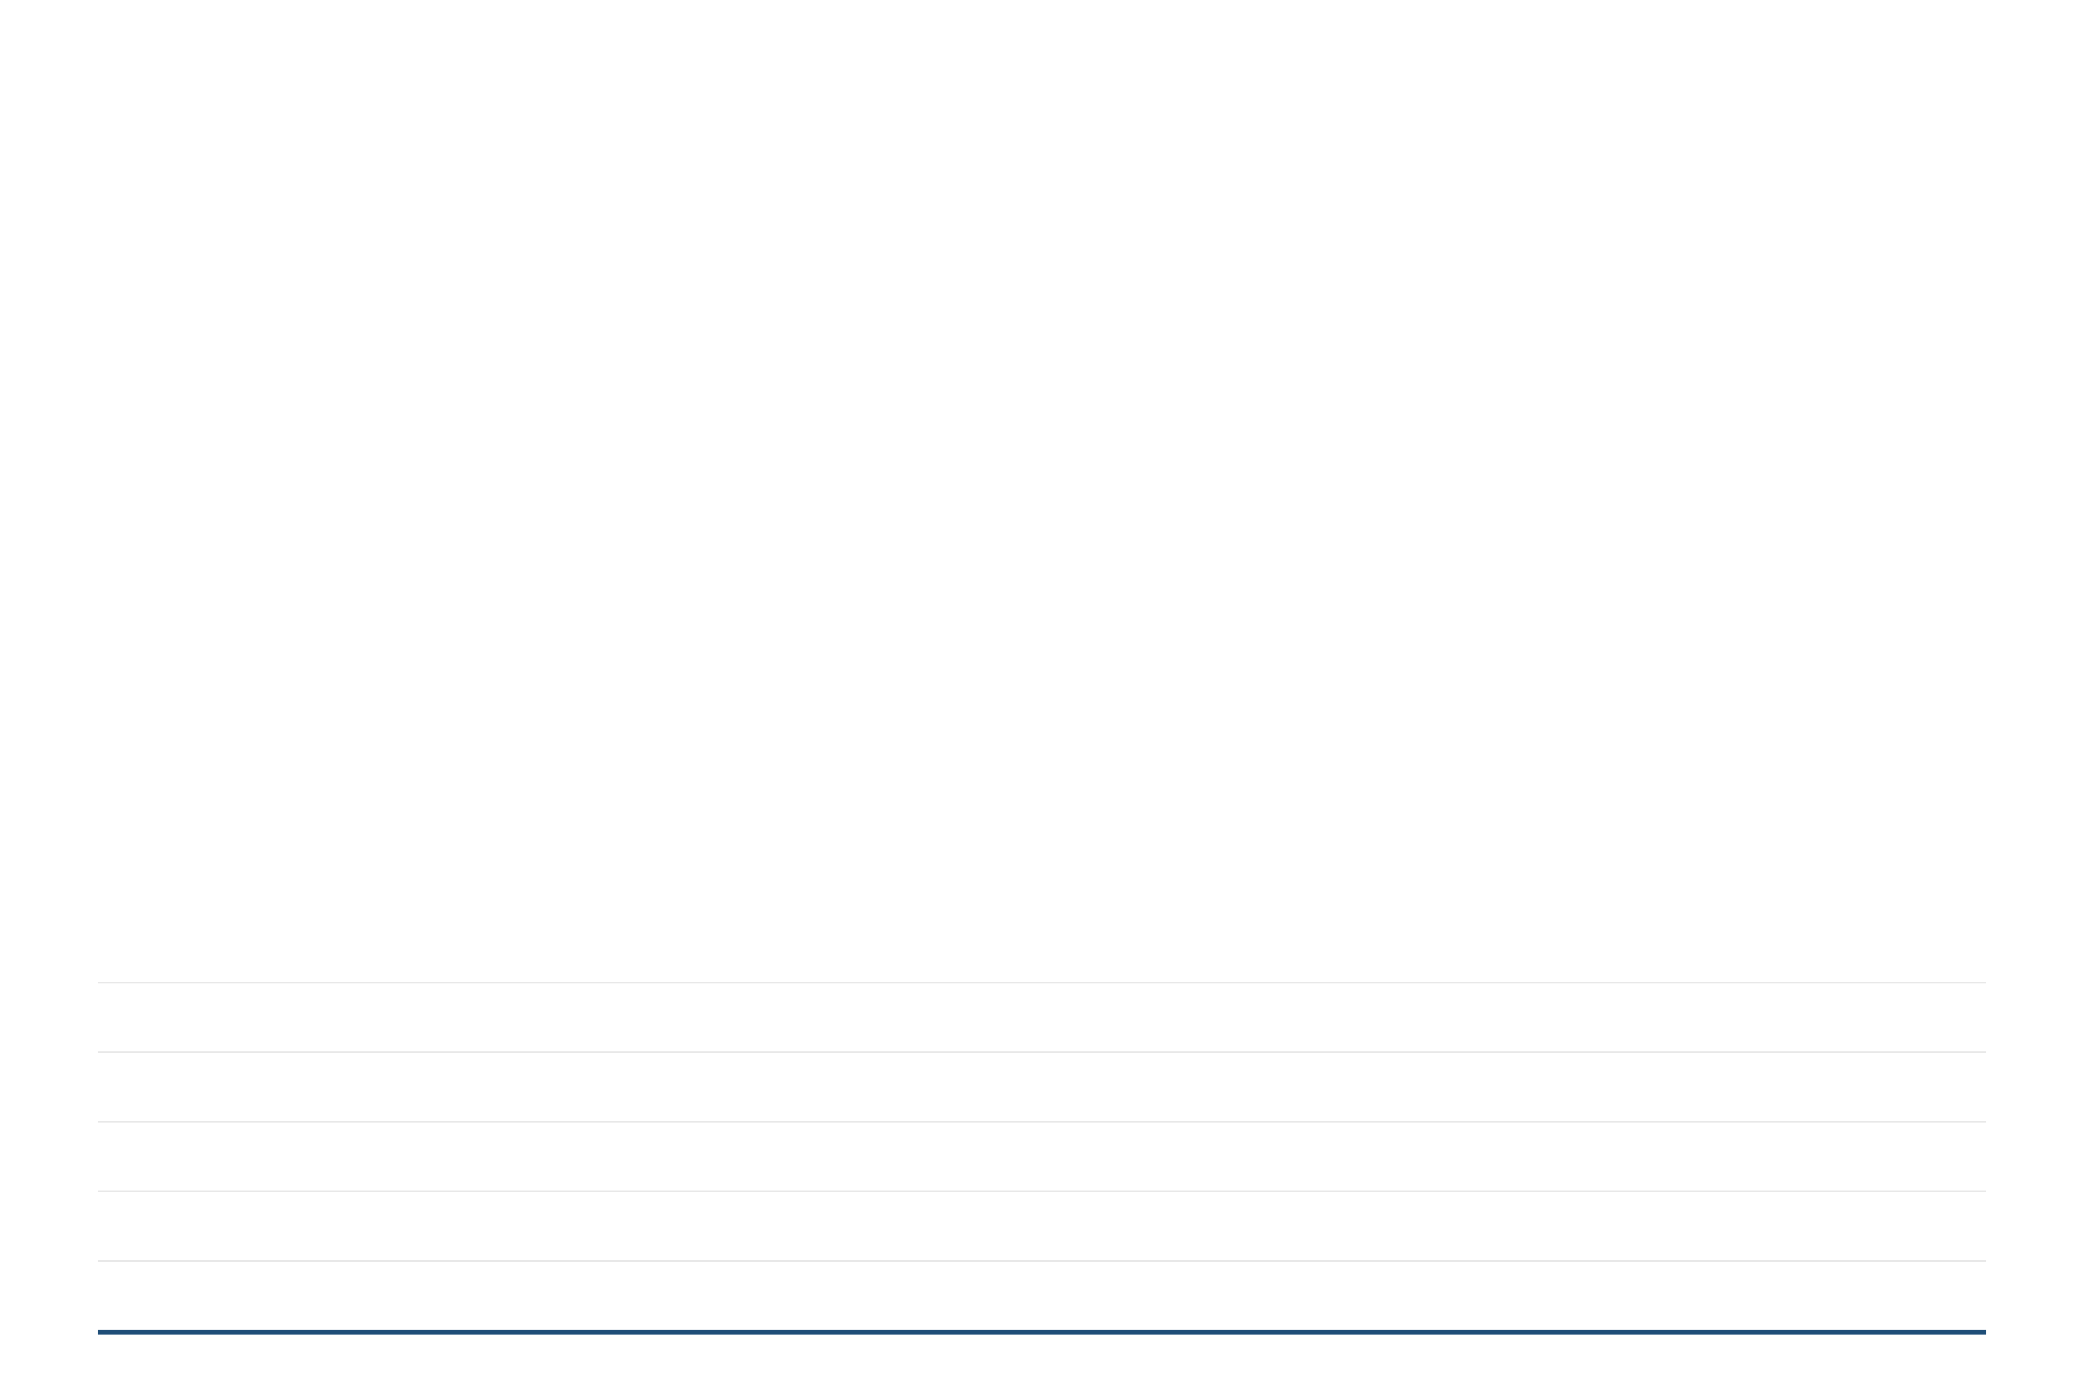
Payment Priority: Government and SSB Received 67% Before Policyholders
Distribution of EC $12,000,000 Sale Proceeds
Of the EC $12M sale price, only 33% reached CLICO policyholders who owned the asset. SSB and government received 67% through debt offsets and statutory payments.
SSB Interest
Gov Other
SSB Debt Offset
Gov Stamp Tax
CLICO Policyholders
51.1%
3.8%
12.0%
0.2%
33.0%
EC $6,128,583
EC $451,784
EC $1,440,000
EC $24,526
EC $3,955,107
Recipient
Amount (EC$)
% of Sale
Description
SSB - Debt Offset
6,128,583
51.1%
Existing CLICO debt (Fixed Deposit)
SSB - Interest (50%)
451,784
3.8%
Half of accrued interest paid
Government - Stamp Tax
1,440,000
12.0%
12% stamp duty on sale
Government - Other
24,526
0.2%
Land taxes and license fees
CLICO Policyholders
3,955,107
33.0%
Net to fund after all deductions
TOTAL
12,000,000
100.0%

Slide 15

Comparative Scenarios: Alternative Outcomes Analysis
What-If Analysis of Transaction Structure Alternatives
Scenario
Sale Price
To Policyholders
Recovery Rate
vs Actual
ACTUAL (2013)
EC $12,000,000
EC $3,955,107
21.4%
BASELINE
At 2010 Valuation
EC $18,500,000
EC $10,455,107
56.5%
+264%
At 2025 Market Value
EC $28,821,474
EC $20,776,581
112.3%
+525%
No SSB Debt Offset
EC $12,000,000
EC $10,083,690
54.5%
+255%
No Government Payments
EC $12,000,000
EC $5,419,633
29.3%
+137%
Critical Finding
Alternative Outcome
If the property had been sold at its 2010 valuation of EC $18.5M, policyholders would have recovered 56.5% instead of 21.4% — a difference of EC $6.5 million.
If sold at 2025 market value (EC $28.8M), policyholders would have achieved 112.3% recovery — exceeding the original valuation and fully compensating for losses. This represents a +EC $16.8M improvement.

Slide 16
Scenario 6: SSB Debt Offset Reduced by 50%
Hypothetical Analysis: Impact of Partial Debt Offset Reduction on Policyholder Recovery
Component
Actual (2013)
Scenario 6
Change
New Recovery Rate
39.2%
Sale Price
EC $12,000,000
EC $12,000,000
—
SSB Debt Offset
(EC $6,128,583)
(EC $3,064,292)
-50%
vs 21.4% actual
SSB Interest (50%)
(EC $451,784)
(EC $225,892)
-50%
Gov Stamp Tax
(EC $1,440,000)
(EC $1,440,000)
—
Policyholder Recovery
EC $7.25M
Gov Other
(EC $24,526)
(EC $24,526)
—
vs EC $3.96M actual
Total Deductions
(EC $8,044,893)
(EC $4,754,710)
-40.9%
Policyholder Recovery
EC $3,955,107
EC $7,245,290
+83.2%
Improvement
Recovery Rate
21.4%
39.2%
+17.8 pts
+83.2%
+EC $3.29M more
Key Insight: Reducing the SSB debt offset by 50% would have nearly doubled policyholder recovery to EC $7.25 million, improving the recovery rate from 21.4% to 39.2%. This demonstrates that the debt offset mechanism was the single largest factor reducing policyholder recovery, accounting for EC $3.29 million (83.2%) of potential additional recovery in this scenario.

Slide 17
Maximum Recovery Gap: Actual vs 2025 Market Value
The EC $14.8 Million Difference Between Worst and Best Outcomes
SCENARIO 1
SCENARIO 3
Actual Transaction
(2013)
At 2025
Market Value
RECOVERY
GAP
EC $4.0M
EC $14.8M
EC $28.8M
21.4%
101.4%
474%
Policyholders received only 21.4% of the 2010 valuation after SSB debt offset (EC $6.6M), government payments (EC $1.5M), and selling below valuation (EC $6.5M discount).
If sold at today's market value (EC $28.8M), policyholders would achieve full recovery plus 1.4% gain, even after all deductions including SSB debt offset and government payments.
Critical Finding: The combination of transaction timing (2013 vs 2025) and structure choices resulted in policyholders receiving EC $14.8 million less than they would have if the property had been sold at its current market value. This represents a 474% difference in recovery outcomes, demonstrating the severe financial impact of the 2013 transaction structure and timing on CLICO policyholders.

Slide 18
Alternative Scenario: If Lands Were NOT Sold to SSB (Part 1)
Calculating What Policyholders Would Have Received Without the SSB Sale
ALTERNATIVE SCENARIO
ACTUAL OUTCOME
If Lands NOT Sold to SSB
What Actually Happened
2010 Land Valuation
EC $18,500,000
2013 Sale Price
EC $12,000,000
Less: SSB Existing Debt (FPA)
(EC $6,128,583)
Less: SSB Debt Offset
(EC $6,128,583)
Less: SSB Accrued Interest (100%)
(EC $451,784)
Less: SSB Interest (50%)
(EC $451,784)
Net Value Retained by CLICO
EC $11,919,633
Less: Government Stamp Tax
(EC $1,440,000)
Less: Government Other
(EC $24,526)
In this scenario, CLICO retains the land, pays SSB's full debt and interest (EC $6.58M), and keeps EC $11.92M in net value for policyholders. Part 2 adds time value interest to reach final recovery amount.
Net to Policyholders
EC $3,955,107
The actual sale resulted in only EC $3.96M for policyholders after SSB debt offset, government payments, and the EC $6.5M discount from the 2010 valuation.

Slide 19
Alternative Scenario: If Lands Were NOT Sold to SSB (Part 2)
Final Recovery Calculation and Comparison with Actual Outcome
Completing the Alternative Scenario Calculation
Net Value Retained by CLICO (from Part 1)
EC $11,919,633
Add: Time Value Interest (2010-2025, 15 years)
EC $3,080,367
Estimated Value for Policyholders
EC $15,000,000
ALTERNATIVE SCENARIO
ACTUAL OUTCOME
EC $15.0M
EC $3.96M
81.1% Recovery
21.4% Recovery
If lands were NOT sold to SSB, policyholders would have received EC $15M after paying SSB's full debt and interest, representing 81.1% recovery of the 2010 valuation.
The actual sale to SSB resulted in only EC $3.96M for policyholders after debt offset, government payments, and the EC $6.5M discount from valuation.
Policyholder Loss from SSB Transaction
EC $11,044,893
279% More Could Have Been Recovered
→ See next slide for comprehensive dashboard visualization with detailed charts and metrics

Slide 20
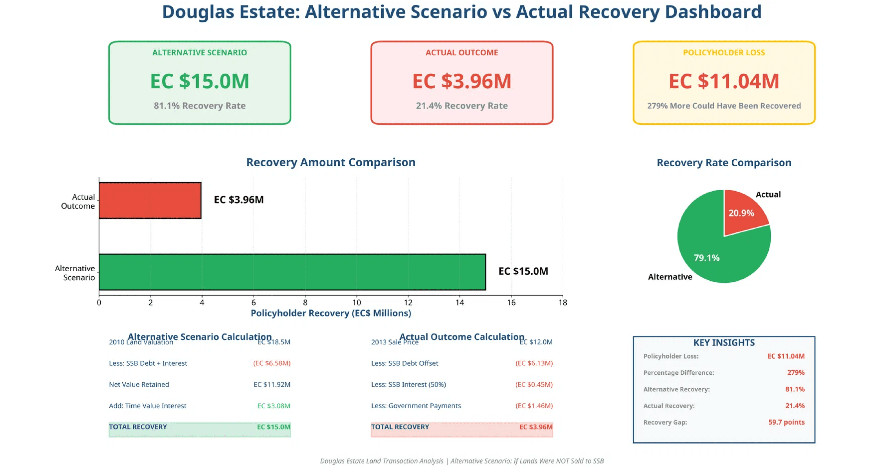
Alternative vs Actual: Comprehensive Dashboard Analysis

Slide 21

Revised Total Policyholder Losses: EC $42.9M
Full Magnitude of Value Transfer from Policyholders to SSB
Immediate Discount
EC $6,500,000
15.5%
SSB Debt Offset
EC $6,128,583
14.6%
Total Loss
SSB Lands Already Sold
EC $6,058,000
14.5%
EC $42.9M
SSB Remaining Land Potential
EC $22,763,474
54.3%
Government Payments
EC $1,464,526
3.5%
Understanding the EC $42.9M Total Loss Calculation
This revised calculation shows the full magnitude of value transfer from CLICO policyholders to SSB. The EC $42.9M represents: (1) the immediate EC $6.5M discount, (2) the EC $6.1M debt offset, (3) the EC $6.058M SSB has already sold, (4) the EC $22.76M remaining land value SSB will realize, and (5) EC $1.46M in government payments. Net recoverable value for policyholders: EC $42.9M vs actual recovery: EC $3.96M. This means policyholders received only 13.2% of what they should have recovered, while SSB gained the remaining 86.8% (EC $38.9M).

Slide 22
Loss Attribution Analysis: EC $14.5M Breakdown
How the Total Policyholder Loss Was Distributed Across Four Categories
Immediate Discount
(Selling below 2010 valuation)
EC $6,500,000
44.7%
SSB Debt Offset
(Existing CLICO debt offset)
EC $6,128,583
42.1%
Total Loss
EC $14.5M
Government Stamp Tax
(12% of sale price)
EC $1,440,000
9.9%
SSB Interest + Gov Other
(Interest payment + fees)
EC $476,310
3.3%
Key Finding: Two Factors Account for 86.8% of Total Loss
The combination of selling below valuation (EC $6.5M, 44.7%) and the SSB debt offset mechanism (EC $6.1M, 42.1%) together account for EC $12.6 million (86.8%) of the total EC $14.5M policyholder loss. These two structural choices had nearly equal impact, each reducing policyholder recovery by approximately EC $6 million. Government payments (stamp tax, fees, and interest) accounted for the remaining 13.2% (EC $1.9M) of the loss.

Slide 23
Scenario Impact: Visual Comparison of Recovery Amounts
Policyholder Recovery Across Five Transaction Structure Scenarios
Visual Analysis: The following chart compares how much CLICO policyholders would have recovered under five different transaction scenarios, demonstrating the financial impact of structural choices made in 2013.
EC $4.0M
EC $10.5M
EC $20.8M
EC $10.1M
EC $5.4M
21.4% recovery
56.5% recovery
112.3% recovery
54.5% recovery
29.3% recovery
ACTUAL
(2013)
At 2010
Valuation
At 2025
Market Value
No SSB
Debt Offset
No Gov
Payments
Actual Outcome
Alternative Scenarios (Better Recovery)
Detailed quantitative analysis and financial impact assessment follows in the next slide

Slide 24
Scenario Impact: Quantitative Analysis and Key Finding
Detailed Comparison of Policyholder Recovery Across Scenarios
Scenario
Policyholder Recovery
Recovery Rate
Difference vs Actual
ACTUAL (2013)
EC $3,955,107
21.4%
BASELINE
At 2010 Valuation
EC $10,455,107
56.5%
+EC $6,500,000
At 2025 Market Value
EC $20,776,581
112.3%
+EC $16,821,474
No SSB Debt Offset
EC $10,083,690
54.5%
+EC $6,128,583
No Government Payments
EC $5,419,633
29.3%
+EC $1,464,526
Critical Impact Analysis
The transaction structure choices resulted in policyholders receiving EC $6.5 million less than if the property had been sold at its 2010 valuation. This loss was driven by two primary mechanisms:
SSB Debt Offset Impact
Government Payments Impact
EC $6.1M
EC $1.5M
Reduced policyholder recovery by offsetting existing debt against sale proceeds
Stamp taxes, land taxes, and license fees paid before policyholder distribution

Slide 25
Time Value Analysis: 2010 Valuation Was Reasonable
Growth Projection Validation (2010-2025, 15-Year Period)
If the EC $18.5M valuation from 2010 had grown at various market rates over 15 years, would it align with the 2025 actual market value of EC $28.8M?
Growth Rate Scenario
Projected 2025 Value
vs Actual Market Value
Conservative (2%)
EC $24,892,982
86.4%
Below actual
ACTUAL 2025 VALUE
EC $28,821,474
100%
BASELINE
Realistic Growth (5%)
EC $38,489,929
133.6%
Above actual
CBI Market Low (8%)
EC $58,632,267
203.4%
Above actual
CBI Market Mid (10%)
EC $77,254,691
268.0%
Above actual
CBI Market High (12%)
EC $101,465,563
352.0%
Above actual
Validation Conclusion
The actual 2025 market value of EC $28.8M falls between conservative (2%) and realistic (5%) growth projections from the 2010 valuation. This suggests the original EC $18.5M valuation was reasonable and appropriately conservative, as it would have required only 2.9% annual growth to reach the current market value—well within normal real estate appreciation rates.

Slide 26
Critical Observations: SSB Returns and Policyholder Losses
Key Findings from Douglas Estate Transaction Analysis (Part 1 of 2)
1
Extraordinary SSB Investment Returns
14.9% Annualized Return (432% Total ROI)
SSB's investment performance exceeded the highest CBI real estate market benchmark (12%) by 137%, achieving EC $28.8M current value from EC $5.4M net investment. This exceptional return was enabled by the debt offset mechanism reducing the effective purchase price to EC $3.10 per square foot.
2
Severe CLICO Policyholder Losses
78.6% Loss Rate (EC $14.5M Lost)
Policyholders recovered only 21.4% (EC $4.0M) of the 2010 property valuation (EC $18.5M). If the property had been sold at its valuation, recovery would have been 56.5% instead of 21.4% — a difference of EC $6.5 million. The loss resulted from immediate discount (EC $6.5M), SSB payments (EC $6.6M), and government payments (EC $1.5M).
3
Debt Offset Mechanism Impact
EC $6.1M Debt Offset + EC $452K Interest
The debt offset mechanism allowed SSB to offset EC $6.6M (54.9% of the EC $12M sale price) against existing CLICO obligations, reducing SSB's actual cash payment to EC $5.4M. This created a significant advantage for SSB while reducing funds available to policyholders, who owned the underlying asset.

Slide 27

Critical Observations: Payment Priority and Valuation Information
Continued: Key Issues Requiring Review
4
Government Payment Priority
EC $1.46M (12.2% of Sale Proceeds)
Government received EC $1.46M in stamp taxes (12%), land taxes, and license fees before policyholders received any distribution. Combined with SSB's 54.9% share, this meant 67% of sale proceeds went to SSB and government before policyholders, who owned the asset, received the remaining 33%.
5
Missing Valuation Documentation
Valuer Identity
The EC $18.5M valuation is referenced in court documents but the written valuation report was not attached to court filings. Although we do not have the valuation report, methodology, assumptions, our research has identified the most likely valuers as James Buchanan & Associates or Edwin Glasford Associates. We have made contact with them but they have not been wiling to provide a copy of the valuation. The valuation which was filed with the Court documents may have been destroyed in a fire at the Court a few years ago.
Overall Assessment
These five critical issues demonstrate a transaction structure that produced exceptional returns for SSB while resulting in severe losses for CLICO policyholders. The debt offset mechanism, government payment priority, and sale below valuation combined to reduce policyholder recovery to 21.4% of the original asset value.

