Slide 1

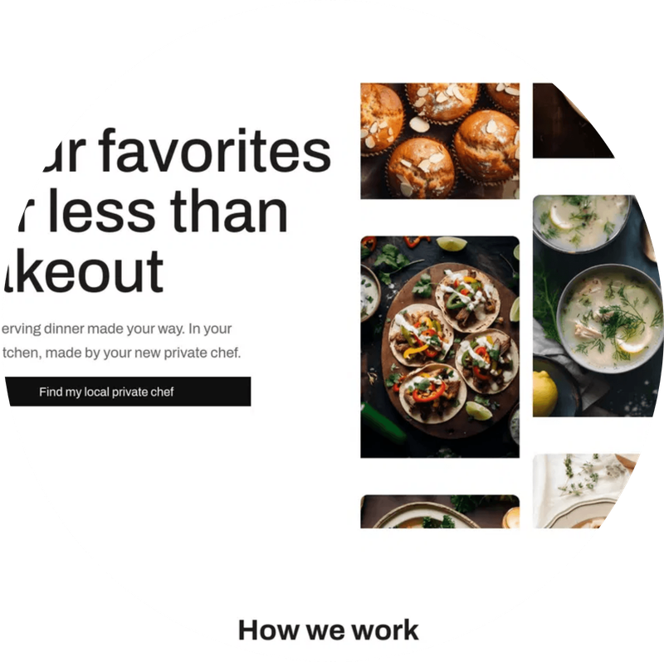
2025 – 2030
EAT
COOK
JOY
INVESTOR PITCH DECK
5-Year Growth Roadmap to $200M
Valuation
YC SAFE
Bringing the Joy of Cooking to Every Home
$27.5M Cap · Min. Check $25,000
www.eatcookjoy.com
Confidential — For Accredited Investors Only

Slide 2
No Time
to Cook
Food Waste
Crisis
Unhealthy
Defaults
70% of working adults skip home cooking due to time constraints, rising meal costs, and the complexity of recipes.
$1 Trillion
Fast food consumption has increased 35% post-pandemic. Home cooking skills are at an all-time low across Gen Z & Millennials.
wasted globally on
THE
PROBLEM
food annually.
Households discard
30% of groceries —
due to wrong portions
and expired
ingredients.
Global Meal Kit & Home Cooking Market: $25.7 BILLION by 2030 — Growing at 13.6% CAGR

Slide 3
A Chef-Curated Cooking Platform That Makes Home Cooking
EASY · JOYFUL · AFFORDABLE
An AI-powered app that manages your meals, places your grocery order, and connects you with chefs when you need the cooking help — all in one seamless experience.
AI Meal Management
Smart Grocery Ordering
OUR
SOLUTION
Personalized meal planning powered by AI — tracks dietary needs, preferences, pantry inventory, and builds your weekly meal plan.
The app places your grocery order directly with partner stores — right ingredients, right portions, zero waste. Up to 20% savings through partnerships.
Chef Discovery & Connection
Community Hub
Connect instantly with vetted local chefs for meal prep sessions or full-service cooking on your schedule.
Cook together — virtual dinner parties, challenges, leaderboards, and social sharing to make cooking a shared joy.
Founded by Zainab Ghadiyali | AI-Powered | Community-First | Scalable SaaS + Commerce Model

Slide 4

$10/mo
20%
SUBSCRIPTION
GROCERY COMMISSION
Free app for all users. Premium tier at $10/month unlocks AI meal management, automated grocery ordering & chef connections.
Earn up to 20% commission on every grocery order placed through the app from partner stores — zero friction for the user.
REVENUE STRATEGY
BUSINESS
MODEL
FREE + PAID TIER
STORE PARTNERSHIPS
FREEMIUM
$30–$150
B2B
DATA
Four distinct revenue streams built on a free-to-join app that converts users into paying subscribers, grocery buyers, and chef clients.
CHEF DISCOVERY FEE
AI & DATA LICENSING
$30–$150 referral fee per chef booking or discovery. Connects home cooks with vetted professional chefs on demand.
Anonymised taste profiles & meal data licensed to retailers, CPG brands & enterprise partners via API.
CHEF MARKETPLACE
ENTERPRISE APIS
LTV $480 · CAC $22 · LTV:CAC = 21.8x · Gross Margin 68% · Payback < 2 Months

Slide 5
$1.2M
~100K
92%
4.8★
3x
ARR (Beta)
Servings
Retention
App Store
YoY Growth
MILESTONE TIMELINE
VALIDATION
2022
Founded · First 100 members · MVP app launch
Named Austin's Top 25 Startups To Watch
■
YC-backed — Top 2% of applicants accepted
2023
YC Batch · $27.5M valuation · 3,000 subscribers
■
TRACTION &
MILESTONES
Featured in TechCrunch & Forbes
■
2024
$380K ARR · Meal kit launch · 12,000 members
Partnership with 3 Michelin-starred chefs
■
Zero paid marketing — all organic growth
2025
Private beta in Texas → $1.2M ARR · ~100K servings · 92% retention · Series A prep
■
NPS Score: 72 (World Class)
■
Texas Private Beta Proves Product-Market Fit · $1.2M ARR · 92% Retention · Ready to Scale Nationally

Slide 6

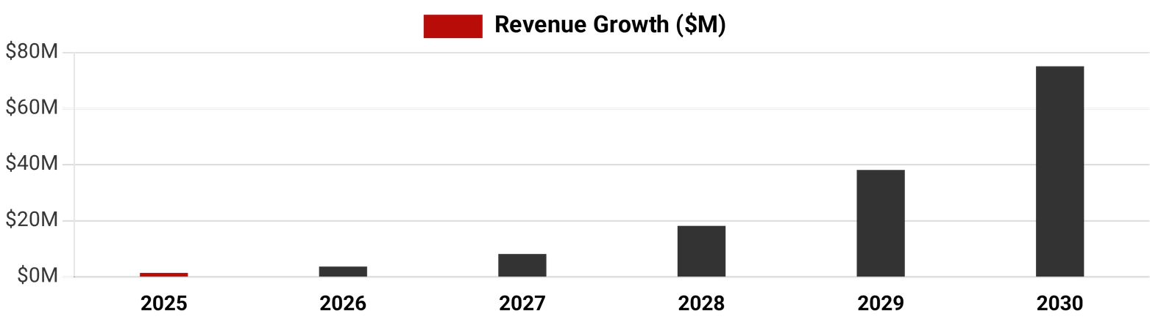
Year
Revenue
Members
Valuation
Milestone
FINANCIAL
ROADMAP
$1.2M
30K
$27.5M
SAFE Round · Current Cap
2025 ★
2026
$3.5M
75K
$50M
Series A Raise
2027
$8.0M
180K
$80M
International Launch
2028
$18M
400K
$120M
Profitability · Strategic Partner
2029
$38M
850K
$160M
Pre-IPO / M&A Ready
2030
$75M
1.5M
$200M
Liquidity Event
★ Current SAFE Cap: $27.5M | Target 2030 Valuation: $200M | Conservative 10x Revenue Multiple vs. SaaS peers at 15–25x
$200M Valuation Target by 2030 · Current Cap $27.5M · 10x Revenue Multiple · 1.5M Members

Slide 7

SAFE INSTRUMENT DETAILS
YOUR $50,000 RETURN SCENARIO
Instrument:
YC Standard Post-Money SAFE
Ownership at Conversion
Valuation Cap:
$27,500,000
0.1818%
Discount:
None
Min. Check Size:
$25,000
$50,000 ÷ $27.5M Cap
Conversion Trigger:
Next Priced Round (Series A+)
Exit Scenario Returns:
INVESTMENT
TERMS
Equity Basis:
Post-Money Cap Table
At $100M Exit
$182K
3.6x
Pro-Rata Rights:
Yes (above $50K)
At $200M Exit
$364K
7.3x
Info Rights:
Quarterly Financials
At $500M Exit
$909K
18x

Slide 8
AI-Personalization
Moat
Community
Network Effect
Vertical
Integration
Proprietary taste graph — 2M+ data points
•
Each new member makes platform more valuable
•
Content + Commerce + Community in one app
•
Recipes tailored to skill + pantry
•
Chef loyalty program locks in supply
•
Competitors only own one layer
•
WHY
EAT COOK
JOY WINS
Gets smarter with every cook
•
Social cooking creates daily engagement habit
•
Supplier relationships = 40% cost advantage
•
Impossible to replicate without our data
•
Viral referral loop — avg 2.3 invites/member
•
Zero-waste model resonates with Gen Z & Millennials
•
No single competitor combines AI + Live Chefs + Meal Kits + Community — Eat Cook Joy owns the full stack.

Slide 9

Funds are primarily directed toward accelerating product development and scaling user onboarding — the two highest-leverage growth levers at this stage.
35%
Tech & AI Development
$2.625M
AI engine v3, iOS/Android app overhaul, ML infrastructure, grocery ordering integration
USE OF
FUNDS
30%
Marketing & Growth
$2.25M
Performance mktg, influencer, PR, SEO, community growth, user onboarding optimization
20%
Operations & Logistics
$1.5M
Supply chain, cold storage, last-mile delivery optimization
10%
Team Hiring
$750K
Engineering, data science, chef partnerships, BD
5%
Legal & Administration
$375K
IP protection, international licensing, compliance
Total Raise: $7.5M SAFE Round · 18-Month Runway · Deployed Across 5 Growth Pillars

Slide 10
ZAINAB GHADIYALI
ZG
$27.5M
Valuation Cap
Founder & CEO · YC Alum · AI & Food Tech Entrepreneur
Former Apple Engineer · Built & sold 2 startups · TEDx Speaker · Stanford MBA
AK
PM
RC
DL
THE
TEAM
Alex Kim
Priya Mehta
Rafael Costa
Dana Liu
CTO
Head of Growth
Head Chef
CFO
AI/ML Lead from Google
Ex-Airbnb · 0–1M users
Michelin-starred · 15 yrs
Ex-Goldman Sachs · MBA Wharton
Backed by Y Combinator · Advisory Board includes Fortune 500 CMOs & Top VC Investors

Slide 11

THE ASK
Join the Eat Cook Joy
Investor Table
Minimum Investment
Valuation Cap
Your Target Equity
$25,000
$27.5M
0.18%
YC SAFE instrument
Post-money cap
At $50K investment
Contact: invest@eatcookjoy.com · www.eatcookjoy.com

