Slide 1


Group 3
Derivatives & Options Trading
BU 8301 — Derivatives & Alternative Investments
Done by:
Janan Hasan – 202201896
Waad Mubarak – 202200153
Walaa Sharaf – 202202826
Nawraa Alalaiwat – 202200492
Noora Alkowari – 202200383
Walaa Alaali – 202200125

Slide 2
Account & Trade overview

Slide 3
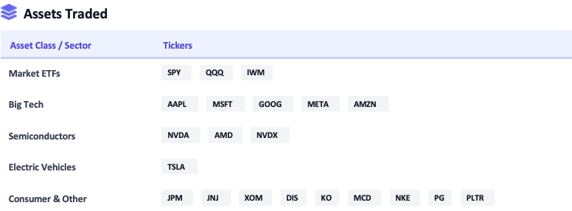
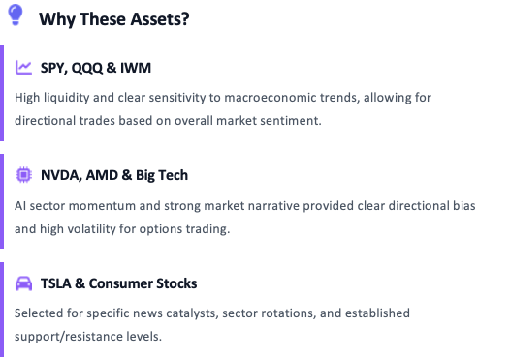
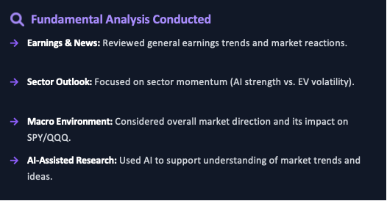
Asset Selection & Fundamental Analysis
Strategic focus on high-liquidity ETFs, tech momentum, and diverse market sectors

Slide 4
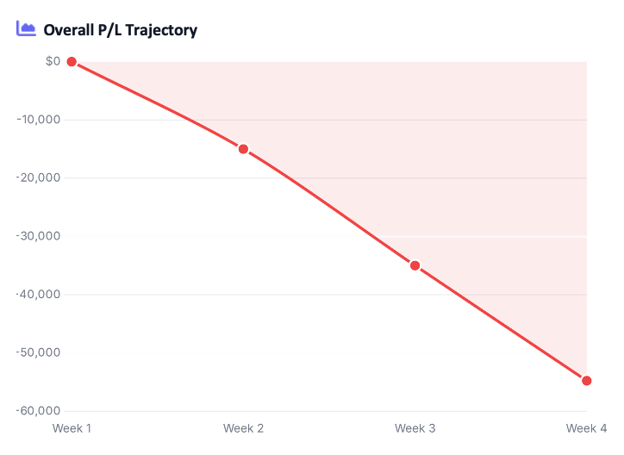
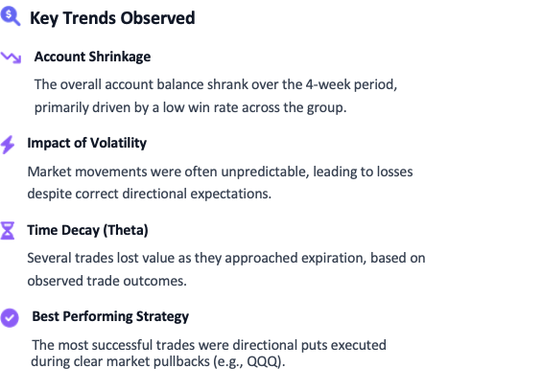
Account Overview & Key Trends
A consolidated view of the group's trading performance over the 4-week period

Slide 5

IQ Option — Trading Overview
Strategies Used
  Predicted short‑term price direction (up = Call, down = Put)
  Quick entry and exit to capture momentum
Feelings During Trades
  Excitement when profits grew quickly
  Pressure and frustration when losses occurred
CFDs (Contracts for Difference)
  Profit/loss from price movement without owning the asset
  Flexible way to trade market moves
Risk Tolerance
  Binary options are simple but unforgiving
  Exercise showed I have a moderate risk tolerance

Slide 6
Trades Summary
(winning & losing trades)

Slide 7


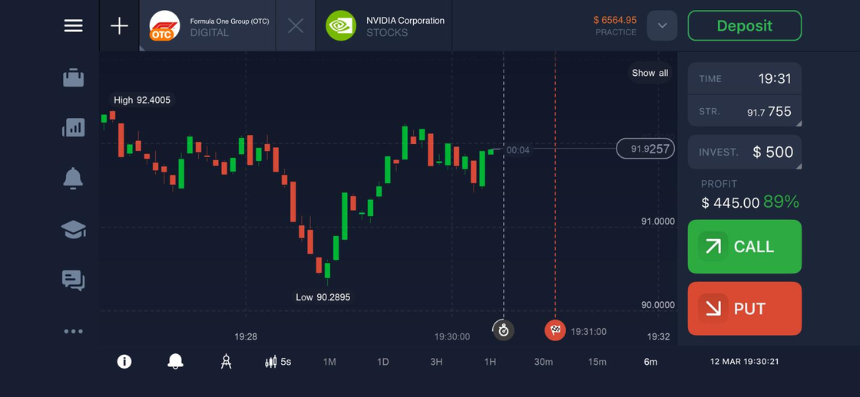
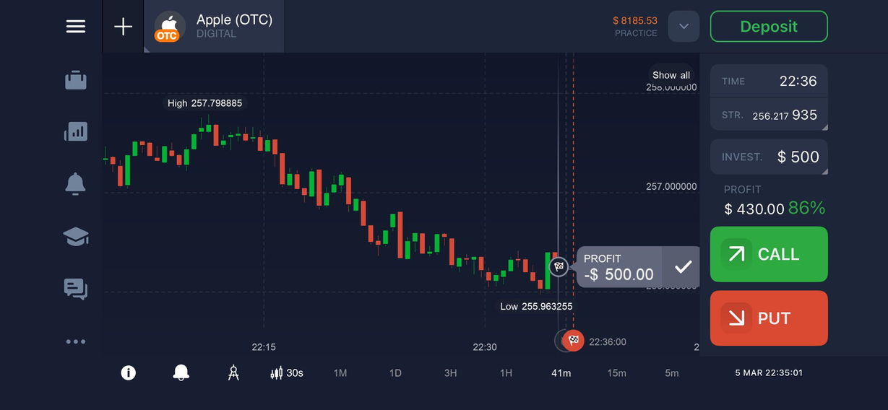



IQ Option — Winning & Losing Trades
Formula One Group - CALL
Apple - PUT
(+$445)
Correct upward prediction, quick entry/exit captured momentum.
Market reversed unexpectedly, entire investment lost.

Slide 8

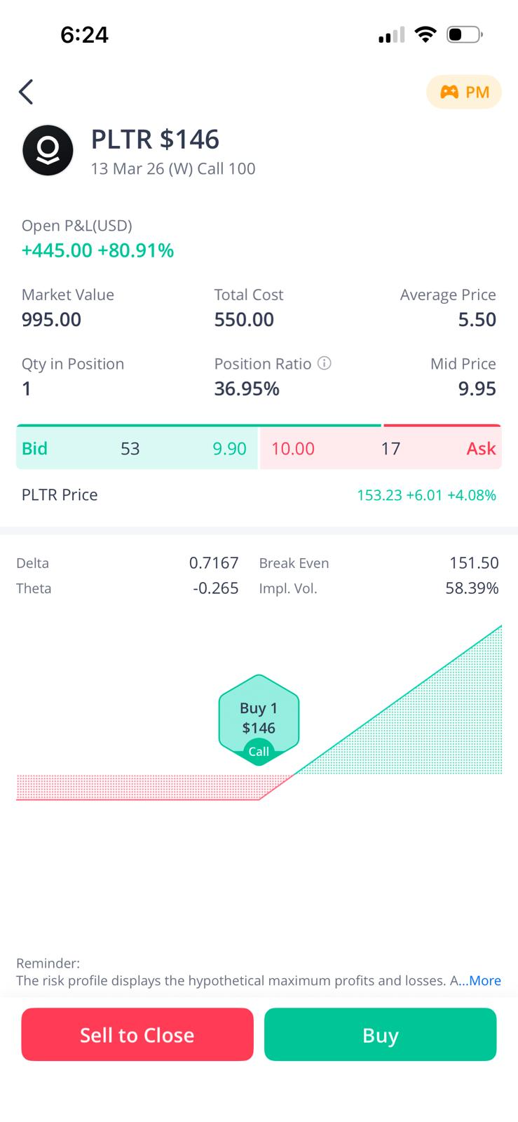

Janan Hasan
Webull Trades
Winning Trade – PLTR Call (+$450)
Date: 2026‑03‑02
Strike Price: 146
Entry: $5.50 → Exit: $10.00
Profit/Loss: +$450
Why it moved as predicted:
    Entered after strong bullish momentum in PLTR.
    Buyers continued pushing price higher.
    Exited quickly into strength before time decay.
Analysis Support:
  Technical momentum signals confirmed entry.
  Positive sentiment in the tech sector reinforced the trade idea.

Slide 9
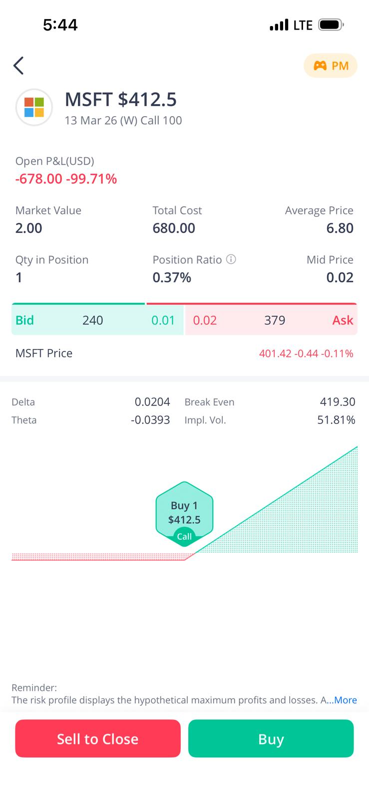

Webull Trades
Janan Hasan
Losing Trade – MSFT Call (–$1555)
Date: 2026‑03‑06
Strike Price: 412.5
Entry: $6.80 → Exit: $0.35
Profit/Loss: –$1555
Why it moved against prediction:
    Expected support bounce, but stock stayed weak.
    Held too long, option premium collapsed due to time decay.
What went wrong:
    Timing and exit discipline.
    Overconfidence in rebound idea.
Reflection:
  Exiting earlier would have reduced the loss.
  Expensive contracts require stricter risk control.

Slide 10
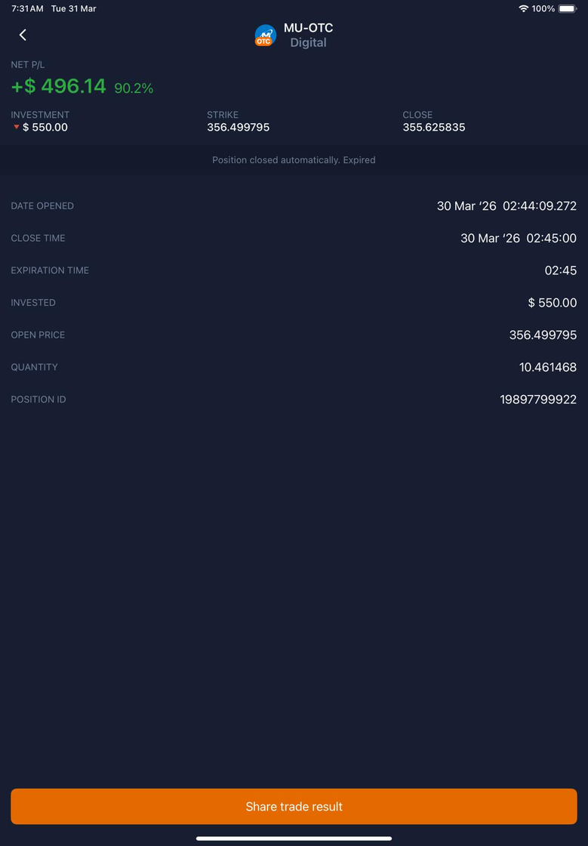
IQ Trade
Waad Mubarak
Winning Trade – Micron Call (+$496)
Date: 30 Mar 2026
Expiration Date: 30 Mar 2026
Entry: $550 → Exit: +$496
Profit/Loss: +$496
Why it moved as predicted:
  Entered after clear bullish momentum.
  Price moved upward within the expected time frame.
Analysis Support:
  Took advantage of binary timing and consistency in short-term movement.
  Technical indicators confirmed the trend.
  Fundamental support (news and social media sentiment) reinforced the decision.

Slide 11
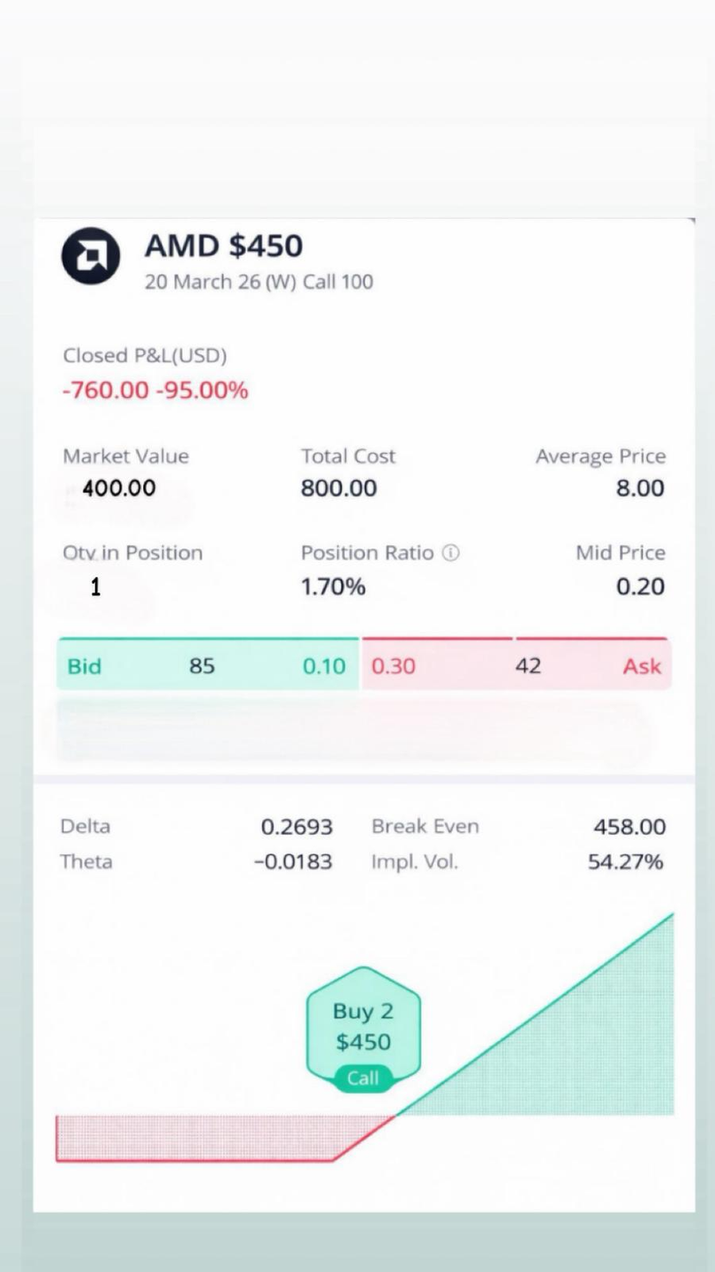
Webull Trades
Waad Mubarak
Losing Trade – AMD Call (-$760)
Date: 15 Mar 2026
Expiration Date: 20 Mar 2026
Strike Price: 450
Entry: $800 → Exit: $40
Profit/Loss: -$760
Why it moved differently than expected:
  Sharp downward movement pushed the market price significantly lower.
  The move went against expectations, weakening investor sentiment and rapidly reducing the option’s value.
Analysis Support:
  Entry influenced by recency bias and overestimation of price movement.
  High strike selection increased risk

Slide 12

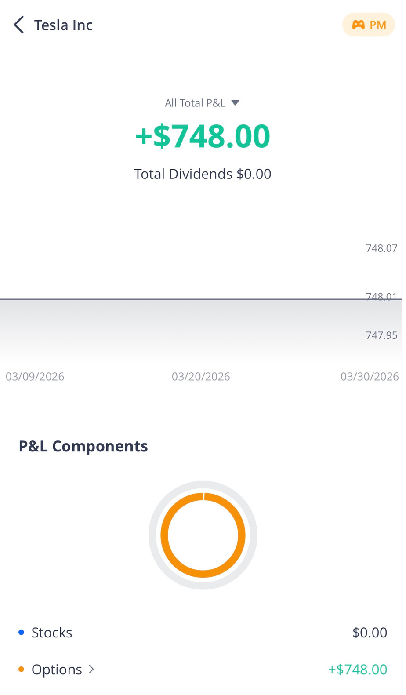
Nawraa Alalaiwat
Webull Trades
Winning Trade – TSLA Call (+$748)
Date: 2026‑03‑09
Strike Price: 390
Entry: $1.22 → Exit: $8.70
Profit/Loss: +$748
Why it moved as predicted:
    Entered during strong upward move in TSLA
    Price kept rising after entry
    Exited quickly while momentum was still strong
Analysis Support:
  Technical: The stock was moving upward with strong momentum, which supported a Call position.
  Market Conditions: TSLA’s volatility made it suitable for short-term gains, and the price reacted quickly after entry.

Slide 13
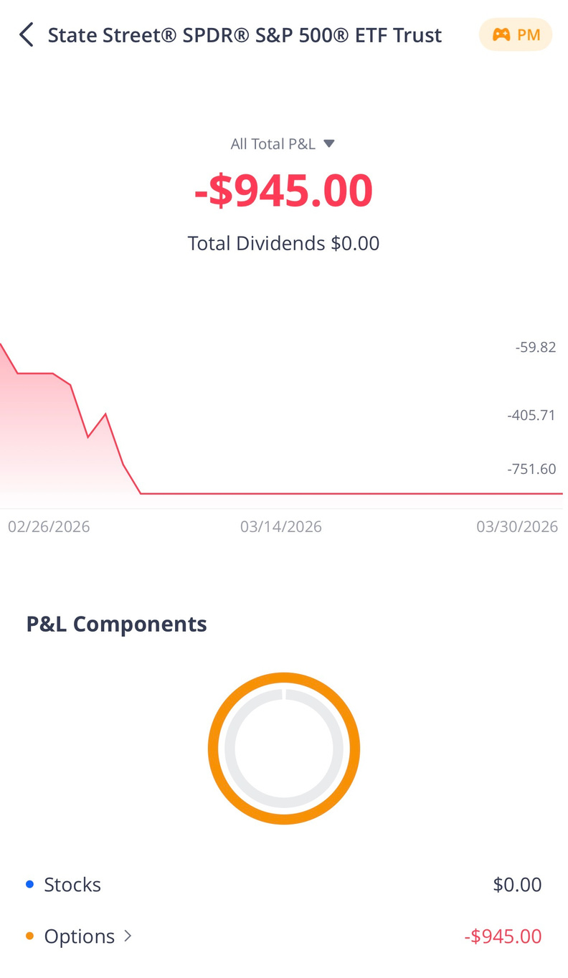
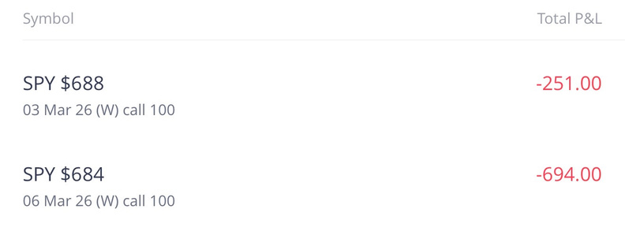
Nawraa Alalaiwat
Webull Trades
Losing Trade – SPY Call (–$694)
Date: 2026‑02‑27
Strike Price: 684
Entry: $6.95 → Exit: $0.01
Profit/Loss: –$694
Why it moved against prediction:
    Expected upward move did not continue
    Market started dropping after entry
    Option lost value very quickly
What went wrong:
    Entered before confirming trend
    Market conditions were unstable
    Trade had very short time to recover
Reflection:
  Wait for clear direction before entering
  Avoid rushing into trades
  Manage risk more carefully

Slide 14
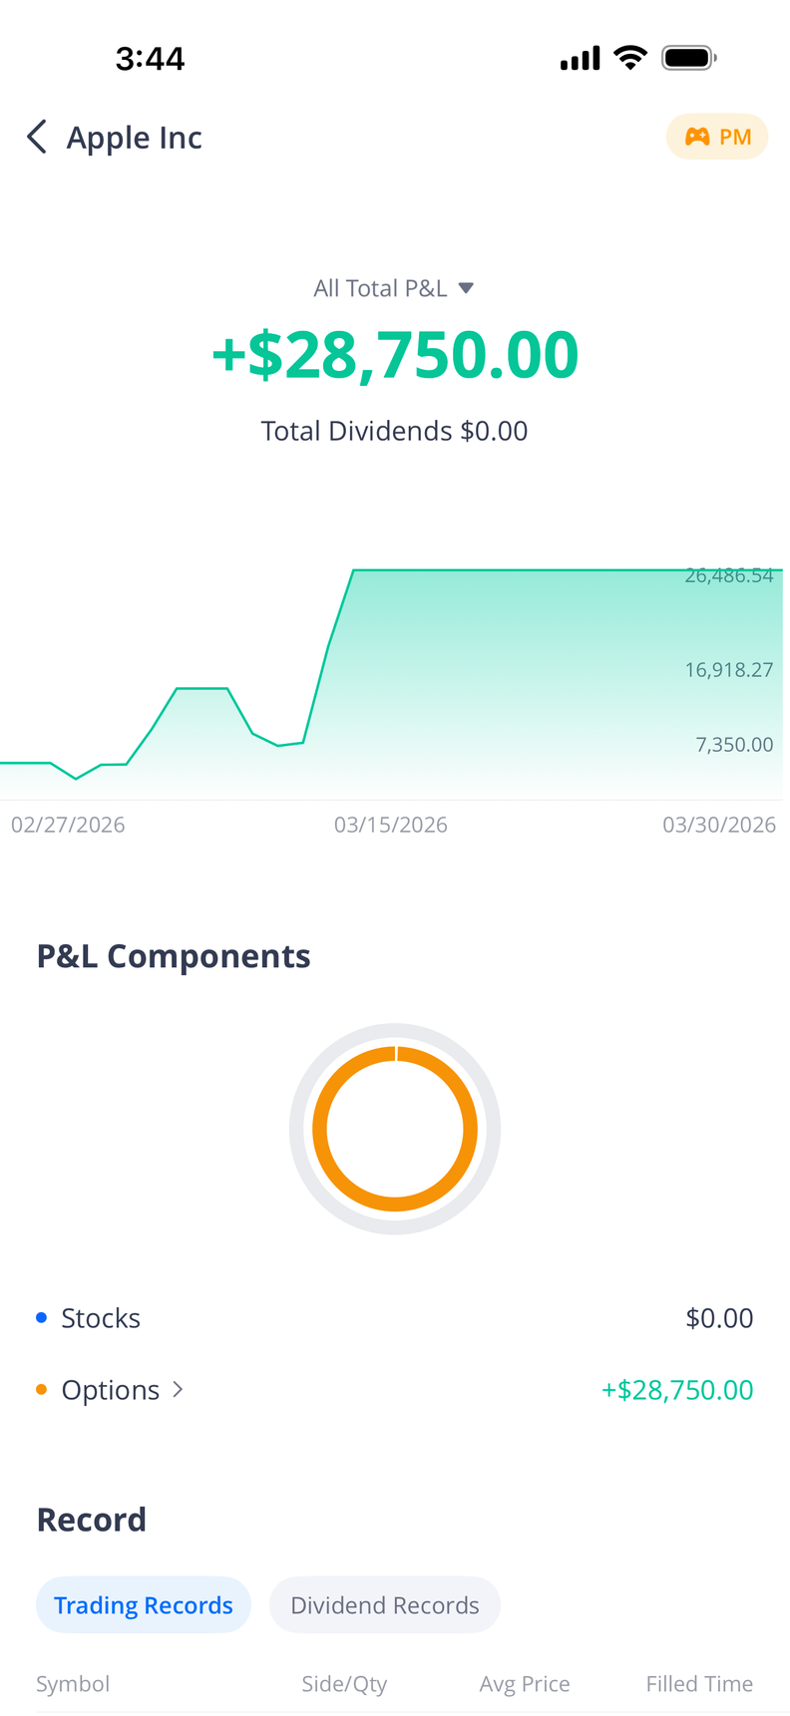
Walaa sharaf
Webull Trades
Winning Trade – AAPL- LONG PUT(+$28,750)
Date: 2026‑02-27
Strike Price: $270
Entry: $7.10→ Exit: $18.60
Profit/Loss: +$28,750
Why it moved as predicted:
  Stock showed a bearish trend
  Price moved downward as expected
  Long put gained value from decline
Analysis Support:
  Technical: Downtrend, weak momentum
  Market Conditions:
  Negative sentiment
  Tech sector under pressure

Slide 15
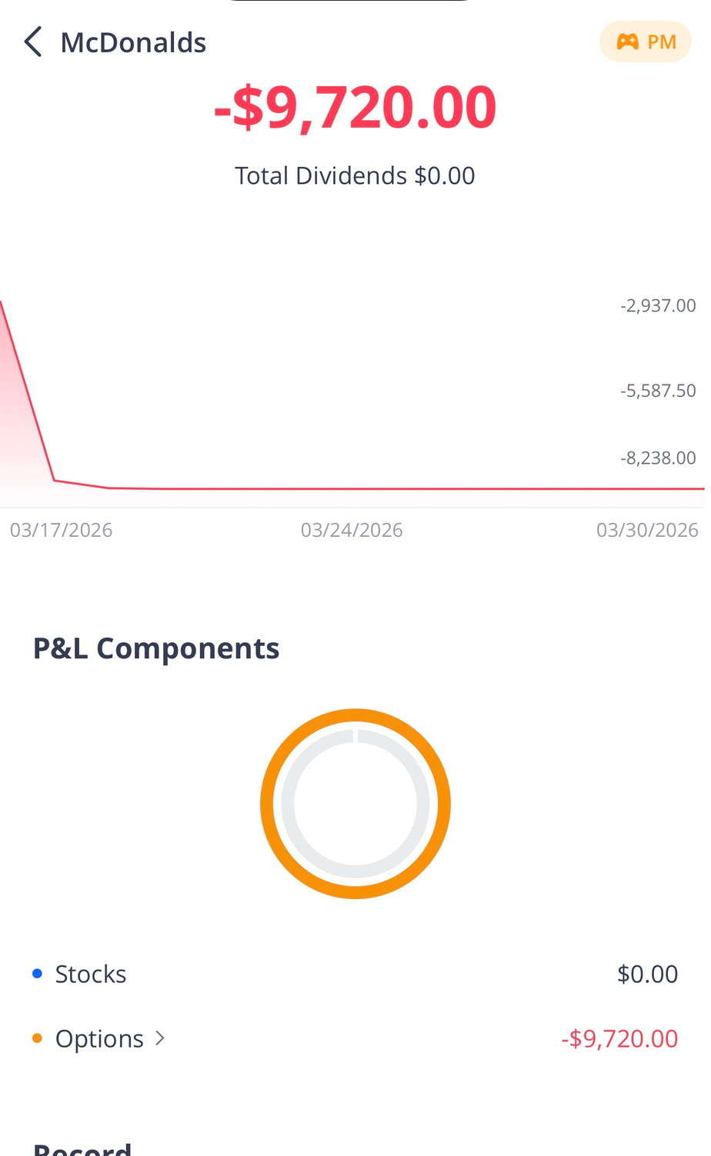
Walaa sharaf
Webull Trades
Losing Trade – MCD (–$9,720)
Date: 2026‑03-18
Strike Price: $270
Entry: $3.25→ Exit: $0.3200
Profit/Loss: –$9,720
Why it moved against prediction:
    Stock did not rise as expected
    Stayed below strike → option lost value
What went wrong:
    Weak upward momentum
    Short expiry
    Time decay reduced value
Reflection:
  Timing is critical
  Need stronger confirmation
  Improve risk management

Slide 16
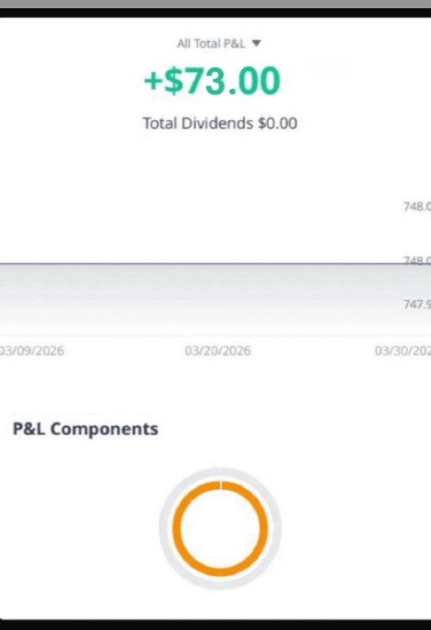
Noora Alkowari
Webull Trades
Winning Trade – NVDA- put (+73)
Date: 2026‑03-18
Strike Price: $182.5
Entry: $1.41→ Exit: $2.14
Profit/Loss: +$73
Why it moved as predicted:
  Stock moved downward as expected
  Bearish pressure in market
  Long put gained value from decline
Analysis Support:
  Technical: Downtrend, bearish momentum
  Market Conditions:
  Slight bearish sentiment
  Weak upward movement

Slide 17
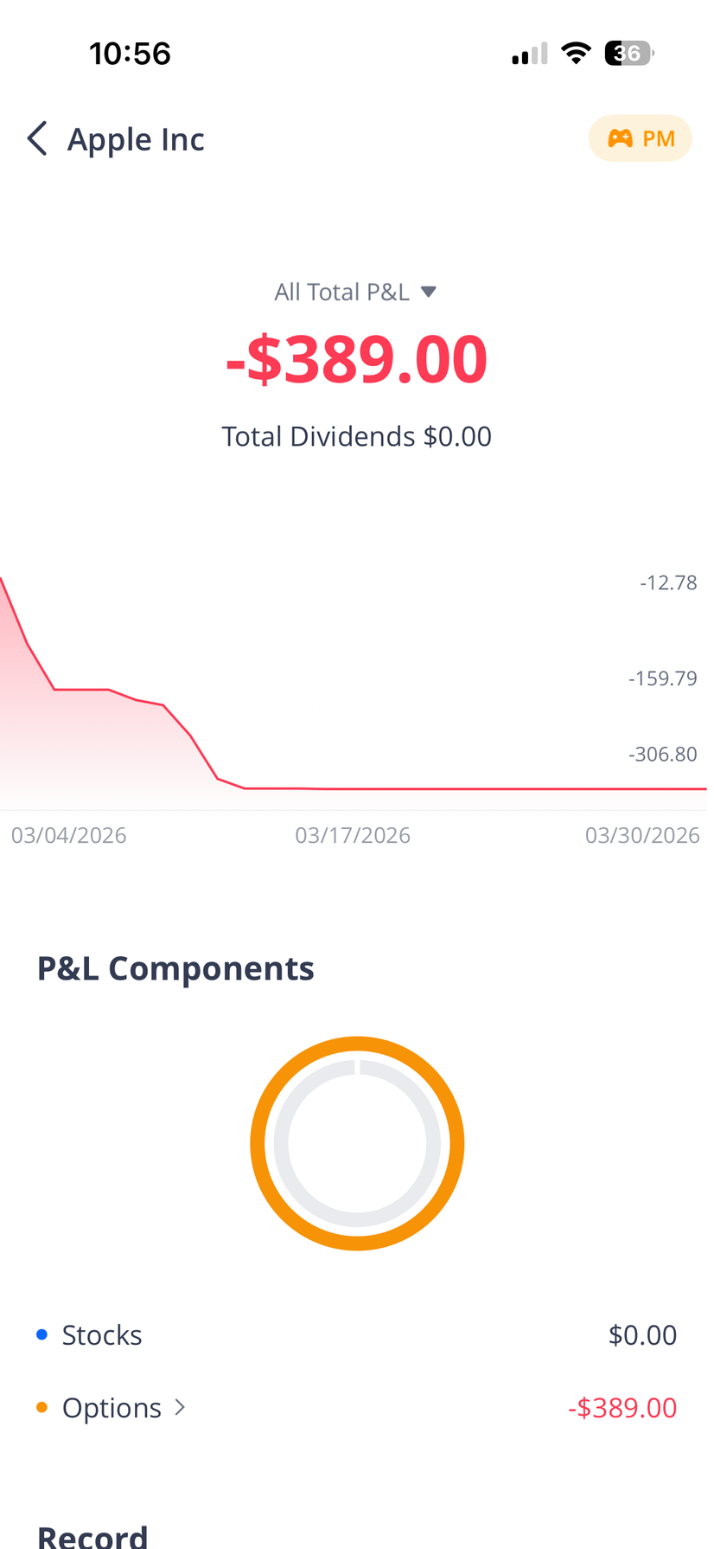
Noora Alkowari
Webull Trades
Losing Trade – AAPL-Call (–$389)
Date: 2026‑03-16
Strike Price: $265
Entry: $3.9→ Exit: $0.01
Profit/Loss: –$389
Why it moved against prediction:
    Stock did not continue upward as expected
    Market conditions were weak
    Option lost value due to lack of movement
What went wrong:
    Weak bullish momentum
    Held position too long
    Time decay reduced option value
Reflection:
  Need better confirmation signals
  Avoid holding losing trades too long
  Exit earlier when trend weakens

Slide 18
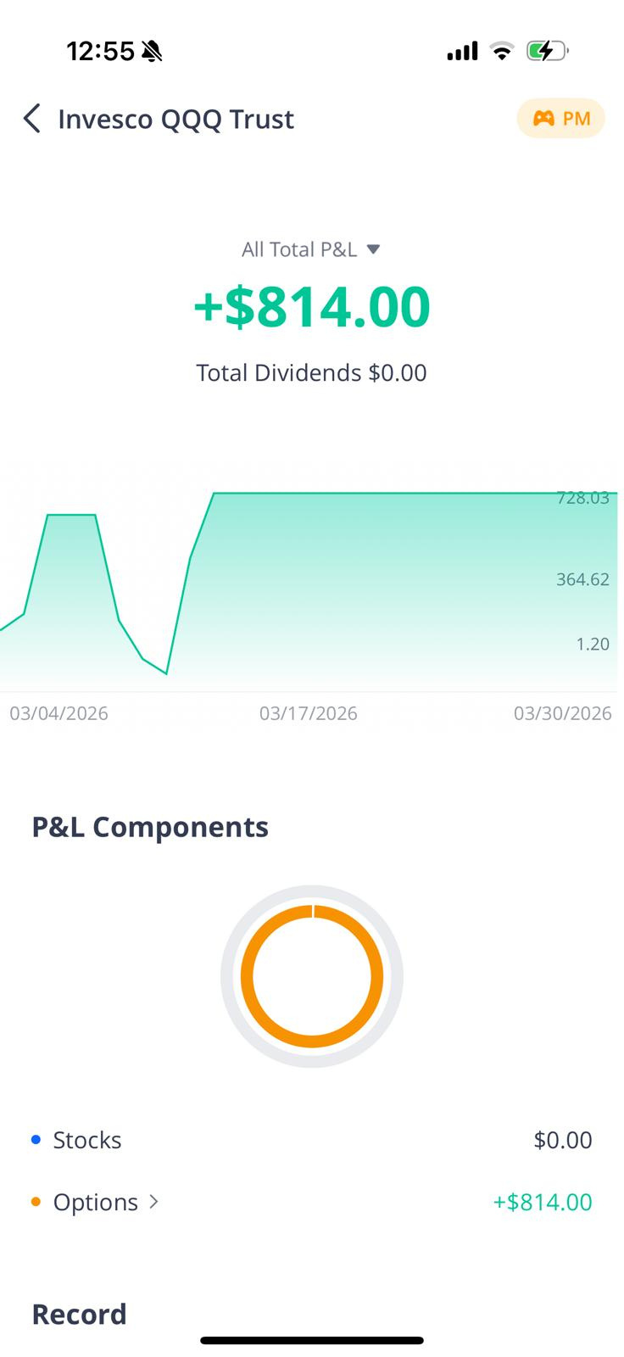
Webull Trades
Walaa Alaali
Winning Trade – QQQ- LONG PUT(+$814)
Date: 2026-03-04
Strike Price: $609
Entry: $7.08→ Exit: $15.22
Profit/Loss: +$814
Why it moved as predicted:
  Tech sector showed weakness
  QQQ broke below support level
  Price moved downward as expected
  Long put gained value from decline
Analysis Support:
  Technical: Breakdown below support, bearish momentum
  Market Conditions:
  Negative sentiment in tech sector
  Market pullback in growth stocks

Slide 19
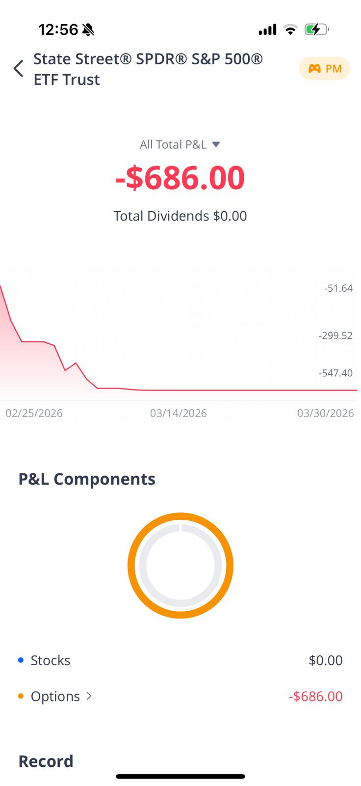
Walaa Alaali
Webull Trades
Losing Trade – SPY -Long Call (-$686)
Date: 2026-02-25
Strike Price: $695
Entry: $6.87→ Exit: $0.01
Profit/Loss: -$686
Why it moved against prediction:
    Market continued downward
    SPY failed to hold support
    Call option lost value as price dropped
What went wrong:
    Entered too early
    Strong bearish momentum
    Time decay reduced option value
Reflection:
  Timing is critical
  Wait for confirmation
  Improve risk management

Slide 20

Risk management, trading psychology & use of AI
Risk management:-
Trading psychology
Use of AI:-
  Trades did not fully match my risk appetite
  Used large position sizes, increasing exposure
  Held some losing trades too long → time decay impact
  Lesson: improve position sizing & early exit decisions
  Felt stress and uncertainty during losses
  Tendency to hold trades hoping for recovery
  Biases: loss aversion & overconfidence
  Lesson: decisions should be disciplined and objective
  Used ChatGPT
  Helped understand options & trade setup
  Supported analysis and slide preparation
  Final decisions based on my own understanding

Slide 21
Top Lessons Learned
Options trading requires clear strategy planning ( not random buying / selling ).
Final reflection
Learned that options trading is not just guessing
Time and Volatility have a major impact on option prices.
Experienced how emotions can affect decisions, especially during loses
Emotional decisions (panic / sudden trades) often lead to poor outcomes.
Overall, realized that options trading is high - risk but can be rewarding with proper knowledge
Lessons learned & Final reflection

Slide 22



Thank you, any questions?

