Slide 1


GLOBAL FINTECH · 7 COUNTRIES · AFRICA & SOUTHEAST ASIA
ALLPAYFAST
Send, Receive & Hold Money Globally — Like a Local.
Real exchange rates. Transparent fees. Deep local integration.
🇿🇦 SOUTH AFRICA
🇰🇪 KENYA
🇨🇲 CAMEROON
🇮🇩 INDONESIA
🇹🇭 THAILAND
🇲🇾 MALAYSIA
🇵🇭 PHILIPPINES
AFRICA
SOUTHEAST ASIA
7 MARKETS · 30+ CURRENCIES · ONE ACCOUNT

Slide 2








ONE ACCOUNT.
EVERY CURRENCY YOU NEED.
A single, powerful account that puts the world's currencies at your fingertips — designed for Africa's modern professionals, businesses, and families.
Multi-currency wallet — manage ZAR, KES, XAF, USD, EUR, GBP and 30+ currencies in one place
Receive like a local — get paid with local account details in South Africa, Kenya, and Cameroon
Send globally — transfer at the real mid-market exchange rate with low, transparent fees
Spend anywhere — linked virtual or physical debit card accepted worldwide
Fully digital — manage everything via mobile app or web, anytime, anywhere
Regulated & secure — your money is safeguarded under local financial regulations

Slide 3



03 · RECEIVE MONEY — 7 COUNTRIES
ALLPAYFAST
RECEIVE LIKE A LOCAL
GET LOCAL ACCOUNT DETAILS IN EACH COUNTRY · NO INTERNATIONAL FEES · INSTANT OR SAME-DAY SETTLEMENT
🌍 AFRICA
🌏 SOUTHEAST ASIA
🇿🇦
South Africa
🇮🇩
Indonesia
ZAR
IDR
From local companies & freelancers
Local bank account + branch code
From employers & marketplaces
Virtual account (BCA, Mandiri) / GoPay, OVO, Dana
🇰🇪
Kenya
🇹🇭
Thailand
KES
THB
From employers & clients
Bank account or M-Pesa paybill/till
From local companies
Bank (PromptPay enabled) / TrueMoney wallet
🇨🇲
Cameroon
🇲🇾
Malaysia
XAF
MYR
From local sources
MTN MoMo / Orange Money wallet or bank
From local clients
Bank (Maybank, CIMB) / Touch 'n Go e-wallet
🇵🇭
Philippines
PHP
From local sources
Bank (BPI, BDO) / GCash / PayMaya

Slide 4
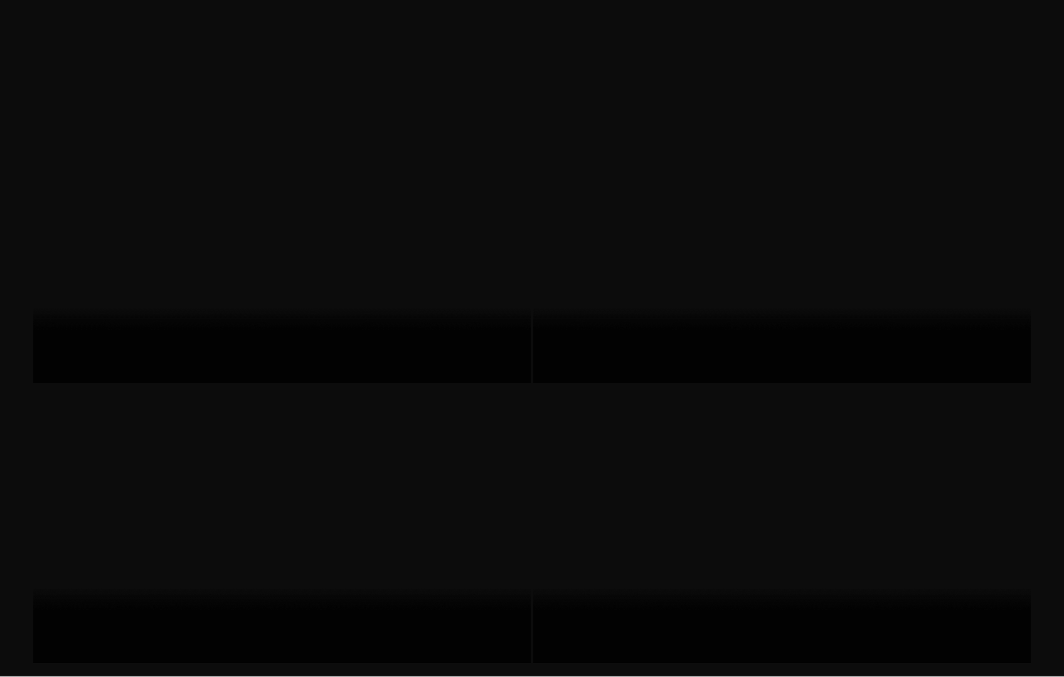

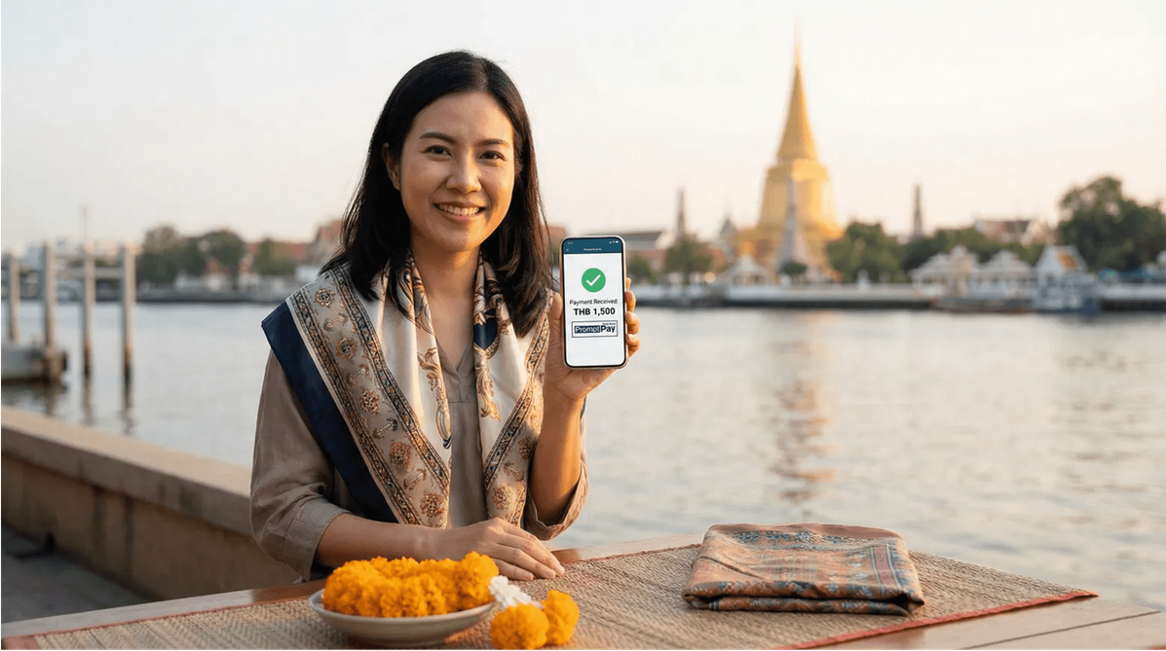
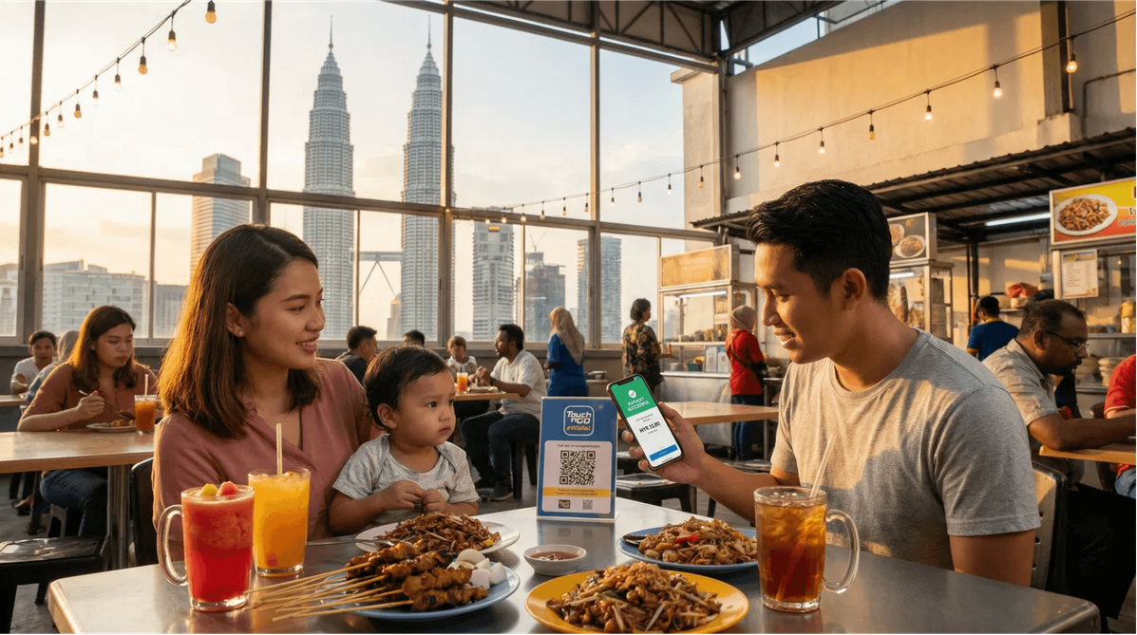
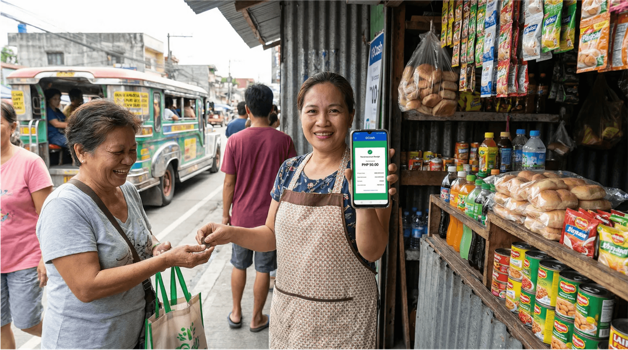
03B · SOUTHEAST ASIA — RECEIVE LIKE A LOCAL
ALLPAYFAST
SOUTHEAST ASIA EXPANSION
INDONESIA · THAILAND · MALAYSIA · PHILIPPINES — 4 NEW MARKETS, LOCAL PAYMENT INTEGRATION
🇮🇩
INDONESIA
🇹🇭
THAILAND
IDR
THB
Virtual account (BCA, Mandiri) · GoPay · OVO · Dana · BI-FAST
PromptPay · TrueMoney · Bank transfer · Omise / 2C2P
🇲🇾
MALAYSIA
🇵🇭
PHILIPPINES
MYR
PHP
FPX · IBG · Touch 'n Go · Maybank · CIMB
GCash · PayMaya · InstaPay · PESONet · Palawan / Cebuana cash

Slide 5

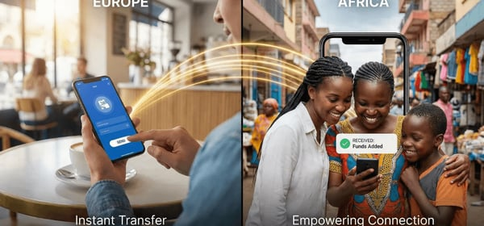
04 · SEND MONEY
ALLPAYFAST
SEND MONEY GLOBALLY
AFRICA · SOUTHEAST ASIA · WORLDWIDE — REAL RATES, TRANSPARENT FEES, MINUTES NOT DAYS
01
Real mid-market rate + small fixed fee displayed upfront — no hidden markups
DESTINATION COUNTRIES & RECEIVE METHODS
COUNTRY
RECEIVE METHODS
02
Most transfers complete within minutes — bulk payments for businesses available
🇿🇦 South Africa
Bank transfer, cash pickup
🇰🇪 Kenya
M-Pesa, bank transfer
03
Bank accounts, mobile wallets, or cash pickup across 7 countries and beyond
🇨🇲 Cameroon
MTN MoMo, Orange Money, bank transfer
🌏 SOUTHEAST ASIA
🇮🇩 Indonesia
Bank transfer (VA), GoPay, OVO, Dana, cash pickup
🇹🇭 Thailand
Bank transfer (PromptPay), TrueMoney, cash
🇲🇾 Malaysia
Bank transfer (IBG), Touch 'n Go, cash pickup
🇵🇭 Philippines
Bank transfer, GCash, PayMaya, cash (Palawan, Cebuana)

Slide 6

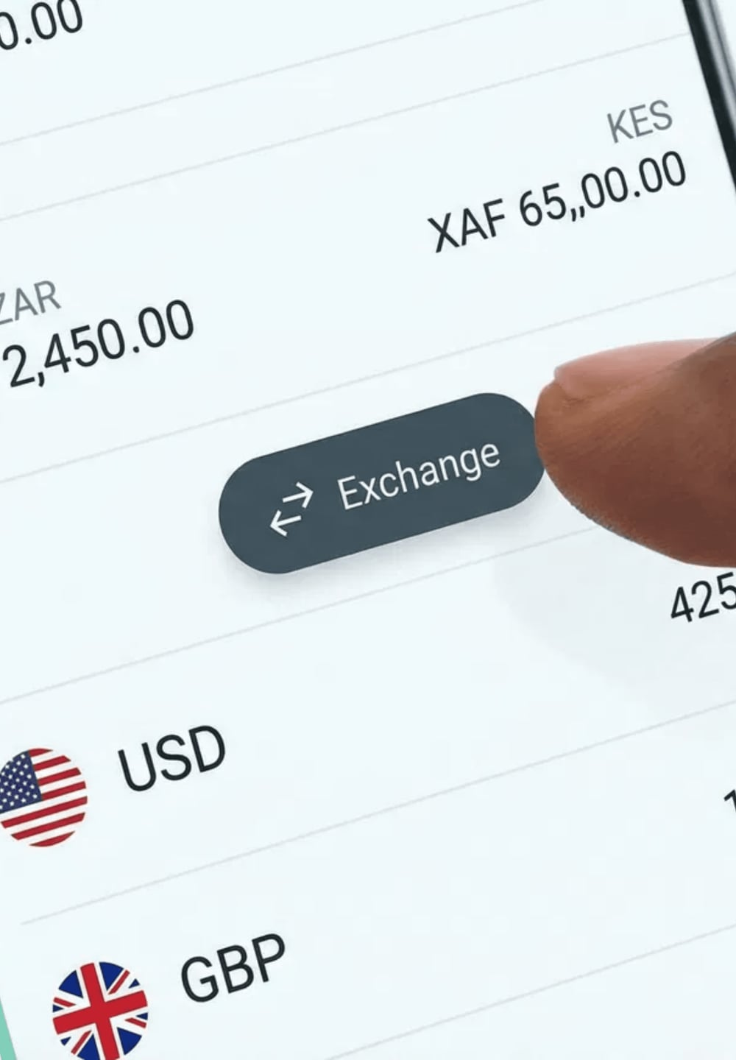




HOLD & EXCHANGE
30+ CURRENCIES
Your money should work for you — hold multiple currencies, convert instantly, and earn interest as we grow.
Hold balances in ZAR, KES, XAF, USD, EUR, GBP and 30+ currencies simultaneously
Switch currencies anytime at the real mid-market rate — no monthly subscription fees
Pay only when you transact — no hidden monthly charges
Earn interest
on select
currency balances
(USD, EUR)
COMING SOON

Slide 7
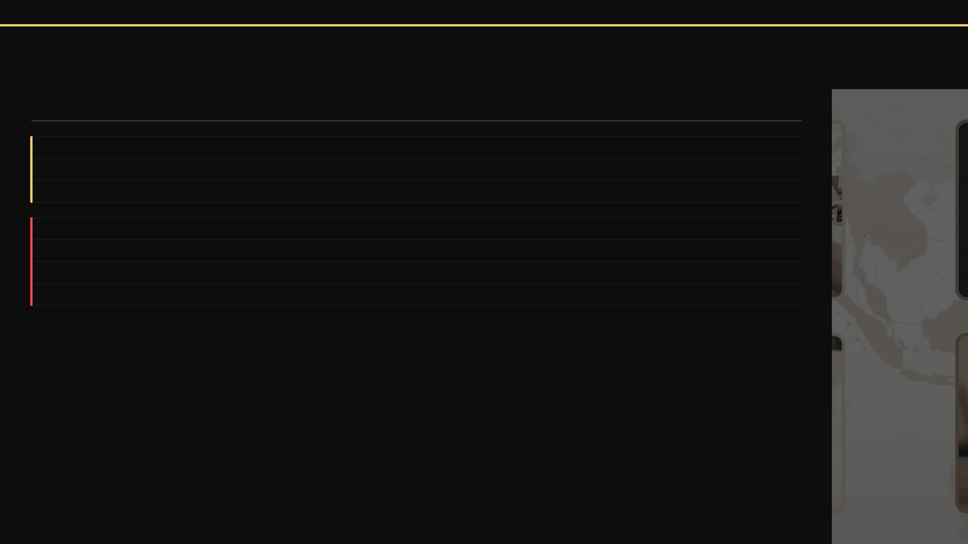

06 · LOCAL PAYMENT INTEGRATION
ALLPAYFAST
DEEP LOCAL INTEGRATION
7 COUNTRIES · DIRECT API CONNECTIONS TO LOCAL PAYMENT RAILS — NO INTERMEDIARIES
COUNTRY
PREFERRED METHODS
OUR INTEGRATION
🌍 AFRICA
🇿🇦 South Africa
Bank EFT, cards
Direct banking rails (SARB-approved)
🇰🇪 Kenya
M-Pesa (80%+), bank transfers
M-Pesa API + aggregator for banks
🇨🇲 Cameroon
MTN MoMo, Orange Money, cash
Direct MTN/Orange API; cash pickup
🌏 SOUTHEAST ASIA
🇮🇩 Indonesia
Bank (VA), GoPay, OVO, Dana, cards
DOKU, Midtrans & BI-FAST gateways
🇹🇭 Thailand
PromptPay, TrueMoney, bank, cards
Direct Thai bank API / Omise, 2C2P
🇲🇾 Malaysia
FPX, IBG, Touch 'n Go, cards
FPX / direct banking partners
🇵🇭 Philippines
GCash, PayMaya, InstaPay, PESONet
E-wallet API & bancnet integration

Slide 8

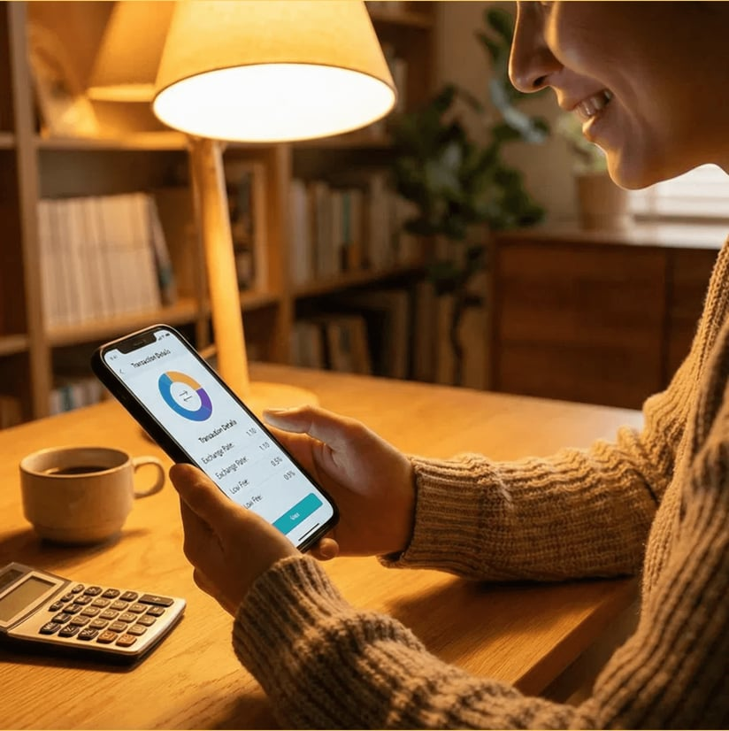
TRANSPARENT FEES
We believe you deserve to know exactly what you pay. Every time. No hidden markups, ever.
MID-MARKET RATE
No hidden markups (the Google rate)
SENDING
0.5%
From just
(varies by corridor)
RECEIVING
Free
for all local incoming transfers
CONVERSION
Small percentage fee shown clearly before you confirm
DEBIT CARD
Free
ATM withdrawals up to monthly limit

Slide 9
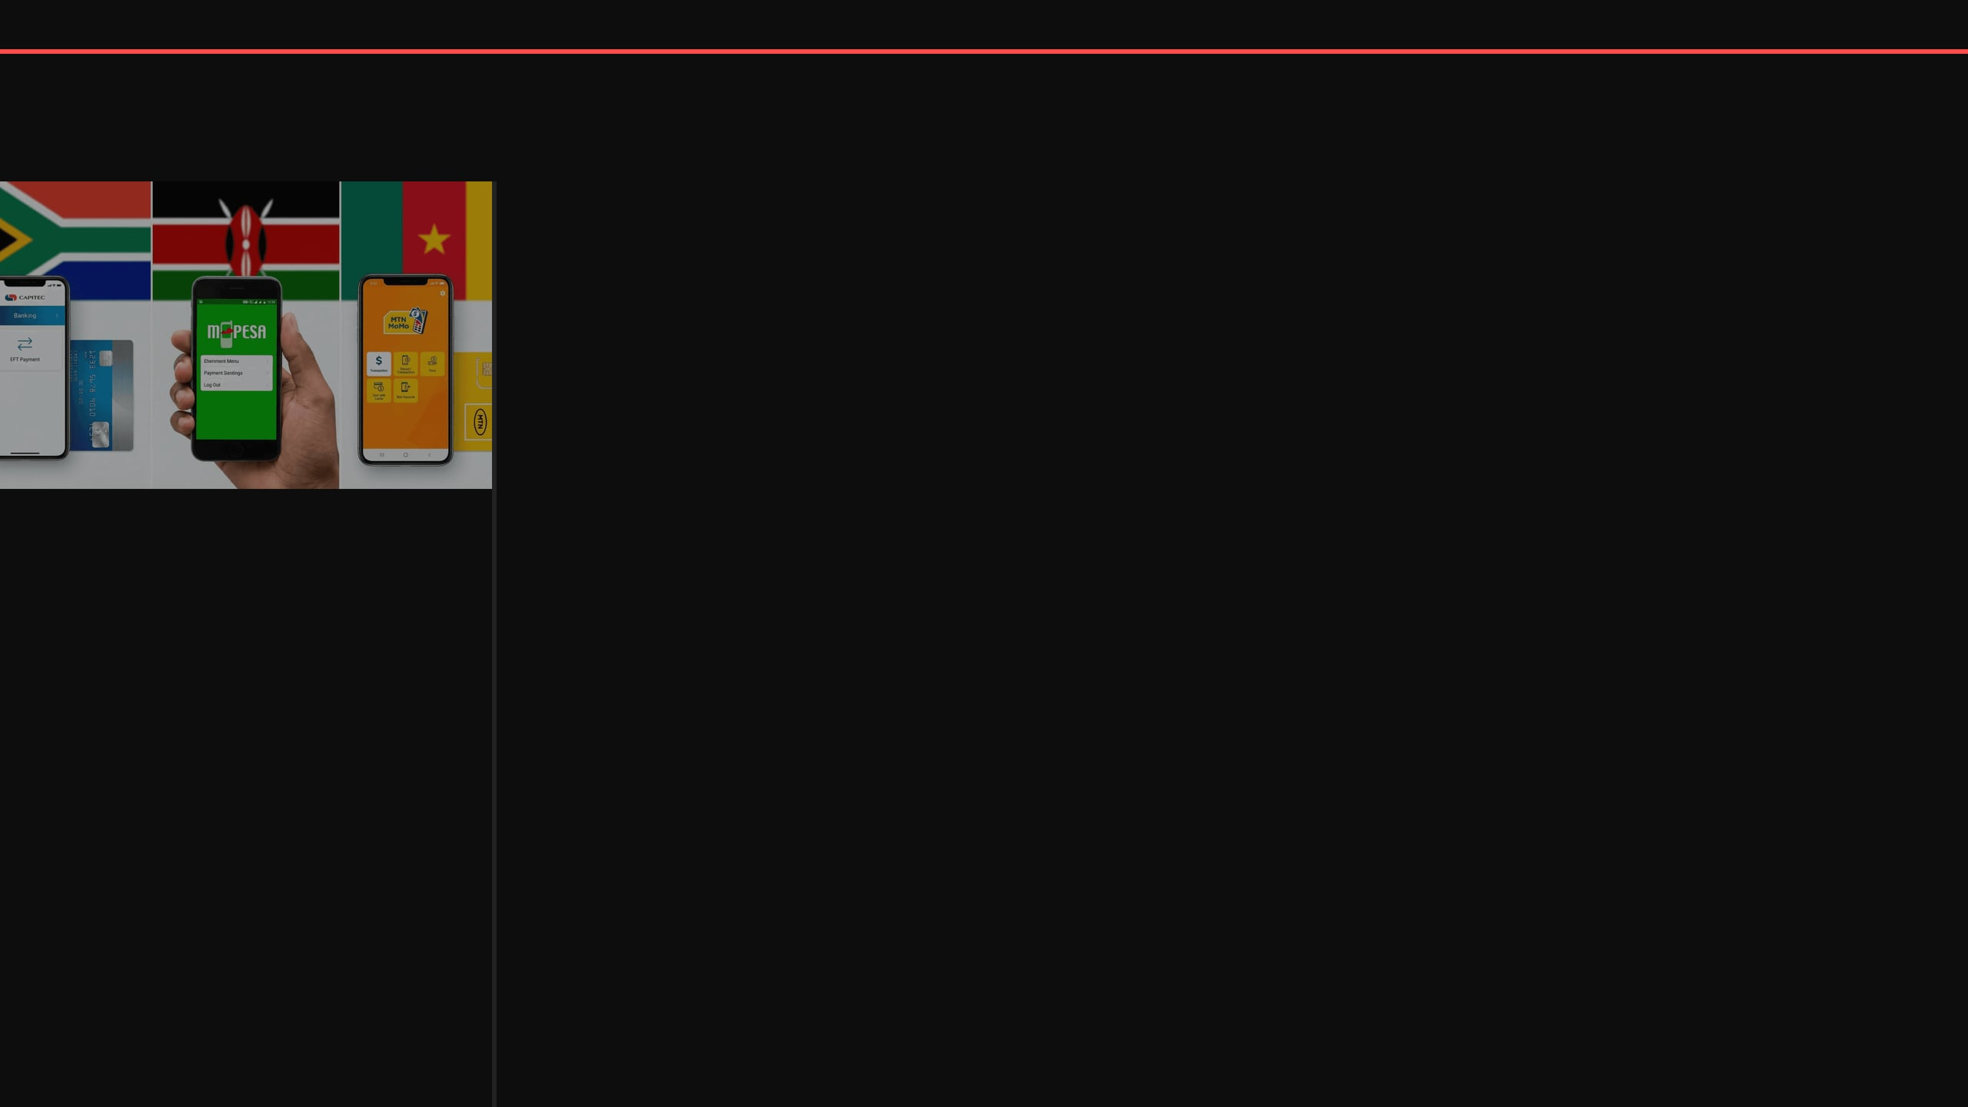
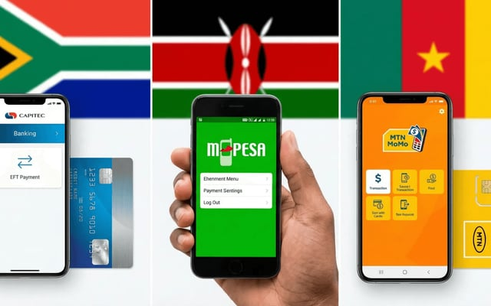
08 · SECURITY & REGULATION
ALLPAYFAST
REGULATED & SECURE IN EVERY MARKET
7 LICENSES · BANK-GRADE SECURITY · CUSTOMER FUNDS FULLY SAFEGUARDED
🌍 AFRICA — REGULATORY LICENSES
🇿🇦
South Africa
SARB — South African Reserve Bank
🇰🇪
Kenya
CBK — Central Bank of Kenya
🇨🇲
Cameroon
COBAC / BEAC — Central African Banking Commission
🌏 SOUTHEAST ASIA — REGULATORY LICENSES
🔐
2FA & Biometric Login
🇮🇩
Indonesia
Real-time fraud monitoring on every
Bank Indonesia / OJK — Financial Services Authority
transaction
🇹🇭
Thailand
🏦
Segregated Trust Accounts
Bank of Thailand
Customer funds held at top-tier banks,
🇲🇾
Malaysia
separate from company funds
Bank Negara Malaysia
🔒
Data Encryption
🇵🇭
Philippines
Local data protection compliance in
BSP — Bangko Sentral ng Pilipinas
all 7 markets

Slide 10
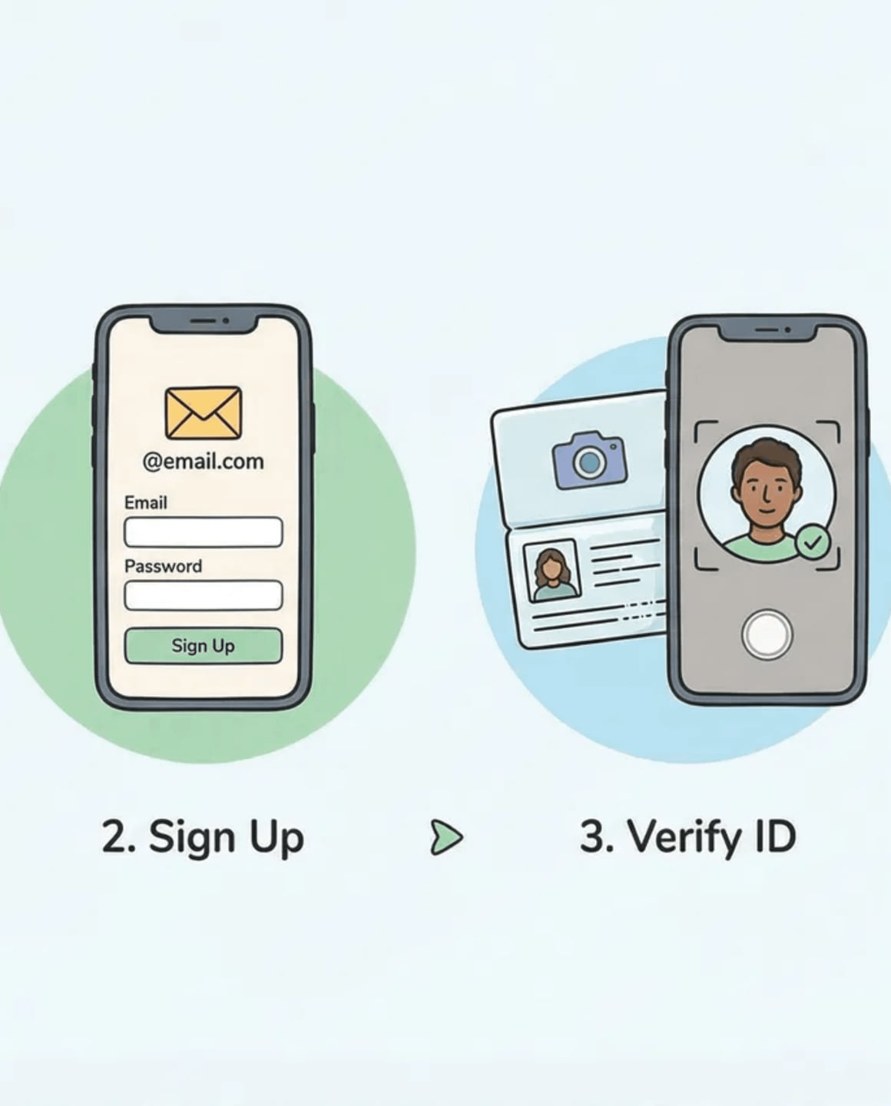
GET STARTED IN
5 SIMPLE STEPS
Opening your ALLPAYFAST account takes less than 10 minutes — entirely on your phone.
1
DOWNLOAD THE APP
SIGN UP
Or visit our website to
2
With your email
begin
address or phone
number
VERIFY YOUR IDENTITY
FUND YOUR ACCOUNT
3
4
Passport, national ID,
Via local bank
transfer, card, or
or proof of address
mobile money
START MANAGING MONEY
5
Send, receive, and
hold money globally

Slide 11



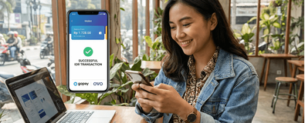


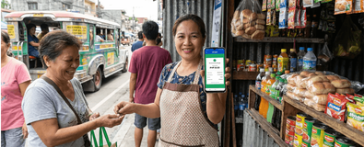
10 · ROADMAP
ALLPAYFAST
LAUNCH ROADMAP
7 COUNTRIES · 2026–2027 · AFRICA FIRST, THEN SOUTHEAST ASIA
Q3 2026
Q4 2026
Q1 2027
Q2 2027
LATER
Soft Launch
Public + Pilots
Full Launch ×4
Full Launch ×2
Product Expansion
🇿🇦 South Africa
🇿🇦 SA Public launch
🇰🇪 Kenya
🇲🇾 Malaysia
Business accounts
(Invite-only)
🇰🇪 Kenya pilot
🇨🇲 Cameroon
🇵🇭 Philippines
Open API
🇮🇩 Indonesia pilot
🇮🇩 Indonesia
Interest & investments
🇹🇭 Thailand

Slide 12







WHY CHOOSE US?
THE SMARTER WAY TO MOVE MONEY
We're not just another fintech. We're built for Africa, by people who understand Africa.
SAVE MONEY
SPEED
Up to 8x cheaper than traditional
Most transfers complete in
banks on international transfers
minutes, not days
CONVENIENCE
LOCAL EXPERTISE
One app for all your currency
Deep understanding of each
needs — send, receive, hold,
spend
country's payment landscape
and culture
TRUST & SECURITY
Backed by global investors, regulated locally in every market
JOIN THOUSANDS OF AFRICANS TAKING CONTROL OF THEIR FINANCIAL FUTURE

