Slide 1

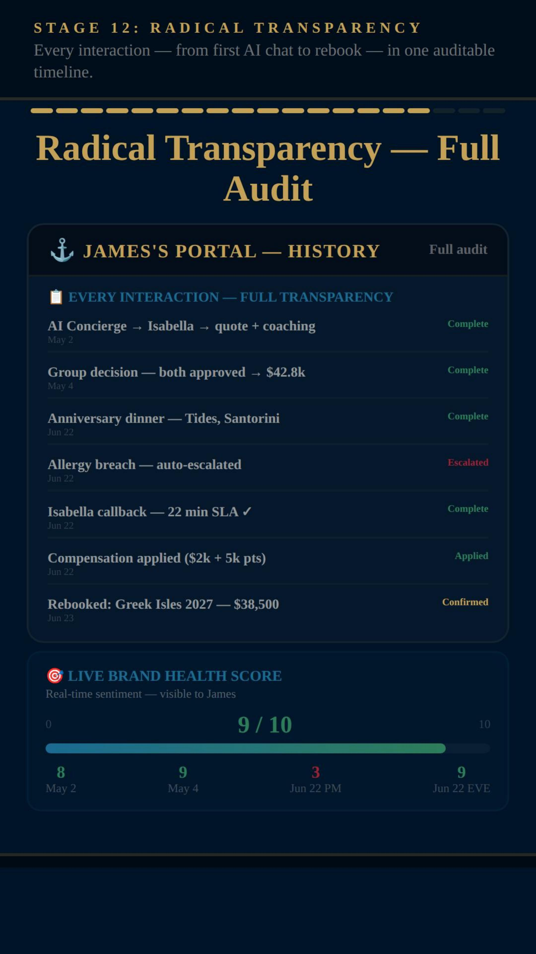
CALL CENTRE HELPER | WEBINAR | MARCH 2026
Trust in Customer
Service Experience is Broken.
Why CX Leaders Need to Prioritise Trust in 2026
Alex Mead
Global CX Director | EPIC CSX
20+ Years Transforming Customer Experiences
What trust should look like →
Every interaction visible • Statuses clear • Full audit trail • Zero mystery
Notes:
Opening — hit them straight away. 96% of unhappy customers never complain, they just leave. TARP/Goodman studies. For every complaint, roughly 24 people walked away silently.

Slide 2

Let's Be Honest About What's Wrong
What your customers go through — and all of it is avoidable
"Tell me again"
59%
of customers say they regularly have to repeat information when transferred across teams and channels
You call, explain everything, get transferred — and start from scratch. Different team, different channel, same story all over again.
Salesforce State of the Connected Customer, 2023
Notes:
Click 1 — Salesforce: 59% repeat information across teams and channels.

Slide 3

Let's Be Honest About What's Wrong
What your customers go through — and all of it is avoidable
"Tell me again"
"Is anyone there?"
59%
33%
of customers say they regularly have to repeat information when transferred across teams and channels
say their biggest frustration is having no visibility of progress after raising an issue
You call, explain everything, get transferred — and start from scratch. Different team, different channel, same story all over again.
You raise an issue. Then nothing. No tracking, no updates, no idea who's dealing with it or whether anyone even is.
Salesforce State of the Connected Customer, 2023
HubSpot Annual State of Service Report, 2024
Notes:
Click 2 — HubSpot: 33% biggest frustration is zero visibility. Not hold times.

Slide 4

Let's Be Honest About What's Wrong
What your customers go through — and all of it is avoidable
"Tell me again"
"Is anyone there?"
"We're putting in AI"
59%
33%
73%
of customers say they regularly have to repeat information when transferred across teams and channels
say their biggest frustration is having no visibility of progress after raising an issue
of CX leaders say AI has not yet improved their customer satisfaction scores
You call, explain everything, get transferred — and start from scratch. Different team, different channel, same story all over again.
You raise an issue. Then nothing. No tracking, no updates, no idea who's dealing with it or whether anyone even is.
Brands invest millions in AI. Customers still can't get a straight answer. The technology changed. The experience didn't.
Salesforce State of the Connected Customer, 2023
HubSpot Annual State of Service Report, 2024
Gartner CX Survey, 2024
Notes:
Click 3 — Gartner: 73% say AI hasn't improved satisfaction. Ask: how many of these happen in YOUR organisation?

Slide 5
What Actually Breaks Trust
Every one is a choice your company is making — whether you realise it or not
1
Every channel starts from scratch
5
"We'll get back to you" — then nothing
2
Generic IVRs and chatbots with zero context
6
Hold music, IVR menus, "press 1 for..."
3
Quotes emailed as PDFs nobody can share
7
AI that blocks instead of helps
4
You raise an issue or concern — then silence
8
Feedback only on the brand's terms
None of this is inevitable. Every single one of these can be fixed — if you're willing to stop patching and start rethinking.
Notes:
Eight trust killers — bold statements only on screen, talk through the detail:
1. Every channel starts from scratch — Customer explains once on chat, again on the phone, again to the specialist. Nobody has the picture.
2. Generic IVRs and chatbots with zero context — No awareness of who you are, what you've already told them, or what's actually going on. Just menus and scripts.
3. Quotes emailed as PDFs nobody can share — A static document that can't be discussed, compared, or decided on together as a group.
4. You raise an issue or concern — then silence — No tracking, no named owner, no timeline. You're left wondering if anyone is even looking at it.
5. We'll get back to you — then nothing — Recovery that's too slow, too generic, or simply never happens at all.
6. Hold music, IVR menus, press 1 for... — A phone experience designed around your operations, not your customer's needs.
7. AI that blocks instead of helps — Chatbots used to deflect customers away from humans, not to make the human interaction better.
8. Feedback only on the brand's terms — Surveys weeks later, generic questions, and nothing changes even when you do respond.
Hit the bottom line: none of this is inevitable. These are choices.

Slide 6

Stop Bolting AI
Onto Broken Things.
Adding AI to legacy processes and legacy thinking doesn't fix anything — it just fast-tracks frustration at scale.
It's time to reimagine how everything could and should be done
in an EPIC way.
Notes:
Dramatic pause slide. Let it land. If you bolt AI onto broken processes and legacy thinking, you don't fix anything — you just fail faster and at scale. Pause. Then say: it's time to reimagine everything. Not tweak. Not patch. Reimagine. In an EPIC way.

Slide 7

What Should Be Possible Right Now
One customer, any channel, one continuous conversation — AI embedded into everything
01
Ask Anything, Anywhere
Customer asks AI a question on chat, WhatsApp, phone, the app — wherever they are. Question flows seamlessly across every channel. AI isn't a support bot — it's embedded into everything.
Notes:
Step 1: Ask anything, anywhere. AI embedded everywhere — not a support bot in a corner.

Slide 8

What Should Be Possible Right Now
One customer, any channel, one continuous conversation — AI embedded into everything
01
02
Ask Anything, Anywhere
AI Supports, Guides, Actions
Customer asks AI a question on chat, WhatsApp, phone, the app — wherever they are. Question flows seamlessly across every channel. AI isn't a support bot — it's embedded into everything.
AI answers questions, builds quotes, remembers preferences, takes actions. When it needs a human touch — it brings in the right person with the full picture.
Notes:
Step 2: AI supports, guides, takes actions. Knows when to bring in a human.

Slide 9

What Should Be Possible Right Now
One customer, any channel, one continuous conversation — AI embedded into everything
01
02
03
Ask Anything, Anywhere
AI Supports, Guides, Actions
Human Steps In — Prepared
Customer asks AI a question on chat, WhatsApp, phone, the app — wherever they are. Question flows seamlessly across every channel. AI isn't a support bot — it's embedded into everything.
AI answers questions, builds quotes, remembers preferences, takes actions. When it needs a human touch — it brings in the right person with the full picture.
The agent arrives knowing what was said, what matters, what's at risk. No repeating. No starting over. AI coaching and context on screen throughout the call.
Notes:
Step 3: Human arrives prepared. Full context. AI coaching on screen.

Slide 10


What Should Be Possible Right Now
One customer, any channel, one continuous conversation — AI embedded into everything
01
02
03
04
Ask Anything, Anywhere
AI Supports, Guides, Actions
Human Steps In — Prepared
Nothing Is Ever Lost
Customer asks AI a question on chat, WhatsApp, phone, the app — wherever they are. Question flows seamlessly across every channel. AI isn't a support bot — it's embedded into everything.
AI answers questions, builds quotes, remembers preferences, takes actions. When it needs a human touch — it brings in the right person with the full picture.
The agent arrives knowing what was said, what matters, what's at risk. No repeating. No starting over. AI coaching and context on screen throughout the call.
Switch from chat to phone to WhatsApp to a group space — the thread never breaks. Every person, every channel sees the same continuous story.
This is where trust is built: the customer says something once and the entire system — AI and human — remembers it.
Notes:
Step 4: Nothing lost. Switch channels freely. Thread never breaks. Hit the insight: customer says it once, system remembers.

Slide 11


I wanted to push GenAI CX boundaries. So I Built It.
EPIC CSX
I used several GenAI engines to do what I'm challenging everyone else to do — reimagine customer service from scratch.
E
Easy
Help is everywhere — not hidden behind a call centre
Not a slideshow. Not a strategy document. A fully working, interactive prototype — built to show what near-perfect customer service looks like.
P
Personalised
AI knows you. Agents arrive prepared. Nothing repeated.
Built for any brand
Designed to rebrand across multiple industries and sectors — not locked to one platform or vendor.
I
Intuitive
The experience anticipates what you need, before you ask
Tested on the hardest scenarios
Luxury cruise and complex holiday bookings — high value, high touch, group decisions, multiple vendors, real emotional stakes.
C
Contextual
Switch channels freely. The conversation never breaks.
GenAI fully integrated
AI woven into every interaction — supporting customers, coaching agents, orchestrating groups — not bolted on afterwards.
Notes:
The pivot. Move from vision to action. Several GenAI engines to reimagine everything. Not a consulting framework — a working prototype. EPIC CSX. Tested on the hardest scenarios: luxury cruise. If it works here, it works anywhere.

Slide 12
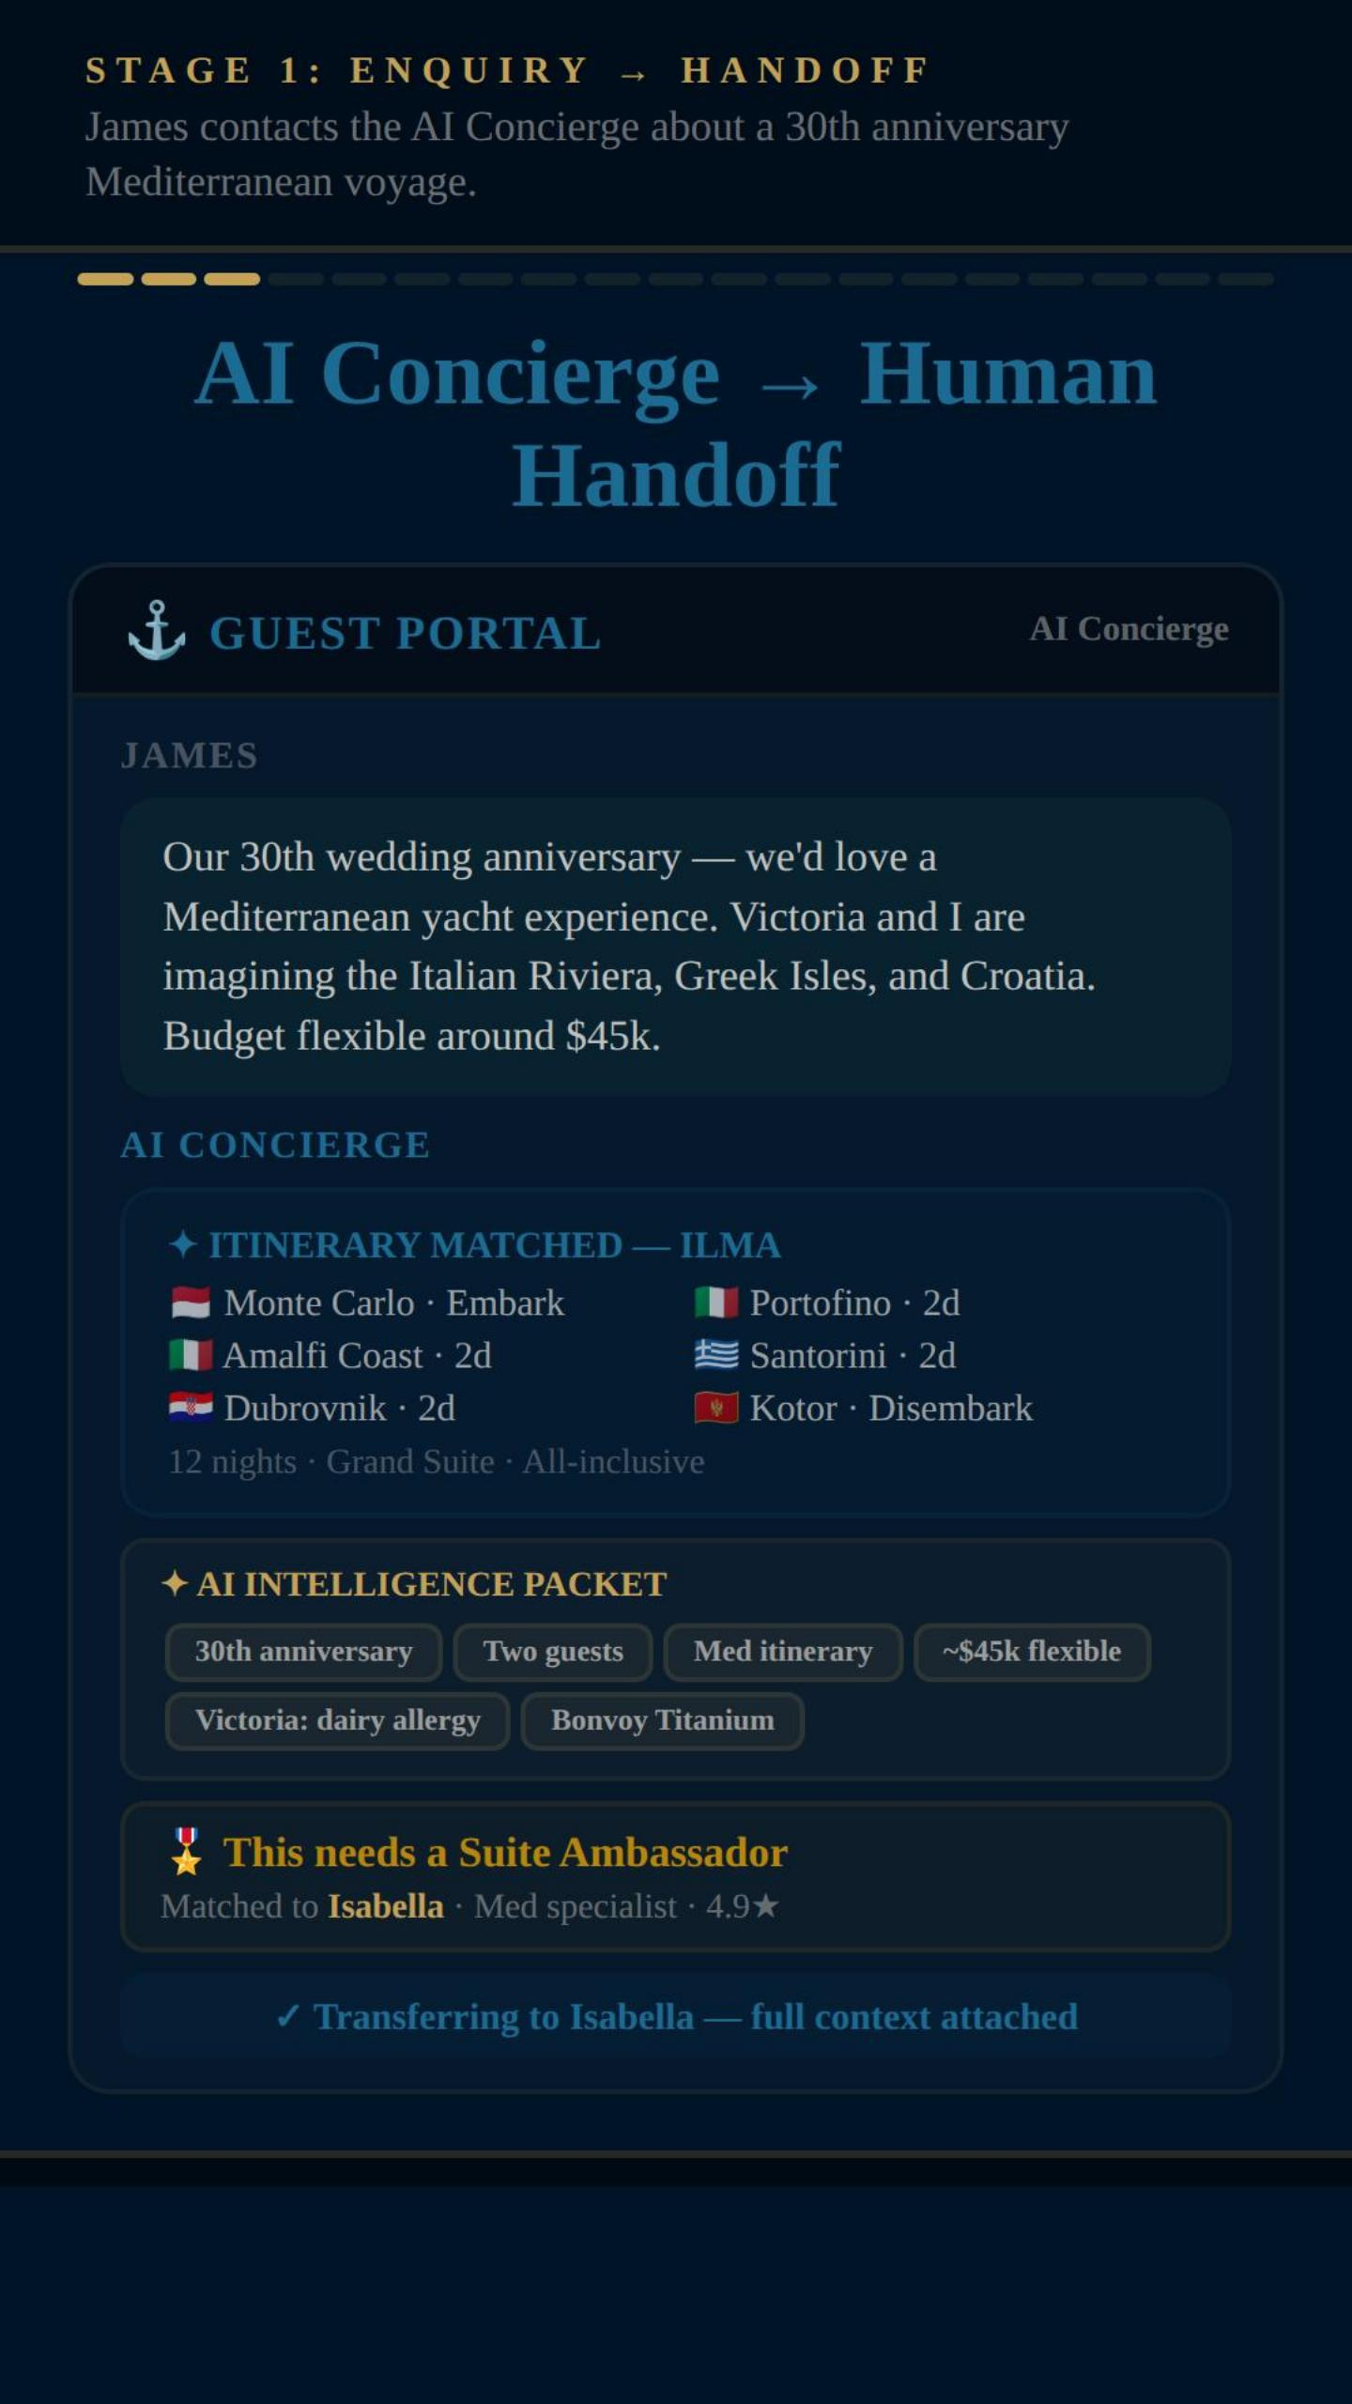

What It Actually Looks Like
EPIC CSX prototype — rebranded for Ritz-Carlton Yacht Collection
AI Concierge → Human Handoff
Customer types a request — AI understands intent, budget, preferences, group size, occasion
AI matches the best itinerary and builds an intelligence packet: anniversary, allergy flags, loyalty status
AI recognises this needs a specialist — matches one by expertise and rating
Full context transferred seamlessly — specialist never asks the customer to repeat
Customer sees the handoff happening — transparent, not a black hole
The customer says it once. AI builds the brief. The specialist arrives prepared. That's the difference between being processed and being known.
Notes:
Screenshot: AI Concierge → Human Handoff. Walk through each bullet point. Hit the insight at the bottom.

Slide 13
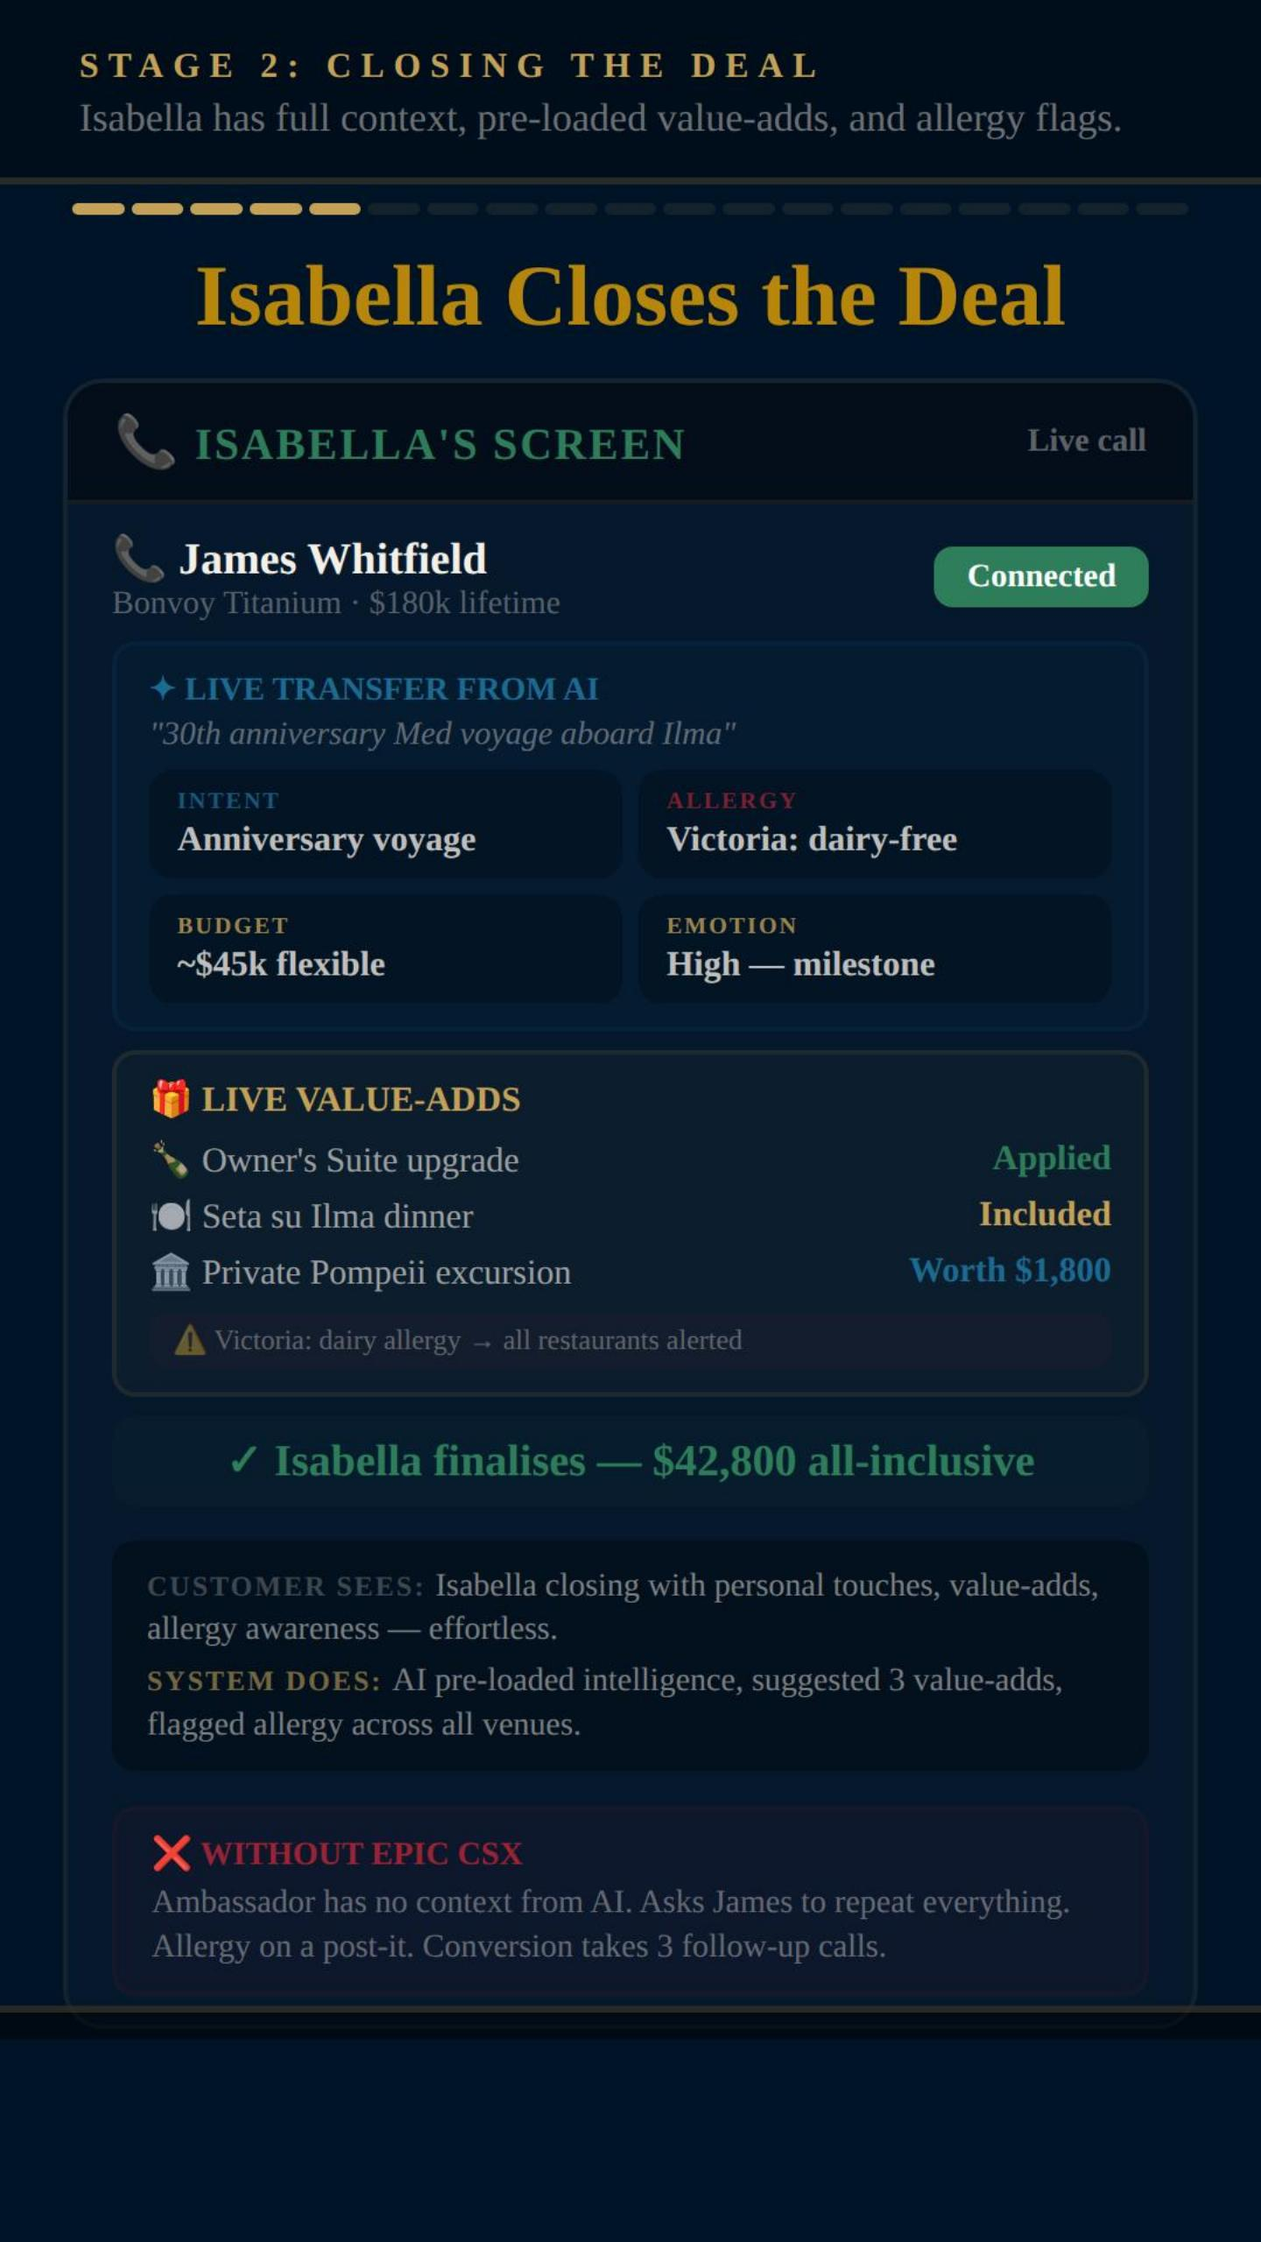
What It Actually Looks Like
The specialist's screen the moment a call transfers from AI
Agent Console — Supercharged
Agent sees intent, budget, emotion level, and allergy flags before saying hello
AI suggests value-adds: suite upgrade, private excursion, personalised dining
Allergy alert auto-pushed to every restaurant and venue on the itinerary
Booking probability, loyalty tier, and group dynamics visible in one view
One call, full context, premium close — no follow-ups, no callbacks needed
This is what AI + Human harmony looks like in practice. AI does the heavy lifting. The specialist delivers the relationship.
Notes:
Screenshot: Agent Console — Supercharged. Walk through each bullet point. Hit the insight at the bottom.

Slide 14
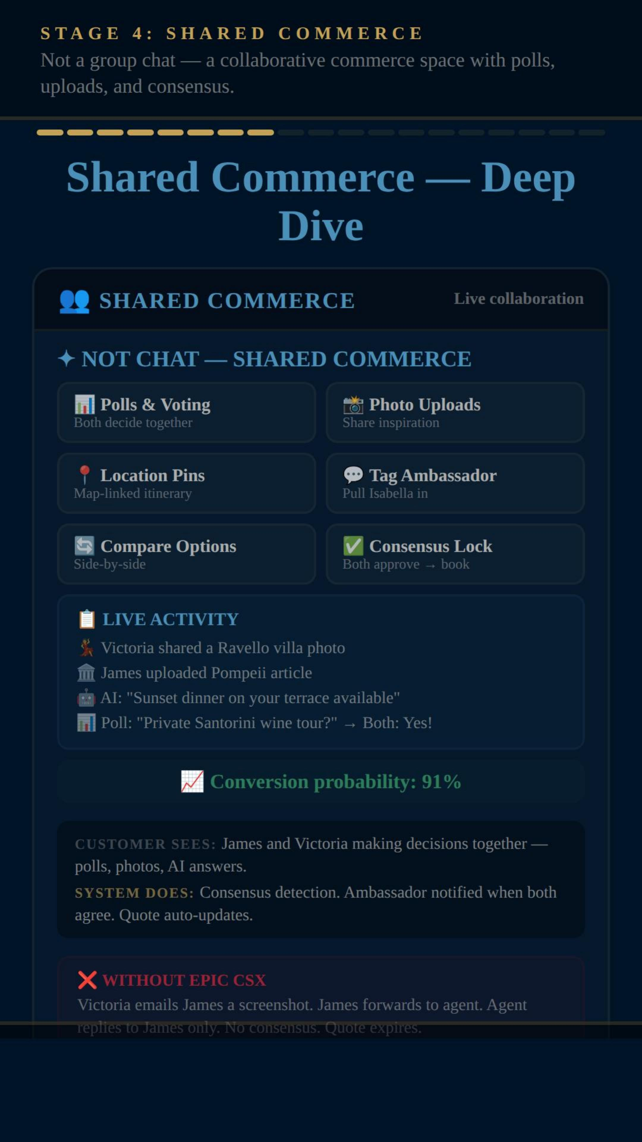
What It Actually Looks Like
Not a group chat — a collaborative commerce space with polls, votes, consensus
Shared Commerce — Polls, Photos, Decisions
Polls & Voting let couples or groups decide together — not via forwarded email PDFs
Photo uploads, location pins, and side-by-side comparisons build shared excitement
AI participates — suggesting options, answering questions, tracking agreement
Live activity: Victoria shared a photo, James uploaded an article, both voted Yes on wine tour
Conversion probability visible — consensus detected, ambassador auto-notified to close
Group decisions are one of the biggest unsolved problems in travel and luxury commerce. This prototype solves it.
Notes:
Screenshot: Shared Commerce — Polls, Photos, Decisions. Walk through each bullet point. Hit the insight at the bottom.

Slide 15
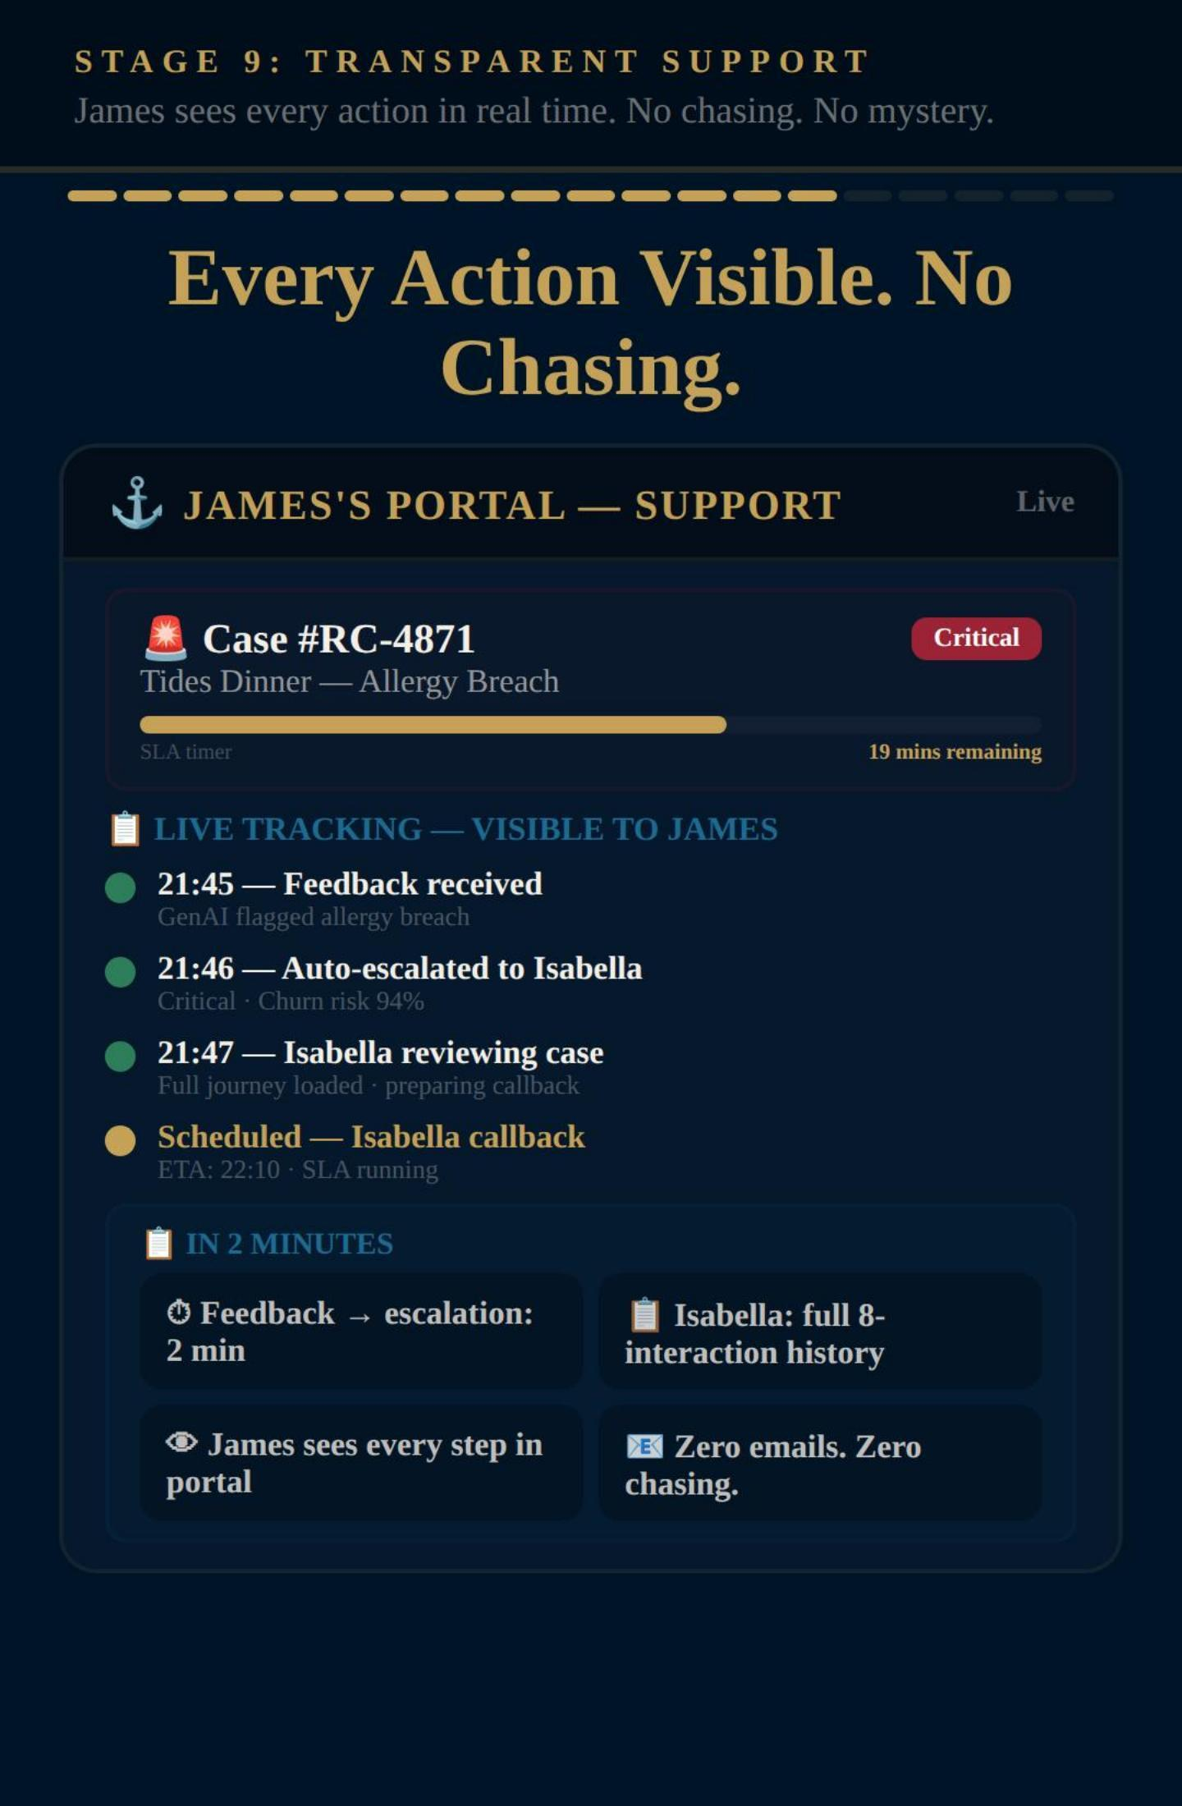
What It Actually Looks Like
Customer portal when something goes wrong — live tracking, named owner, SLA timer
Every Action Visible. No Chasing.
Every action visible in customer portal — live, not via email updates days later
Named owner assigned within 60 seconds, SLA timer visible to the customer
Full timeline: feedback received, auto-escalated, specialist reviewing, callback scheduled
Zero chasing. Zero mystery. Customer knows what's happening and when
Visible progress stops repeat calls — people stop chasing when they can see action
Transparency isn't a nice-to-have. It's the single fastest way to rebuild trust after something goes wrong.
Notes:
Screenshot: Every Action Visible. No Chasing.. Walk through each bullet point. Hit the insight at the bottom.

Slide 16

What the Prototype Proves
Three trust breakthroughs — all working in a live, interactive demo
01
AI + Human Harmony
AI builds the brief from one conversation • Named specialist arrives prepared • Live coaching and sentiment on screen • Customer says it once — nobody asks again • Phone stays central — AI supercharges it
Notes:
Click 1 — AI + Human Harmony: phone stays central, AI supercharges every call. Customer says it once.

Slide 17

What the Prototype Proves
Three trust breakthroughs — all working in a live, interactive demo
01
AI + Human Harmony
AI builds the brief from one conversation • Named specialist arrives prepared • Live coaching and sentiment on screen • Customer says it once — nobody asks again • Phone stays central — AI supercharges it
02
Radical Transparency
Customer sees every action being taken — live • Named owner in 60 seconds — visible • SLA timers the customer can see • No chasing, no wondering, no black holes • Visible progress stops repeat calls
Notes:
Click 2 — Radical Transparency: customer sees everything. Named owner. SLA timers. No black holes.

Slide 18

What the Prototype Proves
Three trust breakthroughs — all working in a live, interactive demo
01
AI + Human Harmony
AI builds the brief from one conversation • Named specialist arrives prepared • Live coaching and sentiment on screen • Customer says it once — nobody asks again • Phone stays central — AI supercharges it
02
Radical Transparency
Customer sees every action being taken — live • Named owner in 60 seconds — visible • SLA timers the customer can see • No chasing, no wondering, no black holes • Visible progress stops repeat calls
03
Recovery Beats Perfection
AI detects problems in real time — not surveys • Auto-escalation within 60 seconds • Specialist calls with full context and real empathy • Customer sees every recovery action in their app • Sentiment: 8.2 → 1.8 → 9.2 — recovery exceeds the original
Notes:
Click 3 — Recovery Beats Perfection: 8.2 → 1.8 → 9.2. Recovery exceeds the original. Service recovery paradox.

Slide 19
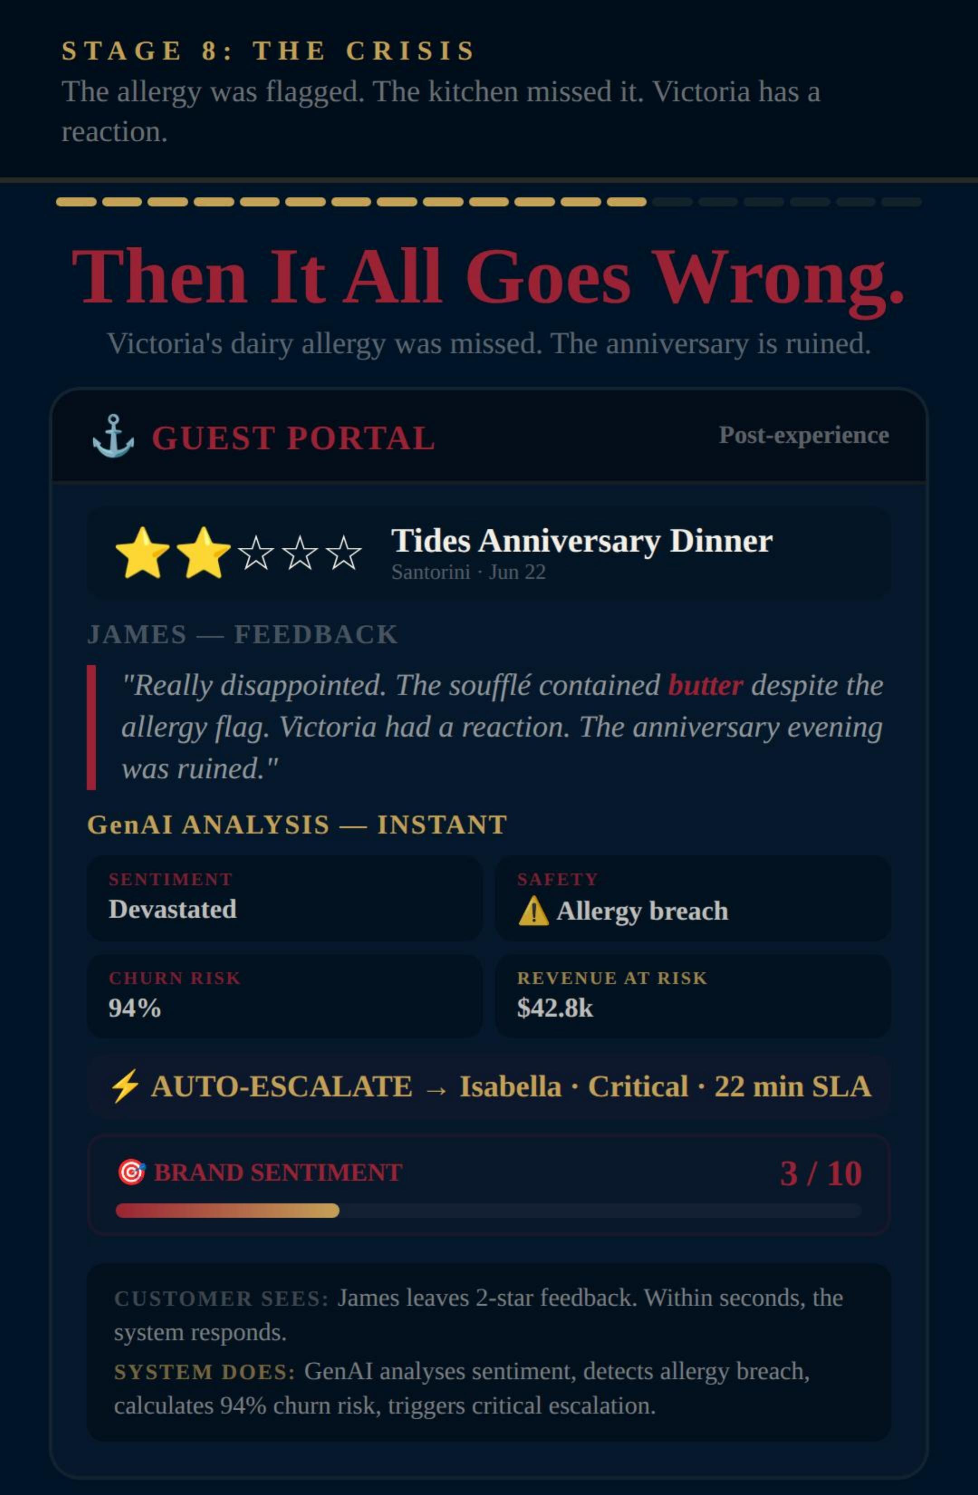
When Things Go Wrong
Victoria was offered a soufflé with butter — despite her dairy allergy being flagged at booking
WHAT HAPPENS NEXT
00:00
Dairy allergy flagged at booking — offered soufflé with butter
00:02
Victoria rates anniversary dinner 2/5 in the app
00:04
AI detects the drop, auto-escalates
00:05
Named specialist assigned — visible
00:25
Specialist calls. Full context. Real empathy.
00:26
Compensation + credit appear in the app
Later
Brand sentiment: 3 → 9. Rebooks next year.
A well-handled recovery creates deeper loyalty than no failure at all. That's proven — and this prototype demonstrates exactly how.
Notes:
The emotional centrepiece. Walk through the dairy allergy story. Allergy flagged at booking, chef briefed, every team assured it was handled — and yet the anniversary soufflé contained butter. Victoria had a reaction. 2/5 in real time — not a survey 28 days later. AI escalates. Specialist calls at 22 minutes with full context. Sentiment: 8 to 3 to 9. The service recovery paradox.

Slide 20
The Full Picture
36 capabilities across 10 areas — not a feature list, a complete customer service operating model
A
Front Door
AI Chat · Intent Detection · Smart Routing · Emotional Recognition
F
Booking
Complete Package · Flights · Hotels · Transfers · Ancillary
B
AI to Human
Sentiment Briefing · Live Coaching · Whispered Guidance · Context Transfer
G
Omnichannel
Channel Continuity · WhatsApp · Zero Re-explaining · Full History
C
Agent
Pre-call Intel · Booking Probability · Conversation History · Recovery Playbooks
H
Transparency
Guest Sentiment Bar · Sub-scores · Journey Timeline · Full Visibility
D
Commerce
Live Quotes · Dual Options · Expiry Urgency · One-click Booking
I
Recovery
Auto-detection · 60s Response · Director Escalation · Resolution Tracking
E
Group
Multi-member Setup · Role-based Privacy · Group Chat · Decision Polls
J
Architecture
Single Data Model · Real-time Sync · Compliance · Privacy Controls
Every capability is demonstrated in a working prototype. This isn't theory — it's a blueprint you can build from.
Notes:
Quick walk through. 10 lifecycle groups, A through J. Don't explain all 36 — point to structure. Highlight Group, Recovery, Transparency. Every one demonstrated in a working prototype. Platform agnostic. Any CRM. Any CCaaS.

Slide 21


The Challenge.
If your customers can't trust you to give them a genuinely great experience — from the first message to the recovery call — they'll find a brand that does.
Not in five years. Now.
Alex Mead
Global CX Director
EPIC CSX
36 capabilities. One vision.
Platform agnostic.
Any CRM. Any CCaaS.
Any brand. Any sector.
linkedin.com/in/alexmead
Have you actually mapped every moment where trust is won or lost?
Does your AI make customers feel helped — or deflected?
Can your customer see what's happening to their issue right now?
Are you redesigning experiences — or just decorating the old ones?
Brands that stop patching and start reimagining will define the next decade of CX.
Notes:
Close with energy. Read the main statement. Four questions — pause on each. Finish with the gold bar. The brands that stop patching and start reimagining will win. I've built the blueprint. It works across any brand, any sector. If this resonates, let's talk.

