Slide 1
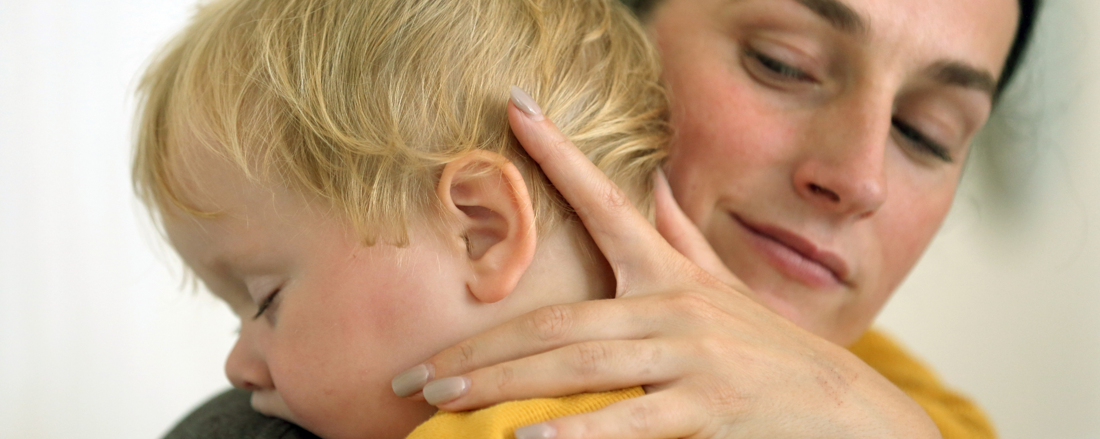

Managing Children’s
Behaviour
iStep Learning LTD
Office Suite 6.05, 80 Coleman Street, London, EC2R 5BJ

Slide 2
Welcome
We're here to explore how to support children positively through their behaviour.
This session is warm, practical, and interactive.
💬
Activity: What do you find most rewarding about your work? Share with a partner.
iStep Learning LTD
Office Suite 6.05, 80 Coleman Street, London, EC2R 5BJ

Slide 3
What We’ll Learn
Understand how children's development affects behaviour.
See behaviour as a way children communicate.
Learn positive, practical strategies.
Reflect on the adult role in creating safe environments.
💬
Discussion: What do you hope to get from today’s session?
iStep Learning LTD
Office Suite 6.05, 80 Coleman Street, London, EC2R 5BJ

Slide 4
Why Children Behave the Way They Do
Behaviour is developmentally driven.
Big emotions are normal. Young brains are still developing.
Children often can't express feelings with words.
💬
Activity: Write down 3 behaviours that challenge you. What might they be communicating?
iStep Learning LTD
Office Suite 6.05, 80 Coleman Street, London, EC2R 5BJ

Slide 5
Key Ideas to Remember
All behaviour is communication.
Children aren’t “naughty” — they’re learning.
We are their co-regulators.
Connection helps calm, not correction alone.
💬
Discussion: Have you ever changed your approach and seen a positive result?
iStep Learning LTD
Office Suite 6.05, 80 Coleman Street, London, EC2R 5BJ

Slide 6
What to Say Instead
Instead of: “Stop it!” Try:
“You’re upset. I’m here.”
“It’s OK to be angry. Let’s find a safe way to show it.”
“I won’t let you hit. Let’s try something else.”
💬
Activity: In pairs, reframe common phrases into calming language.
iStep Learning LTD
Office Suite 6.05, 80 Coleman Street, London, EC2R 5BJ

Slide 7
Helpful Adult Strategies
Stay calm and model regulation.
Get on their level and narrate the feeling.
Offer simple choices.
Focus on what to do, not what not to do.
💬
Role-play: One of you is the child refusing to come inside. How would you respond?
iStep Learning LTD
Office Suite 6.05, 80 Coleman Street, London, EC2R 5BJ

Slide 8
Tools That Help
Calm corners
Visual routines
Emotion charts
Breathing games
Puppets or story-based strategies
💬
Station Activity: Match tools to the behaviours they might support.
iStep Learning LTD
Office Suite 6.05, 80 Coleman Street, London, EC2R 5BJ

Slide 9
You Make the Difference
You are: a co-regulator, safe base, guide, and model.
💬
What’s one strength you bring to your role?
Write it on a post-it for our strengths wall
iStep Learning LTD
Office Suite 6.05, 80 Coleman Street, London, EC2R 5BJ

Slide 10
Reflection
What stood out most today?
One small change to try this week?
Who can support you?
💬
Partner Task: Share your takeaway and create a mini-action plan.
iStep Learning LTD
Office Suite 6.05, 80 Coleman Street, London, EC2R 5BJ

Slide 11
Thank You!
You’re making a difference. Keep learning and growing.
💬
Exit Slip: Write one thing you’ll put into practice this week.
iStep Learning LTD
Office Suite 6.05, 80 Coleman Street, London, EC2R 5BJ

