Slide 1
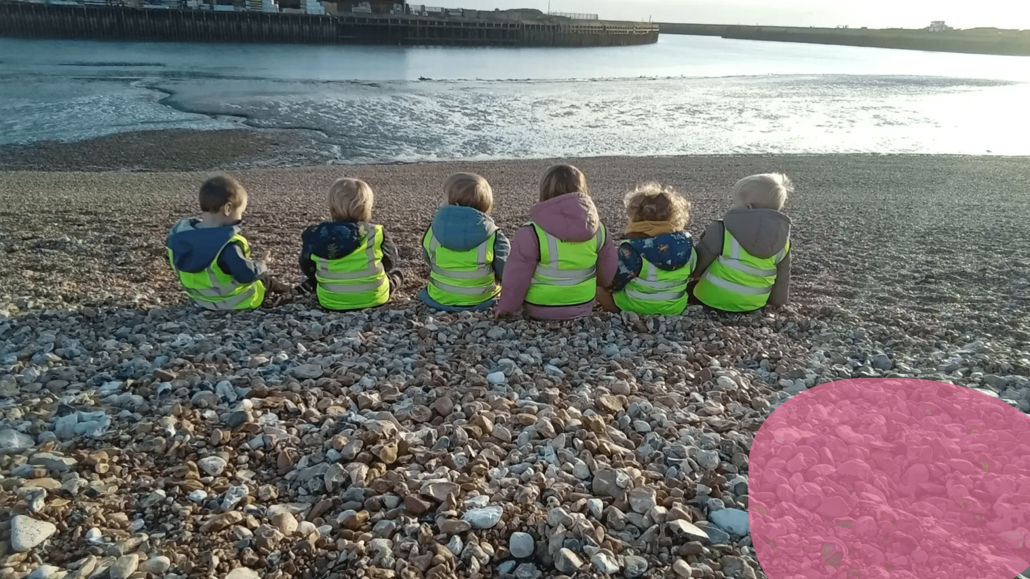

Beach School Curriculum
Early Years Foundation Stage
Aligned with the EYFS Statutory Framework & Beach School Principles
Nurturing Children · Inspiring Learning · Growing Together

Slide 2


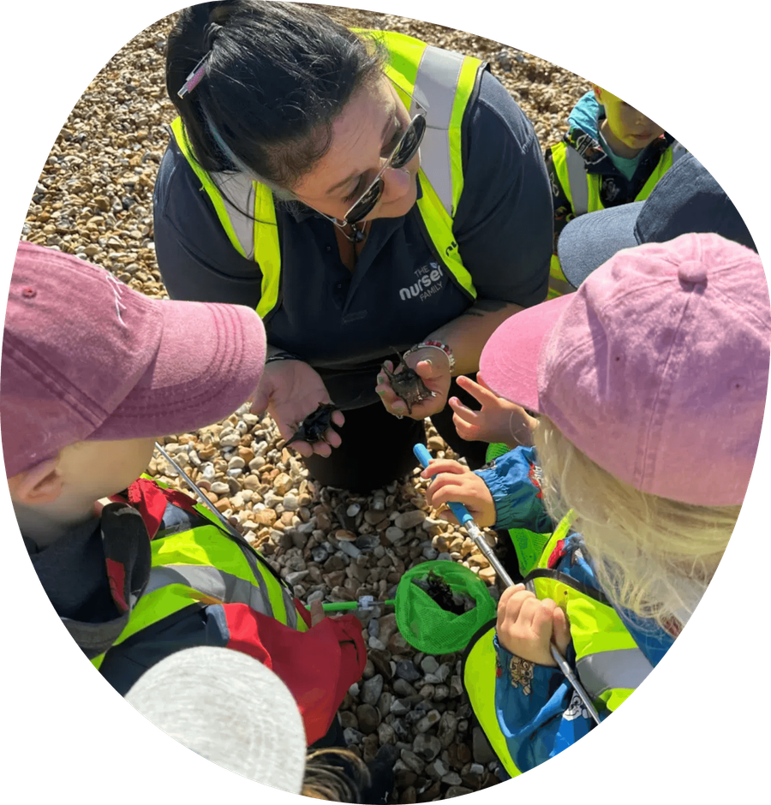

The beach is one of the most powerful classrooms available to young children
Regular, child-centred coastal learning — not a one-off trip
Rooted in Forest School principles, adapted for the coast
Sand, rock pools, driftwood, shells and coastal wildlife invite investigation
Fully integrated into our early years curriculum across all EYFS areas
"Beach School is a well-rounded, flexible, child-focused approach adopted from the Forest School model." — Teach Early Years

Slide 3

Six principles define high-quality Beach School provision at every iSTEP Learning setting
01
02
03
Long-Term Process
Coastal Environment
Supported Risk-Taking
Sustained sessions build deep relationships with the coastal environment and enable children to observe tidal and seasonal change.
The shore — sand, water, rock pools, dunes, wildlife — is central to every learning experience.
Managed risks build resilience, problem-solving, and physical confidence in a safely managed environment.
04
05
06
Holistic Development
Qualified Practitioners
Learner-Centred
Physical, cognitive, social, emotional, and creative development all promoted through the coastal environment.
All sessions led by a minimum Level 3 qualified Beach/Forest School Leader with robust safeguarding in place.
Sessions are responsive to interests; Plan-Do-Review and Sustained Shared Thinking underpin practice.

Slide 4

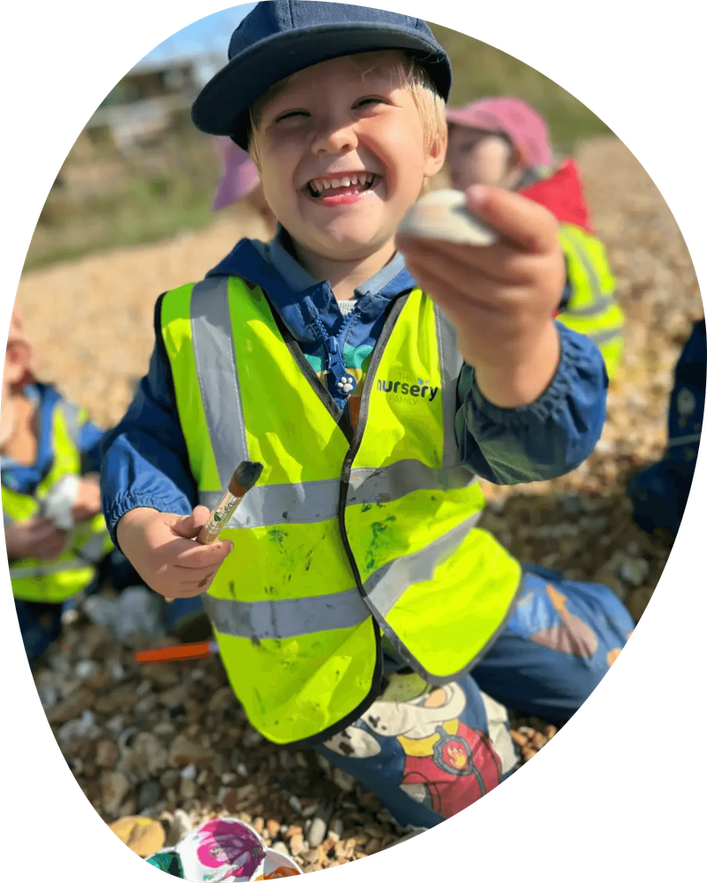
Outdoor coastal learning delivers measurable benefits for children's development and wellbeing
Children who access regular outdoor learning show improved physical health, mental wellbeing, and academic engagement.
The beach simultaneously stimulates all seven areas of EYFS learning — no other environment offers this breadth.
The NHS recommends at least 3 hours of physical activity daily for under-5s — Beach School delivers this naturally.
Regular outdoor play reduces anxiety and builds emotional resilience in young children.
Beach School's sensory richness is particularly beneficial for children with SEND, offering access to learning that indoor settings cannot replicate.
Exposure to natural environments in early childhood is linked to stronger environmental awareness and pro-social behaviours in later life.

Slide 5

Every Beach School session supports all seven areas of EYFS learning simultaneously
EYFS Area
Beach School in Action
Example Activity
PSED
Building confidence, resilience, turn-taking, empathy
Group rock pool exploration; collaborative sandcastle building
Communication & Language
Expanding vocabulary through sensory description and storytelling
Sensory circles; guided conversation prompts
Physical Development
Gross and fine motor skills on uneven terrain
Digging, climbing, balancing on rocks, carrying buckets
Literacy
Mark-making, letter formation, narrative play
Writing names in sand; making words with pebbles
Mathematics
Counting, sorting, measuring, pattern-making
Sorting shells by size/colour; measuring tide marks
Understanding the World
Tidal science, habitats, weather, seasonal change
Rock pool surveys; habitat mapping
Expressive Arts & Design
Sand sculpture, shell art, coastal percussion, imaginative play
Mandala art; driftwood mobiles

Slide 6


The beach naturally promotes all three Characteristics of Effective Learning
Playing and Exploring
Active Learning
Creating and Thinking Critically
Children investigate the coastal environment freely, finding-out and having a go with natural materials, creatures, and tidal phenomena.
Children persist with self-chosen challenges: building dams, engineering sandcastles, tracking tide marks, exploring rock pool habitats.
Children form hypotheses, test ideas, and reflect on their discoveries with practitioner support using Sustained Shared Thinking.

Slide 7

A rich, varied programme of coastal learning unfolds across all four seasons
AUTUMN
WINTER
SPRING
SUMMER
Observing seasonal change
Dramatic winter seas
New life on the shore
Water play
Driftwood den building
Coastal bird ID
Rock pool habitat surveys
Sand construction
Sorting autumn finds
Warming circles
Seaweed identification
Large-scale beach art
Rock pool surveys
Resilience in challenging weather
Spring beach diaries
Shell threading
Transient art
Mark-making in spring sand
Marine life observation
Winter beach mandalas
Sand writing

Slide 8

Managed risk-taking at the beach builds the confidence and resilience children need to thrive
Risk areas managed:
Tidal water and sea access — strict exclusion zones, 1:4 ratio near water, tidal times checked every session
Slippery rocks — non-slip wellies mandatory, surfaces assessed pre-session
KEY PRINCIPLE
Children are never prevented from taking age-appropriate risks — they are supported to take them safely.
Sun exposure (summer) — sun cream, hats, shade, sessions avoid peak UV 11am–3pm
Cold/wet weather (winter) — waterproofs, warm layers, shortened sessions in extreme cold
Sharp objects — beach sweep by leader before children access the area

Slide 9

Beach School is an inherently inclusive environment that benefits every child
The sensory richness of the coastal landscape and freedom to explore at one's own pace make Beach School particularly beneficial for children with SEND.
Individual risk-benefit assessments are completed for children with additional needs; activities and resources are adapted as required.
The SENCO is consulted in planning provision for children with complex needs to ensure full accessibility.
Observations at Beach School frequently reveal aspects of development — such as physical confidence and creative thinking — that may not be visible in the indoor setting.
The environment naturally supports emotional regulation, sensory processing, communication, and social development in a low-pressure, high-stimulation setting.

Slide 10
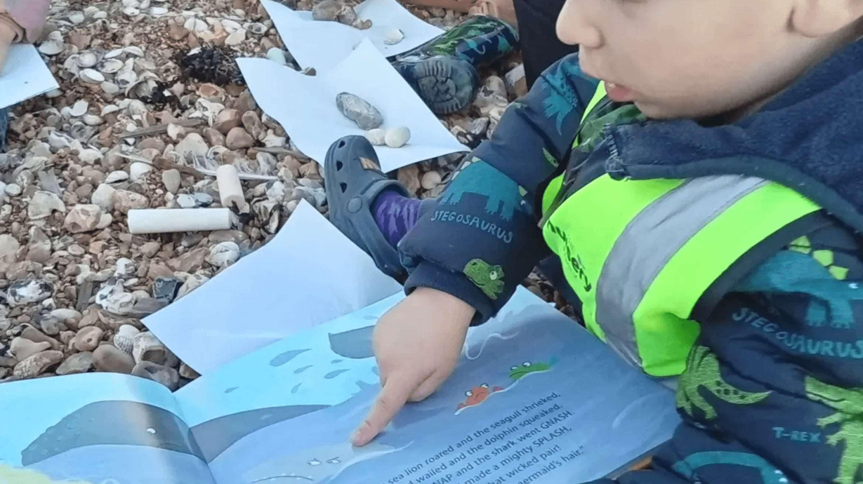
The Beach School practitioner enables, observes, and extends — rather than directs
Create the conditions for free exploration while maintaining robust safety oversight.
Use Sustained Shared Thinking: open questions, speculating alongside children, celebrating the process of discovery.
Document learning through narrative observations, photographs, and children's mark-making — linked to EYFS areas and CoEL.
Observations shared with the key person to inform planning and the child's learning journey.
Reflective practice journals and peer observation across iSTEP Learning settings support continuous CPD.

Slide 11

Parents and carers receive the Beach School curriculum at the start of each term with clear guidance on clothing and equipment.
Regular photo updates, newsletters, and end-of-term celebrations build shared understanding of the value of Beach School.
Strong family partnerships deepen children's connection to coastal learning
Families are invited to contribute observations from beach experiences at home, strengthening the home-setting connection.
Parent engagement in outdoor learning is linked to greater child confidence and sustained curiosity beyond the setting.
iSTEP Learning views families as essential partners in every child's Beach School journey.

Slide 12

Robust qualifications, ratios, and documentation underpin safe, high-quality Beach School provision
Qualifications
Key Documents
All Beach School programmes led by practitioner holding minimum Level 3 in Beach/Forest School Practical Skills and Environmental Management.
Beach School Policy
Supporting practitioners hold current Paediatric First Aid certification and Beach School induction training.
Risk-Benefit Assessments
Tidal & Weather Log
Ratios
Safeguarding Policy
Under 2s: 1:3 | 2–3 years: 1:4 | 3–5 years: 1:6
Near water (all ages): 1:4
Incident Log
Minimum two adults at every session; one must be the qualified leader.
Parent Information Pack

Slide 13

Termly review and reflective practice ensure Beach School provision continually improves
1
2
3
Termly Programme Review
Reflective Practice
Reporting to Senior Leaders
Considers session consistency, EYFS progress, risk assessment robustness, inclusion, and adjustments for the next term.
Beach School Leaders maintain reflective journals; peer observation between leaders across iSTEP Learning settings actively supported.
Written termly summary to Nursery Manager and Operations Director: attendance, learning highlights, incidents, recommendations.
Continuous improvement in Beach School contributes directly to the setting's self-evaluation and Ofsted readiness.

Slide 14

iSTEP Learning
Inspiring Every Child, Every Day
Beach School is not an add-on — it is a core part of how iSTEP Learning delivers outstanding early years education.
Every child deserves the opportunity to learn, grow, and discover in the natural world.
Our Beach School curriculum ensures that every session is purposeful, safe, inclusive, and joyful.
Nurturing Children · Inspiring Learning · Growing Together

