Slide 1


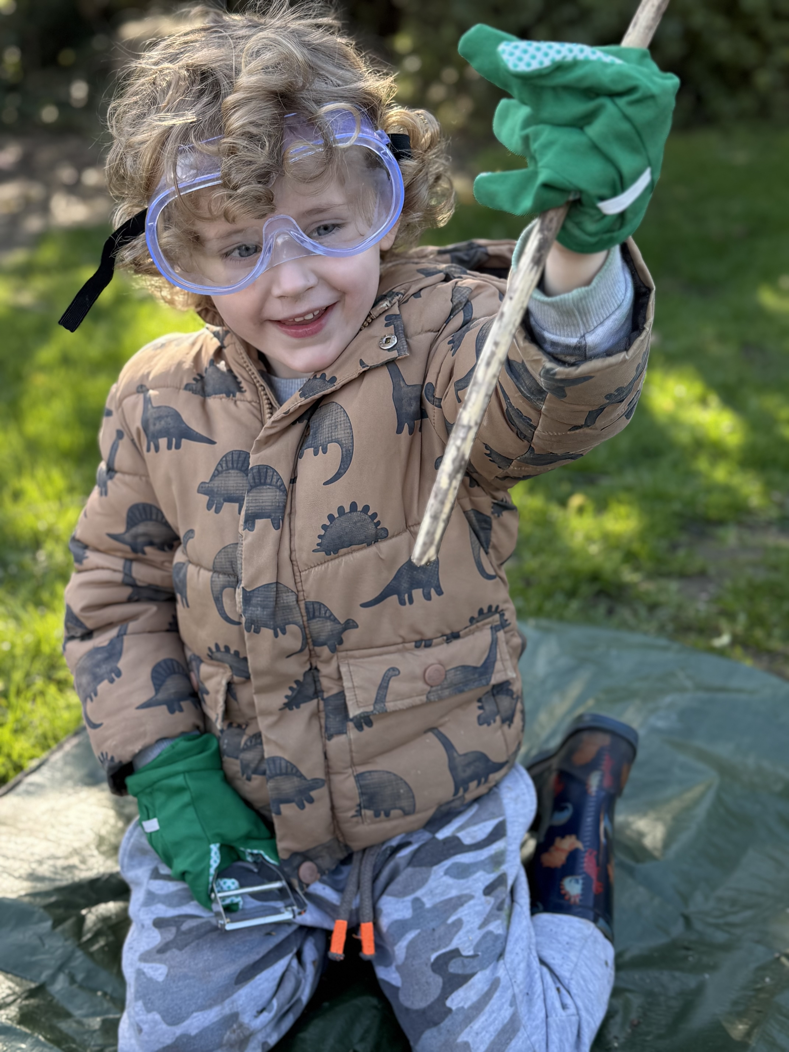

Nurturing Children · Inspiring Learning · Growing Together
Forest School Curriculum
Early Years Foundation Stage
Aligned with the EYFS Statutory Framework & Forest School Association Principles

Slide 2

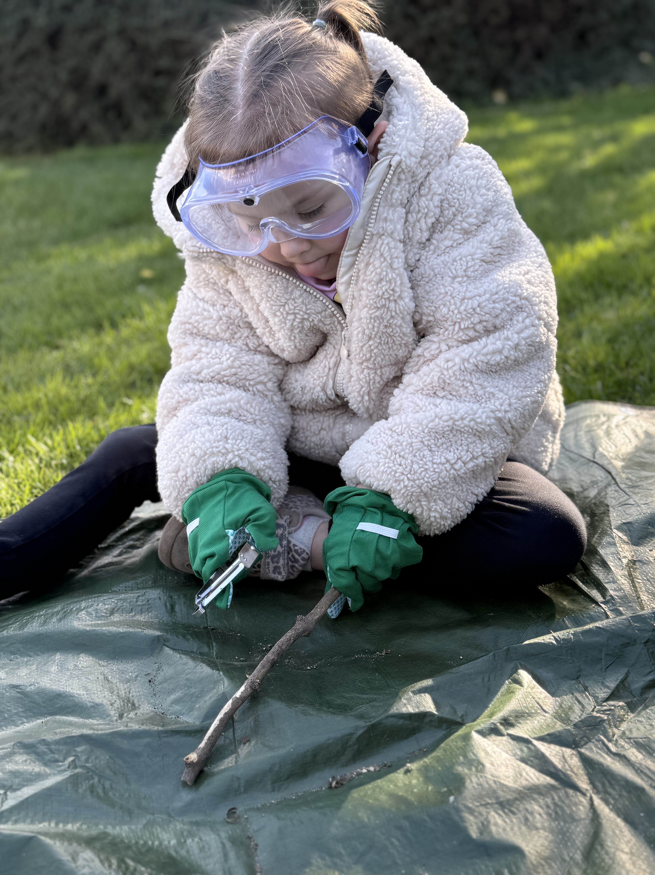

The woodland is one of the richest learning environments available to young children
Forest School is a child-centred, inspirational learning process that offers children regular opportunities for holistic growth through long-term, nature-based sessions.
•
Rooted in Scandinavian outdoor learning traditions, it has been practised in the UK since the 1990s and is now a well-established approach within early years education.
•
Trees, mud, sticks, fire, natural tools, and woodland wildlife provide a dynamic, self-renewing environment that invites curiosity, risk-taking, and deep investigation.
•
At iSTEP Learning, Forest School is fully integrated into our early years curriculum, complementing indoor provision and supporting all seven EYFS areas of learning.
•
"Forest School is a long-term process of regular sessions, rather than a one-off or infrequent visit; the cycle of planning, observation, adaptation and review links each session."
— Forest School Association

Slide 3

Six principles, as defined by the Forest School Association, underpin every iSTEP Learning Forest School programme
01
02
03
Long-Term, Regular Process
Natural Woodland Environment
Supported Risk-Taking
Sustained sessions in the same woodland space build deep familiarity, seasonal awareness, and growing confidence over time.
The woodland — trees, mud, water, fire, wildlife — is central to every learning experience and cannot be replicated indoors.
Managed risks (tool use, fire, climbing, den building) build resilience, problem-solving, and physical confidence.
04
05
06
Holistic Development
Qualified Practitioners
Learner-Centred Community
Physical, cognitive, social, emotional, and creative development are all promoted through the woodland environment.
All sessions led by a minimum Level 3 qualified Forest School Leader with robust safeguarding in place.
Sessions are responsive to children's interests and self-directed play; practitioners observe and extend rather than direct.

Slide 4

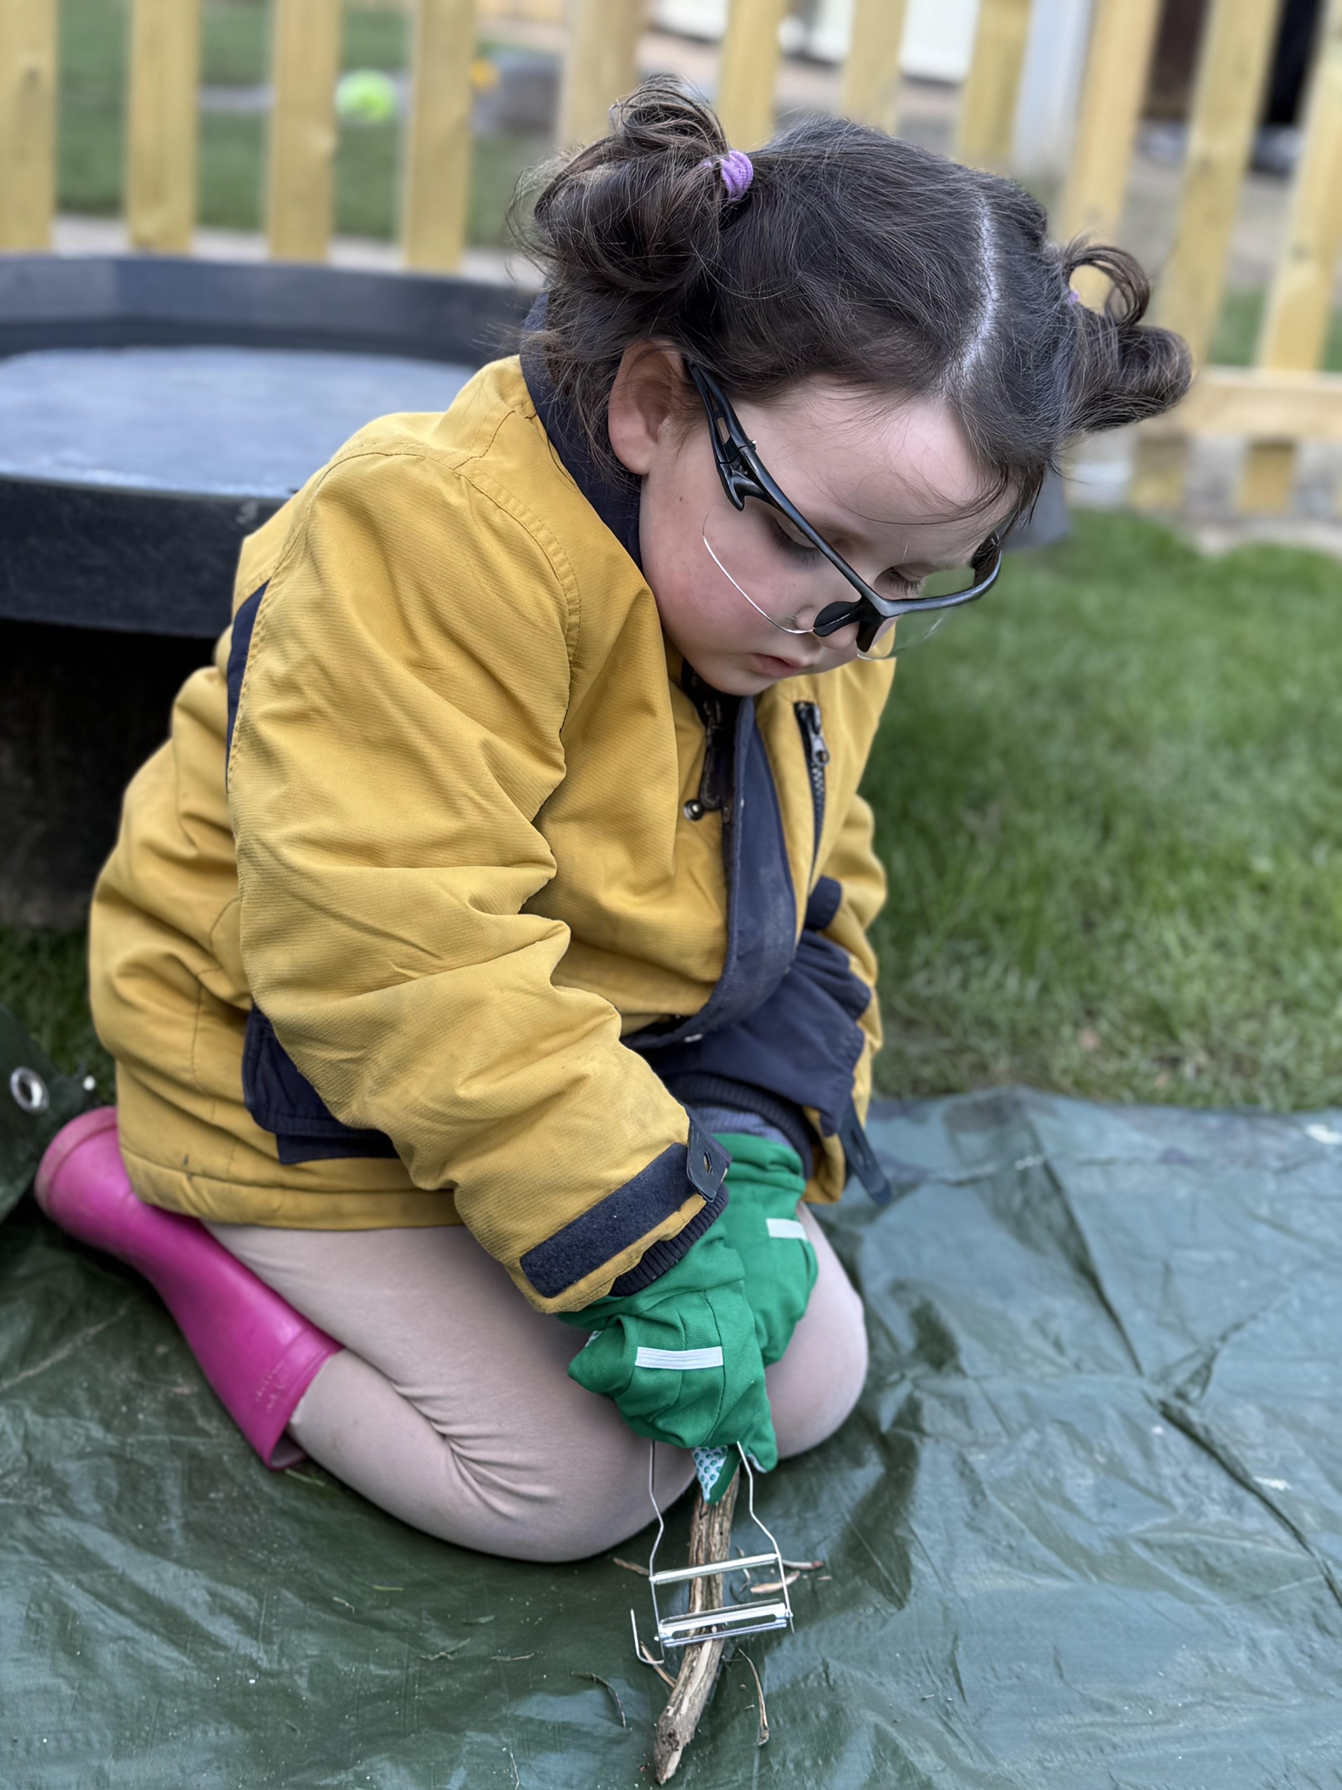

Regular woodland learning delivers measurable, lasting benefits for children's development
■
Children who access regular Forest School sessions show improved self-esteem, confidence, and motivation to learn (O'Brien & Murray, 2007).
■
Tool use, fire, and construction activities develop fine and gross motor skills in ways that indoor environments cannot match.
Forest School supports the development of resilience, independence, and emotional regulation — key protective factors for mental health.
■
Forest School is particularly effective for children with SEND, offering sensory-rich, low-pressure learning that builds confidence and communication.
■
The NHS recommends at least 3 hours of physical activity daily for under-5s — Forest School delivers this through purposeful, joyful outdoor play.
■
Children who experience nature regularly in early childhood are more likely to develop lifelong environmental stewardship.

Slide 5

Every Forest School session supports all seven areas of EYFS learning simultaneously
EYFS Area
Forest School in Action
Example Activity
PSED
Building confidence, resilience, self-regulation, and empathy
Group den building; fire circle; peer collaboration in tool use
Communication & Language
Expanding vocabulary through nature, storytelling, and discussion
Sensory circles; woodland storytelling; guided conversation during foraging
Physical Development
Gross and fine motor skills through climbing, digging, and tool use
Tree climbing; using secateurs; digging; carrying logs
Literacy
Mark-making, storytelling, environmental print
Writing with sticks in mud; story maps; nature journals; woodland poetry
Mathematics
Counting, measuring, sorting, pattern-making
Counting natural objects; measuring sticks; sorting by size/texture
Understanding the World
Seasonal change, habitats, living things, weather
Minibeast hunts; seasonal observation; habitat mapping; fire science
Expressive Arts & Design
Natural art, music, imaginative play, construction
Transient art; mud painting; percussion with sticks; den building

Slide 6
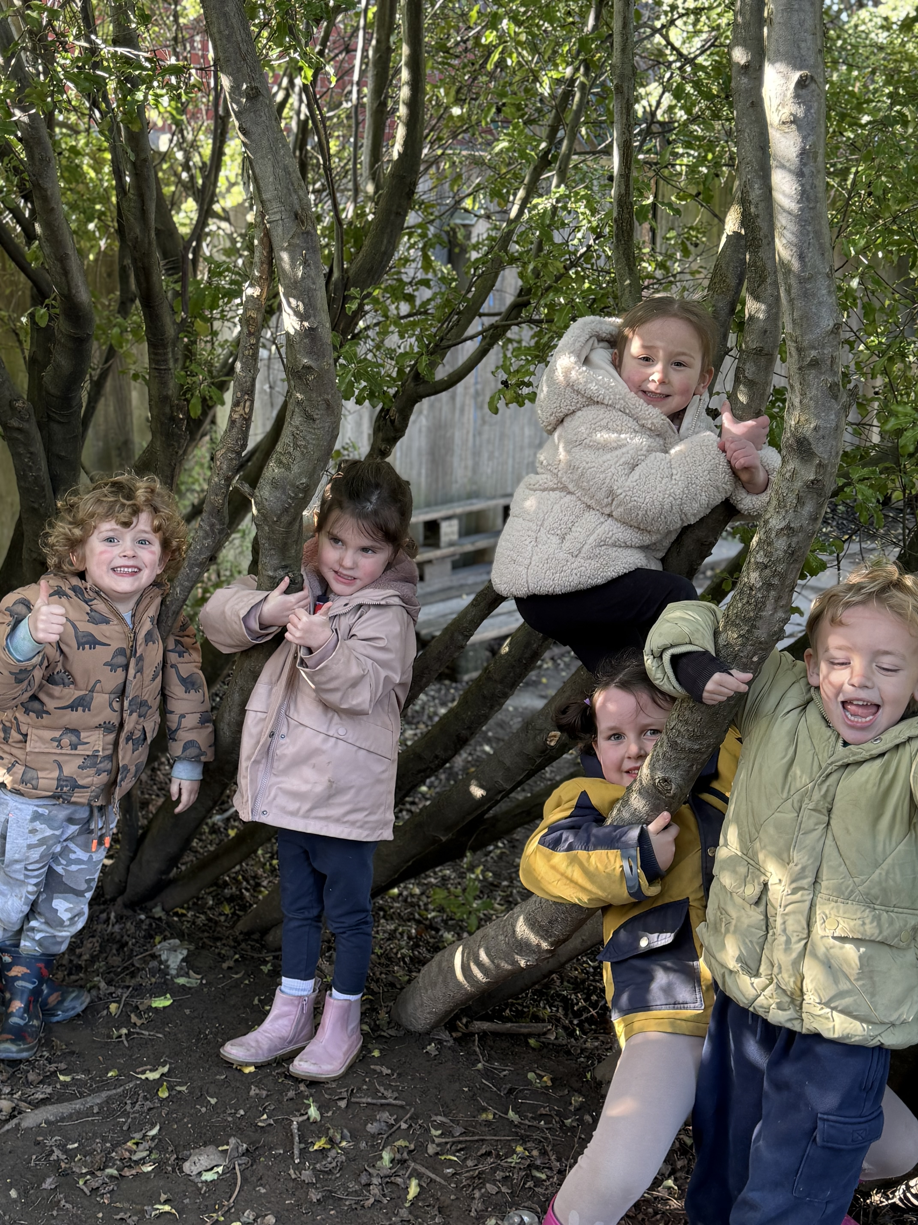
The woodland naturally promotes all three Characteristics of Effective Learning
Playing and Exploring
Active Learning
Creating and Thinking Critically
Children investigate the woodland environment freely, finding-out and having a go with natural materials, tools, fire, and living things.
Children persist with self-chosen challenges: building dens, using tools, making fires, tracking animals, creating woodland art.
Children form hypotheses, test ideas, and reflect on discoveries through Sustained Shared Thinking with practitioners.

Slide 7
A rich, varied programme of woodland learning unfolds across all four seasons
AUTUMN
WINTER
SPRING
SUMMER
Leaf identification & seasonal change observation
•
Tracking animal footprints
•
New growth observation & bird nesting
•
Bug hunting & water play
•
Winter woodland survival skills
•
Large-scale mud art
•
Conker and seed exploration
•
Minibeast hunts & mud kitchen
•
Tool use projects & nature journaling
•
Fire and hot chocolate
•
Den building & transient art
•
Planting seeds
Resilience in challenging weather & bare tree identification
•
•
Woodland games & wild cooking
•
Blossom art & woodland poetry
•
Foraging & fire lighting
•

Slide 8
Supported tool use and managed risk-taking are at the heart of Forest School's developmental impact
Tool Use
Fire
Secateurs, bow saws, and mallets are used with 1:1 supervision. Tool rules are taught at every session, and appropriate PPE (goggles, gloves) is provided.
Fires are lit only by a qualified leader within an established fire circle. Children are briefed on fire rules, and water is adjacent at all times.
Climbing & Physical Challenge
Slips, Trips & Falls
Activities are thoroughly risk-benefit assessed. Children are actively supported and encouraged to self-assess their own risks and capabilities.
The woodland terrain is assessed pre-session. Appropriate footwear is mandatory for all participants, and a comprehensive first aid kit is always on site.
KEY PRINCIPLE
iSTEP Learning adopts the HSE-endorsed risk-benefit approach — the developmental benefits of Forest School activities significantly outweigh the risks when managed by a qualified leader.

Slide 9
Forest School is an inherently inclusive environment that benefits every child
The sensory richness of the woodland, the absence of formal academic demands, and the freedom to explore at one's own pace make Forest School particularly beneficial for children with SEND.
★
Individual risk-benefit assessments are completed for children with additional needs; activities and resources are adapted as required.
★
The SENCO is consulted in the planning of provision for children with complex needs to ensure full participation.
★
Observations at Forest School frequently reveal aspects of development — physical confidence, creative thinking, social skills — not visible in the indoor setting.
★
Forest School supports emotional regulation, sensory processing, communication, and social development in a low-pressure, high-stimulation environment.
★

Slide 10
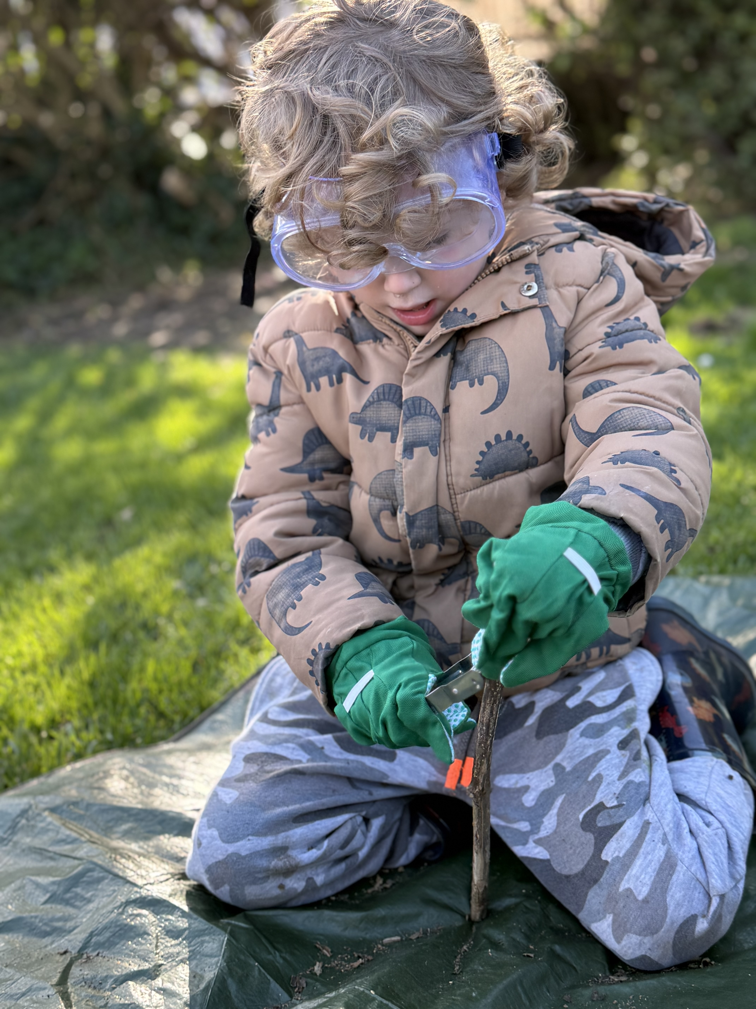
The Forest School practitioner enables, observes, and extends — rather than directs
Create the conditions for free exploration while maintaining robust safety oversight — the practitioner is a facilitator, not a director.
Document learning through narrative observations, photographs, and children's own mark-making — linked to EYFS areas and CoEL.
■
■
Use Sustained Shared Thinking: open questions, speculating alongside children, celebrating the process of discovery.
Observations shared with the key person to inform planning and the child's learning journey.
■
■
Reflective practice journals and peer observation across iSTEP Learning settings support continuous CPD.
■

Slide 11
Strong family partnerships deepen children's connection to woodland learning
■
Parents and carers receive the Forest School curriculum at the start of each term with clear guidance on clothing and equipment.
■
Parent engagement in outdoor learning is linked to greater child confidence and sustained curiosity beyond the setting.
■
Regular photo updates, newsletters, and end-of-term celebrations build shared understanding of the value of Forest School learning.
■
Families are invited to contribute observations from nature experiences at home, strengthening the home-setting connection.
iSTEP Learning views families as essential partners in every child's Forest School journey.

Slide 12
Robust qualifications, ratios, and documentation underpin safe, high-quality Forest School provision
Qualifications
KEY DOCUMENTS
All Forest School programmes led by practitioner holding minimum Level 3 Forest School Leader qualification from an FSA-recognised provider.
■
Forest School Policy
Site Risk-Benefit Assessment
Supporting practitioners hold current Paediatric First Aid certification and Forest School induction training.
Dynamic Risk Assessment
■
Tool and Fire Safety Protocols
Ratios
Safeguarding Policy
Under 2s: 1:3 | 2–3 years: 1:4 | 3–5 years: 1:6
Incident Log
■
During tool use/fire: 1:1
■
Parent Information Pack
Minimum two adults at every session; one must be the qualified Forest School Leader.
■

Slide 13
Termly review and reflective practice ensure Forest School provision continually improves
01
02
03
Termly Programme Review
Reflective Practice
Reporting to Senior Leaders
Considers session consistency, EYFS progress, risk assessment robustness, inclusion, and adjustments for the next term.
Forest School Leaders maintain reflective journals; peer observation between leaders across iSTEP Learning settings actively supported by the Operations Director.
Written termly summary to Nursery Manager and Operations Director: attendance, learning highlights, incidents, recommendations.
Link to quality: Continuous improvement in Forest School provision contributes directly to the setting's self-evaluation and Ofsted readiness.

Slide 14

ISTEP LEARNING
INSPIRING EVERY CHILD, EVERY DAY
Forest School is not an add-on — it is a core part of how iSTEP Learning delivers outstanding early years education.
Every child deserves the opportunity to learn, grow, and discover in the natural world.
Our Forest School curriculum ensures that every session is purposeful, safe, inclusive, and joyful.
NURTURING CHILDREN · INSPIRING LEARNING · GROWING TOGETHER

