Slide 1
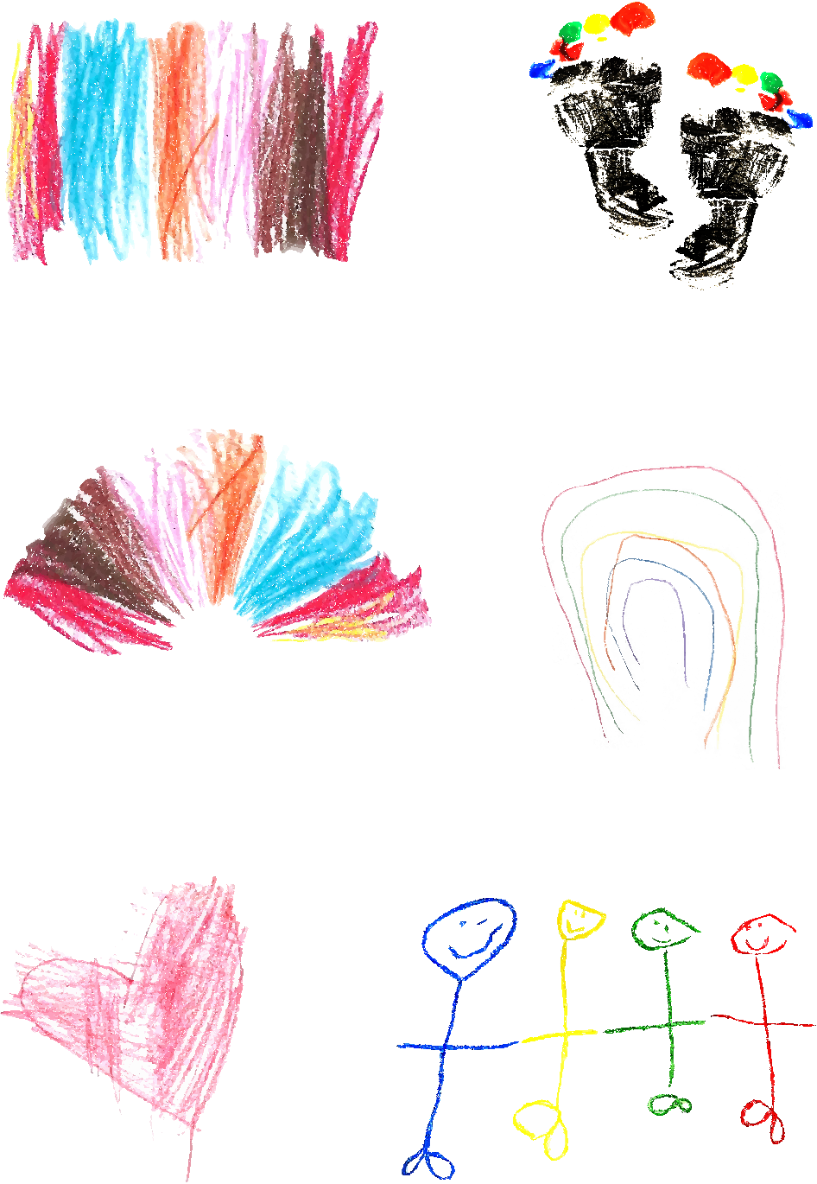


Step
learning
stepping forward together, because we care
Managing childrens behaviour and respectful handling training
For early years practitioners

Slide 2
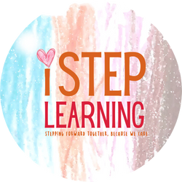
aim and objectives
aim:
To provide early years practitioners with the skills, strategies, and confidence needed to manage children's behaviour in a positive and respectful manner, ensuring a safe, nurturing, and inclusive learning environment.
objectives:
•Understand the developmental stages of children's behaviour and common challenges in early years.
•Learn practical approaches to promote positive behaviour, prevent challenging behaviours, and address issues effectively.
•Develop and teach emotional regulation strategies to children.
•Implement consistent and supportive behaviour management practices collaboratively as a team.
•Involve families in creating cohesive behaviour management plans and share consistent strategies across settings.
•Adapt approaches to reflect the diverse cultural backgrounds and individual needs of all children, including those with SEND.
•Respond to conflicts and crises with appropriate resolution and intervention techniques.
•Evaluate and refine behaviour management strategies through regular observation, reflection, and feedback.

Slide 3
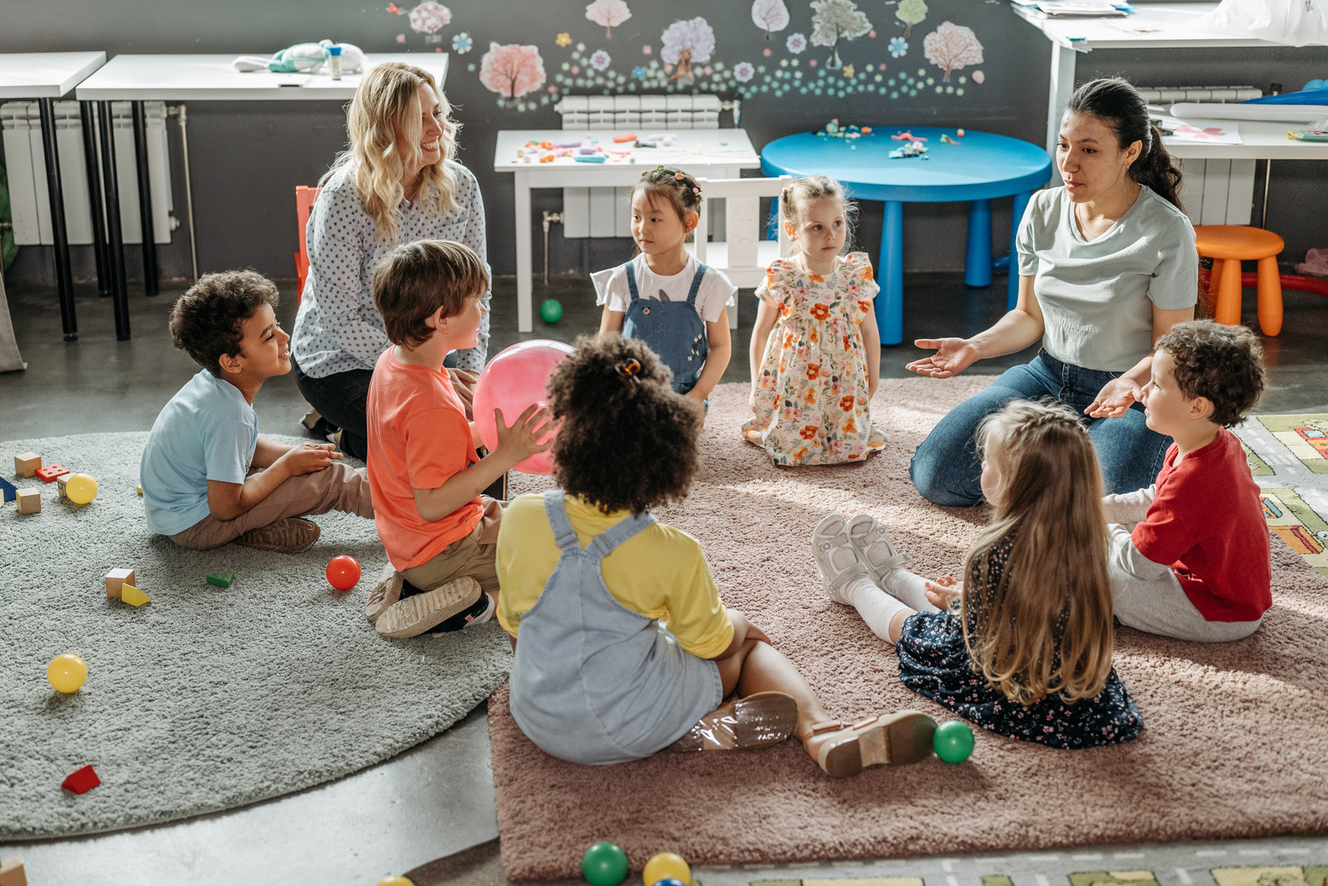
what is managing children’s behaviour and respectful handling?
managing childrens behaviour:
• Helping children learn how to behave in a positive and safe way.
• Supporting children to follow simple rules and routines.
• Using clear and consistent responses to guide behaviour.
respectful handling:
• Communicating with children kindly and at their level.
• Acknowledging and validating their emotions.
• Using physical intervention only when absolutely necessary, and always in a safe and appropriate way.

Slide 4
developmental stages and behaviour
Understanding how developmental stages influence behaviour:
• Infants: Crying as communication, attachment needs.
• Toddlers: Tantrums due to limited emotional regulation.
• Preschoolers: Developing social skills, testing boundaries.
• Strategies: Tailor responses to developmental needs.

Slide 5

getting started
group discussion
What behaviours are hardest to manage in your group?
activity
Work with a partner to list three ways you have handled behaviours positively.
share
Each pair shares one example with everyone.

Slide 6
Understanding Behaviour - Group Work
scenario
A child keeps throwing toys during free play.
activity
Work as a group to find reasons why this might happen and think of solutions.
rflection
How can we set up the room to stop this happening?
share
Groups explain their ideas to everyone.

Slide 7
Handling Behaviour Positively
activity
In pairs, act out these situations:
•Calming down two children fighting over a toy.
•Helping a child to stop playing and come to lunch
reflection
What worked well?
What didn’t?
group feedback
Share your tips with the group.

Slide 8

Practical Tools for Behaviour Management
Tools to support behaviour management
•Behaviour charts and reward systems.
•Emotion cards to help children express feelings.
•Calming corner designs with sensory tools.
•Visual schedules for routine consistency.

Slide 9
Respectful Handling Quiz
When is it ok to step in physically?
A. When the child is in immediate danger
B. When the child is upset but not harming others.
C. Whenever the child doesn’t listen.
answer
A. When the child is in immediate danger.
How can you use kind words to help children calm down?
A. Ignore their feelings and give instructions.
B. Speak softly and acknowledge their feelings.
C. Raise your voice to show authority.
Answer
B. Speak softly and acknowledge their feelings.

Slide 10
inclusion - case study
case study
A new child with special needs struggles to join group play.
activity
- Find reasons why the child might find this hard.
- Think of ways to help them feel included.
share
Groups explain their ideas to everyone.

Slide 11
Working Together as a Team
Questions to Discuss:
• How can we all follow the same rules for managing behaviour?
• How can we help each other with hard situations?
activity
•Make a simple plan for everyone to follow when managing behaviour.
share
Teams share their plans.

Slide 12
Emotional Regulation Strategies
• Teach children simple breathing techniques (e.g., deep breaths).
• Create a calming area with sensory tools for self-regulation.
• Use visual aids (e.g., emotion charts) to help children identify and express feelings.
• Model emotional regulation by demonstrating calm responses during conflicts.
• Encourage mindfulness activities such as guided imagery or yoga.

Slide 13
Engaging Parents in Behaviour Management
• Share consistent strategies between home and the setting.
• Provide regular feedback and updates on children’s progress.
• Offer workshops or resources for parents to reinforce positive behaviour at home.
• Involve parents in setting behaviour goals for their children.
• Build strong communication channels to address concerns collaboratively.

Slide 14
Preventative Measures
• Design the environment to minimise triggers (e.g., clear pathways, quiet zones).
• Establish clear routines and transitions to reduce uncertainty.
• Use positive reinforcement to encourage desired behaviours.
• Anticipate and address potential triggers proactively (e.g., hunger, fatigue).
• Ensure sufficient engaging activities to keep children occupied and motivated.

Slide 15
Cultural Competency in Behaviour Management
• Understand and respect cultural differences in parenting and behaviour norms.
• Adapt strategies to align with children’s cultural backgrounds.
• Communicate with families to learn about their values and expectations.
• Use diverse materials and examples to reflect children’s cultural identities.
• Provide staff training on cultural sensitivity and awareness.

Slide 16
Safe Physical Intervention
• Understand thresholds: Use physical intervention only as a last resort.
• Train staff on safe techniques that minimise risk to children and adults.
• Focus on de-escalation strategies to avoid the need for physical intervention.
• Keep records of any incidents and reflect on ways to prevent recurrence.
• Ensure interventions are consistent with the setting’s policies and guidelines.

Slide 17
safe Physical Intervention
Physical intervention refers to the use of reasonable force by practitioners to prevent children from injuring themselves, others, or damaging property.Physical intervention may also involve environmental constraints put in place to ensure children’s safety. This includes situations where staff use intentional physical force to restrict a child’s movement against their will.
Restrictive physical intervention can be justified when:
  A child is injuring themselves or others.
  A child is damaging property.
  There is an immediate risk of injury or damage, even if it has not yet occurred.

Slide 18
safe Physical Intervention
Guidelines for physical intervention:
  Aim for side-by-side contact to minimise the risk of impact and ensure there is no direct contact between the adult’s and child’s bodies.
  Keep the adult’s back as straight as possible.
  Avoid grasping joints, as this increases the likelihood of pain or damage.
  Ensure the child’s ability to breathe is not restricted.
  Avoid lifting mobile children where possible.
Physical contact should always:
  Be in response to the child’s needs at the time.
  Be of limited duration.
  Be appropriate to the child’s age, developmental stage, gender, ethnicity, and background.

Slide 19
Safe Physical Intervention
Staff should use their professional judgement at all times. Children with special educational needs or disabilities may require additional physical contact to support their learning. These arrangements should:
  Be agreed upon by all involved.
  Be justified based on the child’s needs.
  Be applied consistently and remain open to scrutiny.
The individual behaviour plan should include:
  The risks posed by the child’s behaviour.
  Potential targets of these risks.
  Preventative and responsive strategies to manage risks.
  Plans to support the child’s development.

Slide 20
Safe Physical Intervention
Recording and reporting
  Document who was involved, the reason for using physical intervention, how the child was held, and the date and time of the incident.
  Provide a copy of the record to the parent/carer and inform the setting manager.
Reviewing and monitoring
  Review the individual behaviour plan to reduce the likelihood of future restrictive physical interventions.
  Monitor the use of restrictive physical interventions to identify trends and improve practices.
additional considerations
  Understand what the child may be trying to achieve or communicate through their behaviour.
  Adapt the environment to better meet the child’s needs.
  Encourage the child to adopt new, more appropriate behaviours.
  Ensure staff respond effectively and appropriately to challenging behaviours.

Slide 21
Conflict Resolution Strategies
Steps for resolving peer to peer conflicts
•Listen to each child’s perspective without judgment.
•Encourage children to express their feelings respectfully.
•Facilitate problem-solving to find mutually agreeable solutions.
•Teach restorative practices to repair relationships.

Slide 22
Managing Digital and Screen-time Behaviour
Guidelines for digital behaviour
•Set clear limits on screen-time.
•Use educational content and monitor online activities.
•Encourage active play and creative activities as alternatives.
•Model appropriate screen-time behaviour.

Slide 23
Crisis Management in Behaviour
Steps for handling critical incidents
•De-escalation: Speak calmly, create space, and remove triggers.
•Ensure safety for all children and adults.
•Follow the setting's emergency response protocols.
•Document incidents and reflect on preventative measures.

Slide 24
Monitoring and Evaluating Behaviour Strategies
How to assess and refine behaviour management
•Regularly observe and record children’s behaviours.
•Collect feedback from team members and parents.
•Adjust strategies based on observations and outcomes.
•Use assessment tools to track progress and identify needs.

Slide 25
Conclusion
Managing children's behaviour requires understanding, patience, and teamwork. Respectful handling builds trust and helps children feel valued. By working together, we can create a safe and positive space for all children.
How to assess and refine behaviour management
1. Put your learning into practice in your daily work.
2. Reflect on what works well and what can be improved.
3. Keep supporting each other and share your experiences.
4. Continue learning through feedback and additional training.

