Slide 1
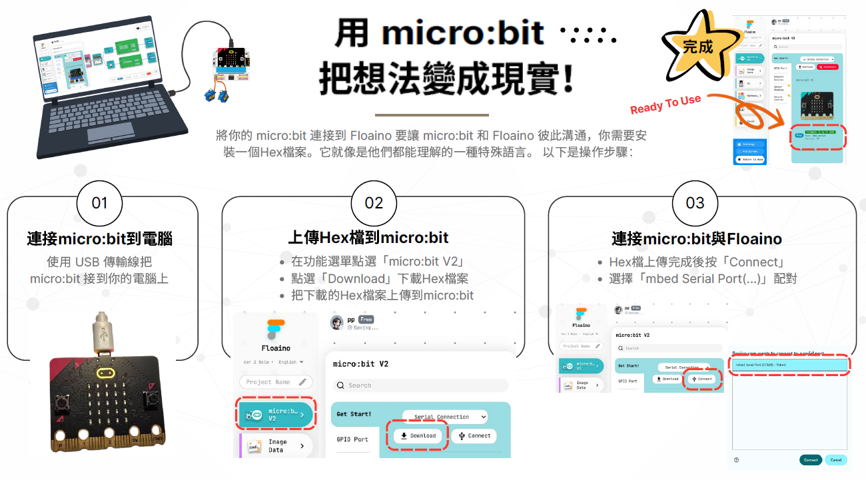
連接到實體micro:bit

Slide 2
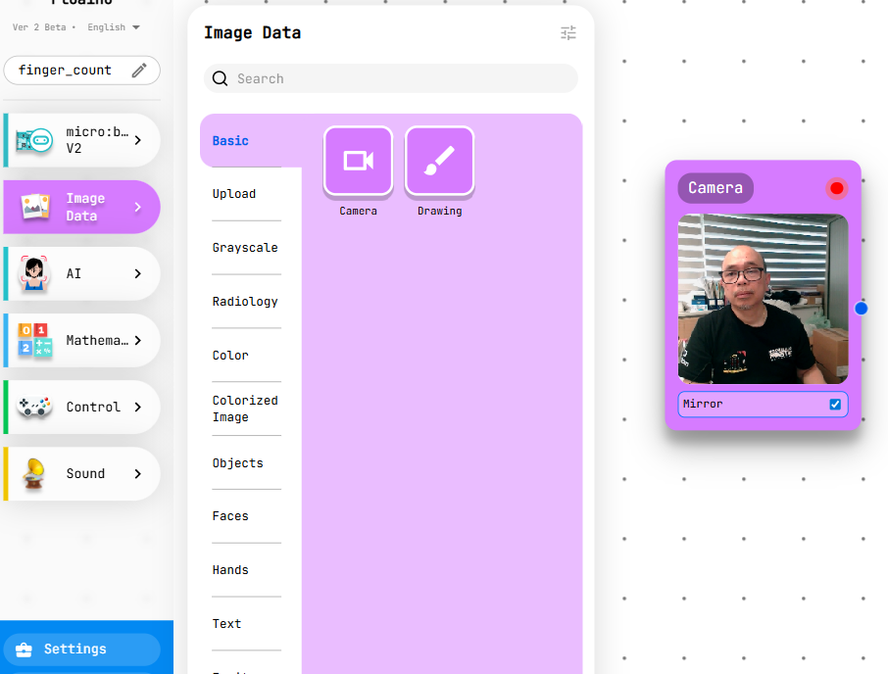
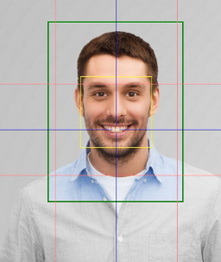
從攝影機捕捉影像
Select Image Data
Select Camera
Drag it into coding area

Slide 3
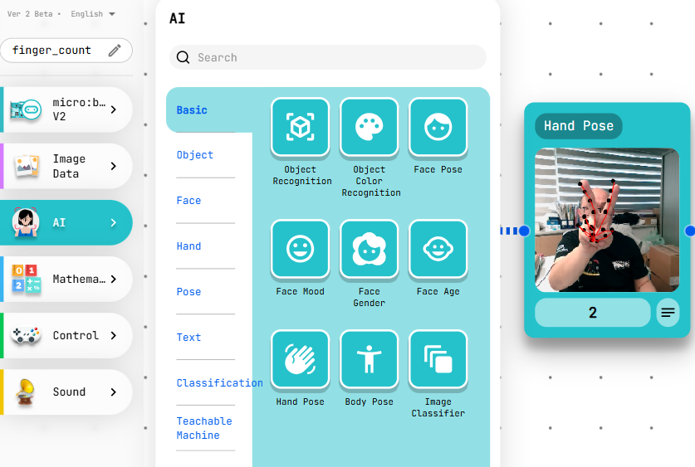
分析手指數量
Select AI
Select Hand Pose
Drag it into coding area

Slide 4
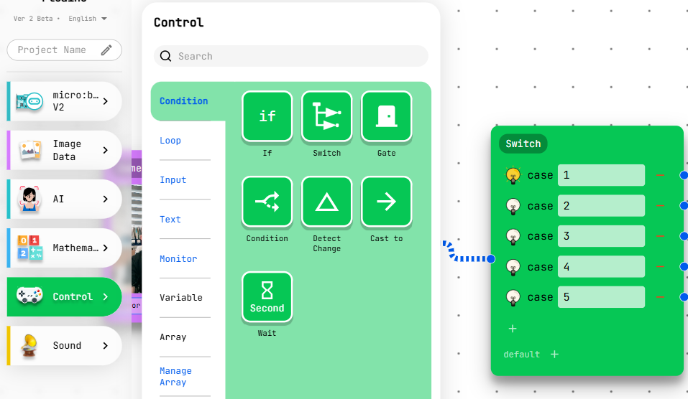
設定case 為1-5
From Control, select Condition and Switch
If finger count = 1, set case 1
If finger count = 2, set case 2
If finger count = 3, set case 3
If finger count = 4, set case 4
If finger count = 2, set case 5

Slide 5
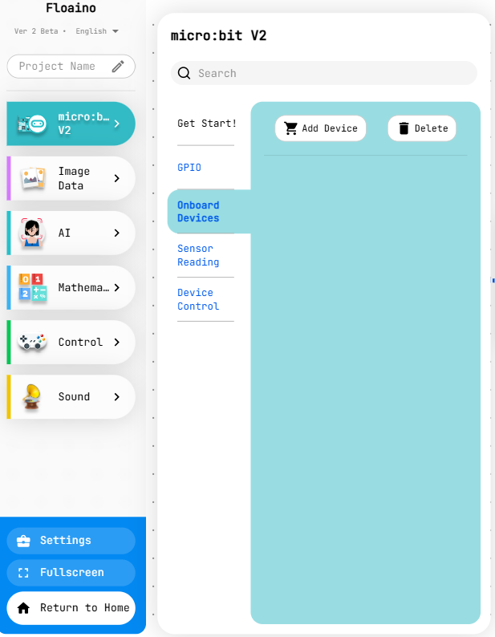
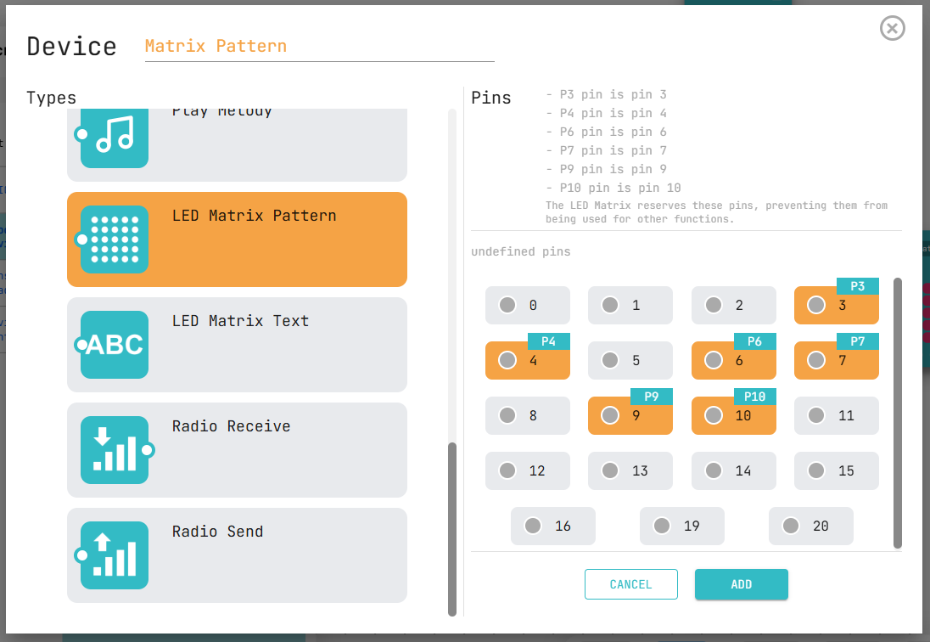
新增 micro:bit 板載設備
Select micro:bit V2 -> Onboard device -> Add device
Scroll down and select LED Matrix Pattern, then ADD

Slide 6
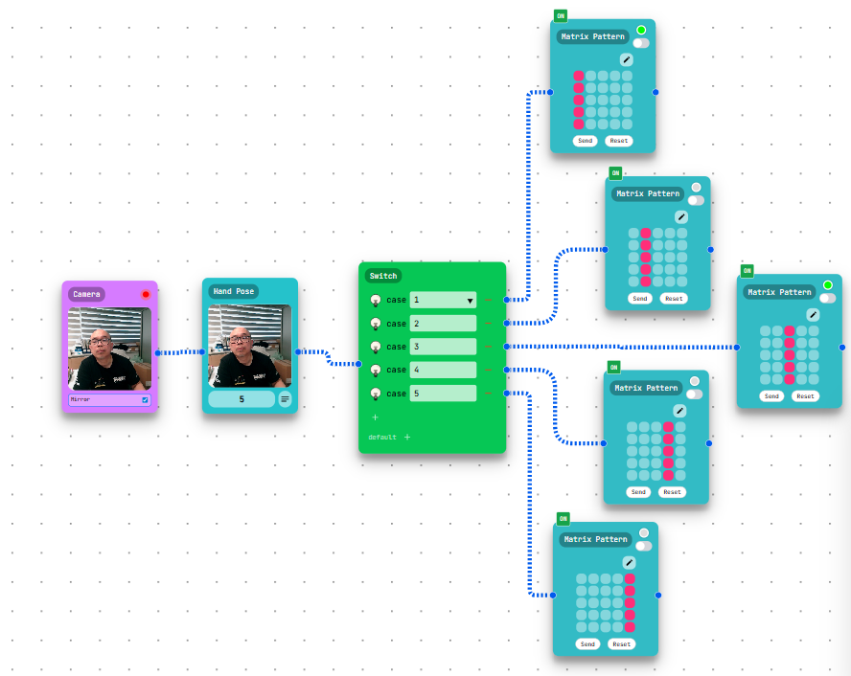
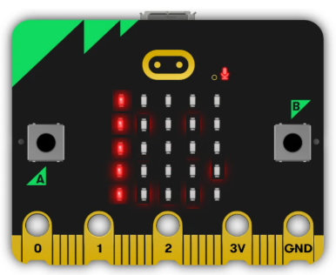

連接指令積木
按圖示連接各積木
根據情況繪製 LED 點陣圖
例如：如果Case = 1，則繪製第一行

