Slide 1

A MOVEMENT IS TAKING PLACE
BUILDING A HOUSE
FOR THE KINGDOM
J
Judah Church Orlando invites you to partner in acquiring a transformational new facility — a campus built to serve thousands, educate leaders, and impact Central Florida for generations.
Bishop Clint S. Brown
Pastor Kendal Brown
SENIOR PASTOR & FOUNDER
CO-PASTOR & MINISTRY LEADER
JUDAH CHURCH · ORLANDO, FLORIDA
New Facility Campaign · 2025–2027
ALL-IN GOAL: $5M–$6M

Slide 2

THE OPPORTUNITY
WHY JUDAH.
WHY NOW.
02
CURRENT SITUATION
THE VISION
~10K sq ft
25–35K sq ft
LEASED RETAIL SPACE · WESTLAND TERRACE STRIP CENTER
OWNED CAMPUS · CENTRAL FLORIDA
No owned property — monthly lease payments with no equity
—
Full ownership — building equity, not paying rent
—
Limited sanctuary capacity constrains growth
—
Main sanctuary seating 1,200+ with world-class AV
—
No dedicated children's wing, youth center, or preschool
—
Dedicated children's ministry & Little Lions Preschool
—
No broadcast studio or production facility
—
MEBCI Institute — ministry & business education
—
No space for MEBCI Institute or community programs
—
Broadcast studio, conference rooms & executive offices
—
Community outreach center serving West Orlando
—
ALL-IN CAMPAIGN GOAL
WHY NOW
$5M – $6M
Orlando's West Side is growing rapidly. Property values are rising. Interest rates are stabilizing. The congregation is ready. The moment is now.
ACQUISITION · BUILDOUT · LAUNCH

Slide 3
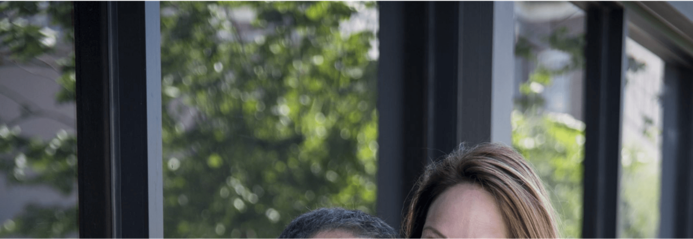

THE LEADERS
PROVEN VISION.
PROVEN RESULTS.
03
Bishop Clint S. Brown
Pastor Kendal Brown
SENIOR PASTOR · JUDAH CHURCH ORLANDO
CO-PASTOR · MINISTRY LEADER · ENTREPRENEUR
A Grammy-nominated worship leader, recording artist, and visionary pastor with over 30 years of ministry experience. Bishop Brown has led congregations of thousands and is one of the most respected voices in contemporary Christian worship.
A dynamic minister, speaker, and businesswoman who brings passion, creativity, and organizational excellence to Judah Church. Pastor Kendal is a powerful voice for women in ministry and a champion for community transformation.
Grammy-nominated artist · 20+ studio albums recorded
University of Alabama graduate — Social Work & Human Services
▸
▸
Former Senior Pastor, Faith World Center / World Outreach Center — 6,000+ members at peak
Founder, Covered Girl Women's Conference — annual women's leadership event
▸
▸
Founded Judah Church Orlando — growing congregation representing multiple nations
Founder, The Kendal Kollection — faith-inspired fashion brand
▸
▸
International conference speaker & worship leader
25+ years of ministry alongside Bishop Brown
▸
▸
PROVEN: LED 6,000+ MEMBER CONGREGATION
HEART FOR WOMEN, FAMILY & COMMUNITY

Slide 4
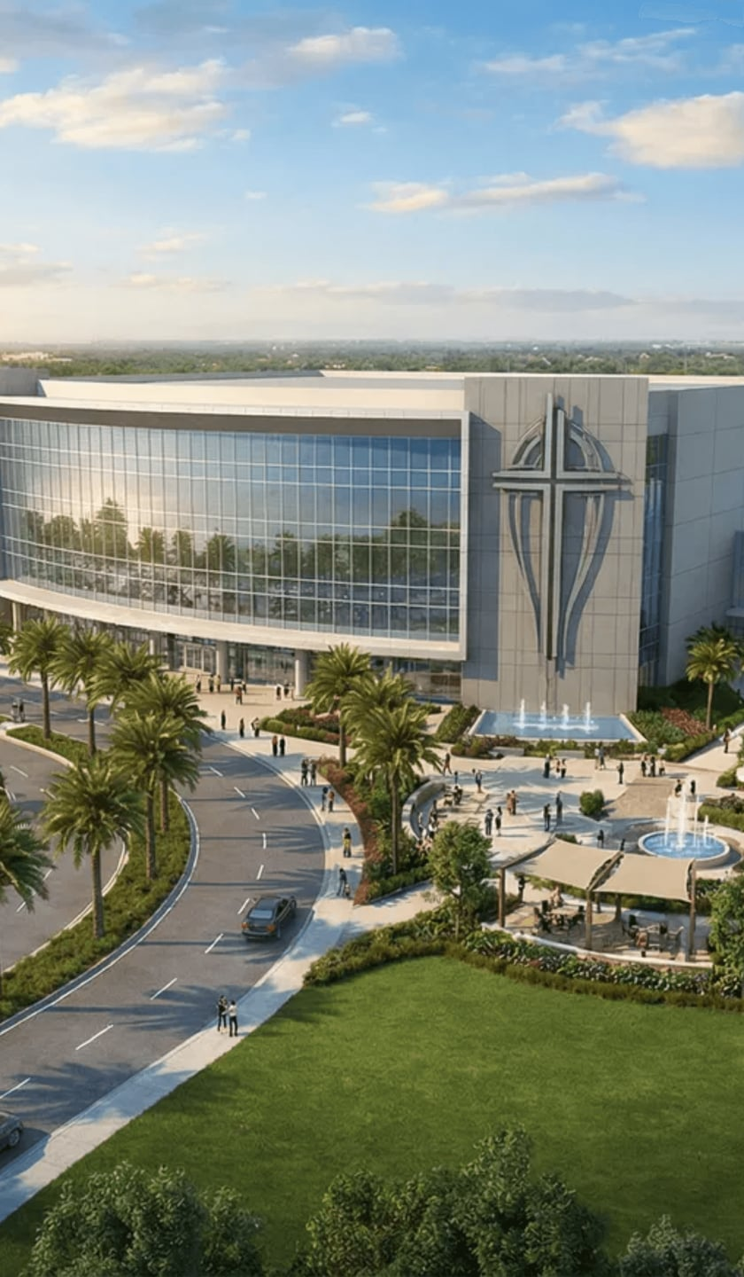
CAMPUS BLUEPRINT
9-ZONE
CAMPUS VISION
04
01
02
03
MAIN SANCTUARY
CHILDREN'S MINISTRY
YOUTH CENTER
1,200+ seats · LED walls · world-class AV & production
Dedicated wing · age-graded classrooms · secure check-in
Teen worship space · lounge · discipleship programs
04
05
06
LITTLE LIONS PRESCHOOL
MEBCI INSTITUTE
BROADCAST STUDIO
M–F operation · licensed · 3 to 5 year olds · 150 students
Ministry & business education · classrooms · coaching suites
Live streaming · recording · podcast & media production
07
08
09
EXECUTIVE OFFICES
CONFERENCE ROOMS
COMMUNITY OUTREACH
Senior leadership · staff · board & admin suites
Multi-purpose · meetings · events · community rentals
Food pantry · counseling · social services · café
THE FUTURE OF JUDAH
25,000–35,000 SQ FT
OWNED CAMPUS
25–35K
1,200+
9
$5M–$6M
SQ FT TARGET
SANCTUARY SEATS
MINISTRY ZONES
ALL-IN BUDGET

Slide 5
MINISTRY EDUCATION & BUSINESS COACHING INSTITUTE
05
THE JUDAH MEBCI
MEBCI
01
02
Ministry Leadership
Business Coaching
Pastoral training & ordination prep
Entrepreneurship & startup launch
MINISTRY EDUCATION &
BUSINESS COACHING INSTITUTE
▸
▸
Preaching & teaching certification
Kingdom business principles
▸
▸
Church administration
Financial literacy & stewardship
▸
▸
Worship & creative arts ministry
1-on-1 executive coaching
Lead with Love.
Serve with Purpose.
▸
▸
A state-of-the-art educational arm of Judah Church — equipping the next generation of Kingdom leaders, marketplace champions, and community servants with practical tools and spiritual foundation.
03
04
Community Education
Certificates & Conferences
GED & workforce readiness
8-week certificate programs
▸
▸
Parenting & family enrichment
Annual leadership summit
▸
▸
Financial counseling
Covered Girl Women's Conference
▸
▸
Health & wellness programs
Online & hybrid learning
▸
▸
REVENUE-GENERATING MINISTRY ARM
Tuition, coaching fees, and conference revenue create a sustainable income stream that supports the entire campus operation.
500+
4
$250K+
GRADUATES / YEAR (PROJECTED)
CORE PROGRAM TRACKS
EST. ANNUAL REVENUE

Slide 6



TARGET PROPERTIES
THREE PATHS
TO THE PROMISE
06
★ TOP PICK
STRONG CONTENDER
OPPORTUNITY ZONE
$3.9M
~$2.4M
$6M
33,000 SQ FT · 2.74 ACRES
SCHOOL COMPLEX · 1.04 ACRES
11,800 SQ FT · 3.6 ACRES
4151 W Oak Ridge Rd
Orlando, FL 32809
4607 N Pine Hills Rd
Orlando, FL 32808
Apopka Ministry Campus
Apopka, FL (Orange County)
C-2 Commercial zoning — church use permitted
Just 3 miles from current Judah Church location
Multi-building: sanctuary, 10+ classrooms, gymnasium
▸
▸
▸
2 miles from International Drive corridor
Currently operating as a school — ready infrastructure
Recording studio already on-site
▸
▸
▸
High traffic count — strong community visibility
Classrooms ideal for MEBCI Institute & preschool
Federal Opportunity Zone — significant tax incentives
▸
▸
▸
Sufficient parking for 1,200+ seat sanctuary
MLS #O6360338 — active listing
Owner financing available — flexible terms
▸
▸
▸
Buildout budget: ~$1M–$1.25M
Familiar West Orlando community footprint
3.6 acres — future expansion potential
▸
▸
▸
ALL-IN ESTIMATE
ALL-IN ESTIMATE
ALL-IN ESTIMATE
~$4.9M–$5.15M
~$3.4M–$3.65M
~$6.25M–$6.5M
All pricing based on current market listings · Subject to negotiation and due diligence · Additional properties available upon request
TARGET: 25,000–35,000 SQ FT · UNDER $6M ALL-IN

Slide 7

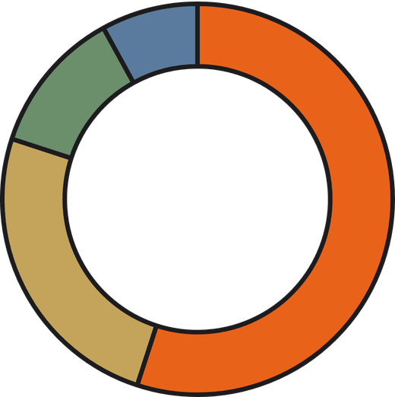
FINANCIAL OVERVIEW
THE NUMBERS.
THE PLAN.
07
ALL-IN CAMPAIGN GOAL
$5M – $6M
FUNDING SOURCE BREAKDOWN
25,000 – 35,000 SQ FT OWNED FACILITY · ORLANDO, FL
PHASE 1
Property Acquisition
$3.5M–$4.5M
Purchase · Title & Closing · Inspections · Financing Costs
PHASE 2
Buildout & Systems
$1M–$1.25M
Sanctuary · AV/Production · Children's Ministry · MEBCI · Preschool
PHASE 3
Furnishing & Launch
$250K–$500K
Offices · Café · Signage · Branding · Operational Reserve
Congregation Giving (3-yr pledge)
55%
Faith-Based Lenders / Mortgage
25%
Grants & Foundations
12%
Kingdom Investors & Major Donors
8%

Slide 8
CONGREGATION GIVING PLAN
THE CHURCH
LEADS THE WAY
08
TIER 1 — CONGREGATION FAMILIES
TIER 2 — BUSINESS OWNERS & LEADERS
$1.8M
$1.5M
3-Year Pledge Commitment
One-Time or Annual Gift
500 families
×
$100/month
×
36 months
=
$1,800,000
150 leaders
×
$10,000 avg
=
$1,500,000
Average pledge of $100/month per household over 3 years. Families giving at their own level of faith — every gift counts. Pledge cards distributed at all services.
Business owners, professionals, and ministry partners within the congregation making significant one-time or annual gifts. Includes naming opportunities for key spaces.
CONGREGATION TOTAL
EXTERNAL INVESTORS & DONORS
ALL-IN CAMPAIGN GOAL
$3.3M
$2.7M
$6M
Combined 3-year giving from families + business leaders
Foundations, faith-based lenders, kingdom philanthropists & grants
Full acquisition, buildout, furnishing & launch reserve
* Giving projections based on current active congregation. All figures are targets, not guarantees.
3-YEAR PLEDGE CAMPAIGN · 2025–2027

Slide 9
EXTERNAL FUNDING STRATEGY
WHO ELSE
INVESTS IN KINGDOM?
09
$2.7M TARGET
Beyond the congregation, these four channels represent proven, accessible sources of capital for faith-based facility projects — each with a track record of funding churches and nonprofits at this scale.
CHANNEL 01
CHANNEL 02
CHANNEL 03
CHANNEL 04
Faith-Based
Lenders
Government &
SBA Programs
Foundations
& Grants
Kingdom
Investors
Church Mortgage Acceptance Co.
SBA 504 Loan Program
Lilly Endowment — Religion Division
National Christian Foundation (NCF)
Specializes exclusively in church property loans. Competitive rates, flexible terms for growing congregations.
Up to $5M for real estate acquisition. Low fixed rates. Available to nonprofits operating community programs (preschool, education).
Grants up to $1M for congregation strengthening, leadership development, and facility projects. Annual application cycle.
Largest Christian grantmaking org in the U.S. Connects donors with ministry projects. $20B+ granted to date.
CHURCHMORTGAGE.COM
SBA.GOV/504
LILLYENDOWMENT.ORG
NCFGIVING.COM
GuideOne Insurance & Lending
CDFI Fund (U.S. Treasury)
John Templeton Foundation
Christian Community Foundation
Faith-based lender with church construction and acquisition loan programs. 25+ years serving ministries.
Community Development Financial Institutions provide below-market loans to faith-based orgs serving low-income communities.
Funds faith-based education, character development, and community transformation initiatives. Strong fit for MEBCI.
Donor-advised funds specifically for church and ministry capital campaigns. Florida chapter active.
CCFGIVING.ORG
GUIDEONE.COM
CDFIFUND.GOV
TEMPLETON.ORG
Kingdom Advisors Network
Protective Life Church Loans
Opportunity Zone Investment
Orange County CDBG Grants
Network of Christian financial advisors and high-net-worth donors actively seeking ministry investment opportunities.
Long-term fixed-rate mortgages for churches. Loans from $500K–$10M. Florida-licensed.
Federal tax incentive for investors placing capital in designated zones. Apopka campus qualifies. Significant investor tax benefit.
Community Development Block Grants available to nonprofits providing social services in Orange County, FL.
PROTECTIVE.COM
KINGDOMADVISORS.COM
IRS OPPORTUNITY ZONE
OCFL.NET/GRANTS
* For internal use — full contact details, application timelines, and outreach strategy available in the Funding Resources document.
🔐 INTERNAL REFERENCE DOCUMENT

Slide 10

EXECUTION ROADMAP
24 MONTHS TO
THE PROMISE
10
01
02
03
04
05
MONTHS 1–3
MONTHS 4–6
MONTHS 7–12
MONTHS 13–18
MONTHS 19–24
Campaign
Launch
Property
Acquisition
Buildout
Phase 1
MEBCI &
Media Launch
Grand
Opening
Announce campaign to congregation
Site inspections & due diligence
Sanctuary renovation & AV install
MEBCI Institute opens for enrollment
Grand Opening celebration services
▸
▸
▸
▸
▸
Negotiate purchase agreement
Children's ministry wing buildout
Full ministry operations at capacity
Pledge card distribution & commitment Sunday
▸
▸
Broadcast studio & production suite
▸
▸
Secure financing & close on property
Little Lions Preschool construction
▸
Preschool first full academic year
▸
▸
▸
Executive offices & admin suites
MEBCI first graduating class
Launch investor pitch website
▸
Youth center & teen programs launch
▸
▸
Engage architect & general contractor
▸
▸
Parking lot & exterior signage
Debt paydown strategy activated
Begin financing pre-approval process
▸
▸
▸
Community outreach center opens
Submit zoning / permit applications
▸
Engage faith-based lender relationships
▸
Conference room rentals begin
▸
▸
24
5
$6M
2027
MONTHS TO GRAND OPENING
EXECUTION PHASES
ALL-IN CAMPAIGN GOAL
TARGET GRAND OPENING YEAR

Slide 11
COMMUNITY IMPACT
THE RIPPLE
EFFECT
10
A new Judah Church campus doesn't just serve the congregation — it transforms West Orlando. Here is the projected impact at full operational capacity within 24 months of opening.
IMPACT
2,500+
150+
500+
WEEKLY ATTENDEES
PRESCHOOL STUDENTS
MEBCI GRADUATES / YEAR
In-person and online at full sanctuary capacity — a 60%+ growth from current membership
Judah's Little Lions Preschool operating M–F, serving West Orlando families with quality early childhood education
Ministry leaders, business owners, and community servants equipped through the MEBCI Institute annually
$2M+
50+
1,000+
ANNUAL ECONOMIC IMPACT
FULL-TIME JOBS CREATED
FAMILIES SERVED MONTHLY
Direct economic contribution to West Orlando through jobs, vendor contracts, and community spending
Pastoral staff, educators, administrators, media team, preschool teachers, and facility personnel
Through food pantry, counseling, financial literacy, community outreach, and social services programs
WEST ORLANDO TRANSFORMED · ONE CAMPUS AT A TIME
* Projections based on comparable ministry growth models and current congregation trajectory

Slide 12

A MOVEMENT IS TAKING PLACE
GIVING LEVELS — NEW FACILITY CAMPAIGN
GIVE.
PRAY.
PARTNER.
Kingdom Builder
$100K+
Naming rights to a major facility space
J
Cornerstone Partner
$50,000
Sanctuary or MEBCI room dedication
Foundation Giver
$25,000
Children's wing or preschool classroom
Pillar of Judah
$10,000
Office suite or conference room dedication
BUILD WITH US.
BELIEVE WITH US.
Brick by Brick
$1,000+
Monthly pledge — every gift builds the house
WEBSITE
judah.cc
ADDRESS
7649 W. Colonial Dr., Orlando, FL 32818
JUDAH.CC/GIVE
CAMPAIGN
judah.cc/newcampus
QR
CODE
Scan to give online · All gifts are tax-deductible
Judah Church is a registered 501(c)(3) nonprofit
LEADERSHIP
Bishop Clint S. Brown & Pastor Kendal Brown
JUDAH CHURCH · ORLANDO, FLORIDA · EST. 1994
Confidential — For Campaign Partners Only
NEW FACILITY CAMPAIGN · $5M–$6M GOAL

