Slide 1

Airmoji FR: Turn Your Exhaust Into Energy
The bolt-on energy recovery system for AI data center HVAC — recovering up to 65% of exhaust fan energy with zero back pressure and zero emissions.
RELEASE CANDIDATE 1 — Q4 2026

Slide 2

Global data center electricity demand is set to double to 945 TWh by 2030 (IEA).
Cooling systems account for 30–40% of total data center energy consumption.
AI data centers waste millions of dollars in kinetic energy every year through their HVAC exhaust fans
HVAC exhaust fans run 24/7 at high velocity — constantly expelling high-kinetic-energy airflow that is currently 100% wasted.
A hyperscale facility with 200 exhaust fans wastes the equivalent of hundreds of kW in unrecovered kinetic energy every hour.
Existing solutions (solar, diesel, LNG) either add emissions, require massive land footprints, or create supply chain dependencies.

Slide 3

Airmoji FR is a bolt-on wind turbine that attaches to your existing HVAC exhaust fans and converts wasted airflow into electricity
Non-Invasive Installation
Closed Energy Loop
Mounts directly onto the exhaust fan housing with no modifications to existing infrastructure.
Electricity generated is returned directly to the host building's electrical system in real time.
Patented Turbine Design
High Energy Recovery
Captures high-velocity exhaust air stream, converting kinetic energy into rotational force.
Recovers up to 65% of the energy consumed by the host exhaust fan.
Zero Back Pressure
Commercial Readiness
Simultaneously enhances airflow efficiency — fan performance is improved, not degraded.
Currently at Release Candidate 1 (RC1) stage, with commercial launch targeted for Q4 2026.

Slide 4

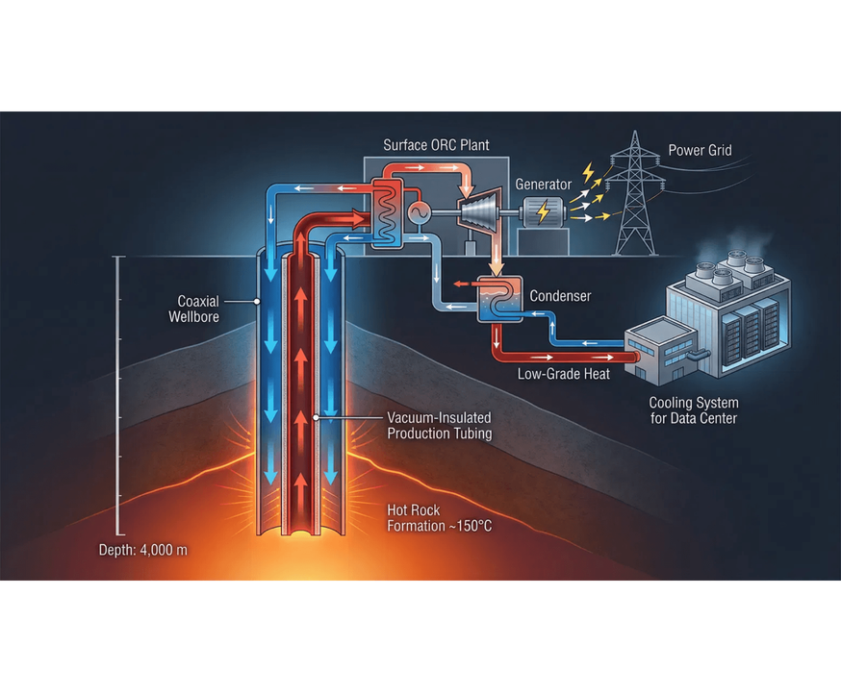
Airmoji FR's three-step process turns existing infrastructure into a continuous power source with no downtime
01
ATTACH
Bolt-on mounting directly to exhaust fan housing. No downtime, no warranty void, no structural modification.
02
CAPTURE
Patented impeller captures exhaust airflow and converts kinetic energy to rotational force with zero back pressure.
03
GENERATE
Generator produces electricity returned directly to the host building's grid, reducing net consumption by up to 65%.

Slide 5

Four precision-engineered impeller configurations optimize energy capture across all HVAC exhaust fan types
CROWN CAGE
SPIRAL VANE
STAR ARRAY
RADIAL DISC
Vertical axis cage design — optimized for low-velocity, high-volume exhaust flows.
High-velocity spiral blade — maximizes capture in high-pressure exhaust streams.
Multi-point star geometry — balanced performance across variable airflow conditions.
Radial blade configuration — suited for large-diameter industrial exhaust fans.
Each variant is matched to specific exhaust fan diameters and airflow volumes for maximum efficiency.

Slide 6

Airmoji FR delivers measurable, continuous energy recovery with zero performance impact on host HVAC systems
ENERGY RECOVERY RATE
Up to
65%
of host fan consumption
BACK PRESSURE
Zero
(enhances airflow efficiency)
INSTALLATION TYPE
Non-invasive, bolt-on
AVAILABILITY
24/7
continuous generation
DIRECT EMISSIONS
0 CO₂
STATUS
RC1 — Release Candidate 1
TARGET LAUNCH
Q4 2026

Slide 7

A single hyperscale data center with 200 HVAC exhaust fans represents a multi-MW continuous energy recovery opportunity
Hyperscale data centers operate dozens to hundreds of large HVAC exhaust fans continuously.
TARGET MARKETS
Hyperscale Data Centers
Each fan is a constant, predictable energy recovery opportunity — not weather-dependent.
Primary target. Hundreds of HVAC exhaust fans running 24/7 — massive recovery potential.
Edge Computing Sites
Array deployment: Airmoji FR units scale linearly across a facility with no diminishing returns.
High ROI. Smaller footprint, but continuous operation makes Airmoji FR highly cost-effective.
Unlike solar (requires land) or diesel (requires fuel), Airmoji FR uses infrastructure you already own.
Industrial HVAC
Broad market. Any industrial facility with large exhaust fans can benefit from Airmoji FR.

Slide 8












Airmoji FR is the only energy recovery solution that requires no new land, no fuel, and no infrastructure changes
CRITERIA
SOLAR
DIESEL
LNG
AIRMOJI FR
Zero Emissions
24/7 Reliability
No Fuel Supply Chain
No Land Footprint
No Infrastructure Change
Predictable Output

Slide 9

Airmoji FR deployment can offset hundreds of thousands of dollars in annual energy costs
~$438k
Accelerated Payback Period
Near-Zero OPEX
No fuel costs, minimal maintenance, and no ongoing supply dependencies after install.
ANNUAL SAVINGS
Payback scales with array size and local electricity rates — higher rates mean faster payback.
Based on recovering 500 kW continuously at a $0.10/kWh average commercial electricity rate.
Preferred Pricing Available
Genmoji is accepting partners for early deployment at preferred pricing tiers.

Slide 10

Airmoji FR RC1 is launching Q4 2026 — join the first wave of data center operators to deploy
RC1 STAGE
EARLY DEPLOYMENT
SECURE ACCESS
Final pre-commercial validation underway.
Partnering with select data center operators.
Register interest now for preferred pricing.
CONTACT
Genmoji — AI Data Center Energy Solutions

